Slide 1
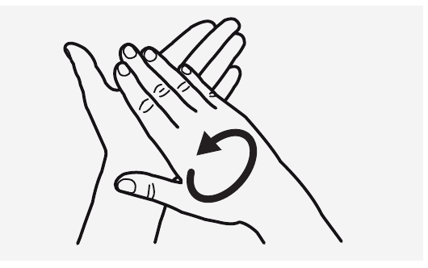
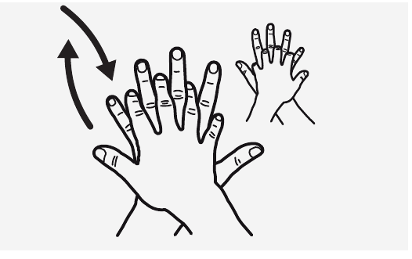
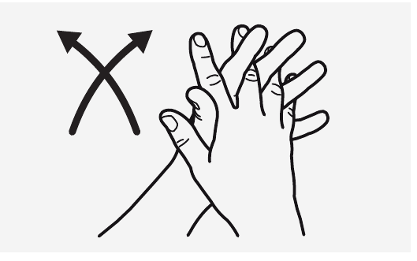
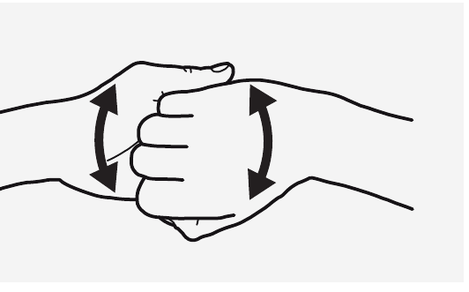
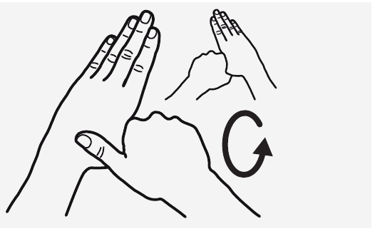
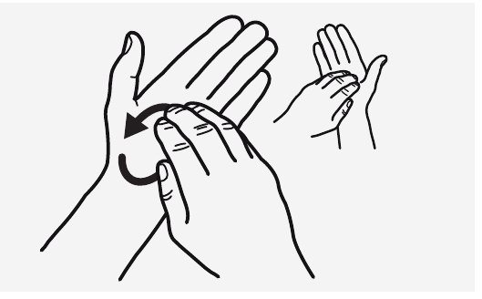
Camera-Based
Handwashing
Assessment
Visual recognition, temporal segmentation
and adaptive action confirmation
Source: WHO, How to Handwash? (2009)
GROUP 43
Shen Ziyi Wang Lepeng Xu Wenzhe Zhu Jianyu
Notes:
SLIDE 1: Camera-Based Handwashing Assessment
TIME 00:00-00:25
SPOKEN SCRIPT
Hello, we are Group forty-three. Our project uses a local camera to assess six-step handwashing. It recognizes hand gestures, reconstructs their order, and measures recognized washing time. We will explain the model, demonstrate the application, and discuss the results and deployment trade-offs.
PRESENTER CUE
Start the presentation timer. Introduce the team without reading every name.
SOURCE
Final project report, Abstract and Section 1.
Cover illustrations reproduced from World Health Organization, How to Handwash? poster (May 2009): https://www.who.int/docs/default-source/sepsis/how-to-handwash-poster.pdf. The six drawings show WHO poster steps 2–7; numbers and captions are cropped in this cover composition.

Slide 2
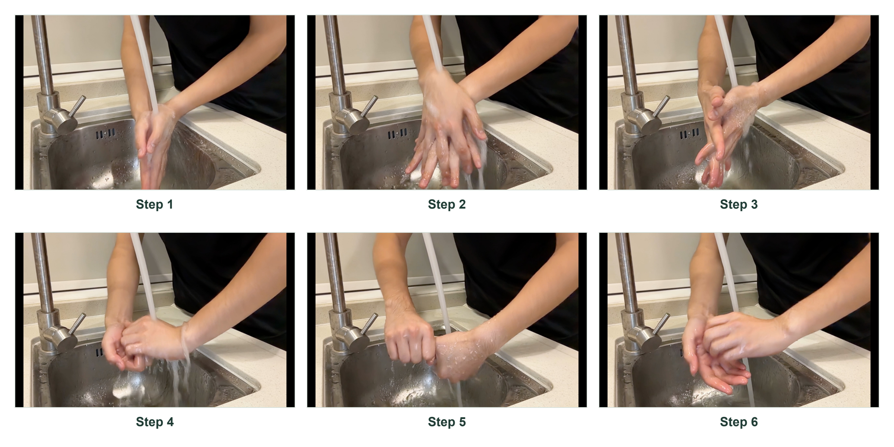
What the system assesses
Six action classes, plus background
Correct order
1 2 3 4 5 6
Recognized washing time
≥ 40 seconds
Background time is excluded
GROUP 43 / FINAL PROJECT
02
Notes:
SLIDE 2: What the system assesses
TIME 00:25-01:05
SPOKEN SCRIPT
A correct gesture prediction is only one part of the task. A person can perform recognizable actions while skipping a step, changing the order, or stopping too early. Our application therefore evaluates the complete procedure. It recognizes six actions and a background class, builds the observed action sequence, and checks total recognized washing time. Completion requires all six steps in the standard order and at least forty seconds of recognized actions. Background time is excluded. This is an assessment of visible procedure, rather than a direct measurement of cleanliness.
PRESENTER CUE
Point to the action examples, then to the order and duration requirements.
SOURCE
Final project report, Sections 1, 2.2 and 6. The 40-second criterion is the application's configured recognized-action threshold.

Slide 3
The self-recorded dataset
6,987
Partition | Videos | Frames
Training | 14 | 2,901
Validation | 8 | 1,364
Test | 10 | 2,722
sampled frames with annotations
32 recordings at approximately 5 fps
6,807 definite labels
180 uncertain transition frames
Standard sequences, altered orders,
missing steps and isolated actions
GROUP 43 / FINAL PROJECT
03
Notes:
SLIDE 3: The self-recorded dataset
TIME 01:05-01:55
SPOKEN SCRIPT
Our target-scene dataset contains six thousand nine hundred and eighty-seven sampled frames from thirty-two recordings. Sampling at about five frames per second captures motion variation and transitions. The recordings include standard sequences, reordered or missing actions, and isolated examples of steps four and five. We split by video, so neighboring frames stay in the same partition. Fourteen videos support training, eight support validation, and ten form the reported test set. We distinguish definite action labels from uncertain transition frames. Those uncertain frames remain explicit in the annotations instead of becoming background labels by default.
PRESENTER CUE
Emphasize frame annotation and the split by video. Avoid describing adjacent frames as independent samples.
SOURCE
Final project report, Tables 2 and 3. dataset/README.md.

Slide 4
Why we model temporal boundaries
Preliminary PSKUS study: macro F1 near transitions
+7.74 pp
over frame-only YOLO
Final systems use
self-recorded data
Early study: 615 videos. Transition-region macro F1 is distinct from output-boundary F1.
GROUP 43 / FINAL PROJECT
04
Notes:
SLIDE 4: Why we model temporal boundaries
TIME 01:55-02:30
SPOKEN SCRIPT
We first studied the public PSKUS dataset to check feasibility. On that preliminary comparison, macro F1 near transitions increased from eighty-three point three for YOLO to ninety point one with GRU, and ninety-one point zero with early boundary awareness. This supported using temporal context and transition supervision. We then trained the final systems on our self-recorded data. The final model set contains no PSKUS-trained weights. The public-data experiment explains the design choice, while our own scene supplies the final evaluation.
PRESENTER CUE
The plot shows preliminary transition-region macro F1, which differs from the final output-boundary F1 metric.
SOURCE
Final project report, Section 2.1 and Table 1. PSKUS study: 615 videos, 5,599 valid centers, 1,068 transition-region centers.

Slide 5
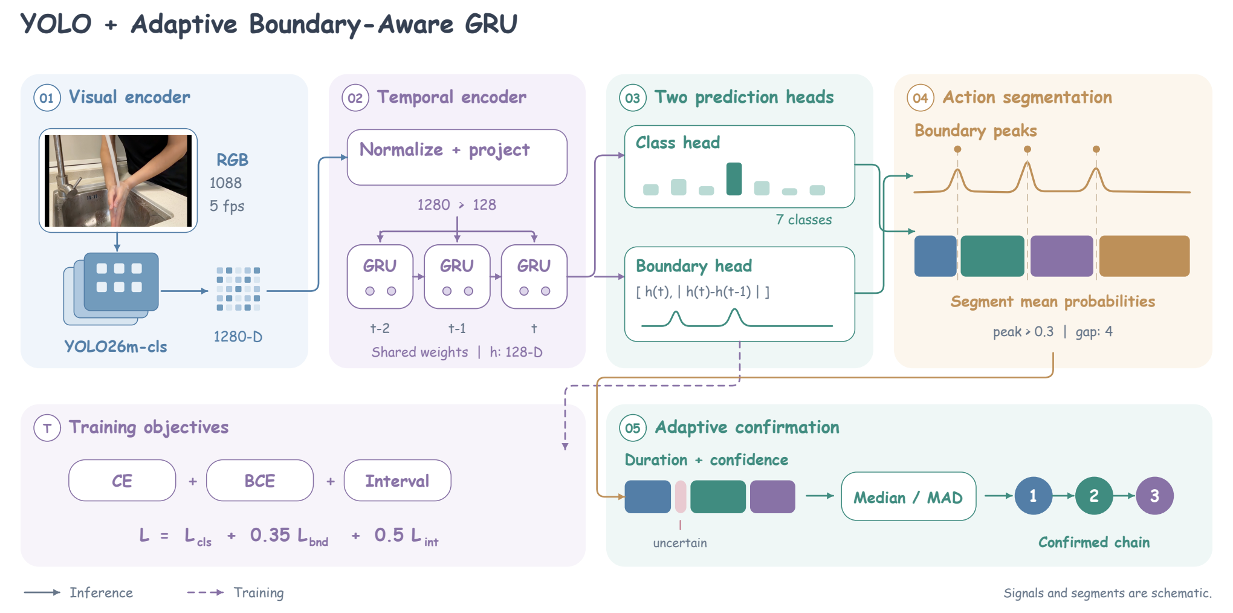
YOLO + Adaptive Boundary-Aware GRU
Visual features, recurrent context and learned action boundaries
Frame input 1088 × 1088
Incremental, unidirectional temporal model
GROUP 43 / FINAL PROJECT
05
Notes:
SLIDE 5: YOLO + Adaptive Boundary-Aware GRU
TIME 02:30-03:30
SPOKEN SCRIPT
Here is the complete architecture. YOLO extracts visual features from each sampled frame. A unidirectional GRU carries information forward through the sequence. Two heads share this temporal representation. The classification head estimates the current action, while the boundary head estimates where an action changes. Boundary-guided decoding produces candidate segments, and adaptive confirmation decides which segments belong in the final chain. This separates frame recognition from confirmation of an action instance. The recurrent state also supports incremental processing during a camera session. We compare this complete method with standalone YOLO, ordinary YOLO plus GRU, and VideoMAE. Each baseline answers a different question about visual recognition, temporal context, or video-window modeling.
PRESENTER CUE
Trace the diagram from the frame thumbnail through the two heads to the final chain. Explain the flow without reading layer dimensions.
SOURCE
Final project report, Section 3 and Figure 1. docs/MODEL_CARD.md.

Slide 6
Adaptive action confirmation
A segment must earn its place in the action chain
01
Smooth labels
About one second of local smoothing
02
Evaluate candidate segments
Relative duration and confidence within the recording
03
Preserve observed order
Raw 1 2 4 5 3 4 6
Final 1 2 4 5 3 6
Original Video 8. Raw and final outputs use different sampling and decoding stages.
GROUP 43 / FINAL PROJECT
06
Notes:
SLIDE 6: Adaptive action confirmation
TIME 03:30-04:20
SPOKEN SCRIPT
Brief prediction changes can create extra actions even when most frames are correct. We smooth labels over about one second, then group adjacent labels into segments. Adaptive confirmation compares each segment's duration and confidence with the recording's own statistics. An unusually short and uncertain segment can remain unconfirmed. This replaces the fixed three-second rule. With fewer than four comparable segments, duration rejection is skipped. The example removes an extra step four while preserving the observed order. We will now play a five-minute recording of the application in use.
PRESENTER CUE
Finish the introduction before 04:20, then start the prepared demonstration video.
SOURCE
Final project report, Section 3.3 and Algorithm 1. Original Video 8: common-center raw chain 1245346, dense-stream final chain 124536. This is a pipeline comparison, not an isolated ablation.

Slide 7
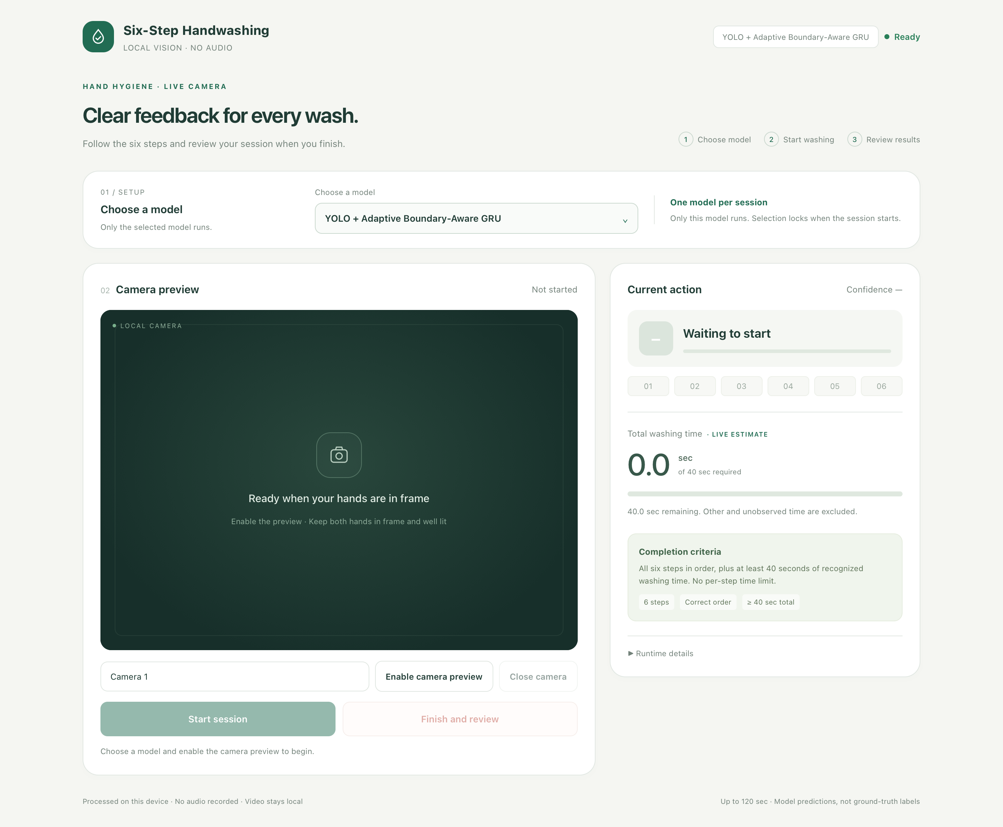
Recorded system demonstration
Application walkthrough
5:00
Pre-recorded video
GROUP 43 / FINAL PROJECT
07
Notes:
SLIDE 7: Recorded system demonstration
TIME 04:20-09:20
PRESENTER CUE
Play the prepared demonstration video from 04:20 to 09:20. No additional live commentary is scripted. When playback ends, return to slide 8.
SOURCE
Final project report, Section 6. src/handwash/self_scene_camera.py and src/handwash/self_scene_assessment.py.

Slide 8
Recognition and boundary results
632 aligned valid centers from 10 videos
Model | Accuracy | Macro F1 | Boundary F1
YOLO | 95.25% | 93.84% | 76.92%
YOLO + GRU | 96.04% | 93.58% | 87.59%
Proposed | 96.52% | 93.71% | 94.40%
VideoMAE | 99.53% | 99.02% | 97.48%
+6.81 pp
Boundary F1 over ordinary GRU
VideoMAE leads these three metrics. Different inputs and final fitting protocols limit causal attribution.
GROUP 43 / FINAL PROJECT
08
Notes:
SLIDE 8: Recognition and boundary results
TIME 09:20-10:25
SPOKEN SCRIPT
That was our system demonstration. We now turn to the quantitative results. The quantitative comparison uses six hundred and thirty-two aligned valid time centers from ten videos. Accuracy and macro F1 use the same reference labels for every model. Boundary F1 measures predicted changes using one-to-one matching with transition tolerance. Our method reaches ninety-six point five two percent accuracy, ninety-three point seven one macro F1, and ninety-four point four boundary F1. Relative to ordinary GRU, the largest improvement is boundary F1, which rises by six point eight one percentage points. VideoMAE achieves the highest values on all three measures. We report that clearly. These are complete-system results under their actual resolutions and training protocols, so they do not establish a controlled architecture-only advantage.
PRESENTER CUE
Read the proposed row and the boundary improvement. Do not read every table cell.
SOURCE
evaluation/metrics.csv and final project report, Table 4. Boundary tolerance: annotation transition interval plus 0.4 seconds. Final temporal heads refit on 22 development videos after selection on the 14/8 split.

Slide 9
Complete action chains
Exact matches across the 10 complete videos
10
10
Observed errors preserved
6
Missing Step 4
1 2 3 5 6
2
Reordered sequence
6 4 5 3 2 1
Only the proposed method applies adaptive confirmation to dense 5 fps predictions.
GROUP 43 / FINAL PROJECT
09
Notes:
SLIDE 9: Complete action chains
TIME 10:25-11:10
SPOKEN SCRIPT
Frame scores do not fully describe sequence quality. YOLO matches only two of the ten complete reference chains, ordinary GRU matches six, and both our final pipeline and VideoMAE match all ten. The examples show that a correct prediction can describe an incorrect procedure. Our model preserves a missing step and a reordered sequence instead of repairing them into the standard order. Only our pipeline uses adaptive confirmation on the dense five-frame-per-second stream. These results therefore compare complete methods, including their decoding, rather than an isolated change to the neural network.
PRESENTER CUE
Point to the four bars, then distinguish prediction correctness from procedure correctness.
SOURCE
evaluation/action_chains.csv and final project report, Tables 4 and 5. Proposed examples: test_error_12356 and test_error_645321.

Slide 10
The local deployment choice
Parameter count and temporal input requirements
Proposed
One frame + recurrent state
VideoMAE
16-frame window
About 3 s of initial context
VideoMAE can stream delayed predictions. Parameter count alone does not establish runtime speed.
GROUP 43 / FINAL PROJECT
10
Notes:
SLIDE 10: The local deployment choice
TIME 11:10-11:55
SPOKEN SCRIPT
We retain our model for the local camera application because deployment also depends on size and temporal input requirements. It has about ten point six four million parameters, compared with eighty-six point two three million for VideoMAE. Its recurrent path consumes a frame and an existing state. VideoMAE uses a sixteen-frame window, requiring about three seconds of initial context at our sampling rate. Centered predictions also use future frames. VideoMAE can run locally and stream delayed predictions, but its workflow differs from immediate incremental feedback. The parameter comparison supports our choice without claiming a measured speed or energy advantage.
PRESENTER CUE
Present VideoMAE as the accuracy reference. Do not claim it is impossible to deploy or that parameter ratio equals speed ratio.
SOURCE
provenance/deployment/architecture_timing.json and final project report, Table 6. Exact parameters: 10,642,639 and 86,232,583. Initial VideoMAE window approximately 3 seconds, centered future context approximately 1.4 seconds.

Slide 11
Conclusions and
next evaluation
Delivered
Next evidence
A working local camera system
Four model comparisons
10/10 final reference chains
New people and camera views
Frozen labels and settings
Sustained hardware measurements
Current evidence: retrospective internal validation in the reviewed scene
GROUP 43 / FINAL PROJECT
11
Notes:
SLIDE 11: Conclusions and next evaluation
TIME 11:55-13:00
SPOKEN SCRIPT
The project delivers a working camera application, annotated data, four comparison models, and reproducible evaluation records. Our selected pipeline combines visual recognition with learned boundaries and adaptive action confirmation. It achieves all ten reference chains in the reviewed evaluation and supports local feedback on both order and recognized duration. The scope of that evidence matters. We have inspected these recordings repeatedly, including correcting labels after reviewing predictions. The results therefore describe internal validation in the recorded scene. The next evaluation should freeze labels and settings, then use new people, camera positions, and lighting. It should also measure sustained throughput on the same hardware. Our contribution is a complete, inspectable assessment system with a clear deployment rationale. Thank you.
PRESENTER CUE
Finish at 13:00. Keep the final slide visible as the recording ends.
SOURCE
Final project report, Section 7. docs/FINAL_RELEASE.md and provenance/README.md.

