Slide 1

FIRST PRESENTATION
Video-based Six-Step
Handwashing Assessment
Live action recognition and six-step completeness reports
Group 43 · 6 October 2026
Shen Ziyi — Data & evaluation
Wang Lepeng — Model & training
Zhu Jianyu — Temporal & rules
Xu Wenzhe — Product, demo & delivery
Notes:
Introduce the four owners and the current delivery: cloud training with local camera inference. This first presentation covers goals, data, techniques and progress.
Source: https://github.com/Frostash030612/handwash-who-six-step/blob/8d7269c/docs/IMPLEMENTATION_PLAN.zh-CN.md

Slide 2
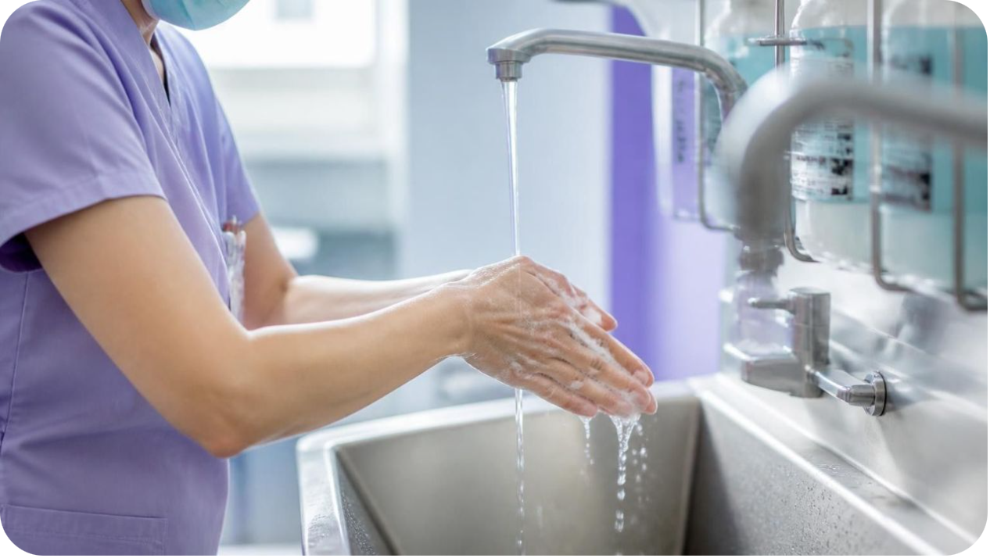
CLINICAL MOTIVATION
Why analyze the whole washing process?
THE CHALLENGE
Similar hand movements can look almost identical.
Hands may overlap, and people may skip or repeat a step.
A useful review needs to show which actions happened, when they happened, and which steps were not detected.
We propose a video-based tool that turns these observations into feedback a user can check.
Notes:
The six names are shortened for presentation. Step 2 involves palm over dorsum with fingers interlaced. Step 3 has opposing palms with interlaced fingers. Step 4 uses the backs of fingers against an opposing palm with fingers interlocked. PSKUS also labels other movements and turning off the faucet. The system must preserve missing, reordered or repeated actions rather than force a fixed six-step sequence.

Slide 3

PROJECT SCOPE
What the project aims to deliver
CORE OUTPUT 01
CORE OUTPUT 02
Live action recognition
A checkable six-step report
Show the current action and a timeline with real timestamps.
Summarize coverage, order, duration and repeated or missed steps.
THE RESEARCH QUESTION
Can a per-frame classifier stay reliable on a live camera feed, and can its label stream become a completeness report a user can check?
Recognition target: Macro-F1 ≥ 0.80 on held-out PSKUS videos
Eight-class space, with the six rubbing steps reported separately. This is a goal, not a result.
Also measure end-to-end latency per frame on the deployment machine.
Notes:
The formal target uses eight PSKUS classes. Report the six rubbing steps separately. No formal experimental result is available.
Source: https://github.com/Frostash030612/handwash-who-six-step/blob/8d7269c/docs/PROJECT_PROPOSAL.md
Source: https://github.com/Frostash030612/handwash-who-six-step/blob/8d7269c/configs/experiments/live_yolo_frame.yaml

Slide 4

BENCHMARK DATASETS
Data required and available
3,185
212
4–6
PSKUS videos
METC videos
Clips per member
Hospital video and frame labels for training and held-out testing.
Independent laboratory setting for cross-domain testing.
Planned self-recorded clips: complete, missed, swapped and too-short steps.
Source total
1 of 11 shards verified locally
(DataSet4)
Source total
Not downloaded yet
Required collection
Real camera and deployment conditions
Before training: clean the data and spot-check labels by hand.
Published sizes are source totals, not a claim that all files are downloaded or processed.
Download status: team checklist dated 3 October 2026. Kaggle is also not downloaded.
Notes:
PSKUS is the main training source. METC and self-recorded clips provide separate evaluation settings. Local download status comes from the supplied team checklist dated 3 October 2026; the repository does not prove a newer local download state.
Source: https://github.com/Frostash030612/handwash-who-six-step/blob/8d7269c/docs/DATA.md
Source: https://github.com/Frostash030612/handwash-who-six-step/blob/8d7269c/docs/SELF_RECORDING.md

Slide 5

DATA INTEGRITY
Reliable training starts with reliable labels
01
02
03
Separate the videos
Match frames to labels
Build short sequences
Training and testing
Keep the real timestamps
Preserve action changes
Every sampled frame needs its own action label.
The same source video must never appear in both training and testing.
We will inspect action changes by hand and evaluate complete videos, including the last action.
Notes:
The data split is a planned 70/15/15 starting point with a fixed seed and no source-video leakage. Identity grouping is preferred when trustworthy IDs exist. Every sampled frame retains its own label and real timestamp. Short sequences here preserve data order and action boundaries; the mainline classifier trains on individual frames.
Source: https://github.com/Frostash030612/handwash-who-six-step/blob/8d7269c/docs/IMPLEMENTATION_PLAN.zh-CN.md

Slide 6
SYSTEM ARCHITECTURE
Cloud training, local camera inference
STAGE 1 · RECOGNISE THE ACTION
Sample frames
YOLO26n-cls
Train in the cloud
5 fps, 224 × 224
Keep real timestamps
Per-frame classification
Transfer learning
Cleaned PSKUS
Video-disjoint splits
STAGE 2 · SHOW IT LIVE
Export weights
Verify on real video
Camera web page
Checkpoint, label order
and preprocessing
Existing infer pipeline
and six-step report
Current step, progress
and final report
Mainline: frame training, no temporal head. Live display averages only the last 9 received frames.
First delivery: a live camera web page on the deployment machine. Cloud training, local inference.
Notes:
YOLO26n-cls uses train.mode frame and temporal.kind none. The live service applies a trailing probability average over received frames with smooth_window 9. This is inference-side smoothing, not a trained temporal model.
Source: https://github.com/Frostash030612/handwash-who-six-step/blob/8d7269c/docs/IMPLEMENTATION_PLAN.zh-CN.md
Source: https://github.com/Frostash030612/handwash-who-six-step/blob/8d7269c/configs/experiments/live_yolo_frame.yaml

Slide 7
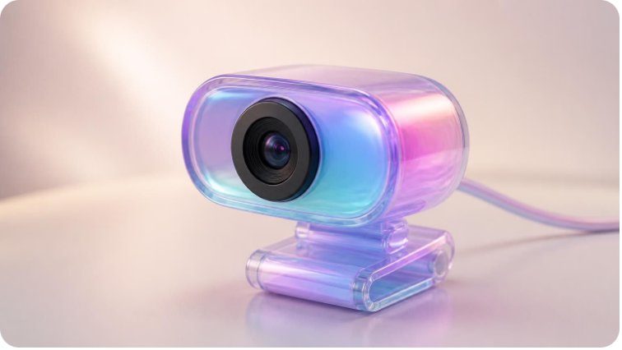
INTERACTION DESIGN
What the user will see
Illustrative workflow, not an experimental result
1
2
3
4
Pick a camera
Live preview
Six-step progress
Session report
Select the external camera and allow browser access.
See the current step and its confidence.
Track provisional coverage while washing.
Stop the session to compute the final completeness report.
Real-time display is provisional and averages only frames already received.
The final report is computed when the session stops.
exp.pt: seven-class feasibility demo weights, not an accuracy result.
Camera accuracy and latency have not yet been measured.
Notes:
The live backend and camera page exist at code level. The four blocks describe the implemented interaction rather than measured performance. The demonstration entry is python scripts/run_camera.py --demo-exp.
Source: https://github.com/Frostash030612/handwash-who-six-step/blob/8d7269c/docs/IMPLEMENTATION_PLAN.zh-CN.md
Source: https://github.com/Frostash030612/handwash-who-six-step/blob/8d7269c/README.md

Slide 8
EXPERIMENTS AND EVALUATION
Comparisons and measures of success
CONTROLLED COMPARISONS
Are the actions correct?
Group | Setting
A | Frame-only baseline
B | Same checkpoint + probability smoothing
C · optional | Mean-pool head
D · optional | GRU / TCN head
Per-class recall, confusion matrix and Macro-F1.
Macro-F1 gives equal weight to all 8 PSKUS classes; report the 6 rubbing steps separately.
Are the timing and reports useful?
Missed-step precision / recall, order inversions, short-step detection and duration error.
Segment F1 at time IoU 0.10 / 0.25 / 0.50.
Time IoU = interval overlap / interval union.
Does it work beyond training?
METC and self-recorded clips, same checkpoint.
Latency: frame capture to displayed result.
Throughput: processed frames per second.
A/B: baseline versus fewer label changes.
C/D: temporal-head value (optional research).
Fix data, splits, seed and backbone.
PE and MS-TCN++ are candidates, not commitments.
Missed-step precision = correct flags / all flags.
Recall = correct flags / all true omissions.
Notes:
A/B reuse one checkpoint and compare label-change counts as well as recognition and latency. C/D train separate controlled temporal models. The delivery line remains A/B. Evaluate eight PSKUS classes and report the six rubbing steps separately. Report PSKUS, METC and self-recorded results independently. Match segment labels and temporal overlap for segment F1.
Source: https://github.com/Frostash030612/handwash-who-six-step/blob/8d7269c/docs/EXPERIMENTS.md
Source: https://github.com/Frostash030612/handwash-who-six-step/blob/8d7269c/docs/IMPLEMENTATION_PLAN.zh-CN.md

Slide 9



WHAT ALREADY WORKS
Progress so far
Repository and contracts
Data safeguards and report rules
Live product code
Five layers and five CLI pipelines: prepare, train, evaluate, infer, assess.
396 contract-layer tests documented; no data or GPU required. CI workflow configured.
Live inference backend and local camera page are in place at code level.
Demo entry: python scripts/run_camera.py --demo-exp
Three independent video-split guards and one authoritative label space, including METC 0–6.
Missed steps, order inversions, short steps, repetitions and overall score are implemented.
No formal experimental result yet (version 0.1.0).
The synthetic smoke run proves pipeline execution only. Demo weights check feasibility, not accuracy.
Real-camera classification accuracy and latency remain unmeasured.
Notes:
396 is the documented contract-test count in CHANGELOG, not a newly measured test result. A CI workflow exists, but its latest remote execution status has not been independently confirmed. The only recorded experiment is a synthetic smoke run with metrics explicitly marked meaningless.
Source: https://github.com/Frostash030612/handwash-who-six-step/blob/8d7269c/CHANGELOG.md
Source: https://github.com/Frostash030612/handwash-who-six-step/blob/8d7269c/docs/EXPERIMENTS.md
Source: https://github.com/Frostash030612/handwash-who-six-step/blob/8d7269c/docs/IMPLEMENTATION_PLAN.zh-CN.md

Slide 10
PROJECT ROADMAP
Course anchors and technical steps
COURSE ANCHORS
TECHNICAL STEPS
Fix data and spot-check labels by hand
1
30 Sep 2026
Freeze splits and manifest
2
Proposal submitted · done
Cloud YOLO training · pending clean data
3
6 Oct 2026
Local video inference acceptance
4
First presentation · today
Live inference service · code in place
5
31 Oct 2026
Camera web page · code in place
6
All deliverables due
Real-camera acceptance and delivery
7
Code in place does not imply real-camera acceptance.
The validated pipeline stays the final deliverable if time runs short.
Notes:
The current execution order is data quality, cloud training, local video validation, then real-camera acceptance. The repository still marks formal training as pending, so no running training job or completed result is claimed.
Source: https://github.com/Frostash030612/handwash-who-six-step/blob/8d7269c/docs/IMPLEMENTATION_PLAN.zh-CN.md
Source: https://github.com/Frostash030612/handwash-who-six-step/blob/8d7269c/docs/PROJECT_PLAN_4_WEEK.md

