Slide 1

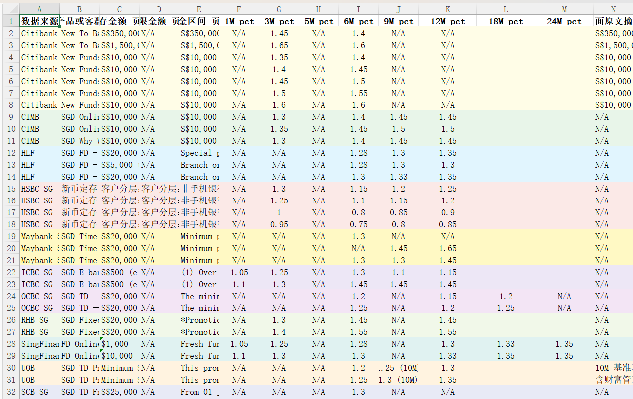
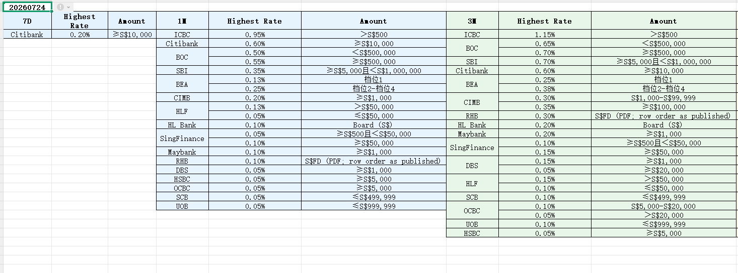

Graduate Diploma in Systems Analysis
RateStats
From Manual Rate Collection
to Python Automation + AI Search
RateStats
Python + AI
Search Pipeline
By: Xu Wenzhe | Host: Bank of China Singapore Branch (FinTech)
Introduction
Banks need Singapore market deposit and promo rates across ~17 banks (~47 product nodes) for recurring market comparison. The work originally began as fully manual copy-paste of rates into Excel — slow, error-prone, and difficult to schedule. RateStats was built to turn that manual process into a repeatable Python pipeline, then extend it with controlled AI Search for URL discovery and validation.
Objective
1) Build a Python application to fetch and parse bank rate pages (HTML / PDF / API), then generate MarketRateData and Rainbow Excel outputs that business users can run on a schedule.
2) Plug AI Search into the same pipeline to discover and validate source URLs when bank websites change — using controlled AI Search plus hybrid Rules + ML, not unrestricted cloud LLM agents.
Diagrams / Screenshots — MarketRateData & Rainbow Table
Fig 1. MarketRateData (tenure rates)
Fig 2. Rainbow Table (bank × tenure)
Solutions / Key Features
Challenges, Lessons Learnt
Business Impact & Recommendations
• Python extractors: HTML / PDF / API (HSBC, DBS, OCBC…)
• AI Search (Vertex) proposes candidate URLs
• Hybrid filter: host whitelist + ML ranker (~95% hit)
• Batch + Task Scheduler → dated runs/
• Multi-AI benchmark: Vertex / Serper / Brave / Tavily
• Build order: Manual → Python → AI Search + Rules/ML
• Challenge: AI returned wrong-bank pages (e.g. ICBC → HLF).
• Lesson: Domain whitelist before ML; hybrid Rules + ML beats pure AI ranking.
• Challenge: Same bank, wrong page type (OCBC Premier vs SGD board).
• Lesson: Hard-reject patterns + hard_negatives.csv.
• Lesson: Build usable Python product first; plug AI into a real pipeline.
• Lesson: Controlled AI Search over unrestricted cloud agents.
• Impact: Manual copy → Python Excel app → less URL hunting with AI (~95% hit).
• Impact: Schedulable MarketRateData / Rainbow for market comparison.
• Recommend: Expand hard_negatives; re-tune picker after each batch.
• Recommend: Scale controlled AI discovery to other external-data monitoring.
Industrial Attachment Project Showcase
Bank of China Singapore · Xu Wenzhe

