Slide 1
Virtualization in Computing
A computer, physically, is a set of hardware combined (memory, disk, processor, motherboard etc). And virtualization, as an idea, is to create a virtual version of something.
Back to computing, the hardware virtualization is virtual instance of a device or resource such as a server, storage, network etc.
When a hardware virtualization gives us a virtual computer, it’s called a “Virtual Machine”,
Moreover the OS virtualization gives what is called a “Container”

Slide 2
Containers vs Virtual Machines
Containers are an abstraction at the app layer that packages code and dependencies together.
Multiple containers can run on the same machine and share the OS kernel with other containers, each running as isolated processes.
Containers consume less resources compared to Virtual Machines.
Each VM has a full copy of an operating system so they can be slow to boot.
Virtual machines (VMs) are an abstraction of physical hardware turning one server into many servers.

Slide 3
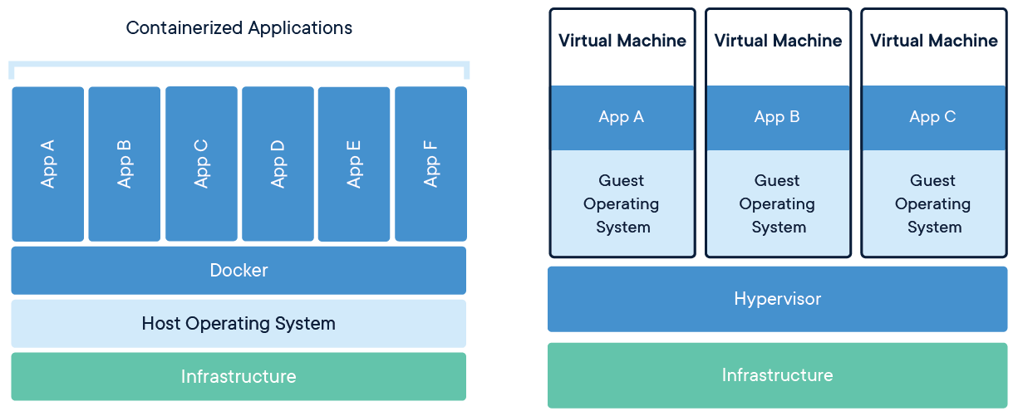

Slide 4
What’s a Container?
A container is an isolated package of code/binary with its dependencies.

Slide 5
Key features
Containers are made to run anything anywhere, designed to be portable, that means you can create, move and manage containers with ease across servers that run different operating systems.
Made to simplify development, shipment and deployment of software.
Secure because they are isolated, one container can’t see what’s inside another.
Lightweight because they don’t run an entire OS, instead they share the machine’s OS kernel
Unlike VMs, containers are low cost because they don’t require extra OS licensing

Slide 6
Container runtime
A container runtime, also known as container engine, is a software that can run containers on a host operating system.
Common examples of container runtimes are runC, containerd, Docker, and Windows Containers

Slide 7
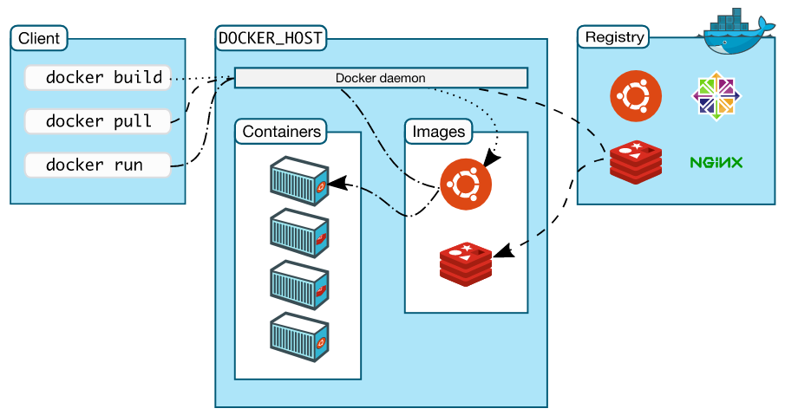
Docker Architecture

Slide 8
Docker Architecture
Docker uses a client-server architecture. The client communicate with the daemon using a REST API, and the daemon role is building, running, and distributing containers.
The daemon, is also called “dockerd”, its role is to manage Docker objects such as images, containers, networks, and volumes.
The client, it is the “docker” command line tool, it is the primary way to interact with daemon.
The registry, it is a store of images. Docker Hub is a public registry used as a default source of images by daemon. It is always possible to run a private registry.

Slide 9
Docker Objects
Docker is a tool for creating and managing objects such as images and containers
Containers, a runnable stateless instance of an image, meaning once it is removed, the changes to its state will be lost.
Images, an image is a snapshot of a container, it can be described as a virtual reusable copy of a container.

Slide 10
Lab 1
Creating and managing containers

Slide 11
Containerization
It is the packaging of software code with the libraries and dependencies required to run it as a single lightweight executable called a container.

Slide 12
Lab 2
Building container images

Slide 13
Network
Containers can communicate via network with each other, Docker provide the ability to setup and manage different networks to be used among containers.

Slide 14
Volumes
Containers are stateless, meaning when they are removed, all changes will be lost, in order to persist data, it’s possible to mount a path in host machine to a path within a container.

Slide 15
Lab 3
Creating non-ephemeral containers

Slide 16
Alternatives to Docker
Docker is not the only way to create containers, many others ways exist such as
Podman
Containerd
runC
CRI-O
Windows Containers

