Slide 1




A Cross-Modal Densely Guided Knowledge Distillation Based on Modality Rebalancing Strategy for Enhanced Unimodal Emotion Recognition
Shuang Wu¹, Heng Liang², Yong Zhang³, Yanlin Chen⁴, Ziyu Jia⁵
¹South China University of Technology
²The University of Hong Kong
³Huzhou University
⁴New York University
⁵Institute of Automation, Chinese Academy of Sciences
Notes:
Hello everyone, thank you for watching this video. We will be sharing our work online.

Slide 2
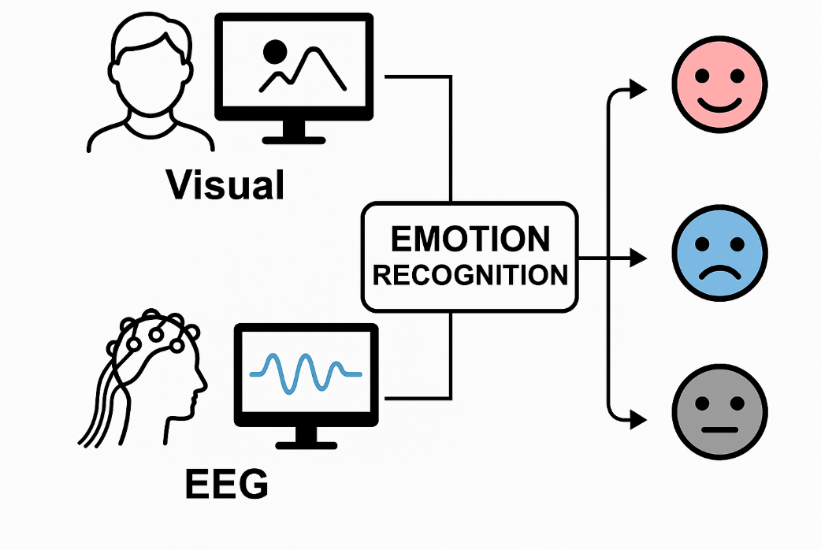
Research Background
Emotion Recognition
Wide Applications: Intelligent Assistants, Online Education, Smart Healthcare
Multimodal Approach: Fusing Visual and EEG signals
Visual (Facial)&EEG
Complementary features
The Core Question of This Research:
How to transfer expensive "multimodal knowledge" to a low-cost "unimodal network"?
Ultimate Goal: To improve the accuracy of the unimodal model, enabling its performance to approach that of the multimodal model.

Slide 3
Related Work
Cross-modal Knowledge Distillation
Multi-modal Fusion
Approach: Knowledge transfer from a multimodal teacher → a unimodal student
Goal: Reduce model complexity for easier real-world deployment
Challenge: Knowledge Loss (Large structural gap between teacher and student networks, causing difficulty in knowledge transfer)
Approach: Directly fuse multiple sources of information like visual and EEG signals
Goal: Pursue higher accuracy and robustness
Challenge: Modality Imbalance (Dominant modality steers the training, while the weaker modality is neglected)

Slide 4
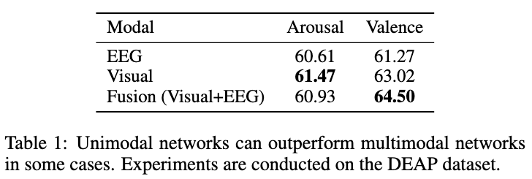
Challenge 1
Unimodal can outperform multimodal.
Cause: Imbalanced modal strength & convergence.
Flawed Solutions:
Enhancing weak modality → High computational cost.
Suppressing strong modality → Degrades overall performance.
Notes:
To achieve the transfer of multimodal knowledge to a unimodal model, two main challenges exist. First, as shown in the table on the right, although multimodal fusion should theoretically outperform unimodal approaches, in practice, unimodal networks often surpass multimodal ones. This reflects the key problem of "modality imbalance." Specifically, there are significant differences in feature representation capabilities and training convergence speeds among different modalities. A dominant modality may steer the learning process, while a weaker modality struggles to contribute fully, ultimately limiting the fusion performance. To address this, existing methods are mainly twofold: one is to enhance the expressive power of the weak modality, for instance, by introducing unimodal supervision or auxiliary modules, but this increases computational overhead. The other is to suppress the contribution of the strong modality by dynamically adjusting the learning rates of each modality, but this may weaken the overall performance. Therefore, current methods still struggle to strike a balance between improving fusion performance and maintaining network efficiency, and modality imbalance remains a core challenge in multimodal fusion.

Slide 5
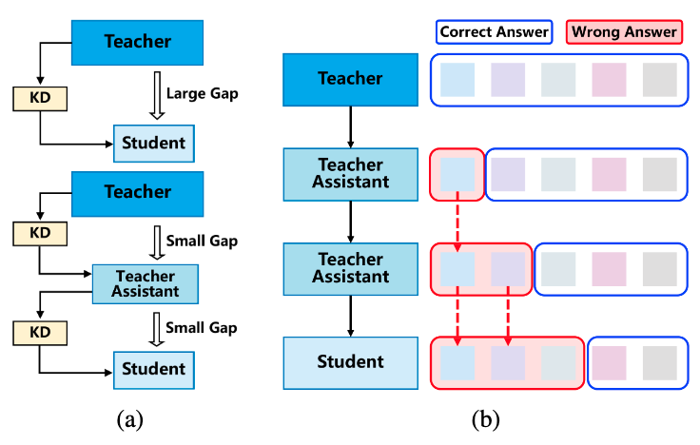
Challenge 2
The Structural Gap
Teacher: Complex, multimodal, high-performance.
Student: Lightweight, unimodal, weaker.
Problem: This gap causes knowledge loss during direct distillation.
Flawed Solution (TA Networks):
Single-layer TA: Too simple to bridge the gap.
Multi-layer TA: Prone to error accumulation.
Notes:
In cross-modal knowledge distillation, high-performance multimodal teacher networks are typically complex, containing multiple branches to process features from different modalities. In contrast, student networks are more lightweight, relying on only a single modality input. This significant gap in structure and capability can easily lead to knowledge loss during transfer, limiting the effectiveness of distillation. To bridge this gap, researchers have introduced intermediate teacher assistant (TA) networks to act as a "bridge" between the teacher and the student. Among them, single-layer TA methods are simple to implement but struggle to adapt to complex structural differences. Multi-layer TA (MTAKD) methods, on the other hand, improve matching accuracy by passing knowledge layer by layer but are prone to "error accumulation," where knowledge is progressively distorted across multiple layers, ultimately affecting the student network's performance. Therefore, how to compress the structural gap while avoiding error propagation has become another major challenge in current cross-modal distillation research.

Slide 6
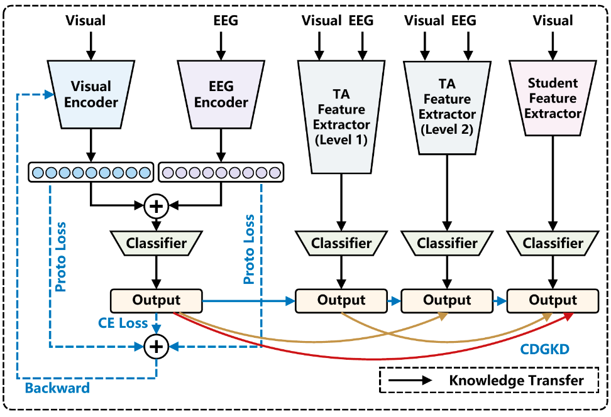
Methodology Overview
Prototype Loss-Driven Modality Rebalancing Strategy
Cross-modal Densely Guided Knowledge Distillation (CDGKD) Method
Notes:
This study proposes a cross-modal knowledge distillation framework to enhance the performance of visual-only unimodal emotion recognition. The framework consists of two key modules: First, a modality rebalancing strategy driven by prototype loss effectively mitigates the modality imbalance problem during multimodal fusion by introducing class prototype constraints, enabling the teacher network to more fully integrate visual and EEG information. Second, the proposed Cross-modal Densely Guided Knowledge Distillation (CDGKD) method introduces multi-level teacher assistant networks to progressively narrow the structural and expressive capability gap between the teacher and student networks, while reducing error accumulation during knowledge transfer, ensuring a stable and effective distillation process. This framework ultimately enables the student network to achieve recognition performance close to that of the multimodal network, using only the visual modality.

Slide 7
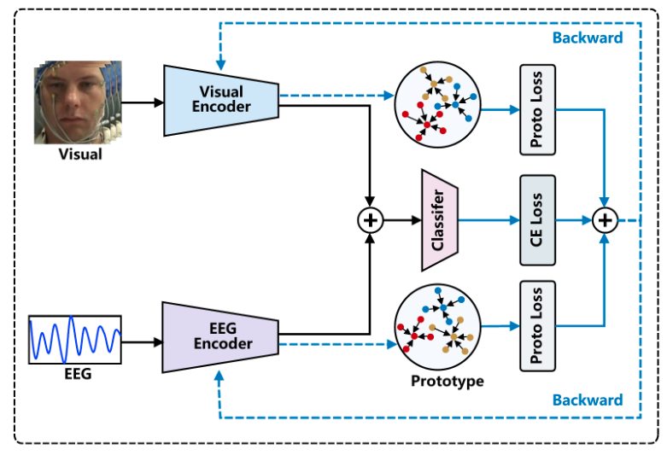
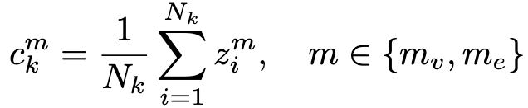
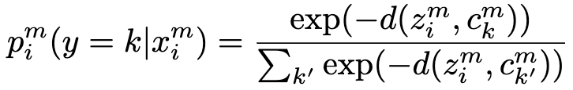
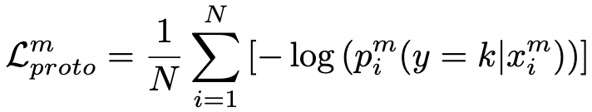
Method
1.Prototype-based Modality Rebalancing
Prototype:
Prototype-based Probability Distribution:
Prototype-based Loss Function:
Notes:
Specifically, first, to alleviate the imbalance between the visual and EEG modalities during fusion, this paper proposes a modality rebalancing strategy based on prototype loss. The core idea is straightforward: for each emotion class, we define a central point in the feature space, which we call a "prototype." Our goal is to train the model to pull all samples from the same class closer to their shared prototype.
Looking at the equations on the left:
First, the prototype calculation. The prototype c_k^m for a class k is simply the average of all sample features belonging to that class. It acts as the standard representation for that emotion.
Next, the probability distribution. The second equation calculates the probability that a sample belongs to a certain class. This is based on its distance to each class prototype—essentially, the closer a sample is to a prototype, the higher its probability for that class.
Finally, our Prototype Loss function, L_proto^m. This is a negative log-likelihood loss. By minimizing this loss, we effectively pull each sample's features towards their correct class prototype, making the features much more distinct and discriminative.
In short, this prototype strategy not only improves our feature quality, but it also provides a crucial metric to measure the convergence speed of each modality. This allows us to dynamically rebalance their contributions, effectively solving the modality imbalance problem.

Slide 8
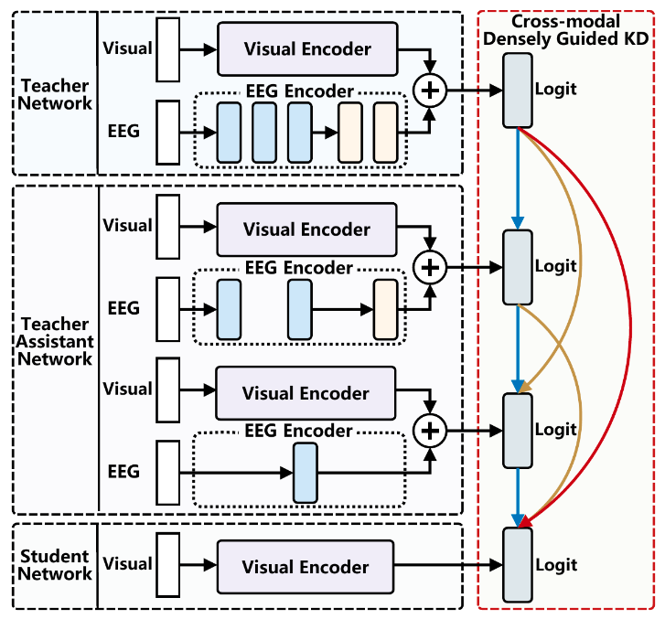
Method
2. Cross-modal Densely Guided Knowledge Distillation (CDGKD)
Progressively bridge the teacher-student gap using multiple Teacher Assistant (TA) networks.
Densely guide the student with random supervision from all higher-level models.
Mitigate error accumulation, significantly improving student performance.
Notes:
Second, to mitigate information loss and error accumulation during cross-modal knowledge transfer, this paper proposes the Cross-modal Densely Guided Knowledge Distillation (CDGKD) method. This method, through a multi-level guidance mechanism, introduces multiple intermediate TA networks to construct a step-by-step knowledge transfer path from the teacher to the student, with each network being randomly supervised by a higher-level model. The TA networks progressively simplify the EEG encoder until the student model retains only the visual modality input, achieving a smooth transition to a unimodal model and thereby effectively enhancing the student network's emotion recognition performance.

Slide 9
Experiments
Datasets
DEAP Dataset
EEG and facial video recordings from 32 subjects watching music videos.
22 subjects with complete bimodal data were used in the experiment.
MAHNOB-HCI Dataset
30 subjects performed self-assessment after watching emotional videos.
Samples from 24 subjects with complete EEG and facial video data were selected.
Both datasets provide labels for Valence and Arousal.
Notes:
We evaluated our proposed method on two public multimodal emotion recognition datasets: DEAP and MAHNOB-HCI. The DEAP dataset contains EEG signals and facial videos from 32 subjects watching music videos; 22 of these subjects had complete bimodal data and were used in the experiments. The MAHNOB-HCI dataset also provides EEG and facial video data, where 30 subjects self-assessed their emotions after watching emotional videos; we selected the 24 subjects with complete data. Both datasets include emotion labels such as valence and arousal.

Slide 10
Experiments
Knowledge Distillation Baseline Methods:
KD[1]: Trains student on the teacher's final output (logits).
Fitnets[2]: Uses intermediate teacher features as "hints" to guide the student.
NST[3]: Minimizes the Maximum Mean Discrepancy (MMD) between features.
TAKD[4]: Uses a Teacher Assistant (TA) model to bridge the teacher-student gap.
EmotionKD[5]: Dynamically adjusts multimodal structure based on unimodal performance.
AMBOKD[6]: Uses online distillation and dynamic weights to mitigate modality imbalance.
Notes:
To demonstrate the effectiveness of CDGKD, we compared our proposed method with these knowledge distillation methods under the same experimental settings.

Slide 11
Experiments
Multimodal Emotion Recognition Baselines:
CNN+SVM[7]: Uses CNN for facial features and Wavelet+SVM for EEG, combined with decision-level fusion.
CNN+LSTM[8]: Fuses keyframes of facial micro-expressions with EEG/GSR/PPG signals at the decision level.
EmotionKD[5]: Combines EEG and GSR data, enhancing performance through modal interaction.
DGC+JCA[9]: Extracts structural features using Graph Convolution and fuses them with a cross-modal attention mechanism.
Notes:
To demonstrate the effectiveness of the prototype-based loss function, we compared our proposed method with these multimodal emotion recognition methods.

Slide 12
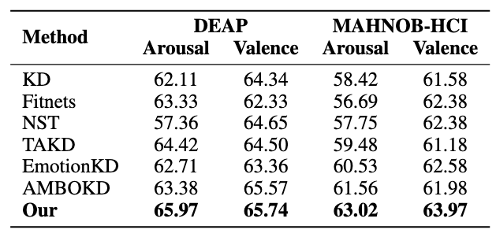
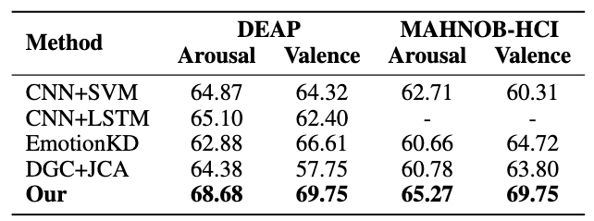
Experiments
Performance Comparison with Baseline Methods:
Our method achieves the best performance on both the DEAP and MAHNOB-HCI datasets.
Notes:
We use accuracy as the evaluation metric, assessing performance on the Arousal and Valence emotion recognition tasks respectively. The experimental results show that our method significantly outperforms other baselines on both the DEAP and MAHNOB-HCI datasets, in the training of both the multimodal teacher network and the distilled unimodal student network.

Slide 13
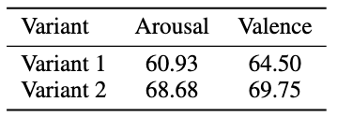
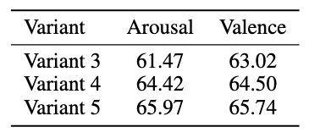
Ablation Study
Ablation for Prototype Loss
Ablation for CDGKD + Random Learning Strategy
Variant 3: Without Knowledge Distillation
Variant 4: CDGKD, without random learning strategy
Variant 5: CDGKD + Random learning strategy
Variant 1: Without Prototype Loss
Variant 2: With Prototype Loss

Slide 14
Main Contributions
Proposed an innovative cross-modal knowledge distillation framework to boost unimodal visual emotion recognition.
First to design a prototype loss-based modality rebalancing strategy to effectively mitigate modality imbalance and enhance the teacher network's expressiveness.
Proposed the CDGKD cross-modal distillation method to efficiently bridge the structural gap between teacher and student models, enabling precise knowledge transfer.
Notes:
In summary, we propose an innovative cross-modal knowledge distillation framework for enhancing unimodal visual emotion recognition performance. We are the first to design a modality rebalancing strategy based on prototype loss, which effectively solves the modality imbalance problem in multimodal feature fusion and improves the quality of the teacher network's multimodal knowledge representation. We proposed the Cross-modal Densely Guided Knowledge Distillation (CDGKD) method, which successfully bridges the structural gap between the teacher and student networks, achieving efficient cross-modal knowledge transfer. Experimental results demonstrate that this framework achieves excellent emotion recognition performance on both the DEAP and MAHNOB-HCI datasets.

Slide 15
References
[1] Geoffrey Hinton. Distilling the knowledge in a neural network. arXiv preprint arXiv:1503.02531, 2015.
[2] Adriana Romero, Nicolas Ballas, Samira Ebrahimi Kahou, Antoine Chassang, Carlo Gatta, and Yoshua Bengio. Fitnets: Hints for thin deep nets. arXiv preprint arXiv:1412.6550, 2014.
[3] Zehao Huang and Naiyan Wang. Like what you like: Knowledge distill via neuron selectivity transfer. arXiv preprint arXiv:1707.01219, 2017.
[4] Seyed Iman Mirzadeh, Mehrdad Farajtabar, Ang Li, Nir Levine, Akihiro Matsukawa, and Hassan Ghasemzadeh. Improved knowledge distillation via teacher assistant. In Proceedings of the AAAI conference on artificial intelligence, volume 34, pages 51915198, 2020.
[5] Yucheng Liu, Ziyu Jia, and Haichao Wang. Emotionkd: a cross-modal knowledge distillation framework for emotion recognition based on physiological signals. In Proceedings of the 31st ACM International Conference on Multimedia, pages 6122–6131, 2023.
[6] Zixing Li, Chao Yan, Zhen Lan, Xiaojia Xiang, Han Zhou, Jun Lai, and Dengqing Tang. Adaptive modality balanced online knowledge distillation for braineye-computer based dim object detection. arXiv preprint arXiv:2407.01894, 2024.
[7] Yongrui Huang, Jianhao Yang, Siyu Liu, and Jiahui Pan. Combining facial expressions and electroencephalography to enhance emotion recognition. Future Internet, 11(5):105, 2019.
[8] Nastaran Saffaryazdi, Syed Talal Wasim, Kuldeep Dileep, Alireza Farrokhi Nia, Suranga Nanayakkara, Elizabeth Broadbent, and Mark Billinghurst. Using facial micro-expressions in combination with eeg and physiological signals for emotion recognition. Frontiers in Psychology, 13:864047, 2022.
[9] Cheng Cheng, Wenzhe Liu, Lin Feng, and Ziyu Jia. Dense graph convolutional with joint cross-attention network for multimodal emotion recognition. IEEE Transactions on Computational Social Systems, 2024.
Notes:
The following are the references for this paper.

Slide 16
Thanks!
Notes:
Thank you for your attention!

