Slide 1
Compressing Deep Neural Network
Chen Zhao
2017.12.7

Slide 2
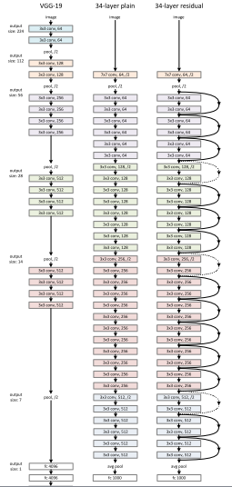
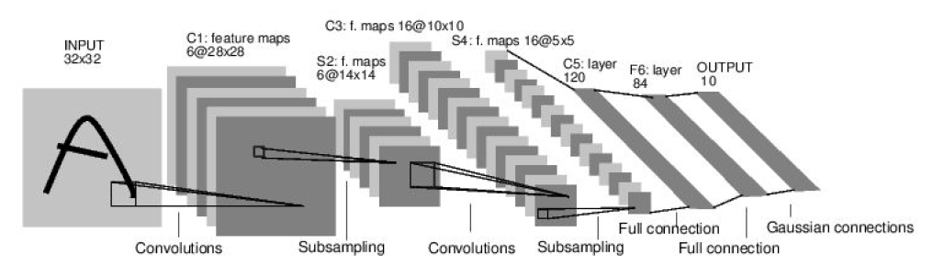
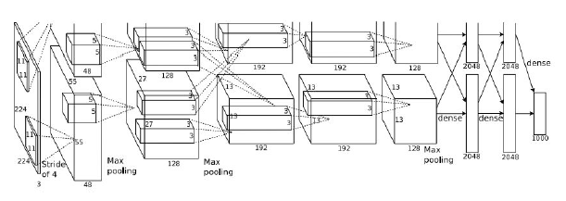
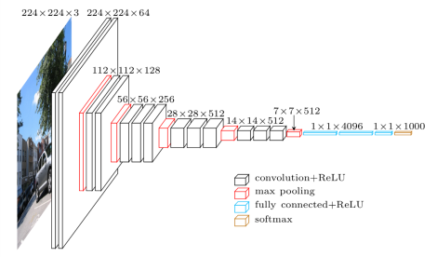
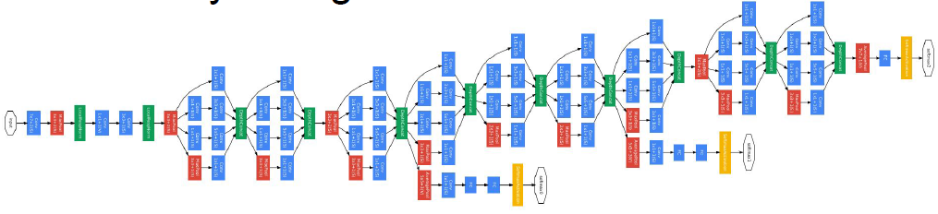
Why we need compression
Wider and deeper, more and more parameters

Slide 3
Why we need compression
Large storage and memory space
Wider and deeper, more and more parameters
Intensive computation
Large bandwidth for deployment

Slide 4
Why we need compression
Resource has a cost
Electricity
Inference on mobile device
GPUs, storage, memory
Limited
Time

Slide 5
Why we need compression
We need to compress the network so that
Fewer parameters
Keep its performance

Slide 6

Computational complexity
The total time complexity of all convolutional layers
Decrease the number of parameters
Reduce number of convolutional layers (shallower): d
Reduce the number of filters (narrower): n_{l-1}, n_{l}
Reduce the filter size or make the filter sparse: s_{l}
Dominated by convolutional operations

Slide 7
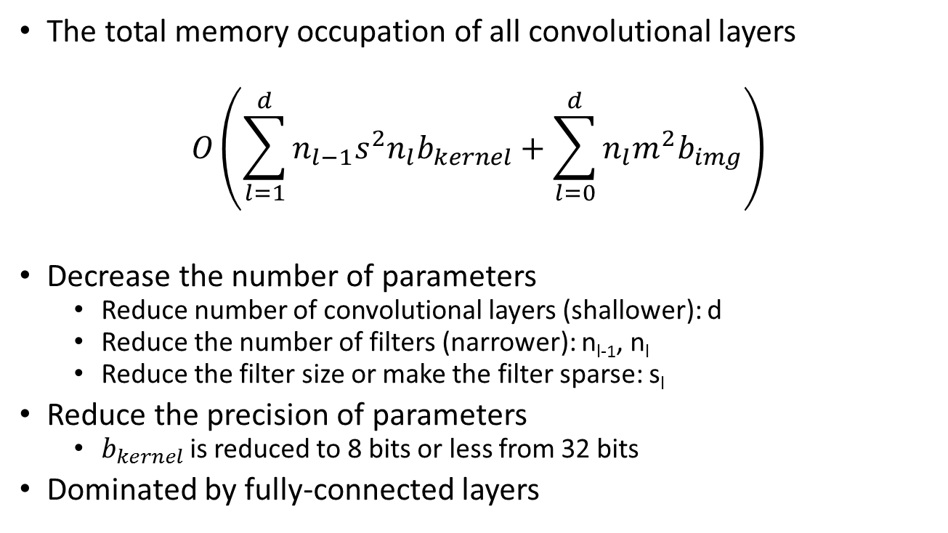
Memory usage
The total memory occupation of all convolutional layers
$$O\left(\sum_{l=1}^{d}{{n_{l−1}s}^{2}n_{l}b_{kernel}}+\sum_{l=0}^{d}{{n_{l}m}^{2}b_{img}}\right)$$
Decrease the number of parameters
Reduce number of convolutional layers (shallower): d
Reduce the number of filters (narrower): n_{l-1}, n_{l}
Reduce the filter size or make the filter sparse: s_{l}
Reduce the precision of parameters
$b_{kernel}$ is reduced to 8 bits or less from 32 bits
Dominated by fully-connected layers

Slide 8
Taxonomy of network compression
Training
Light network structure
Low-rank decomposition
FFT-based algorithms
Inference
Network pruning
Knowledge distillation
Quantization / binarization / hashing
Low-rank decomposition
FFT-based algorithms
Sparsity constraint

Slide 9
Taxonomy of network compression
Training
Light network structure
Low-rank decomposition
FFT-based algorithms
Inference
Network pruning
Knowledge distillation
Quantization / binarization / hashing
Low-rank decomposition
FFT-based algorithms
Sparsity constraint

Slide 10
Low rank decomposition
Based on the observation or assumption that the weight matrix/tensor in neural network is low rank.
Feature k
2D Weights of a fully-connected layer
Feature k+1

Slide 11
Low rank decomposition
Based on the observation or assumption that the weight matrix/tensor in neural network is low rank.
*
Feature k
4D Convolutional kernel banks
Feature k+1

Slide 12

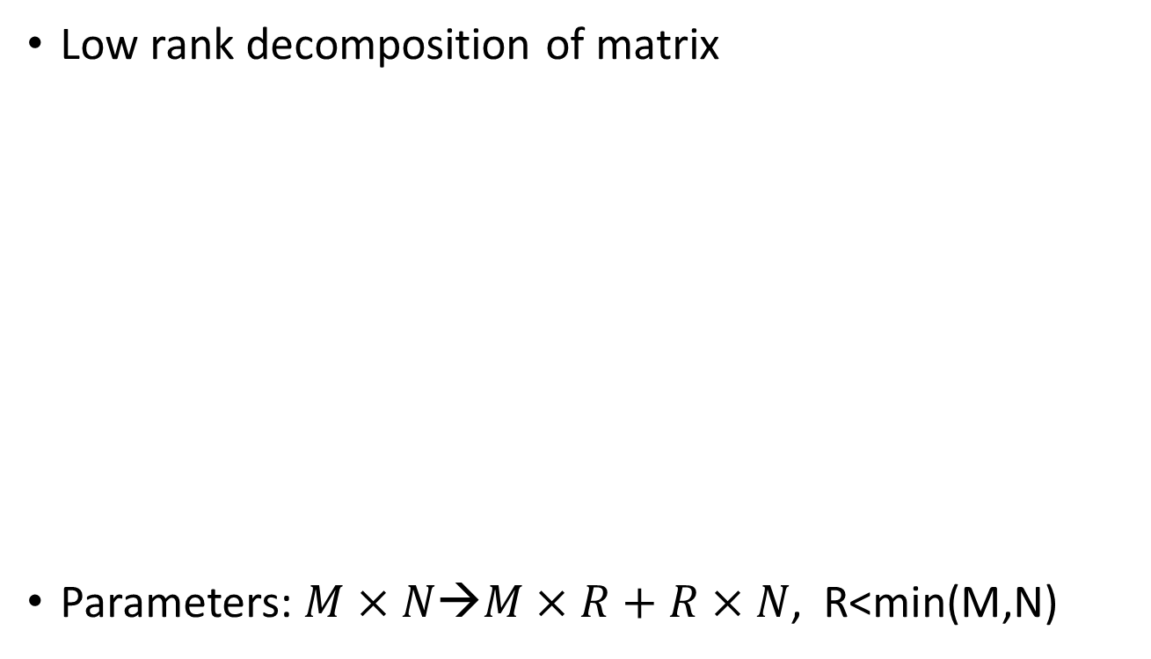


Low rank decomposition
Low rank decomposition of matrix
Parameters: $M×N$→$M×R+R×N\text{, }\text{R}\text{<}\text{min}\text{(}\text{M}\text{,}\text{N}\text{)}$
$$W∈ℝ^{M×N}$$
$$A∈ℝ^{M×R}$$
$$B∈ℝ^{R×N}$$

Slide 13
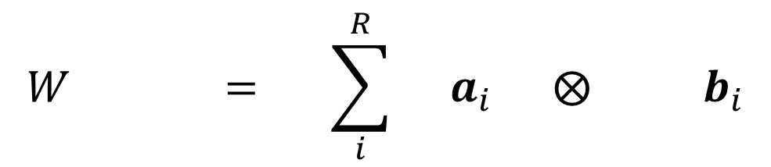
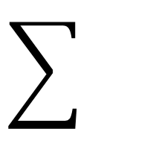
Low rank decomposition
Low rank decomposition of matrix
$$W = \sum_{i}^{R}{ a_{i} ⨂ b_{i}}$$

Slide 14
Low rank decomposition
Network layers after decomposition
Feature k
Feature k+1
Feature k+2

Slide 15


Low rank decomposition of 4D tensor
Convert to 2D matrix
4D Tensor $W∈ℝ^{C×d×d×F}$
2D M$atrix W∈ℝ^{C×(d^{2}F)}$

Slide 16
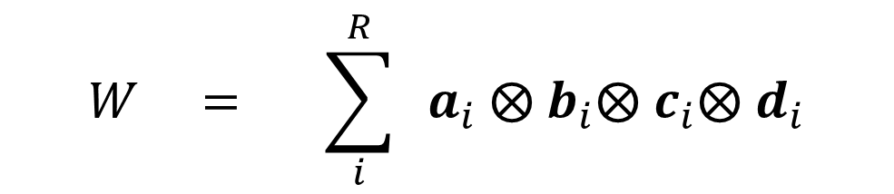
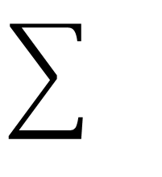
Low rank decomposition of 4D tensor
Canonical polyadic (CP) decomposition
$$W = \sum_{i}^{R}{ a_{i} ⨂ b_{i}⨂ c_{i}⨂ d_{i}}$$

Slide 17
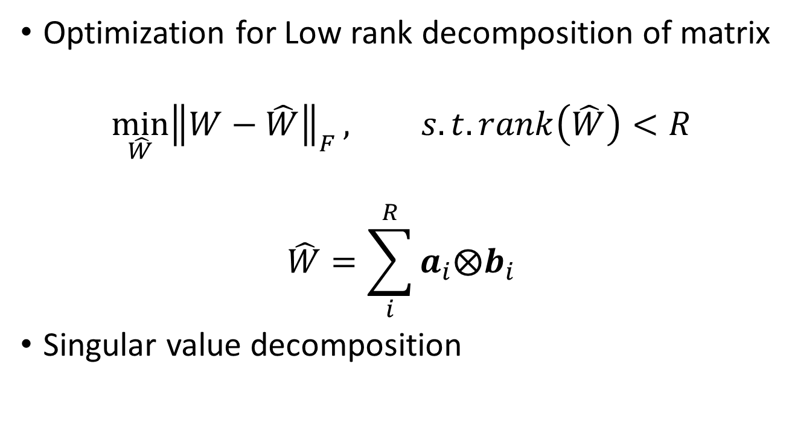
Low rank decomposition
Optimization for Low rank decomposition of matrix
$$\min_{\hat{W}}{{\left\|W−\hat{W}\right\|}_{F}}, s.t. rank\left(\hat{W}\right)<R$$
$$\hat{W}=\sum_{i}^{R}{a_{i}⨂b_{i}}$$
Singular value decomposition

Slide 18



Low rank decomposition
Optimization for Low rank decomposition of tensor
Alternate least squares, greedy solution

Slide 19
Representative papers: 1
Exploiting Linear Structure Within Convolutional Networks for Efficient Evaluation^{[1]:} use clustering
First layer (convert to 2D)
[1] Denton, E. L., Zaremba, W., Bruna, J., LeCun, Y., & Fergus, R. (2014). Exploiting linear structure within convolutional networks for efficient evaluation. In Advances in Neural Information Processing Systems (pp. 1269-1277).

Slide 20


Representative papers: 1
Exploiting Linear Structure Within Convolutional Networks for Efficient Evaluation^{[1]}
First layer (convert to 2D)
The f-th filter
$$W∈ℝ^{C×d×d}$$
$$W∈ℝ^{C×(d^{2})}$$
[1] Denton, E. L., Zaremba, W., Bruna, J., LeCun, Y., & Fergus, R. (2014). Exploiting linear structure within convolutional networks for efficient evaluation. In Advances in Neural Information Processing Systems (pp. 1269-1277).

Slide 21
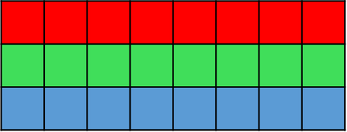





Representative papers: 1
Exploiting Linear Structure Within Convolutional Networks for Efficient Evaluation^{[1]}
First layer (convert to 2D)
Cluster all ${\tilde{U}}_{f}$ of all F filters
$$W∈ℝ^{3×(d^{2})}$$
[1] Denton, E. L., Zaremba, W., Bruna, J., LeCun, Y., & Fergus, R. (2014). Exploiting linear structure within convolutional networks for efficient evaluation. In Advances in Neural Information Processing Systems (pp. 1269-1277).

Slide 22
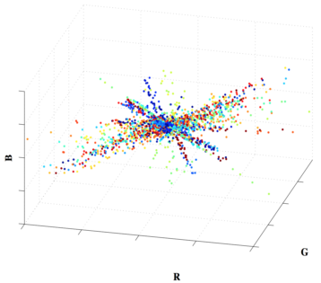
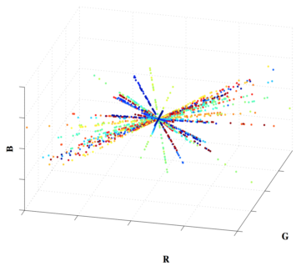
Representative papers: 1
Exploiting Linear Structure Within Convolutional Networks for Efficient Evaluation^{[1]}
[1] Denton, E. L., Zaremba, W., Bruna, J., LeCun, Y., & Fergus, R. (2014). Exploiting linear structure within convolutional networks for efficient evaluation. In Advances in Neural Information Processing Systems (pp. 1269-1277).

Slide 23
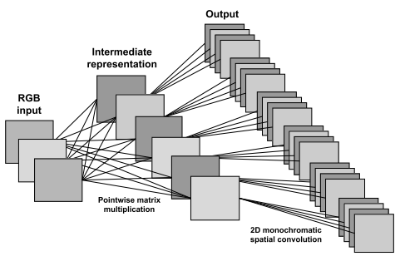

Representative papers: 1
Exploiting Linear Structure Within Convolutional Networks for Efficient Evaluation^{[1]}
First layer
[1] Denton, E. L., Zaremba, W., Bruna, J., LeCun, Y., & Fergus, R. (2014). Exploiting linear structure within convolutional networks for efficient evaluation. In Advances in Neural Information Processing Systems (pp. 1269-1277).

Slide 24
Representative papers: 1
Exploiting Linear Structure Within Convolutional Networks for Efficient Evaluation^{[1]}
Higher layers: sub-tensor is low rank
Input channels
Output channels
[1] Denton, E. L., Zaremba, W., Bruna, J., LeCun, Y., & Fergus, R. (2014). Exploiting linear structure within convolutional networks for efficient evaluation. In Advances in Neural Information Processing Systems (pp. 1269-1277).

Slide 25
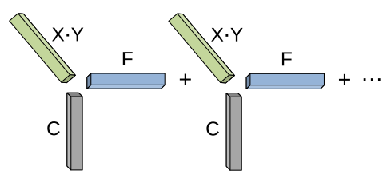
Representative papers: 1
Exploiting Linear Structure Within Convolutional Networks for Efficient Evaluation^{[1]}
Higher layers: sub-tensor is low rank; sum of rank 1 tensors
Finetune upper layers while fixing the current layer
[1] Denton, E. L., Zaremba, W., Bruna, J., LeCun, Y., & Fergus, R. (2014). Exploiting linear structure within convolutional networks for efficient evaluation. In Advances in Neural Information Processing Systems (pp. 1269-1277).

Slide 26
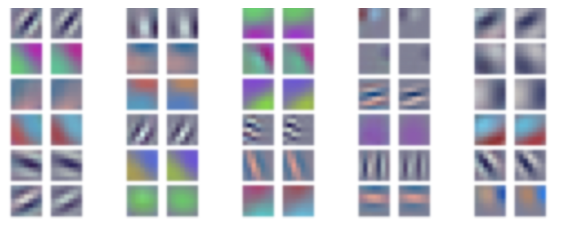
Representative papers: 1
Exploiting Linear Structure Within Convolutional Networks for Efficient Evaluation^{[1]}
[1] Denton, E. L., Zaremba, W., Bruna, J., LeCun, Y., & Fergus, R. (2014). Exploiting linear structure within convolutional networks for efficient evaluation. In Advances in Neural Information Processing Systems (pp. 1269-1277).

Slide 27
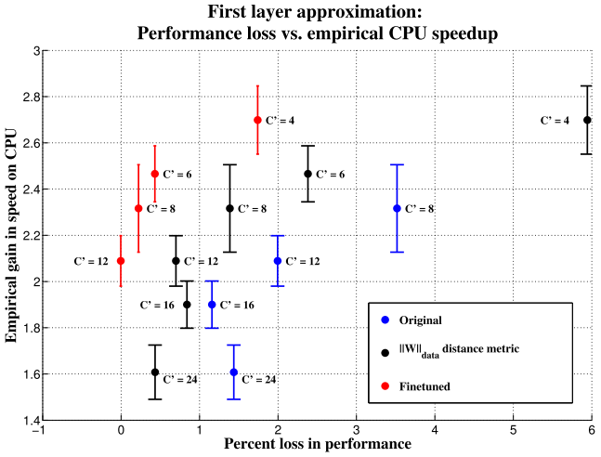
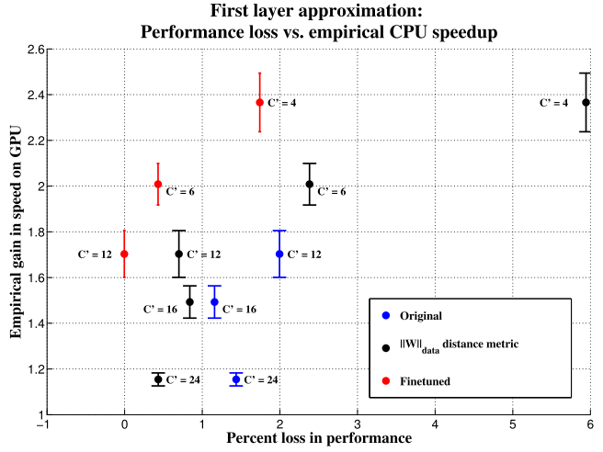

Representative papers: 1
Exploiting Linear Structure Within Convolutional Networks for Efficient Evaluation^{[1]}: $2×$
[1] Denton, E. L., Zaremba, W., Bruna, J., LeCun, Y., & Fergus, R. (2014). Exploiting linear structure within convolutional networks for efficient evaluation. In Advances in Neural Information Processing Systems (pp. 1269-1277).

Slide 28
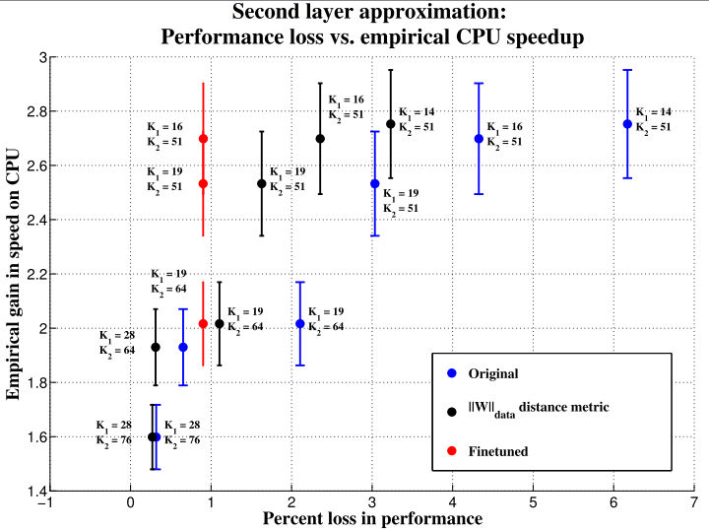
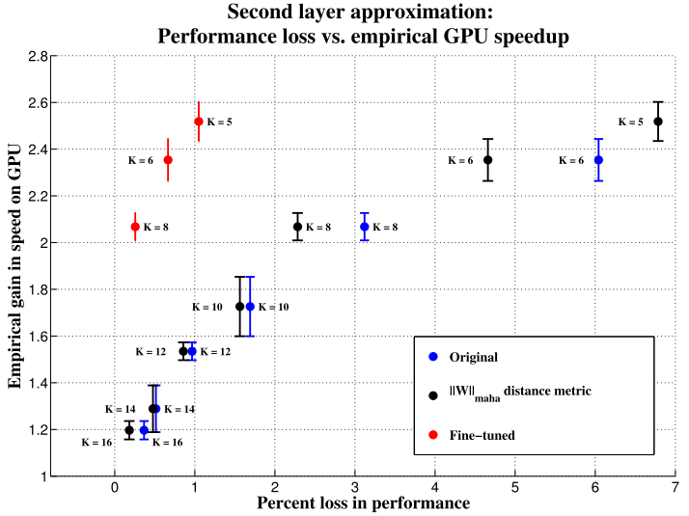
Representative papers: 1
Exploiting Linear Structure Within Convolutional Networks for Efficient Evaluation^{[1]}
[1] Denton, E. L., Zaremba, W., Bruna, J., LeCun, Y., & Fergus, R. (2014). Exploiting linear structure within convolutional networks for efficient evaluation. In Advances in Neural Information Processing Systems (pp. 1269-1277).

Slide 29
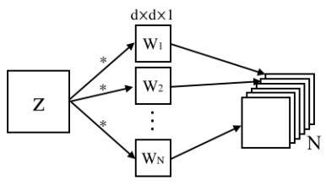
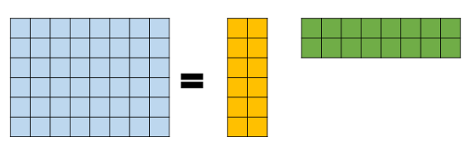



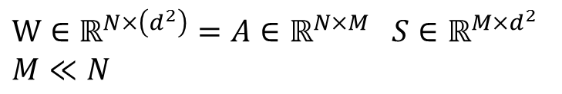
Representative papers: 2
Speed up convolutional neural networks with low rank expansions^{[2]}
Dependency of output channels
$$d^{2}$$
$$N$$
$$W∈ℝ^{N×\left(d^{2}\right)}=A∈ℝ^{N×M} S∈ℝ^{M×d^{2}}$$
$$M≪N$$
$$W∗z= A S∗z=A (S∗z)$$
[2] Jaderberg, M., Vedaldi, A., & Zisserman, A. (2014). Speeding up convolutional neural networks with low rank expansions. arXiv preprint arXiv:1405.3866.

Slide 30
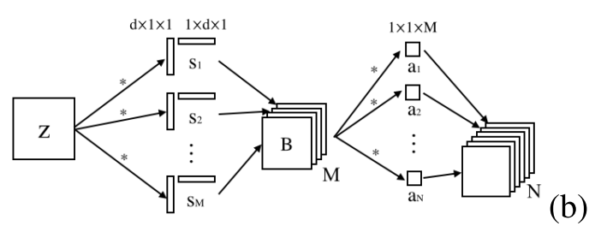

Representative papers: 2
Speed up convolutional neural networks with low rank expansions^{[2]}
Dependency of output channels
$$W∗z= A S∗z=A (S∗z)$$
[2] Jaderberg, M., Vedaldi, A., & Zisserman, A. (2014). Speeding up convolutional neural networks with low rank expansions. arXiv preprint arXiv:1405.3866.

Slide 31
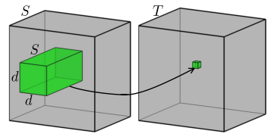
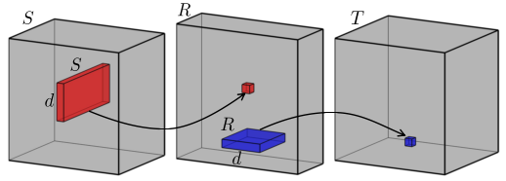
Representative papers: 2
Speed up convolutional neural networks with low rank expansions^{[2]}
Each convolutional layer is factored as a sequence of two regular convolutional layers
[2] Jaderberg, M., Vedaldi, A., & Zisserman, A. (2014). Speeding up convolutional neural networks with low rank expansions. arXiv preprint arXiv:1405.3866.

Slide 32
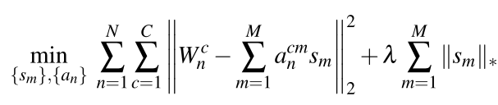

Representative papers: 2
Speed up convolutional neural networks with low rank expansions^{[2]}
Filter reconstruction optimization
Data reconstruction optimization
[2] Jaderberg, M., Vedaldi, A., & Zisserman, A. (2014). Speeding up convolutional neural networks with low rank expansions. arXiv preprint arXiv:1405.3866.

Slide 33
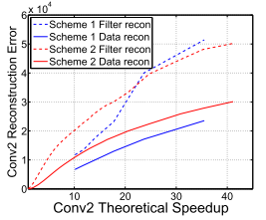
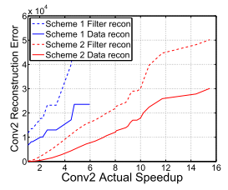

Representative papers: 2
Speed up convolutional neural networks with low rank expansions^{[2]}: scene character classification-4 layers -- $2.5×$, $×$
[2] Jaderberg, M., Vedaldi, A., & Zisserman, A. (2014). Speeding up convolutional neural networks with low rank expansions. arXiv preprint arXiv:1405.3866.

Slide 34
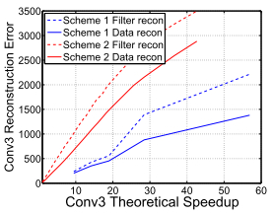
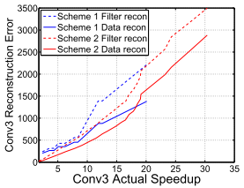
Representative papers: 2
Speed up convolutional neural networks with low rank expansions^{[2]}: scene character classification-4 layers,
[2] Jaderberg, M., Vedaldi, A., & Zisserman, A. (2014). Speeding up convolutional neural networks with low rank expansions. arXiv preprint arXiv:1405.3866.

Slide 35
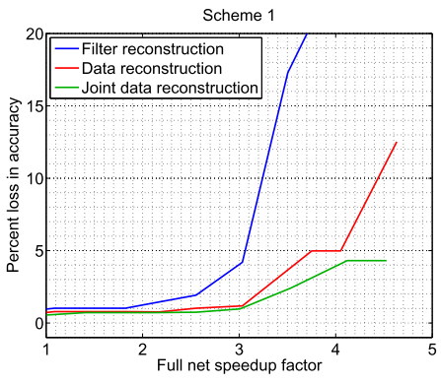
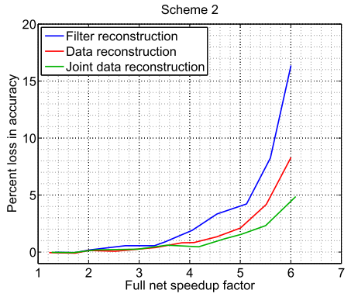
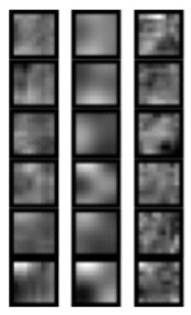
Representative papers: 2
Speed up convolutional neural networks with low rank expansions^{[2]}: scene character classification-4 layers
[2] Jaderberg, M., Vedaldi, A., & Zisserman, A. (2014). Speeding up convolutional neural networks with low rank expansions. arXiv preprint arXiv:1405.3866.

Slide 36
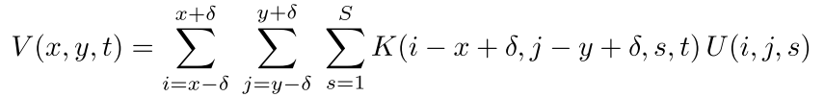
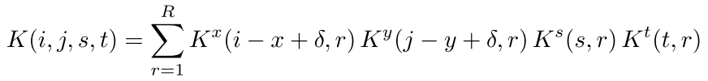
Representative papers: 3
Speeding-up convolutional neural networks using fine-tuned CP-decomposition^{[3]}
[3] Lebedev, V., Ganin, Y., Rakhuba, M., Oseledets, I., & Lempitsky, V. (2014). Speeding-up convolutional neural networks using fine-tuned cp-decomposition. arXiv preprint arXiv:1412.6553.

Slide 37
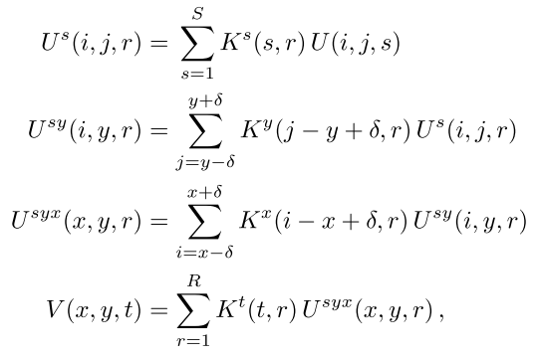
Representative papers: 3
Speeding-up convolutional neural networks using fine-tuned CP-decomposition^{[3]}
[3] Lebedev, V., Ganin, Y., Rakhuba, M., Oseledets, I., & Lempitsky, V. (2014). Speeding-up convolutional neural networks using fine-tuned cp-decomposition. arXiv preprint arXiv:1412.6553.

Slide 38
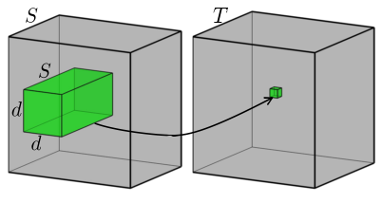
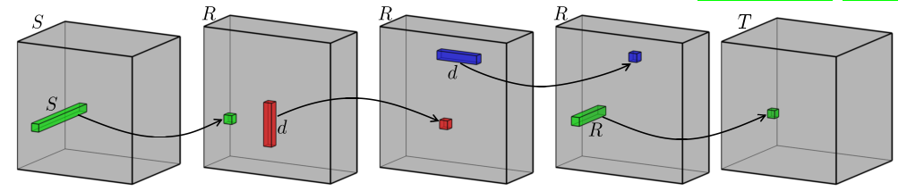
Representative papers: 3
Speeding-up convolutional neural networks using fine-tuned CP-decomposition^{[3]}
[3] Lebedev, V., Ganin, Y., Rakhuba, M., Oseledets, I., & Lempitsky, V. (2014). Speeding-up convolutional neural networks using fine-tuned cp-decomposition. arXiv preprint arXiv:1412.6553.

Slide 39
Representative papers: 3
Speeding-up convolutional neural networks using fine-tuned CP-decomposition^{[3]}
Optimization: non-linear least squares, Gauss-Newton
Finetune all the layers: gradient explosion for inserted layers
Test on
small character-classification CNN: 1% drop, 8.5x speedup
Alexnet: 1% drop, 4x speedup
focus on single layers
[3] Lebedev, V., Ganin, Y., Rakhuba, M., Oseledets, I., & Lempitsky, V. (2014). Speeding-up convolutional neural networks using fine-tuned cp-decomposition. arXiv preprint arXiv:1412.6553.

Slide 40
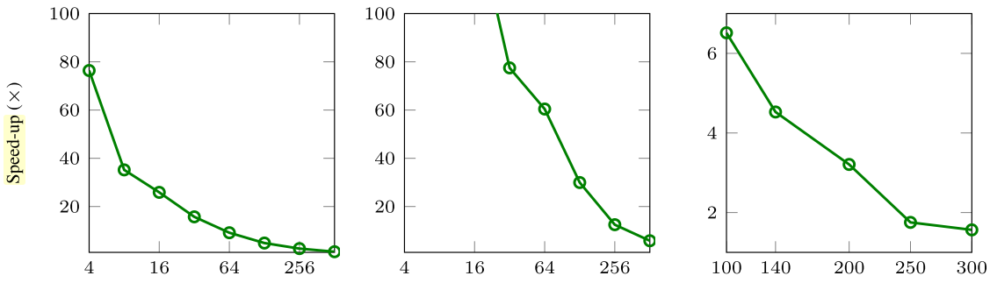
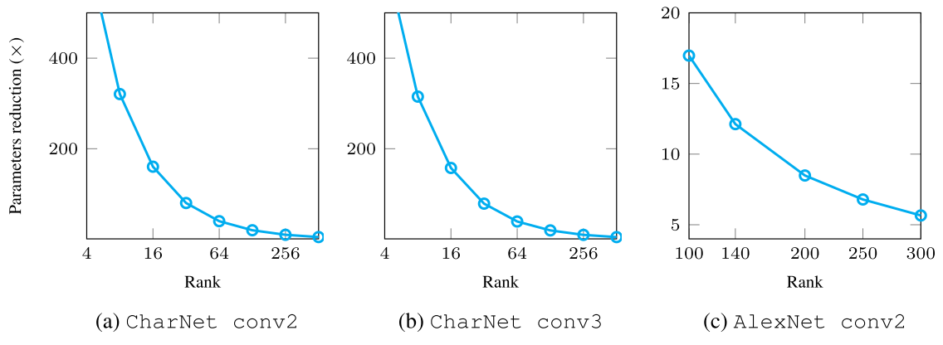
Representative papers: 3
Speeding-up convolutional neural networks using fine-tuned CP-decomposition^{[3]}

Slide 41
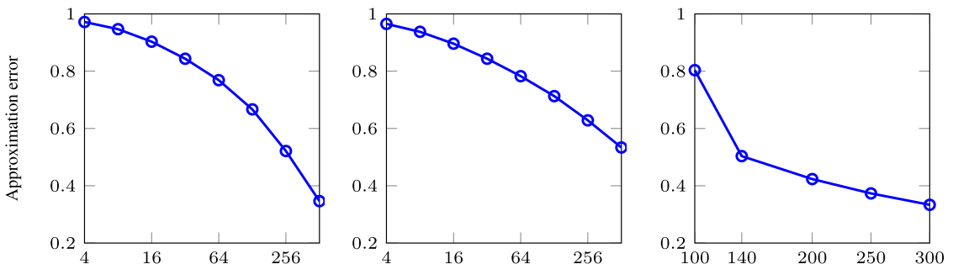
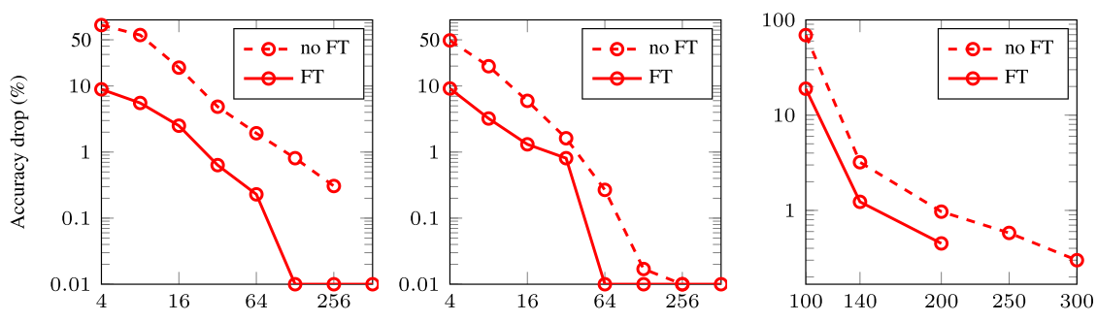
Representative papers: 3
Speeding-up convolutional neural networks using fine-tuned CP-decomposition^{[3]}

Slide 42
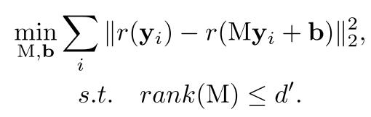
Representative papers: 4
Accelerating very deep convolutional networks for classification and detection^{[4]}
Low rank of response map
Data reconstruction optimization: consider non-linear operator
Alternate solver, generalized SVD
[4] Zhang, X., Zou, J., He, K., & Sun, J. (2016). Accelerating very deep convolutional networks for classification and detection. IEEE transactions on pattern analysis and machine intelligence, 38(10), 1943-1955.

Slide 43
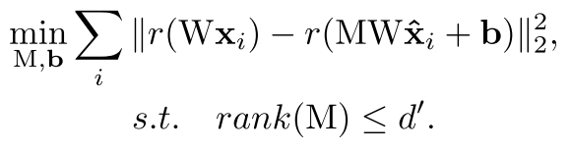
Representative papers: 4
Accelerating very deep convolutional networks for classification and detection^{[4]}
Asymmetric reconstruction of multiple-layer: consider error propagation through the whole network
[4] Zhang, X., Zou, J., He, K., & Sun, J. (2016). Accelerating very deep convolutional networks for classification and detection. IEEE transactions on pattern analysis and machine intelligence, 38(10), 1943-1955.

Slide 44

Representative papers: 4
Accelerating very deep convolutional networks for classification and detection^{[4]}
Test on SPP-10: linear VS. nonlinear
[4] Zhang, X., Zou, J., He, K., & Sun, J. (2016). Accelerating very deep convolutional networks for classification and detection. IEEE transactions on pattern analysis and machine intelligence, 38(10), 1943-1955.

Slide 45

Representative papers: 4
Accelerating very deep convolutional networks for classification and detection^{[4]}
Test on SPP-10: symmetric VS asymmetric
[4] Zhang, X., Zou, J., He, K., & Sun, J. (2016). Accelerating very deep convolutional networks for classification and detection. IEEE transactions on pattern analysis and machine intelligence, 38(10), 1943-1955.

Slide 46

Representative papers: 4
Accelerating very deep convolutional networks for classification and detection^{[4]}
Test on SPP-10: absolute performance
[4] Zhang, X., Zou, J., He, K., & Sun, J. (2016). Accelerating very deep convolutional networks for classification and detection. IEEE transactions on pattern analysis and machine intelligence, 38(10), 1943-1955.

Slide 47

Representative papers: 4
Accelerating very deep convolutional networks for classification and detection^{[4]}
Test on VGG-16: absolute performance
[4] Zhang, X., Zou, J., He, K., & Sun, J. (2016). Accelerating very deep convolutional networks for classification and detection. IEEE transactions on pattern analysis and machine intelligence, 38(10), 1943-1955.

Slide 48
Taxonomy of network compression
Training
Light network structure
Low-rank decomposition
FFT-based algorithms
Inference
Network pruning
Knowledge distillation
Quantization / binarization / hashing
Low-rank decomposition
FFT-based algorithms
Sparsity constraint

Slide 49
Network pruning
Goal: remove unimportant parameters
What is unimportant parameters:
Low magnitude, less salient
Step:
Calculate parameters importance
Prune the parameters with least importance
Retrain the network

Slide 50

Network pruning^{[1]}
Prune filters instead of weights
Pruning a filter results in removal of its corresponding feature map and related kernels in the next layer.
[1] Li, Hao, et al. "Pruning filters for efficient convnets." arXiv preprint arXiv:1608.08710 (2016).

Slide 51

Network pruning^{[1]}
how to deal with residual block: based on the filters of the shortcut layers
how many filters to be removed in each layer: same ratio for layers with the same feature map size

Slide 52
Taxonomy of network compression
Training
Light network structure
Low-rank decomposition
FFT-based algorithms
Inference
Network pruning
Knowledge distillation
Quantization / binarization / hashing
Low-rank decomposition
FFT-based algorithms
Sparsity constraint

Slide 53


Knowledge distillation
Goal: Compressed model (student) mimics the function learned by a complex model (teacher) ^{[1,2]}
[1] Hinton, Geoffrey, Oriol Vinyals, and Jeff Dean. "Distilling the knowledge in a neural network." arXiv preprint arXiv:1503.02531 (2015).
[2] Romero, Adriana, et al. "Fitnets: Hints for thin deep nets." arXiv preprint arXiv:1412.6550 (2014).

Slide 54

Knowledge distillation
Hint based training^{[2]}
[2] Romero, Adriana, et al. "Fitnets: Hints for thin deep nets." arXiv preprint arXiv:1412.6550 (2014).

Slide 55
Taxonomy of network compression
Training
Light network structure
Low-rank decomposition
FFT-based algorithms
Inference
Network pruning
Knowledge distillation
Quantization / binarization / hashing
Low-rank decomposition
FFT-based algorithms
Sparsity constraint

Slide 56
Quantization
Goal: reduce precision from 32 floating point to …
Method: quantize the parameters so that they take fewer bits
Quantization Methods ^{[1]}
Binarization
Scalar quantization using k-means
Product quantization
Residual quantization
[1] Gong, Yunchao, et al. "Compressing deep convolutional networks using vector quantization." arXiv preprint arXiv:1412.6115 (2014).

Slide 57



Quantization
Binarization
Scalar quantization using k-means ^{[2]}
[2] Han, Song, Huizi Mao, and William J. Dally. "Deep compression: Compressing deep neural networks with pruning, trained quantization and huffman coding." arXiv preprint arXiv:1510.00149 (2015).

Slide 58




Quantization
Product quantization
Residual quantization

Slide 59
Taxonomy of network compression
Training
Light network structure
Low-rank decomposition
FFT-based algorithms
Inference
Network pruning
Knowledge distillation
Quantization / binarization / hashing
Low-rank decomposition
FFT-based algorithms
Sparsity constraint

Slide 60
Light network structure
Goal: design new models with more efficient computation instead of attempting to accelerate pre-trained models
Examples
Squeezenet
Mobilenets
PVANet
Notes:
More speed up. However, constructing a newCNN from scratch might be difficult without using a large amount of computing resources.

Slide 61

Squeezenet
Principles:
Use 1*1 kernel instead of 3*3
Use fewer input feature maps
Downsample late in the network

Slide 62


Slide 63
Thanks very much!

