Slide 1
Memory Networks
(MemNN)
Humam Alwassel
IVUL Group Meeting
May 04, 2017
Slides are borrowed from Jason Weston’s “Memory Networks for Language Understanding” ICML Tutorial 2016

Slide 2
Motivation for MemNN: QA Tasks
John was in the bedroom.
Bob was in the office.
John went to kitchen.
Bob travelled back home.
Where is John? A:kitchen
John is in the playground.
Bob is in the office.
John picked up the football.
Bob went to the kitchen.
Where is the football? A:playground
Where was Bob before the kitchen? A:office

Slide 3
Motivation for MemNN: Tasks Requiring Long(er) Memory
Slides from Jason Weston’s “Memory Networks for Language Understanding” ICML Tutorial 2016

Slide 4
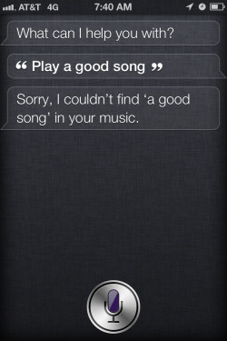
Motivation for MemNN: Intelligent Conversational Agents
Slides from Jason Weston’s “Memory Networks for Language Understanding” ICML Tutorial 2016

Slide 5
Memory Networks
Class of models that combine large memory with learning component that can read and write to that memory.
Incorporates reasoning with attention over memory (RAM).
Most ML has limited memory which is more-or-less all that’s needed for “low level” tasks e.g. object detection.
Motivation: long-term memory is required to read a story and then e.g. answer questions about it.
Similarly, it’s also required for dialog: to remember previous dialog (short- and long-term), and respond.
Slides from Jason Weston’s “Memory Networks for Language Understanding” ICML Tutorial 2016

Slide 6
What is a Memory Network?
MemNNs have four component networks (which may or may not have shared parameters):
I: (input feature map) convert incoming data to the internal feature representation.
G: (generalization) update memories given new input.
O: produce new output (in feature representation space) given the memories.
R: (response) convert output O into a response seen by the outside world.
Slides from Jason Weston’s “Memory Networks for Language Understanding” ICML Tutorial 2016

Slide 7

I
R
input x
I(x)
G
I(x)
O
o = O(I(x), m)
r = R(o)
update
read
Memory
update: $m_{i}=G\left(m_{i}, I\left(x\right), m\right),∀i$

Slide 8
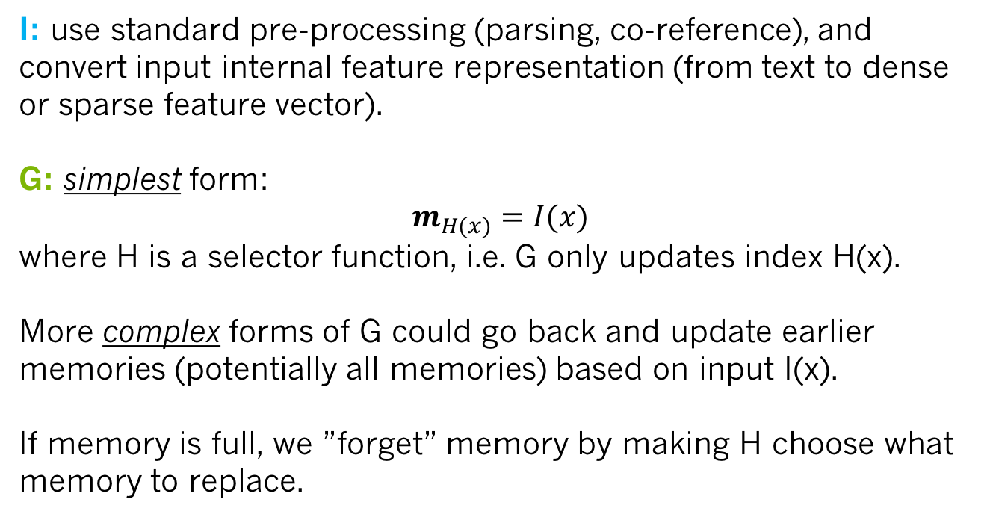
I
R
input x
I(x)
G
I(x)
O
o = O(I(x), m)
r = R(o)
update
read
Memory
update: $m_{i}=G\left(m_{i}, I\left(x\right), m\right),∀i$
I: use standard pre-processing (parsing, co-reference), and convert input internal feature representation (from text to dense or sparse feature vector).
G: simplest form:
$m_{H(x)}=I(x)$
where H is a selector function, i.e. G only updates index H(x).
More complex forms of G could go back and update earlier memories (potentially all memories) based on input I(x).
If memory is full, we ”forget” memory by making H choose what memory to replace.

Slide 9
I
R
input x
I(x)
G
I(x)
O
o = O(I(x), m)
r = R(o)
update
read
Memory
update: $m_{i}=G\left(m_{i}, I\left(x\right), m\right),∀i$
O: typically responsible for reading from memory and extracting the most relevant memories to the input that would give us a good response.
R: produces the final response based on the output of O.
For example in the setting of question answering, O finds the relevant memories to the question, while R produces the actual wording of the answer. R could be an RNN that’s conditioned on the output of O.

Slide 10
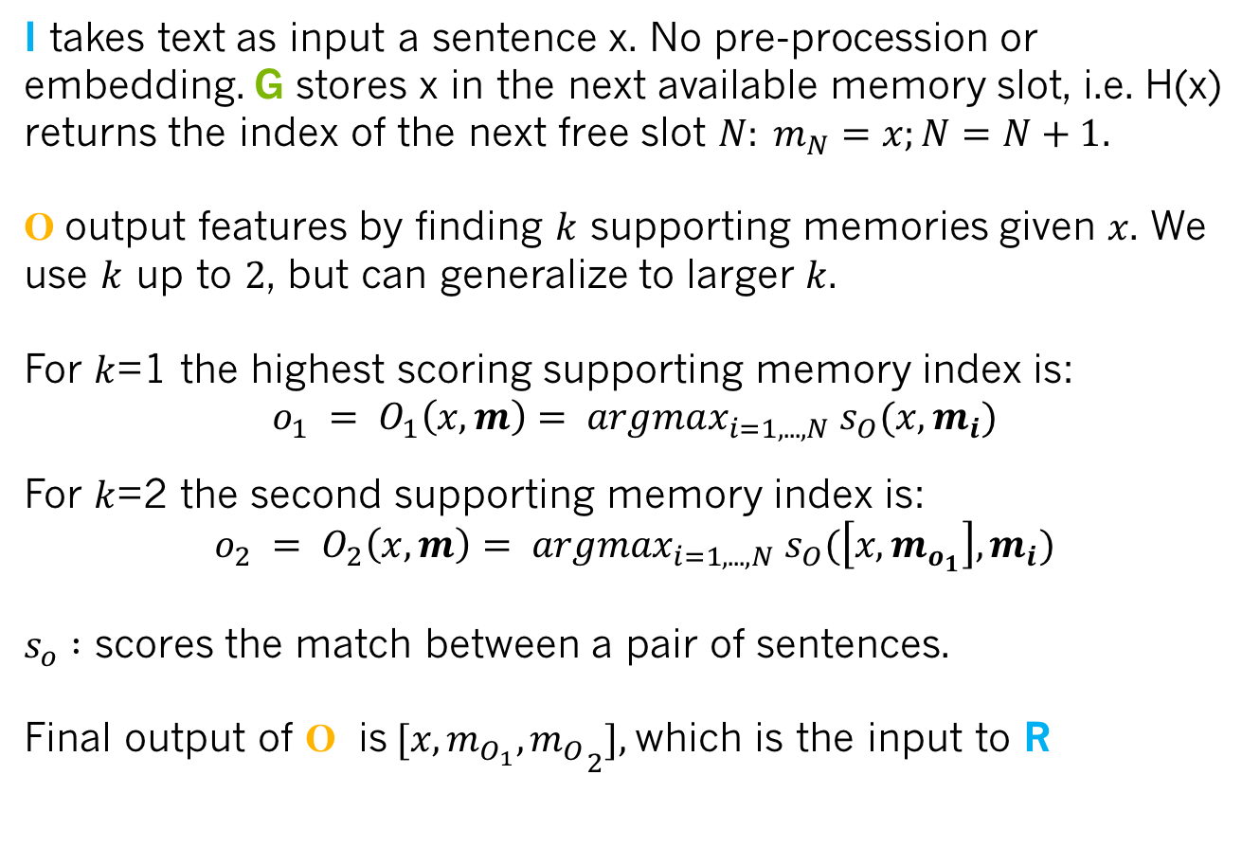
A basic MemNN Implmentation for Text
I takes text as input a sentence x. No pre-procession or embedding. G stores x in the next available memory slot, i.e. H(x) returns the index of the next free slot $N: m_{N}=x;N=N+1$.
O output features by finding $k$ supporting memories given $x$. We use $k$ up to $2$, but can generalize to larger $k$.
For $k$=1 the highest scoring supporting memory index is:
$$o_{1} = O_{1}\left(x, m\right)= argmax_{i=1,...,N} s_{O}(x, m_{i})$$
For $k$=2 the second supporting memory index is:
$$o_{2} = O_{2}\left(x, m\right)= argmax_{i=1,...,N} s_{O}(\left[x,m_{o_{1}}\right], m_{i})$$
$s_{o} :$ scores the match between a pair of sentences.
Final output of O is${[x,m_{O_{1}}, m_{O}}_{2}],$which is the input to R

Slide 11
Task (1) Factoid QA with Single Supporting Fact (“where is actor”)
(Very Simple) Toy reading comprehension task:
John was in the bedroom.
Bob was in the office.
John went to kitchen.
Bob travelled back home.
Where is John? A:kitchen
SUPPORTING FACT
Slides from Jason Weston’s “Memory Networks for Language Understanding” ICML Tutorial 2016

Slide 12
(2) Factoid QA with Two Supporting Facts (“where is actor+object”)
A harder (toy) task is to answer questions where two supporting statements have to be chained to answer the question:
John is in the playground.
Bob is in the office.
John picked up the football.
Bob went to the kitchen.
Where is the football? A:playground
Where was Bob before the kitchen? A:office
Slides from Jason Weston’s “Memory Networks for Language Understanding” ICML Tutorial 2016

Slide 13
(2) Factoid QA with Two Supporting Facts (“where is actor+object”)
A harder (toy) task is to answer questions where two supporting statements have to be chained to answer the question:
John is in the playground.
Bob is in the office.
John picked up the football.
Bob went to the kitchen.
Where is the football? A:playground
Where was Bob before the kitchen? A:office
SUPPORTING FACT
SUPPORTING FACT
To answer the first question Where is the football? both John picked up the football and John is in the playground are supporting facts.
.
Slides from Jason Weston’s “Memory Networks for Language Understanding” ICML Tutorial 2016

Slide 14
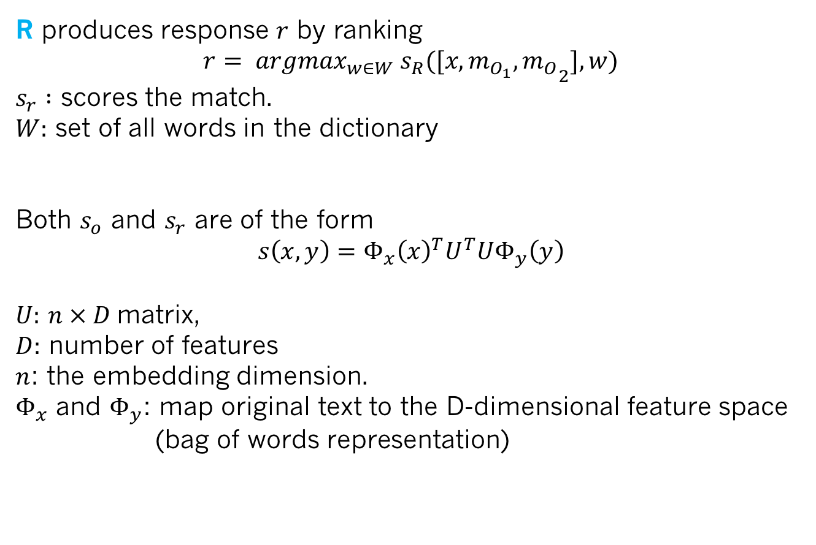
A basic MemNN Implmentation for Text
R produces response $r$ by ranking
$$r= argmax_{w∈W} s_{R}({[x,m_{O_{1}}, m_{O}}_{2}], w)$$
$s_{r} :$ scores the match.
$W:$ set of all words in the dictionary
Both $s_{o}$ and $s_{r}$ are of the form
$$s\left(x,y\right)=Φ_{x}{\left(x\right)}^{T}U^{T}UΦ_{y}\left(y\right)$$
$U:$ $n × D$matrix,
$D:$ number of features
$n$: the embedding dimension.
$Φ_{x}$ and $Φ_{y}$: map original text to the D-dimensional feature space (bag of words representation)

Slide 15
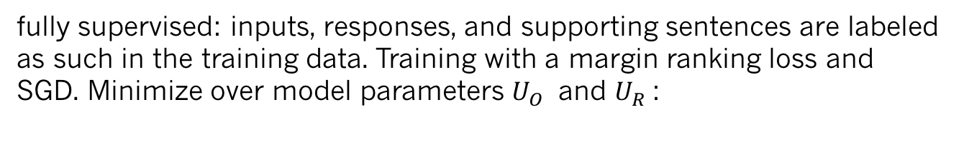
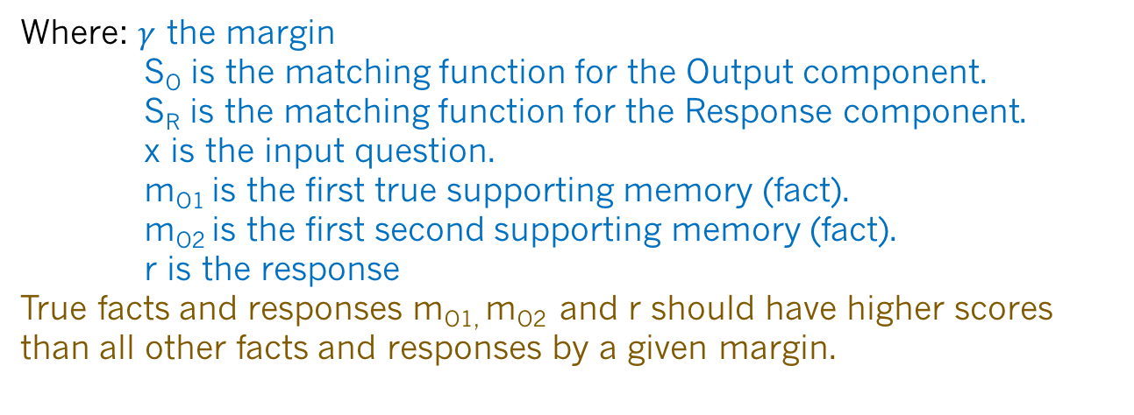
Training
fully supervised: inputs, responses, and supporting sentences are labeled as such in the training data. Training with a margin ranking loss and SGD. Minimize over model parameters $U_{O}$ and $U_{R}$:
Where: $γ$ the margin
S_{O} is the matching function for the Output component.
S_{R} is the matching function for the Response component.
x is the input question.
m_{O1} is the first true supporting memory (fact).
m_{O2} is the first second supporting memory (fact).
r is the response
True facts and responses m_{O1,} m_{O2} and r should have higher scores than all other facts and responses by a given margin.
Slides from Jason Weston’s “Memory Networks for Language Understanding” ICML Tutorial 2016

Slide 16
Variants of this Implementation
Some options and extensions:
Representation of inputs and memories could use all kinds of encodings: bag of words, RNN style reading at word or character level, etc.
Different possibilities for output module: e.g. multi-class classifier or uses an RNN to output sentences.
If the memory is huge (e.g. Wikipedia) we need to organize the memories. Solution: hash the memories to store in buckets (topics). Then, memory addressing and reading doesn’t operate on all memories.
If the memory is full, there could be a way of removing one it thinks is most useless; i.e. it ``forgets’’ somehow. That would require a scoring function of the utility of each memory..
Slides from Jason Weston’s “Memory Networks for Language Understanding” ICML Tutorial 2016

Slide 17
Comparing triples
We also need time information for the bAbI tasks. We tried adding absolute time as a feature: it works, but the following idea can be better:
Seems to work better if we compare triples:
s(x,y,y’) returns < 0 if y is better than y’
returns > 0 if y’ is better than y
We can loop through memories, keep best m_{i} at each step.
Now the features include relative time features:
Slides from Jason Weston’s “Memory Networks for Language Understanding” ICML Tutorial 2016

Slide 18
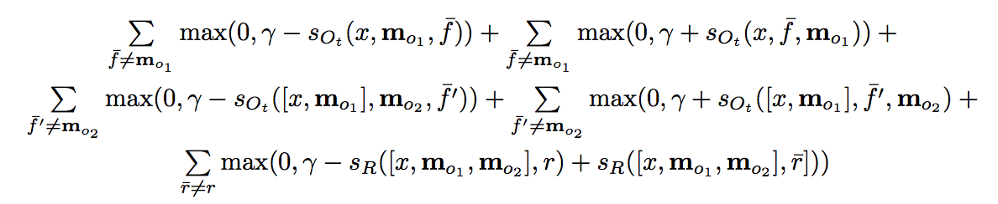
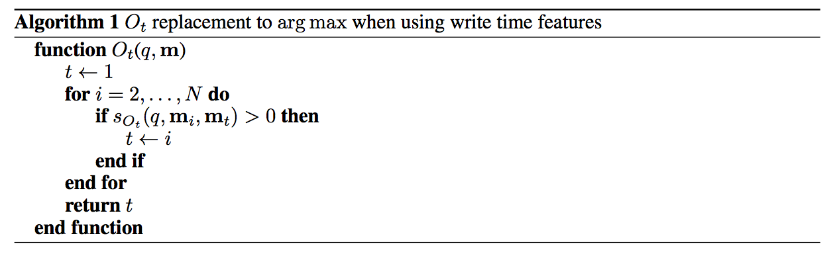
Comparing triples: Objective and Inference
Similar to before, except now for both m_{o1} and m_{o2} we need to have two terms considering them as the second or third argument to the S_{Ot} as they may appear on either side during inference:
Slides from Jason Weston’s “Memory Networks for Language Understanding” ICML Tutorial 2016

Slide 19
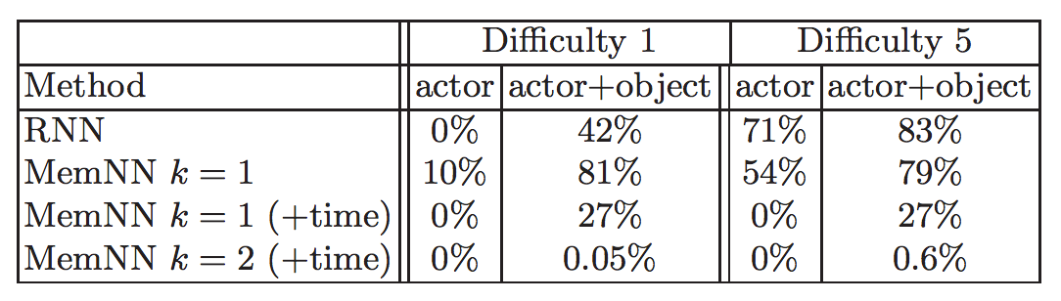
bAbI Experiment 1
10k sentences. (Actor: only ask questions about actors.)
Difficulty: how many sentences in the past when entity mentioned.
Fully supervised (supporting sentences are labeled).
Compare RNN (no supervision)
and MemNN hops k = 1 or 2, & with/without time features.
Difficulty 5 -- Max mem. sz. required: 65 Average mem. sz. required: 9
Slides from Jason Weston’s “Memory Networks for Language Understanding” ICML Tutorial 2016

Slide 20
bAbI Experiment 1
Example test story + predictions:
Antoine went to the kitchen. Antoine got the milk. Antoine travelled to the office. Antoine dropped the milk. Sumit picked up the football. Antoine went to the bathroom. Sumit moved to the kitchen.
where is the milk now? A: office
where is the football? A: kitchen
where is Antoine ? A: bathroom
where is Sumit ? A: kitchen
where was Antoine before the bathroom? A: office
Slides from Jason Weston’s “Memory Networks for Language Understanding” ICML Tutorial 2016

Slide 21
Unsegmented setup; R module is an RNN
Joe went to the garden then Fred picked up the milk; Joe moved to the bathroom and Fred dropped the milk, and then Dan moved to the living room.
Where is Dan? A: living room I believe
Where is Joe? A: the bathroom
Fred moved to the bedroom and Joe went to the kitchen then Joe took the milk there and Dan journeyed to the bedroom; Joe discarded the milk.
Where is the milk now? A: the milk is in the kitchen
Where is Dan now? A: I think he is in the bedroom
Joe took the milk there, after that Mike travelled to the office, then Joe went to the living room, next Dan went back to the kitchen and Joe travelled to the office.
Where is Joe now? A: I think Joe is in the office
Slides from Jason Weston’s “Memory Networks for Language Understanding” ICML Tutorial 2016

Slide 22
Larger QA: Reverb Dataset in (Fader et al., 13)
14M statements, stored as (subject, relation, object) triples. Triples are REVERB extractions mined from ClueWeb09.
Statements cover diverse topics:
(milne, authored, winnie-the-pooh)
(sheep, be-afraid-of, wolf), etc...
Weakly labeled QA pairs and 35M paraphrased questions from WikiAnswers:
``Who wrote the Winnie the Pooh books?
``Who is poohs creator?’’
Slides from Jason Weston’s “Memory Networks for Language Understanding” ICML Tutorial 2016

Slide 23
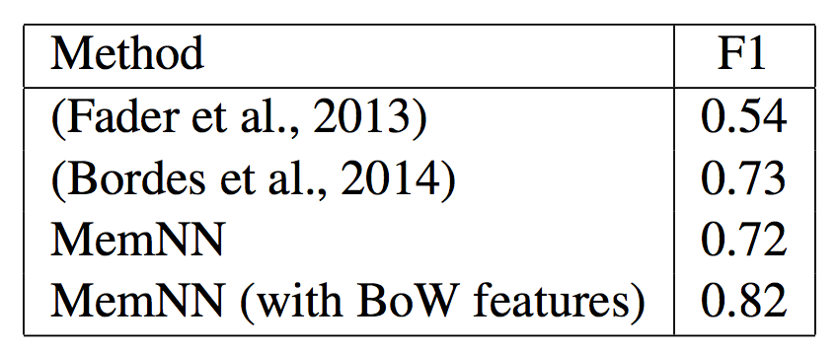
Results: QA on Reverb data from (Fader et al.)
14M statements stored in the memNN memory.
k=1 loops MemNN, 128-dim embedding.
R response simply outputs top scoring statement.
Time features are not necessary, hence not used.
We also tried adding bag of words (BoW) features.
Slides from Jason Weston’s “Memory Networks for Language Understanding” ICML Tutorial 2016

Slide 24
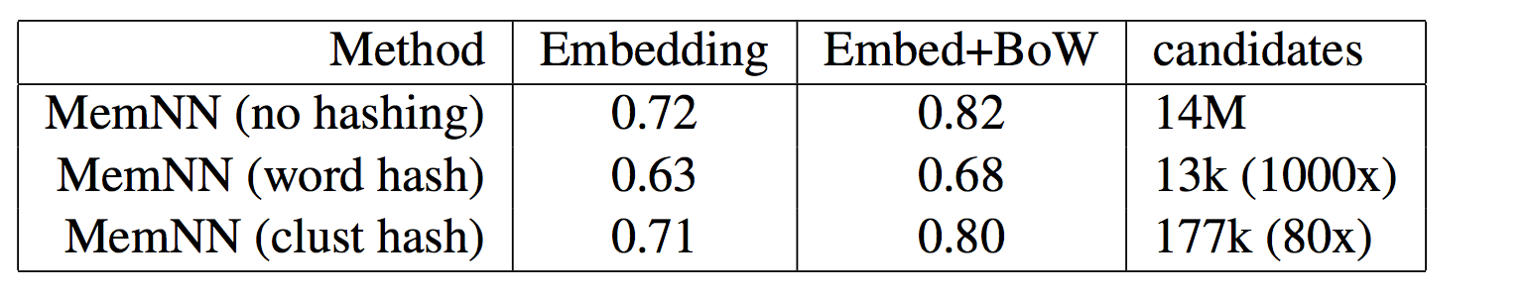
Fast QA on Reverb data
Scoring all 14M candidates in the memory is slow.
We consider speedups using hashing in S and O as mentioned earlier:
Hashing via words (essentially: inverted index)
Hashing via k-means in embedding space (k=1000)
Slides from Jason Weston’s “Memory Networks for Language Understanding” ICML Tutorial 2016

Slide 25
What was next for MemNNs?
Make the language much harder: coreference, conjunctions, negations, etc. etc – will it work?
MemNNs that reason with more than 2 supporting memories.
End-to-end? (doesn’t need supporting facts)
More useful applications on real datasets.
Dialog: Ask questions? Say statements?
Do MemNN ideas extend to other ML tasks and model variants, .e.g. visual QA, perform actions…? [A: yes!].
Slides from Jason Weston’s “Memory Networks for Language Understanding” ICML Tutorial 2016

Slide 26
End-to-end Memory Network (MemN2N)
New end-to-end (MemN2N) model (Sukhbaatar ‘15):
Reads from memory with soft attention
Performs multiple lookups (hops) on memory
End-to-end training with backpropagation
Only need supervision on the final output
It is based on “Memory Networks” by [Weston, Chopra & Bordes ICLR 2015] but that had:
Hard attention
requires explicit supervision of attention during training
Only feasible for simple tasks
Slides from Jason Weston’s “Memory Networks for Language Understanding” ICML Tutorial 2016
Notes:
In this work …
Merge references
Add memn2n

Slide 27




MemN2N architecture
supervision
Output
read
addressing
Controller module
Memory Module
read
addressing
Memory vectors
(unordered)
Internal state
vector
Input
Slides from Jason Weston’s “Memory Networks for Language Understanding” ICML Tutorial 2016
Notes:
The model consists from two parts
…
Let take a closer look at memory module

Slide 28
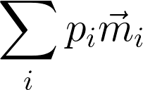


Memory Module
Weighted Sum
Attention weights
/ Soft address
To controller
(added to
controller state)
Softmax
Dot Product
Addressing signal
(controller
state vector)
Memory vectors
Slides from Jason Weston’s “Memory Networks for Language Understanding” ICML Tutorial 2016
Notes:
Lets take closer look at memory module
…

Slide 29


Question & Answering
Answer
kitchen
Memory Module
Weighted Sum
Controller
Dot product + softmax
1: Sam moved to garden
2: Sam went
to kitchen
3: Sam drops
apple there
Where is Sam?
Question
Input story
Slides from Jason Weston’s “Memory Networks for Language Understanding” ICML Tutorial 2016
Notes:
Here we are applying our model to QA task
But note that it can be used in other tasks such as lang model

Slide 30
Training on 1k stories
Weakly supervised
Supervised Supp. Facts
TASK | N-grams | LSTMs | MemN2N | Memory Networks | StructSVM+coref+srl
T1. Single supporting fact | 36 | 50 | PASS | PASS | PASS
T2. Two supporting facts | 2 | 20 | 87 | PASS | 74
T3. Three supporting facts | 7 | 20 | 60 | PASS | 17
T4. Two arguments relations | 50 | 61 | PASS | PASS | PASS
T5. Three arguments relations | 20 | 70 | 87 | PASS | 83
T6. Yes/no questions | 49 | 48 | 92 | PASS | PASS
T7. Counting | 52 | 49 | 83 | 85 | 69
T8. Sets | 40 | 45 | 90 | 91 | 70
T9. Simple negation | 62 | 64 | 87 | PASS | PASS
T10. Indefinite knowledge | 45 | 44 | 85 | PASS | PASS
T11. Basic coreference | 29 | 72 | PASS | PASS | PASS
T12. Conjunction | 9 | 74 | PASS | PASS | PASS
T13. Compound coreference | 26 | PASS | PASS | PASS | PASS
T14. Time reasoning | 19 | 27 | PASS | PASS | PASS
T15. Basic deduction | 20 | 21 | PASS | PASS | PASS
T16. Basic induction | 43 | 23 | PASS | PASS | 24
T17. Positional reasoning | 46 | 51 | 49 | 65 | 61
T18. Size reasoning | 52 | 52 | 89 | PASS | 62
T19. Path finding | 0 | 8 | 7 | 36 | 49
T20. Agent’s motivation | 76 | 91 | PASS | PASS | PASS
Slides from Jason Weston’s “Memory Networks for Language Understanding” ICML Tutorial 2016

Slide 31
Attention during memory lookups
Samples from toy QA tasks
 | Test Acc | Failed tasks
MemNN | 93.3% | 4
LSTM | 49% | 20
MemN2N 1 hop | 74.82% | 17
2 hops | 84.4% | 11
3 hops | 87.6.% | 11
20 bAbI Tasks

