Slide 1
Visual Question Answering (VQA)
Jia-Hong,Huang
09/15/2016
Some slides are borrowed from
Aahitagni Mukherjee and Shubham Agarwal
etc.

Slide 2
Agenda
1. What is VQA?
2. Popular datasets in VQA.
3. Important research tools in VQA.
4. Main research lines in VQA.
5. Conclusion.
During the talk, I will also go through some papers.

Slide 3
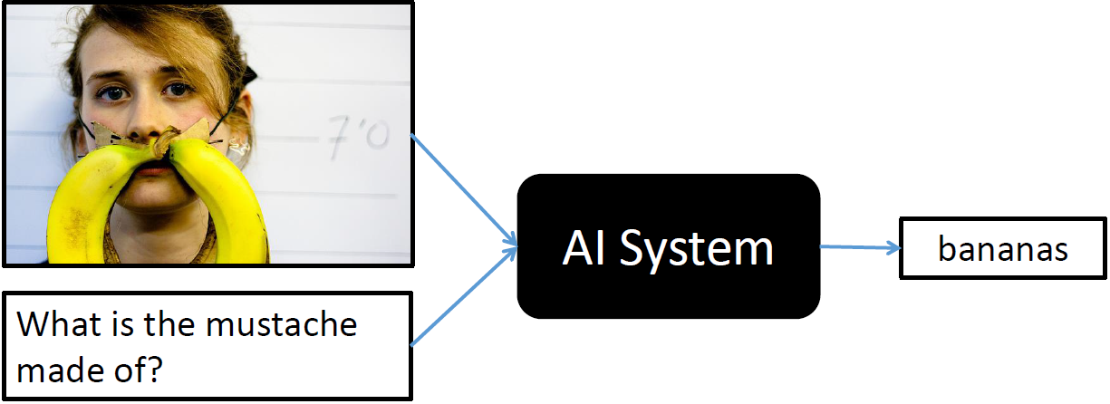
What is VQA?
http://www.visualqa.org/

Slide 4
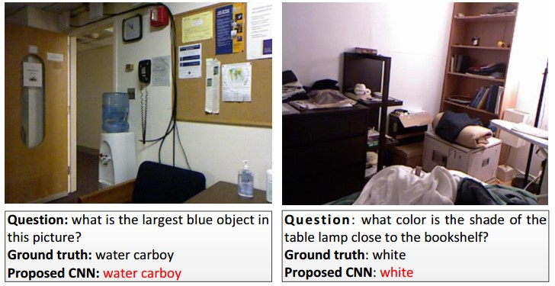
Visual Question Answering
Given an image, and a natural language-like question, find the correct answer to it
Training on a set of triplets (image, question, answer).
Free-form and open-ended questions.
Answers can be single word or multiple word.
Lin Ma et al 2015

Slide 5
Challenges
The output is to be conditioned on both image and language inputs.
A better representation of the image content is essential
Interactions between the two modalities need to appropriately modelled.
Lin Ma et al 2015

Slide 6
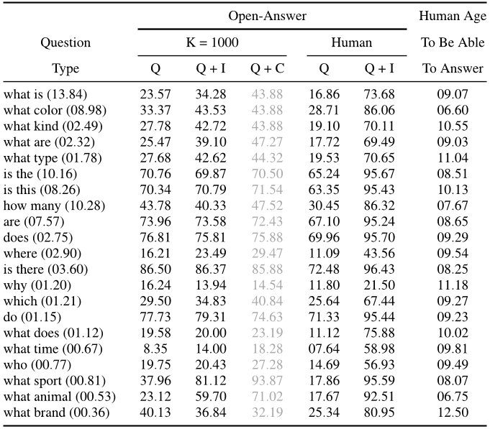
Popular datasets in VQA
1. MSCOCO
2. COCO-QA
3. VAQ (largest)
4. NYUDv2
5. DAQUAR

Slide 7

MS-COCO dataset
COCO is a image recognition, segmentation, and captioning dataset. COCO has several features:
Object segmentation
Recognition
Multiple objects per image
More than 300,000 images
More than 2 Million instances
80 object categories
5 captions per image
etc…

Slide 8
COCO-QA dataset
COCO-QA contains 78,736 QA pairs for training and 38,948 pairs for testing. QA pairs were generated automatically from the COCO captions using an question generating algorithm. COCO-QA has 430 unique, one word answers. All question belong to one of four categories: object(69.84%), number(7.47%), color(16.59%), and location(6.10%).

Slide 9
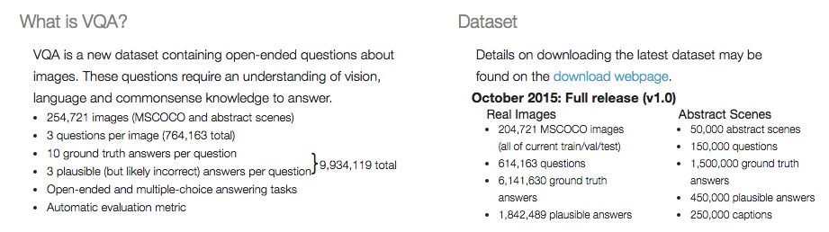
VQA dataset (largest one in VQA)
http://www.visualqa.org/

Slide 10
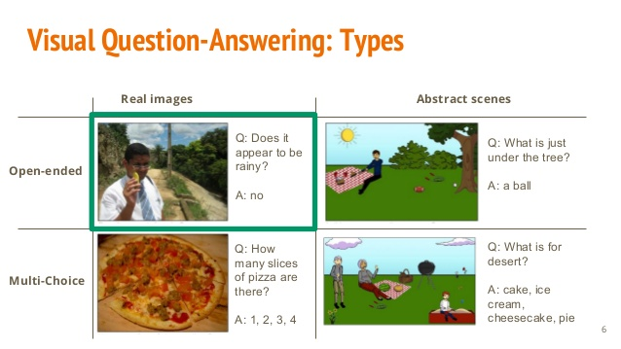
VQA dataset-example image
http://www.visualqa.org/

Slide 11
NYUDv2 dataset
NYU-Depth V2 contains 1449 RGBD images together with annotated semantic segmentations, where every pixel is labeled into some object class with a confidence score. Originally 894 classes are considered.

Slide 12
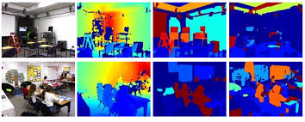
NYUDv2 dataset-example image

Slide 13
DAQUAR dataset
DAQUAR( The Dataset for Question Answering on Real-world images) is a collection of question-answer pairs for the NYU Depth V2 dataset. The dataset is available in two configurations. DAQUAR-FULL consists of 6795 (train) and 5673 (test) question-answer pairs. DAQUAR-37 has 37 object categories, and 3825 (train) and 297 (test) question-answer pairs.
(This dataset only contains indoor scenes.)

Slide 14
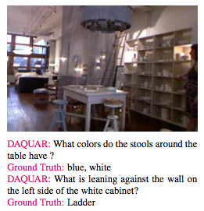
DAQUAR dataset-example image

Slide 15
Important research tools in VQA
1. Wu-Palmer Similarity Measure(WUPS score) is used for
performance evaluation – Script by Malinowski M.
2. Stanford Parser (not today’s focus, too linguistic )
3. GloVe – Global Vectors for Word Representation
4. word2vector (this is very similar to GloVe)
Used for performance evaluation of caption generation
5. METEOR (not today’s focus)
6. BLEU (not today’s focus)

Slide 16
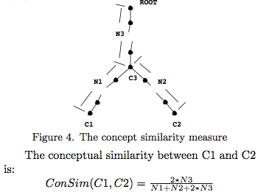
WUPS score
Go to paper
(A Multi-World Approach to Question Answering about Real-World Scenes based on Uncertain Input. )

Slide 17

GloVe and word2vector
Go to paper
(GloVe: Global Vectors for Word Representation. )

Slide 18
Main research lines in VQA
1.CNN-based framework
2.Attention-based framework
3.LSTM-based framework
4.Otherwise.(such as caption generation etc.)

Slide 19
CNN-based framework
Using 3 CNN’s - one to extract sentence representation, one for image representation, and the third is a multimodal layer to fuse the two.

Slide 20
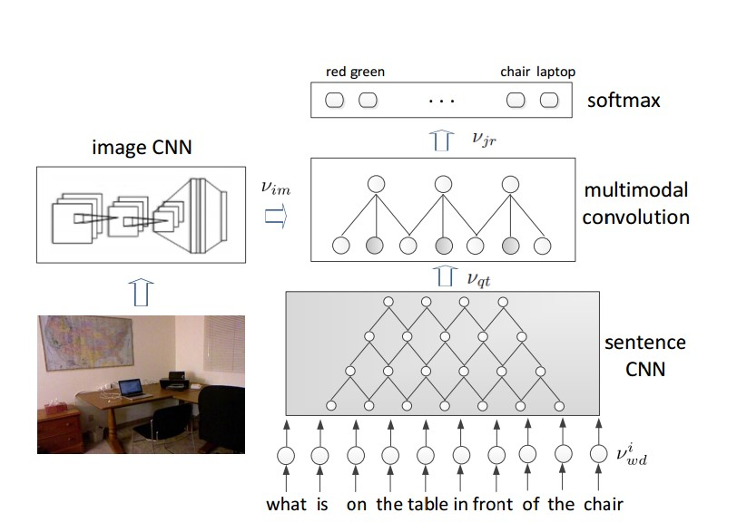
CNN model in VQA
Lin Ma et al 2015

Slide 21
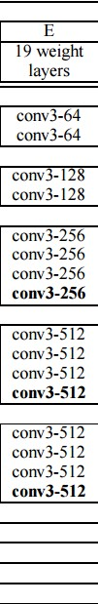
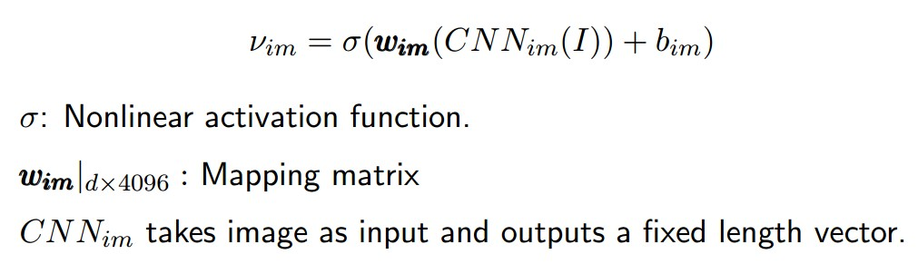
Image CNN
Input RGB image
Max pool
Max pool
Max pool
Max pool
Max pool
FC - 4096
FC - 4096
FC - 1000
Softmax
Simoyan et al. 2015

Slide 22
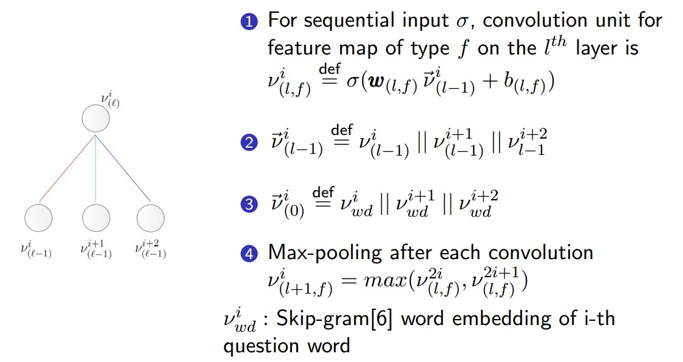
Sentence CNN
Lin Ma et al 2015

Slide 23
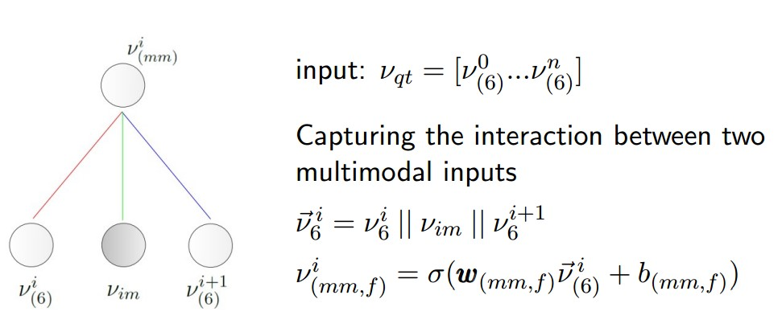
Multimodal Convolutional Layer
Lin Ma et al 2015

Slide 24
Attention-based framework
The concept about using attention-based framework to solve VQA problem, such as caption generation, was mentioned before.
So we skip this.

Slide 25
LSTM-based framework
LSTM neural-based approach:
image representation from a CNN is fed to each hidden layer of a single LSTM. The LSTM then models the concatenation of question and answer.

Slide 26
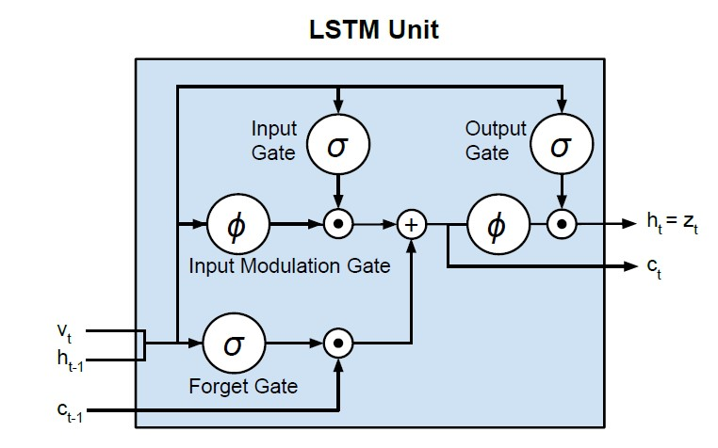
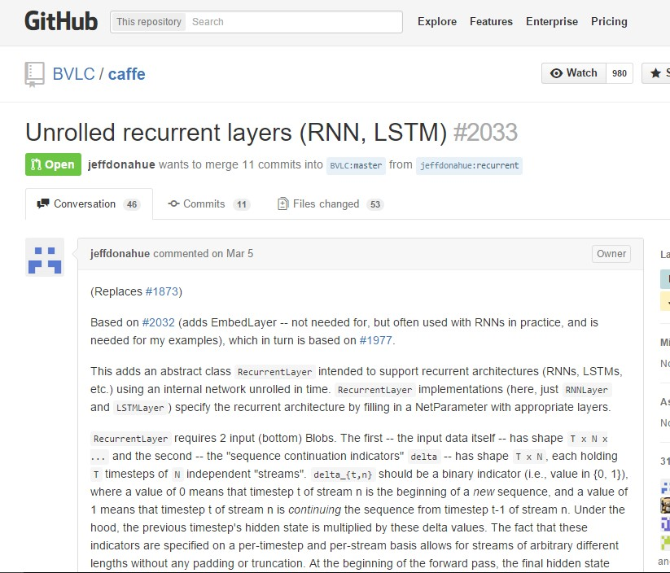
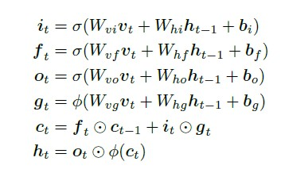
LSTM
Malinowski et al. 2015
https://github.com/junhyukoh/caffe-lstm

Slide 27
Proposed Modification
LSTM
LSTM
LSTM
LSTM
LSTM
LSTM
What
is
on
the
table
<end>
Lin Ma et al 2015

Slide 28
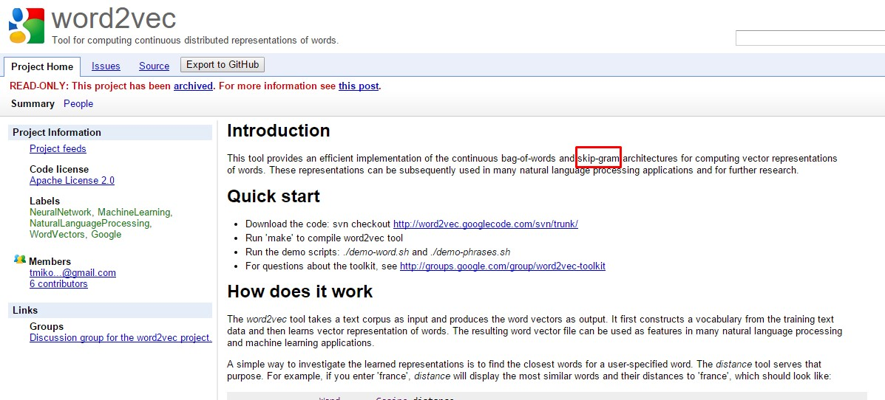
Before Inputting to LSTM
Mikolov et al. 2013
https://code.google.com/p/word2vec/

Slide 29
Comparison of Gated Recurrent Neural Networks - LSTM and GRU
Go to 2 papers
(1. Ask Your Neurons: A Neural-based Approach to Answering Question about Images.)
(2. Empirical Evaluation of Gated Recurrent Neural Networks on Sequence Modeling.)

Slide 30
Conclusion
The key to VQA task is the effective fusion of visual and textual features.

Slide 31

Thank you and (V)QA time
http://www.visualqa.org/

