Slide 1
Tensor Decompositions

Slide 2
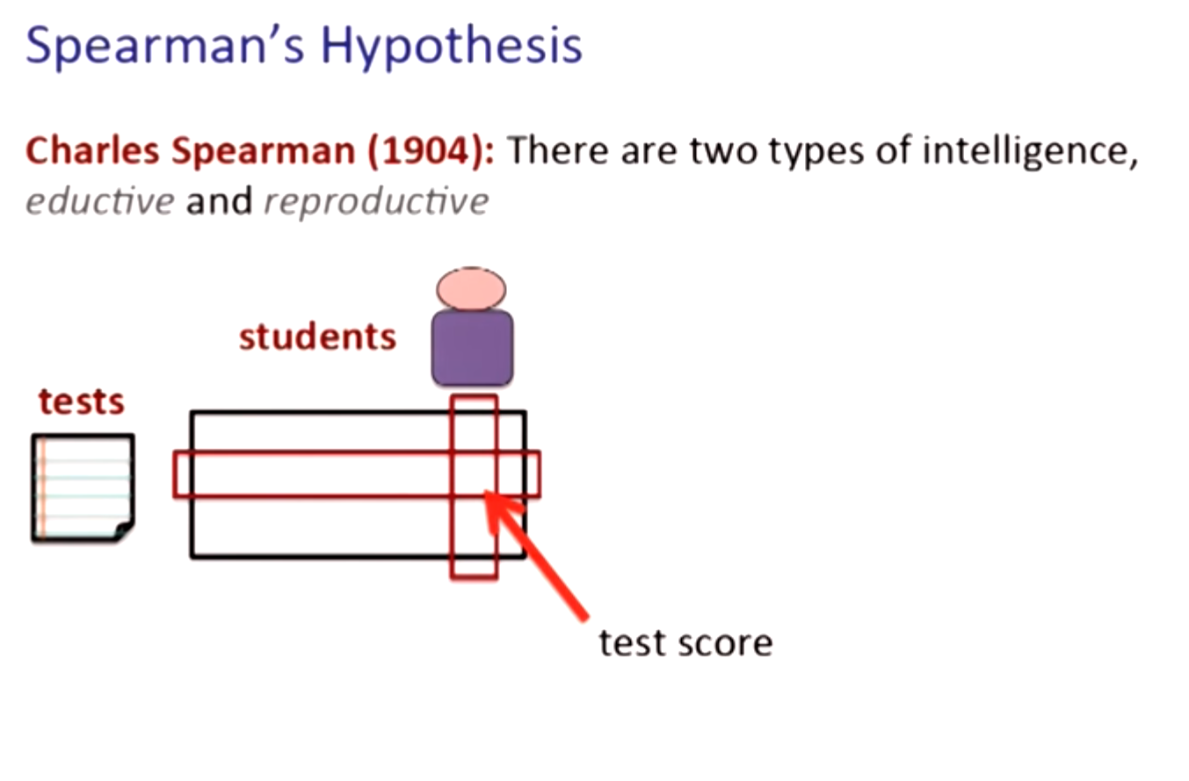

Slide 3
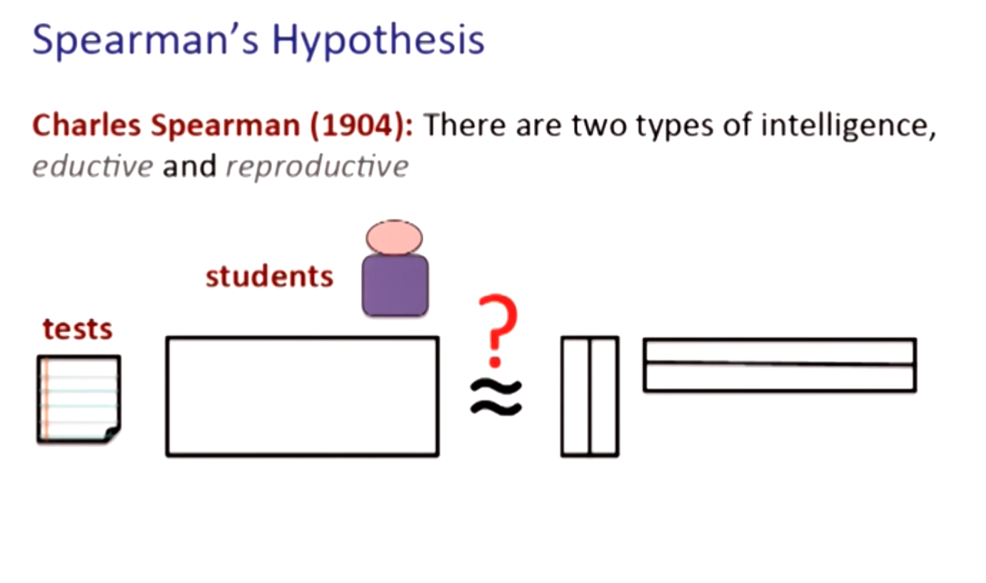

Slide 4
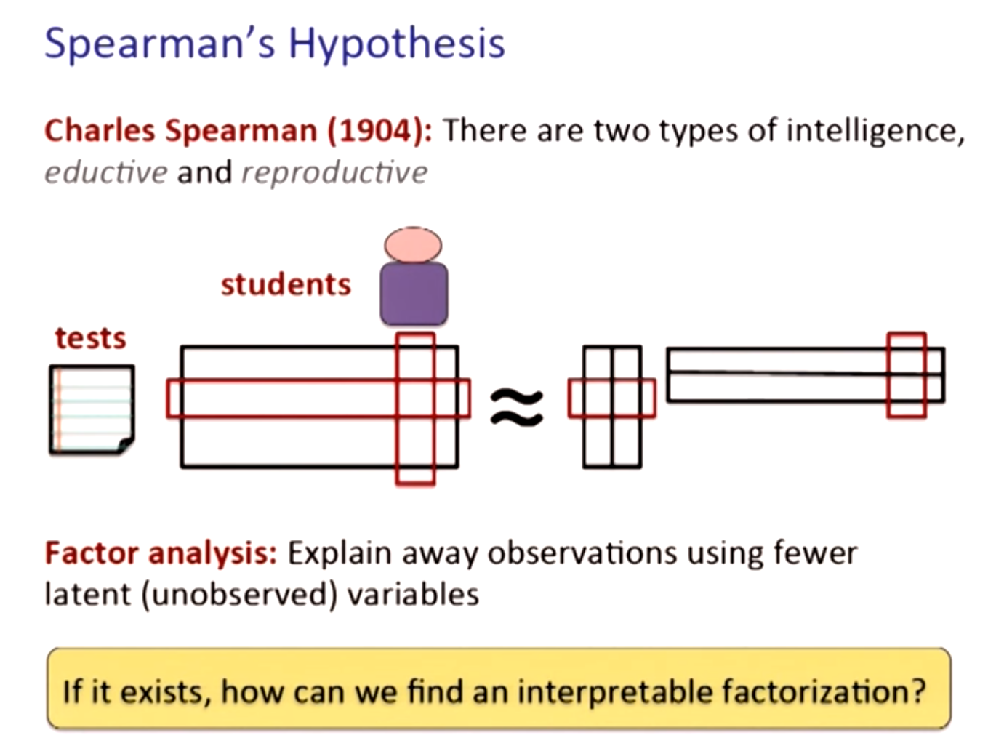

Slide 5
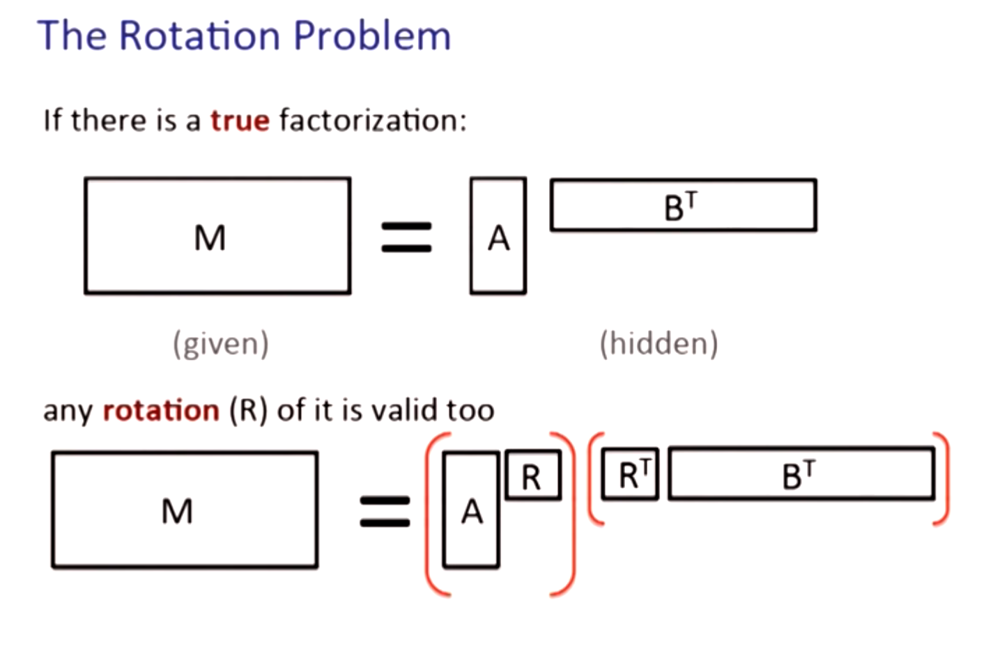

Slide 6
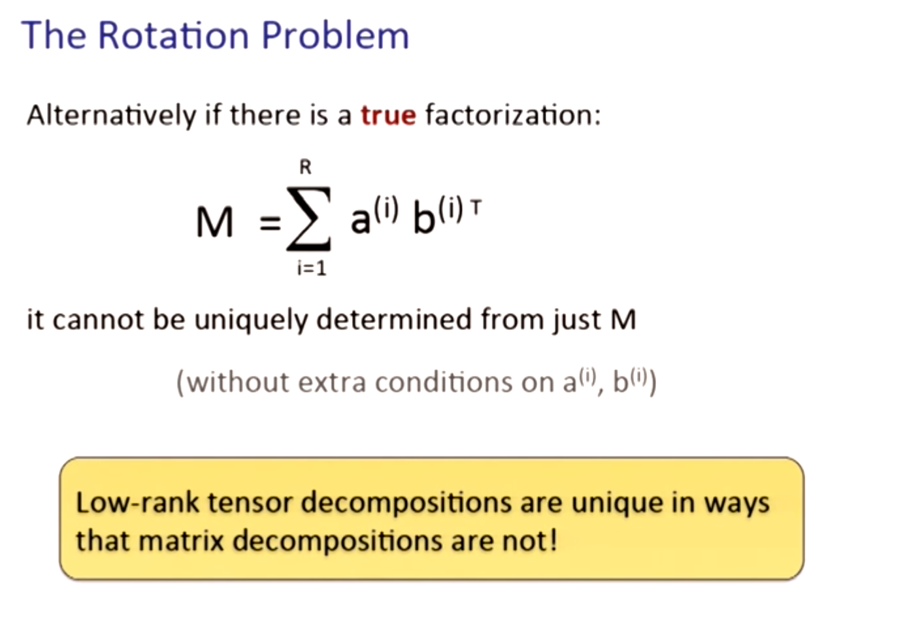

Slide 7
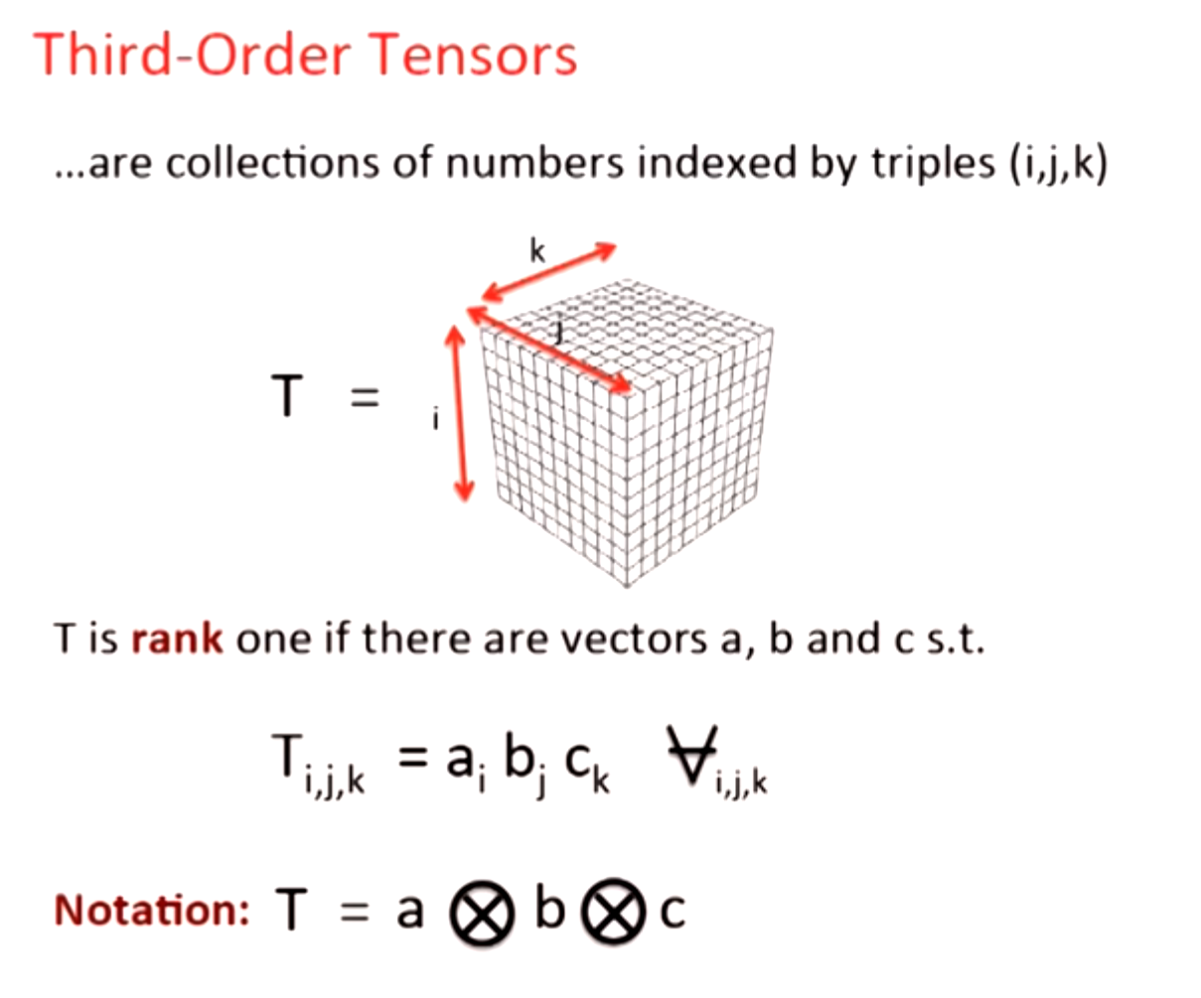

Slide 8
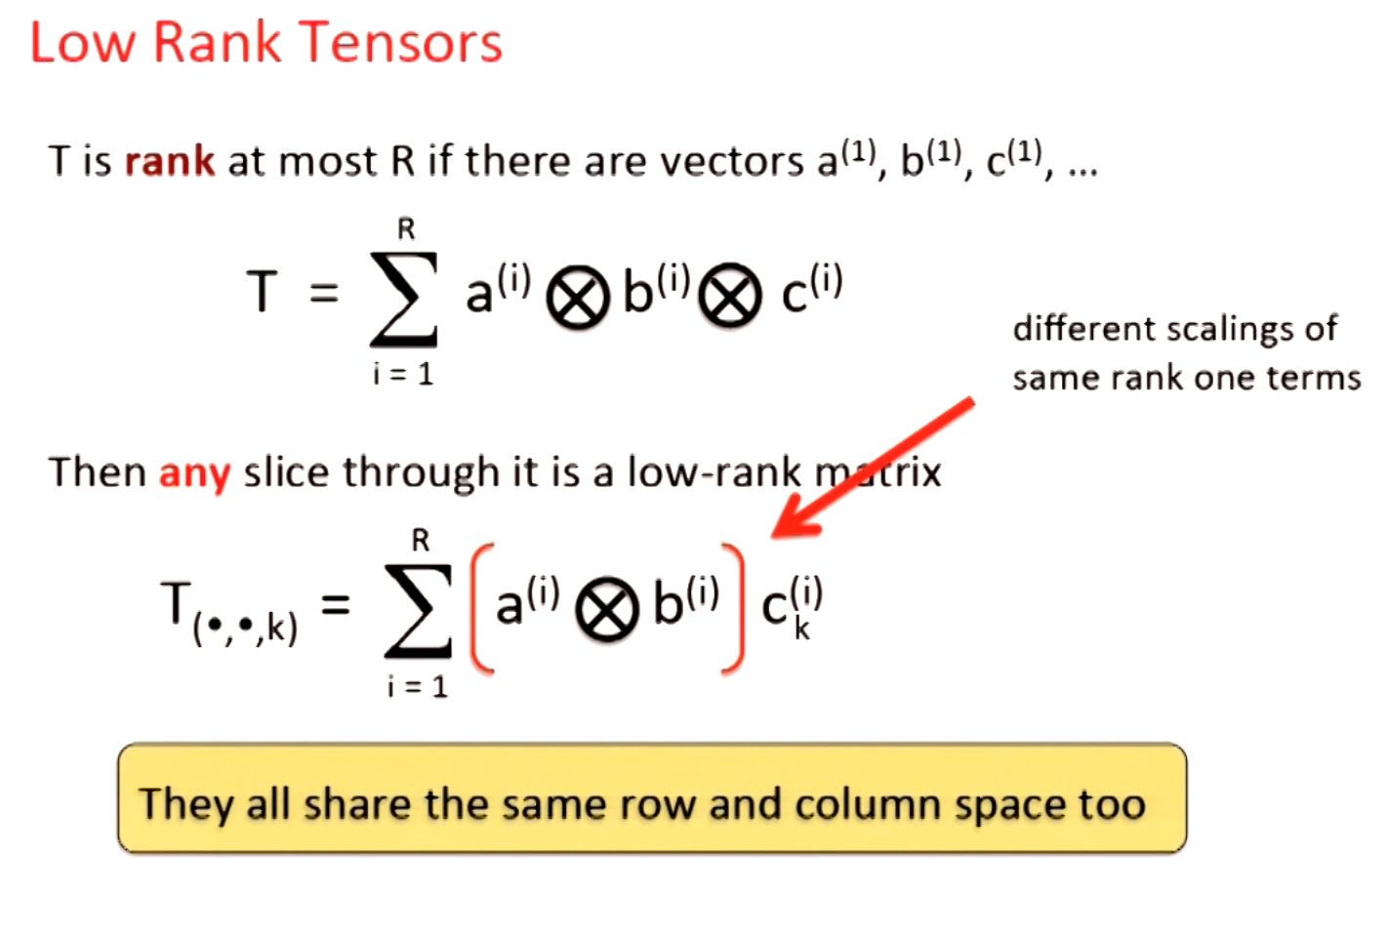

Slide 9
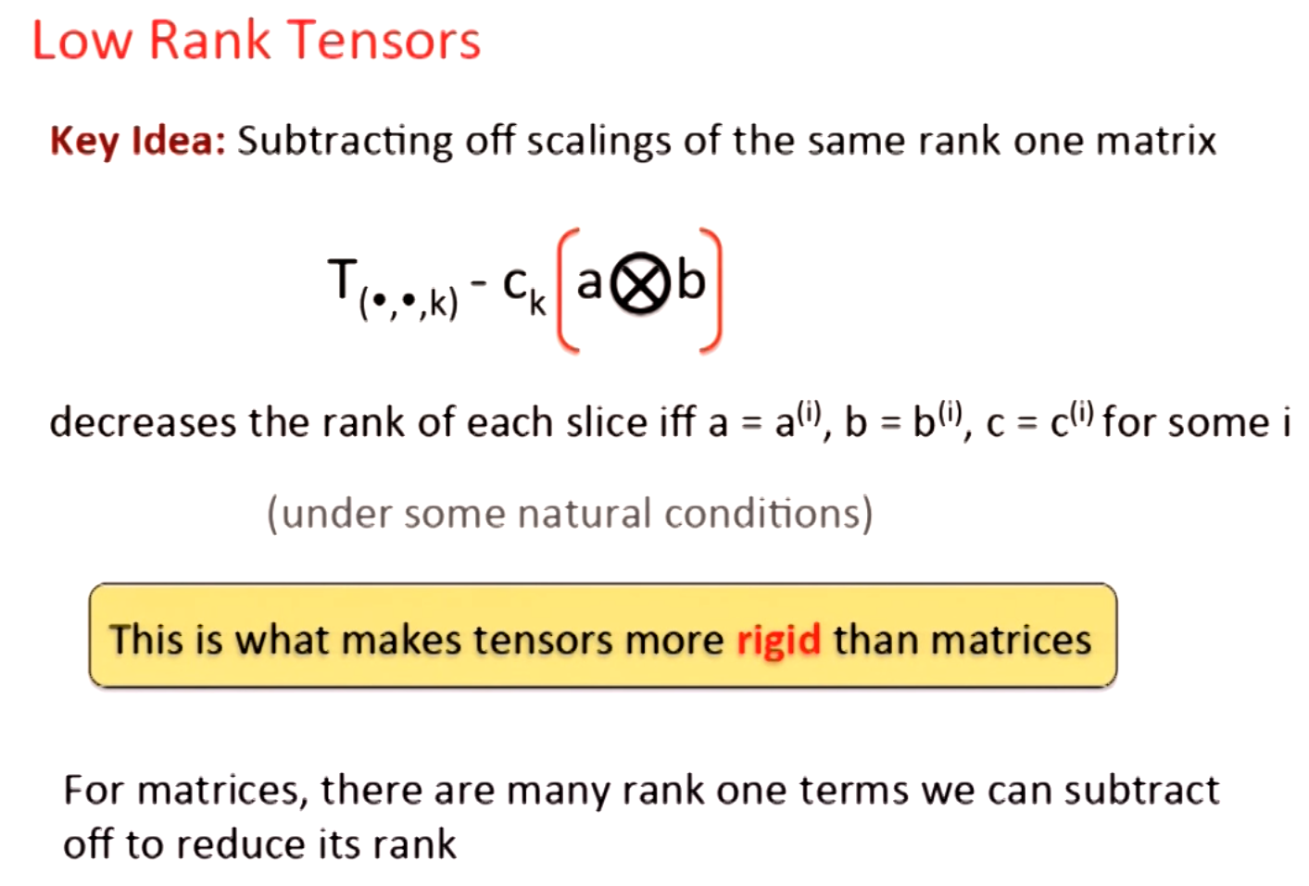

Slide 10
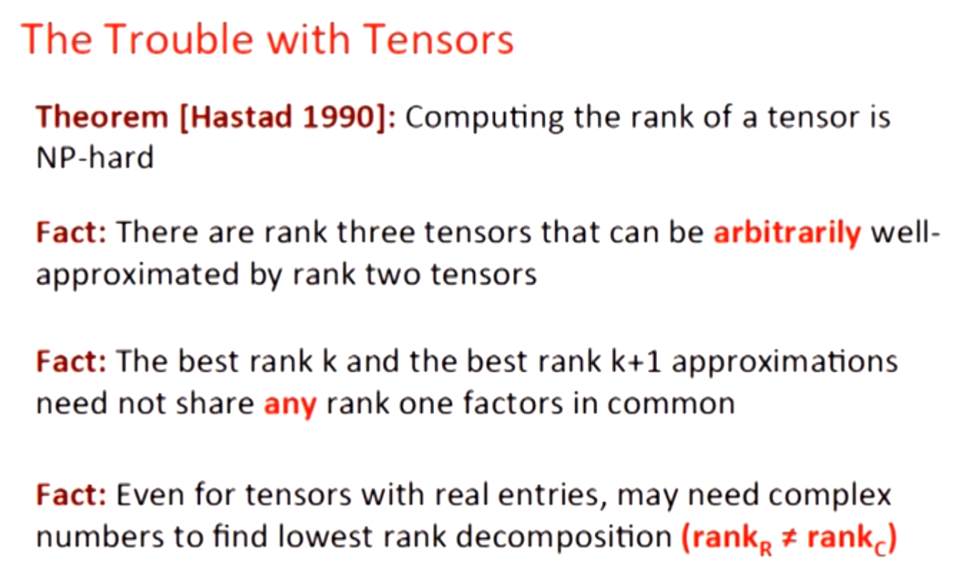

Slide 11
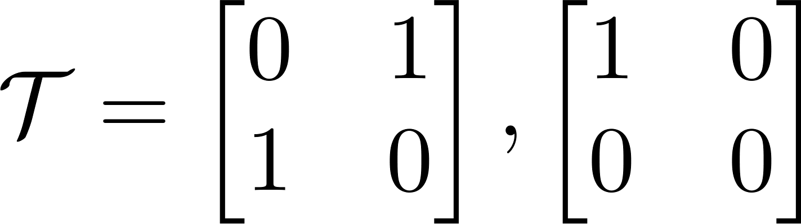
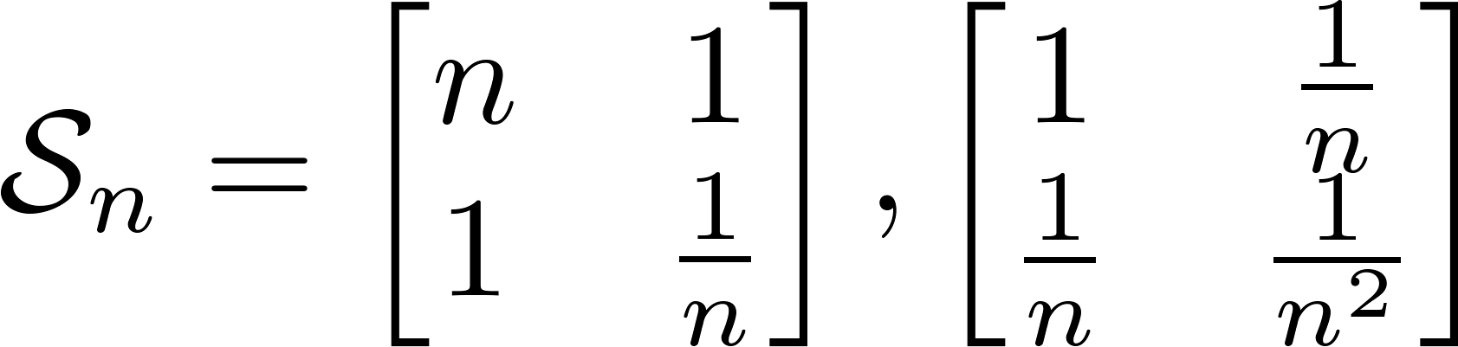
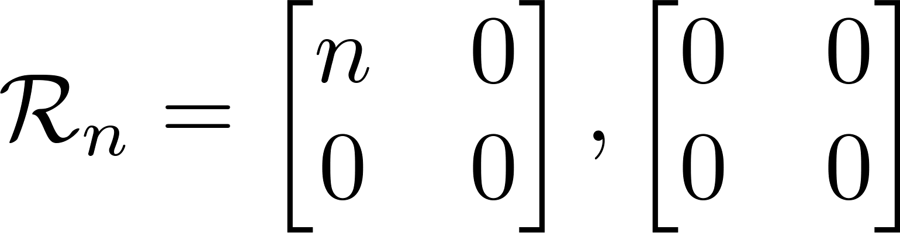
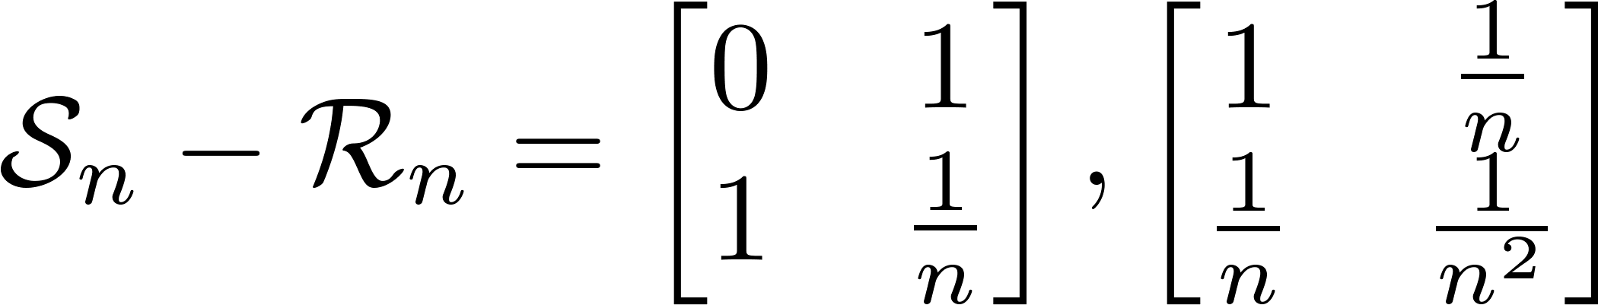
Rank 3 tensor.
Rank 2 tensor.

Slide 12
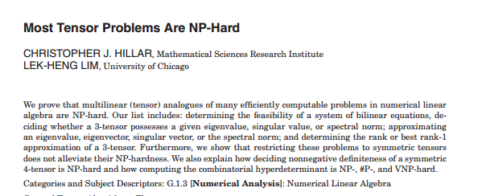
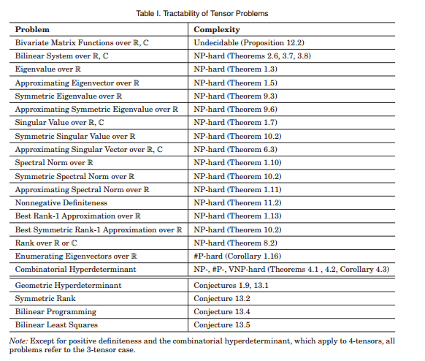

Slide 13
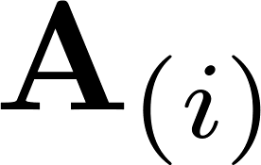
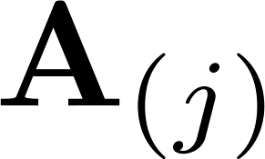
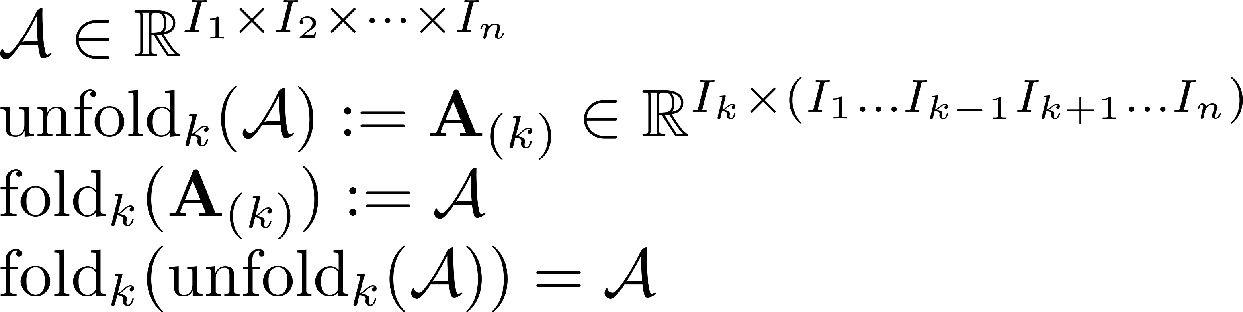
Tensor multiplication: the n-mode product
It is common to unfold a tensor into a matrix
The unfolding along mode i makes that mode the first mode in the matrix and the other modes are handled cyclically.
For instance, row i of contains all elements of A which have the jth index equal to i.

Slide 14
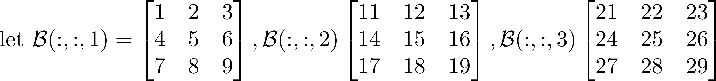
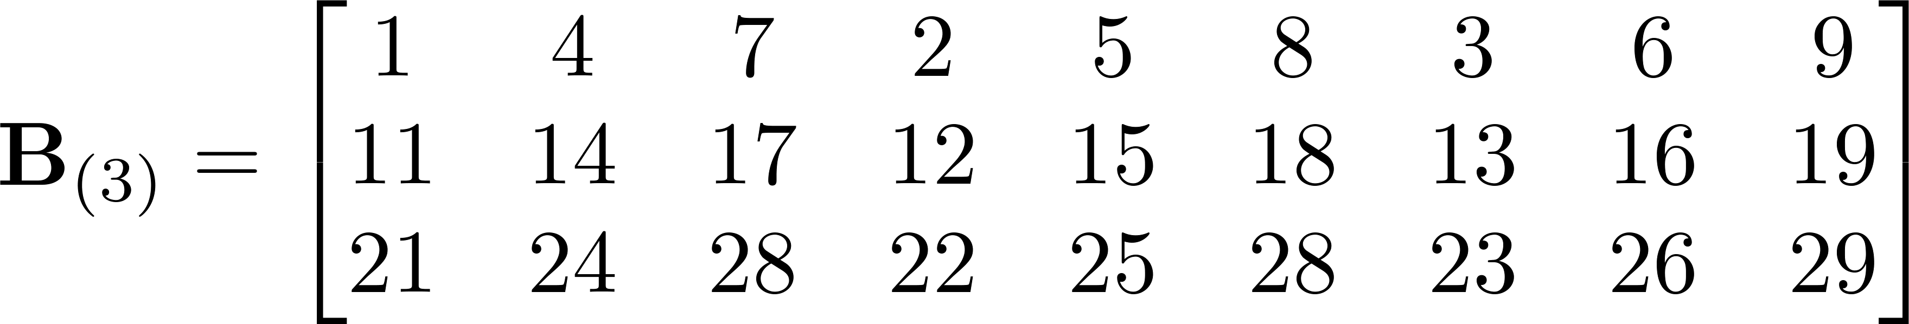
Tensor multiplication: the n-mode product
Tensor unfold example

Slide 15
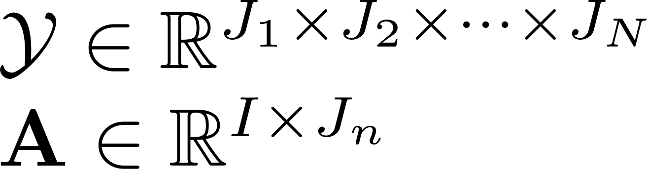
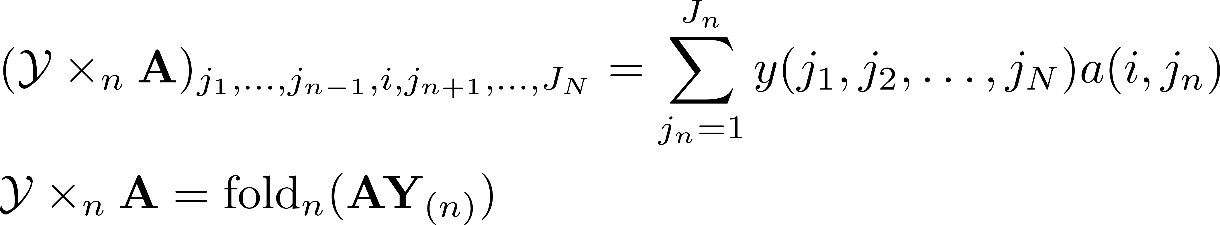
Tensor multiplication: the n-mode product

Slide 16

Tucker decomposition (HOSVD)

Slide 17
Tensor completion application
Go to paper

Slide 18
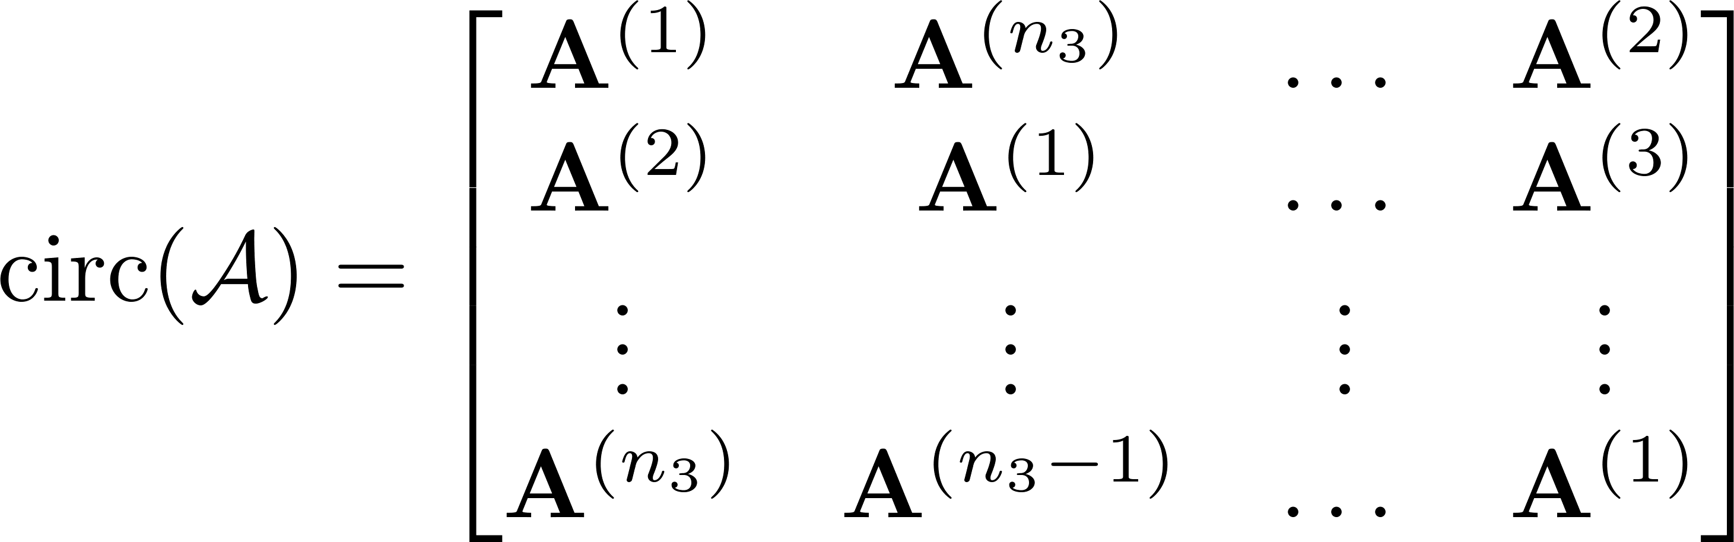
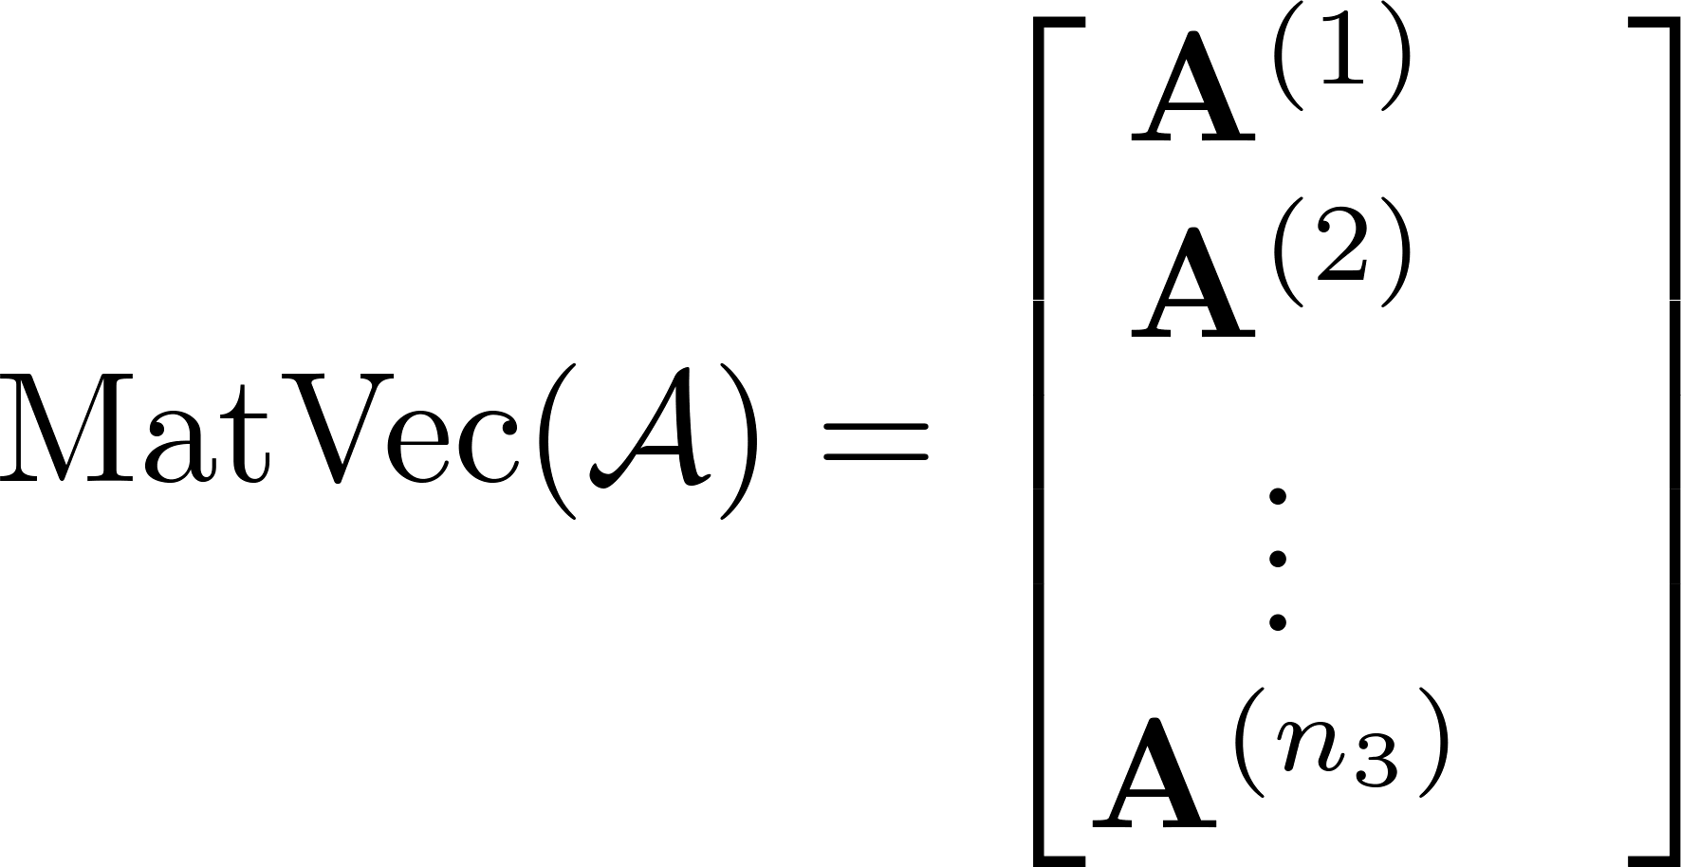
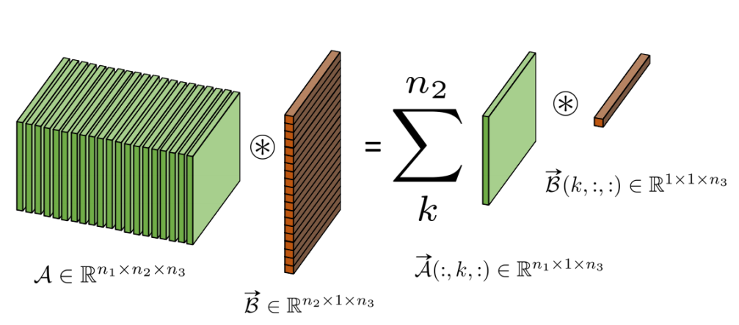
T-SVD for 3rd order tensor factorization
T-products and some definitions

Slide 19
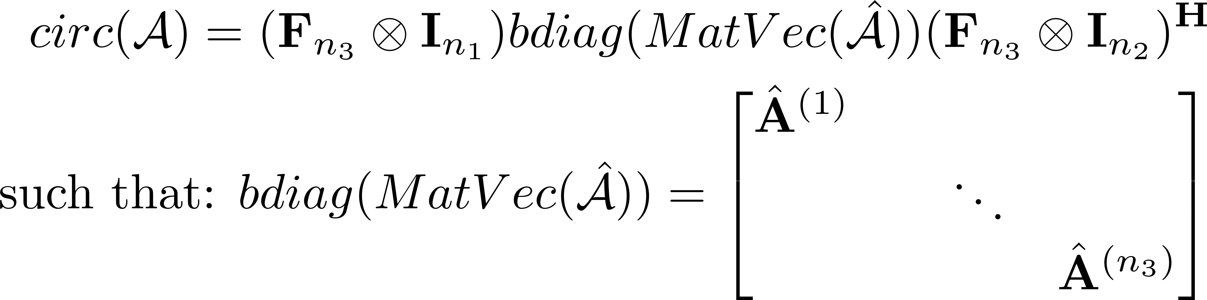
Circ factorization

Slide 20

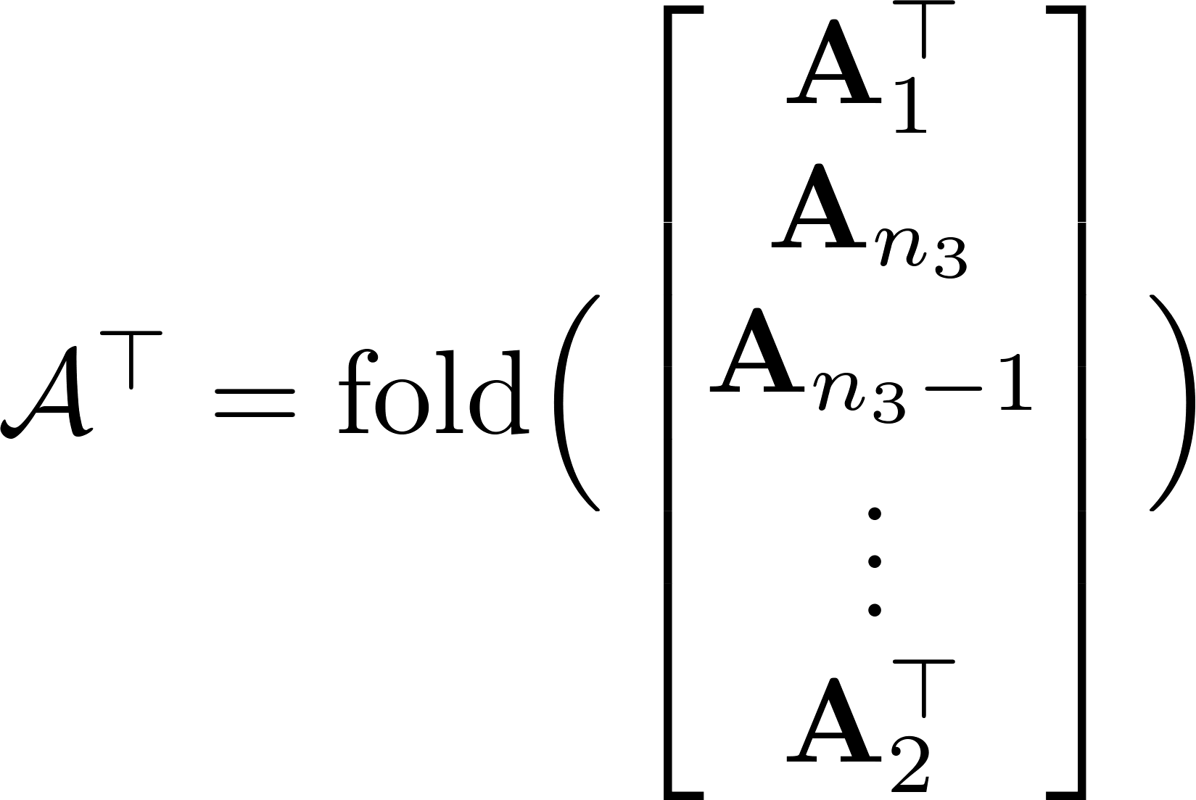
New Product Decompisition f Tensors
Go to paper

Slide 21
Other decompositions
Tensor Train
Tensor Ring
Exponential Family Tensor Factorization

Slide 22
Tensor CSC
Go to paper

