Slide 1
Adversarial Attacks and Neural Networks' Robustness
IVUL Group Meeting – October 23, 2018
Salman Alsubaihi

Slide 2
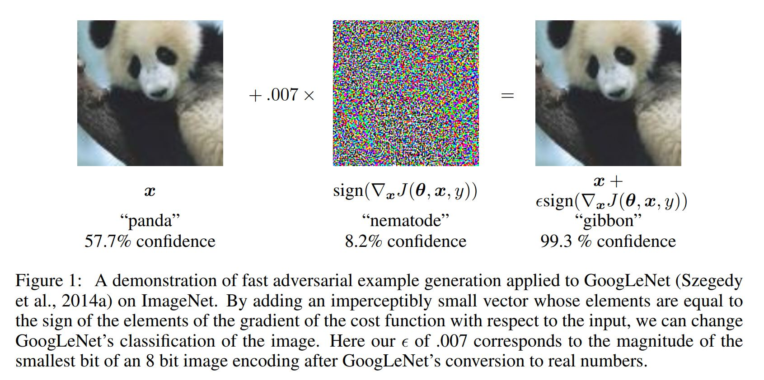
Motivation

Slide 3
Outline
Introduction.
Previous work.
Paper’s work.
Other methods for attacks and robustness.

Slide 4
Introduction
White-box vs black-box attacks.
Are white-box attacks realistic?

Slide 5
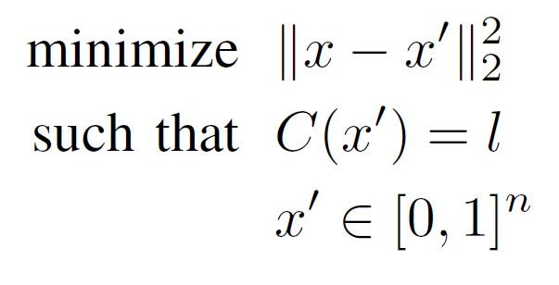
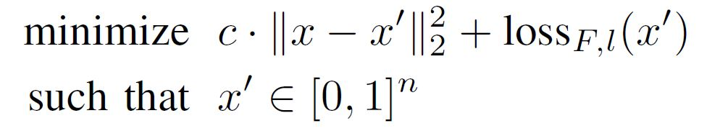
Previous Work
L-BFGS:
Given an image x, their method finds a different image x’ that is similar to x, but labeled differently by the classifier.
Or Alternatively
This optimization problem is solved repeatedly for different values of C (Line search).

Slide 6
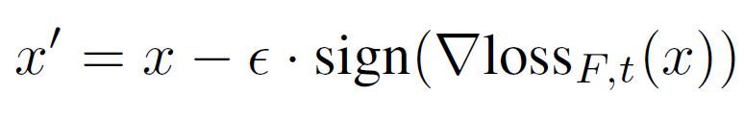
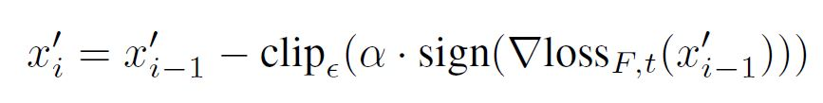
Fast Gradient Sign:
Note: fast but gives far examples.
Iterative Gradient Sign:

Slide 7
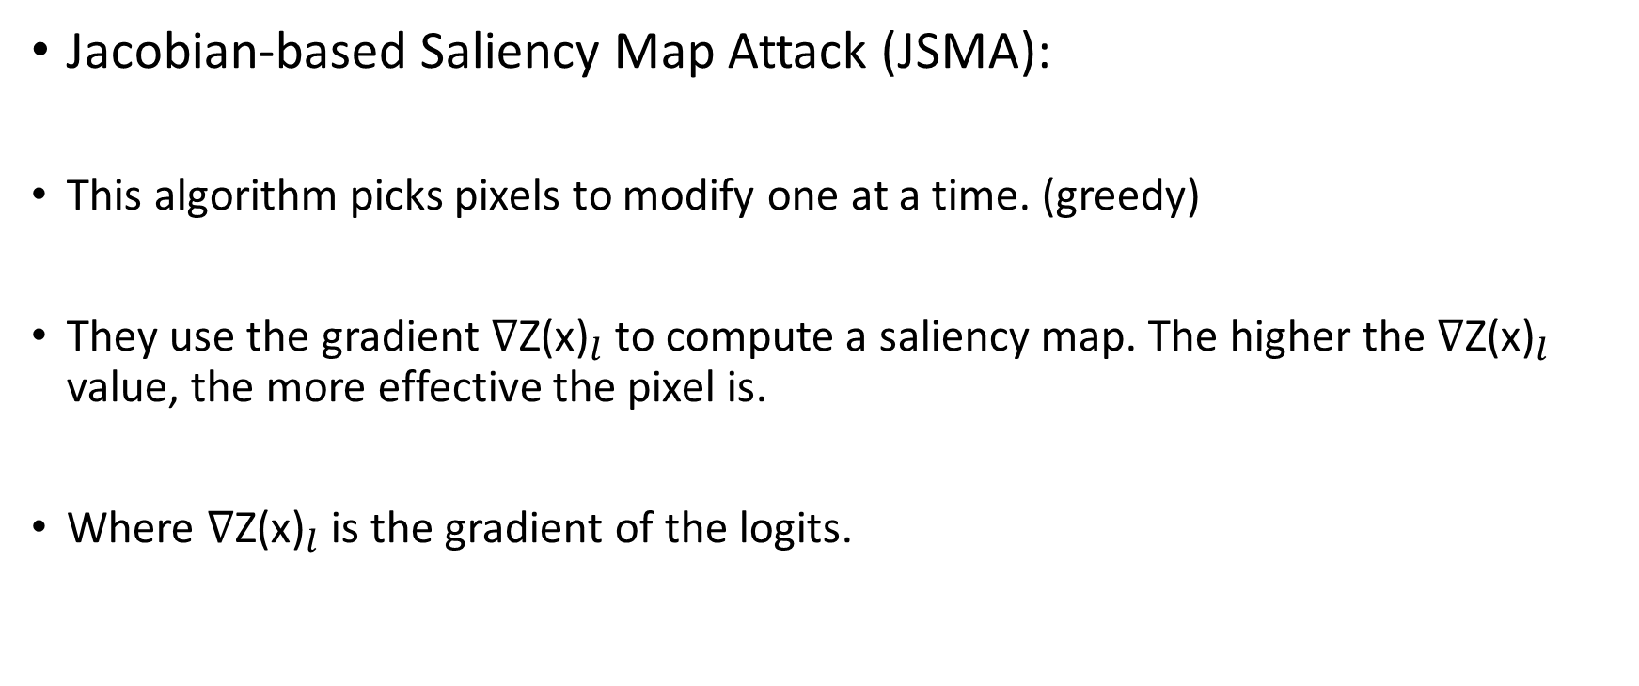
Jacobian-based Saliency Map Attack (JSMA):
This algorithm picks pixels to modify one at a time. (greedy)
They use the gradient ${\text{∇Z}\text{(}\text{x}\text{)}}_{l}$ to compute a saliency map. The higher the ${\text{∇Z}\text{(}\text{x}\text{)}}_{l}$ value, the more effective the pixel is.
Where ${\text{∇Z}\text{(}\text{x}\text{)}}_{l}$ is the gradient of the logits.

Slide 8
Deepfool:
Deepfool is an untargeted attack technique optimized for the L2 distance metric.
Efficient and produces closer adversarial examples than the L-BFGS.

Slide 9
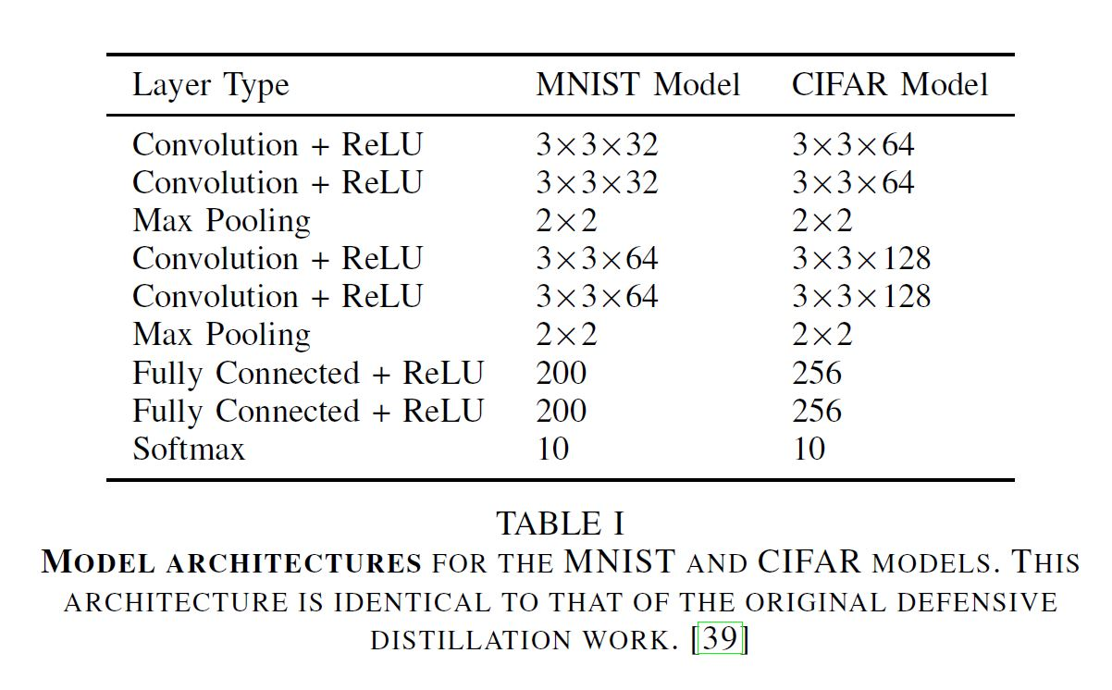
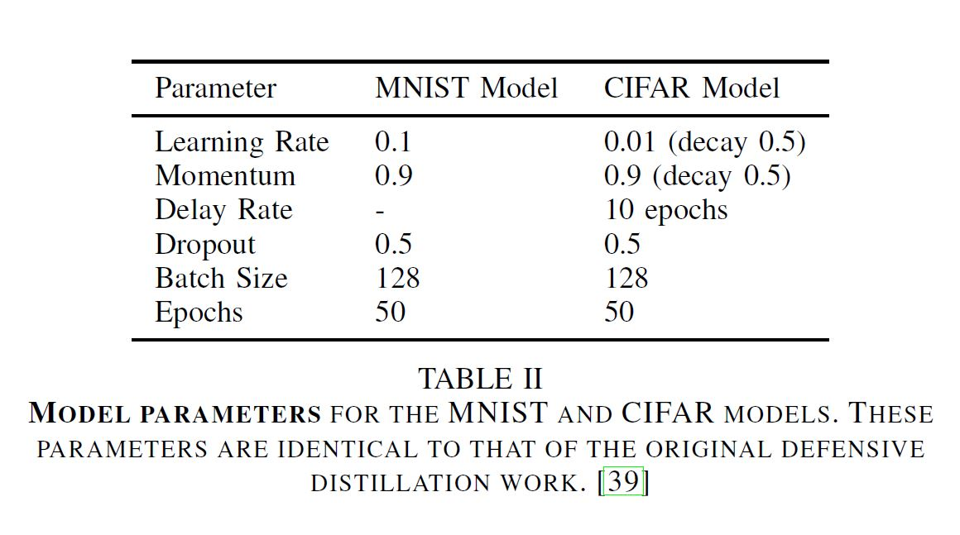
Experimental Setup
99.5% accuracy is achieved on MNIST and 80% accuracy on CIFAR-10.
Imagenet is also considered using a pre-trained Inception v3 network, which achieves 96% top-5 accuracy.

Slide 10
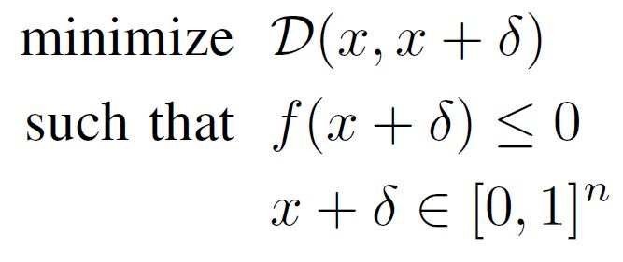
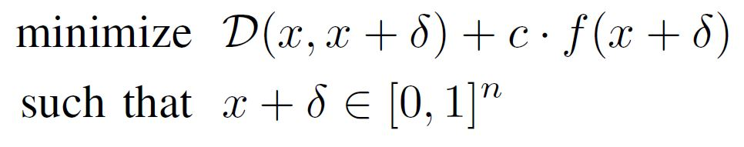
Paper’s Approach
They define the problem of finding an adversarial instance for an image x as follows:
Where f is defined such that C(x + δ) = t if and only if f(x + δ) ≤ 0.
How different are these two formulations?
Or alternatively

Slide 11
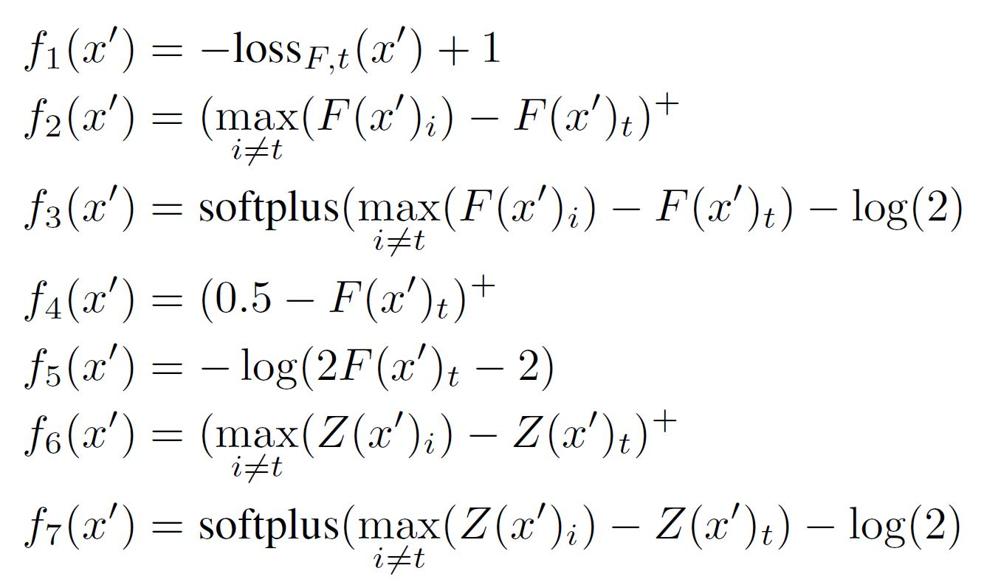
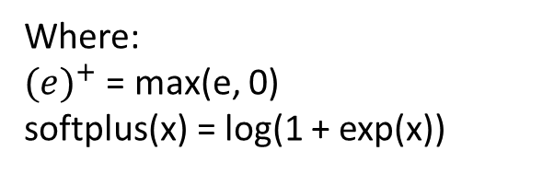
Paper’s Approach
A) Objective Function: Different f functions are considered
Where:
${(e)}^{+}$ = max(e, 0)
softplus(x) = log(1 + exp(x))

Slide 12
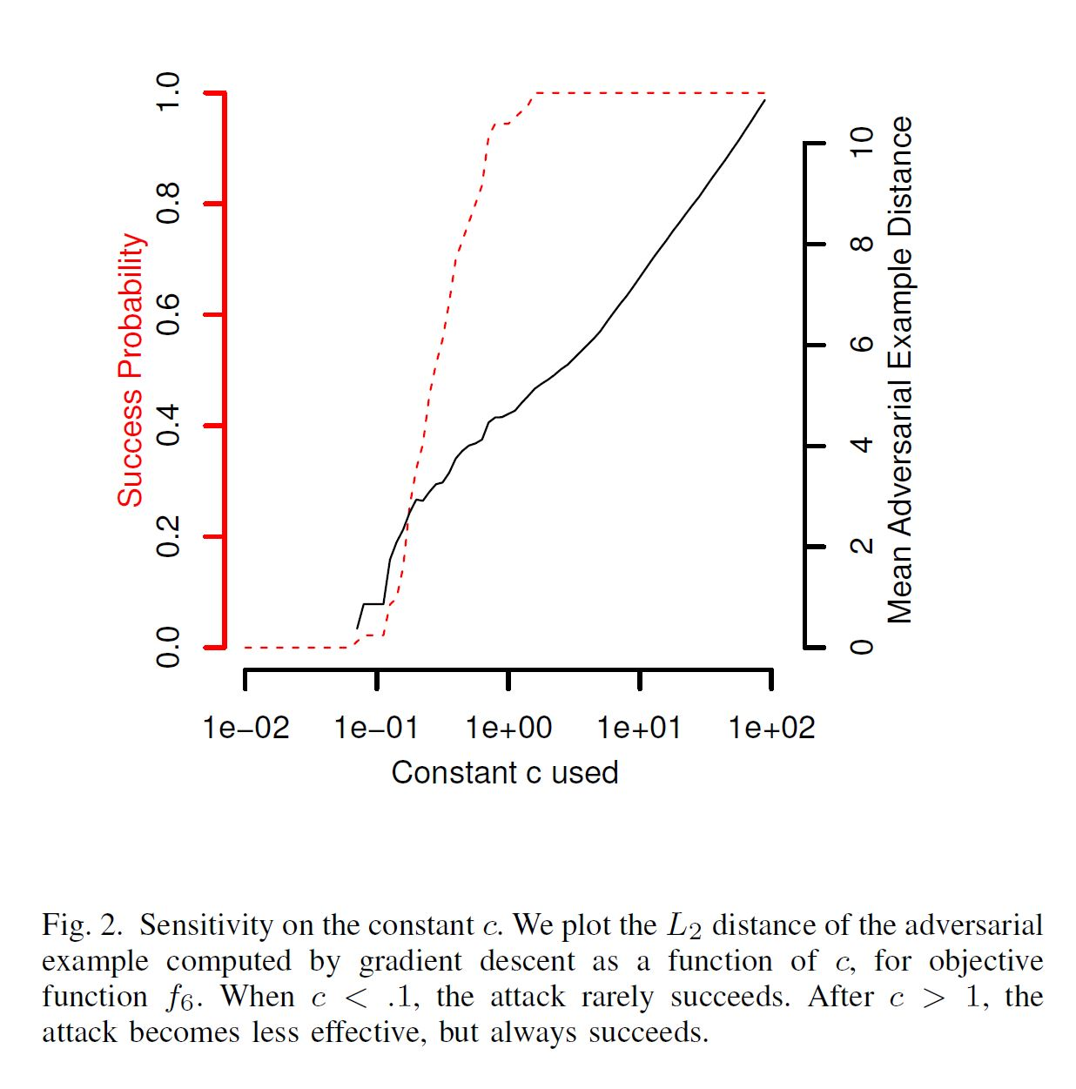
Choosing the constant c
For c = 0:01 to c = 100 (on log scale)
On the MNIST dataset.

Slide 13
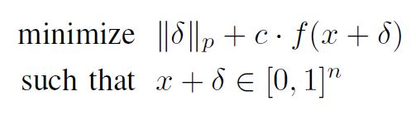
Paper’s Approach
B) Box constraints:
Previous work uses LBFGS-B, which supports box constraints natively.
Three different methods are investigated to approach this:
1. Projected gradient descent.
Works poorly for some gradient descent approaches, such as those with momentum.
2. Clipped gradient descent.
Incorporates clipping into the objective function. They replace f(x + δ) with f(min(max(x + δ, 0), 1)).
3. Change of variables.
Introduces a new variable w. Instead of optimizing over
the variable δ , they optimize over w.

Slide 14
Paper’s Approach
C) Discretization:
In a valid image, each pixel intensity must be a (discrete) integer in the range {0, 1, . . . , 255}
This is not captured in our formulation. Rounding will slightly degrade the quality of the adversarial example.
To restore the attack quality, they perform greedy search on the lattice defined by the discrete solutions. (changing one pixel value at a time)
Discretization is not an issue in FGSM.

Slide 15
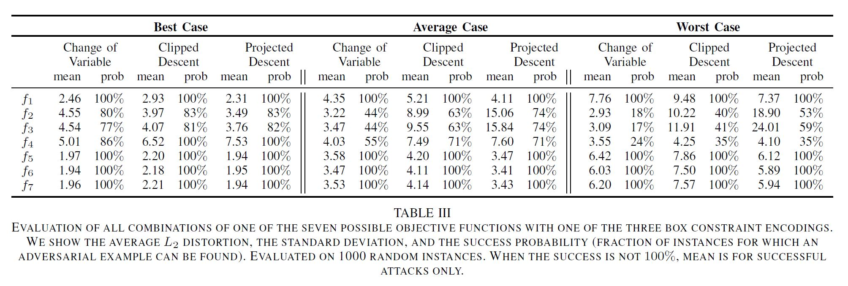
Evaluation of approaches
$L_{2}$ norm is used as distance metric in this case.

Slide 16
More on choosing the constant c
Why are some loss functions better than others?
For loss function f1 and f4, there is no good constant c that is useful throughout the duration of the gradient descent search.
The relative value of the two terms in the objective should remain approximately equal.

Slide 17
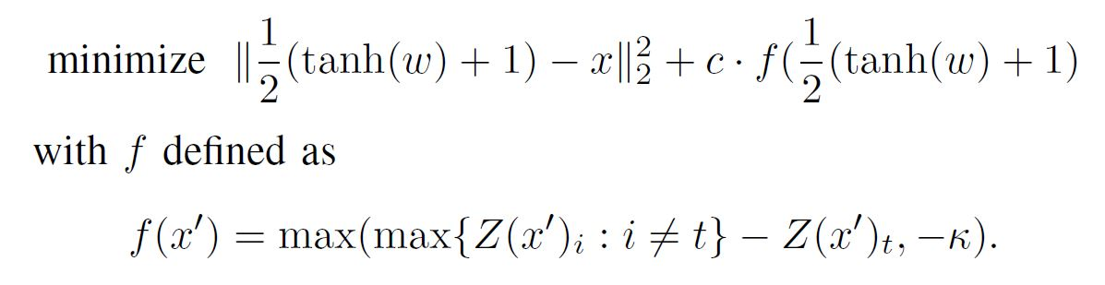
Three More Attacks
L2 Attack:
The confidence with which the misclassification occurs can be controlled by adjusting k.
Multiple starting-point gradient descent: to mitigate the greedy nature of gradient descent.

Slide 18
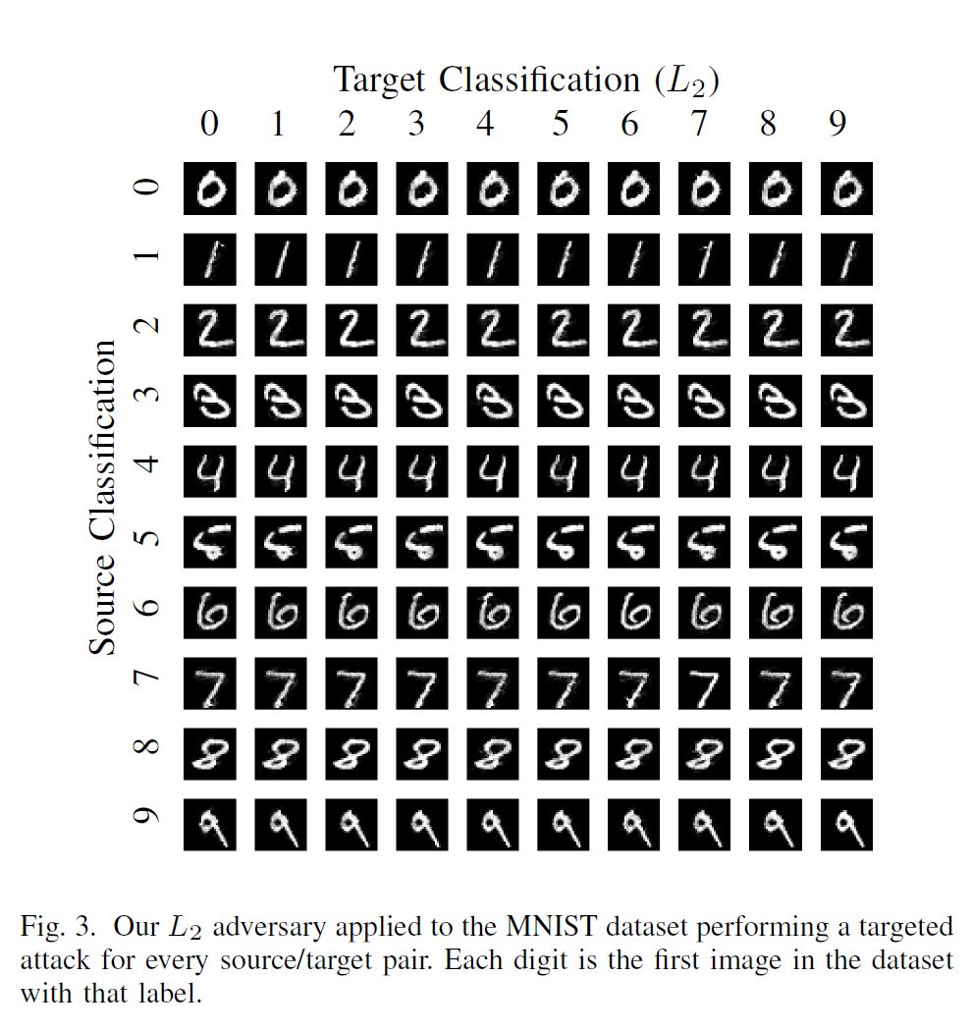
L2 Attack on MNIST

Slide 19
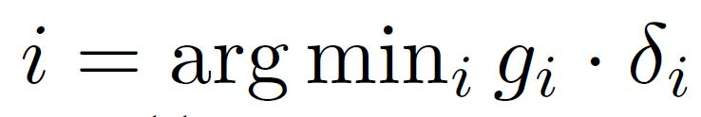
Three More Attacks
L0 Attack:
The L0 distance metric is ill-suited for standard gradient descent.
The algorithm follows a greedy elimination process. until we have a minimal subset of pixels that can be modified to generate an adversarial example.
In each iteration, L2 attack is used to identify which pixels are unimportant.
They compute g = ∇f(x + δ) then select the pixel to fix.
“warm-start” is used.

Slide 20
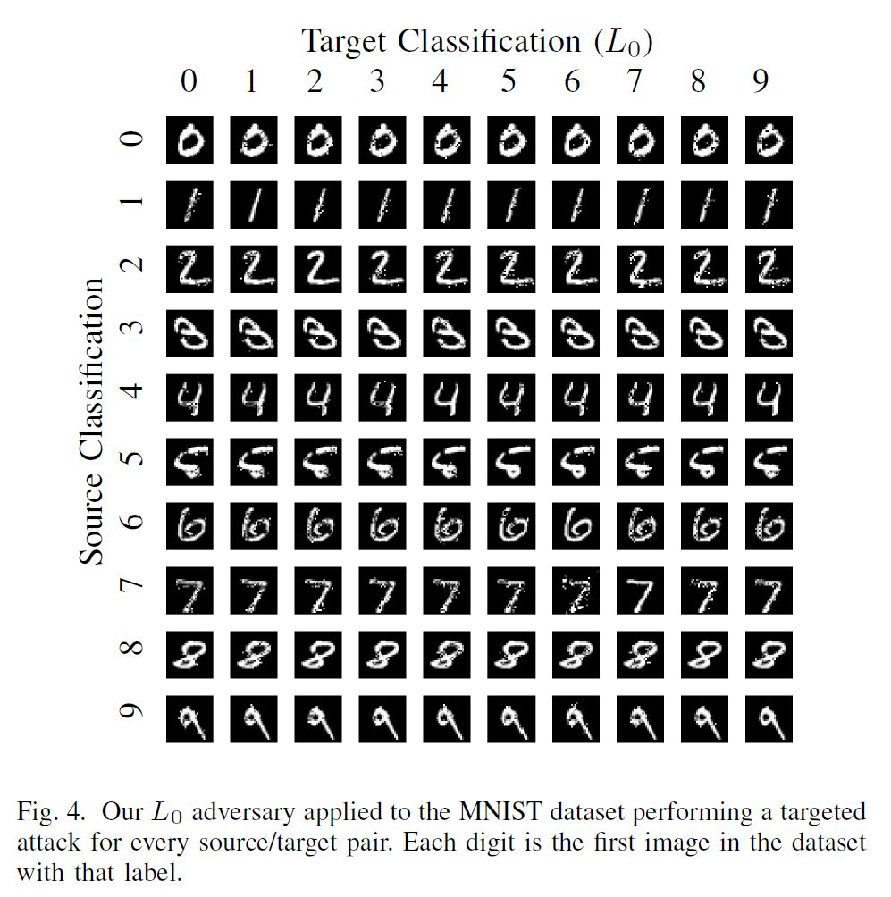
L0 Attack on MNIST

Slide 21
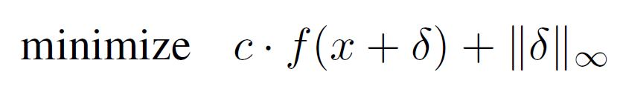
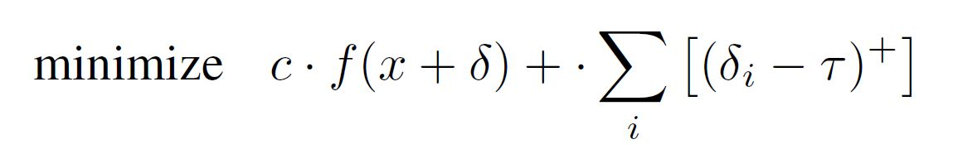
Three More Attacks
L∞ Attack:
The L∞ distance metric is not fully differentiable.
Experiments with naively optimizing
This produced very poor results. Gradient descent very quickly becomes stuck oscillating between two suboptimal solutions.
This is resolved by an iterative attack. Using the formulation
τ is initially 1 and decreases in each iteration

Slide 22
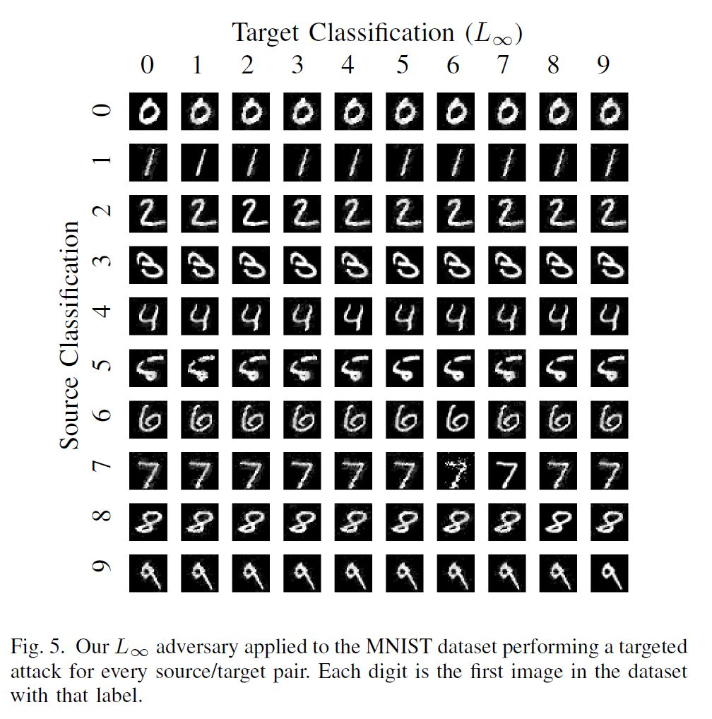
L∞ Attack on MNIST

Slide 23
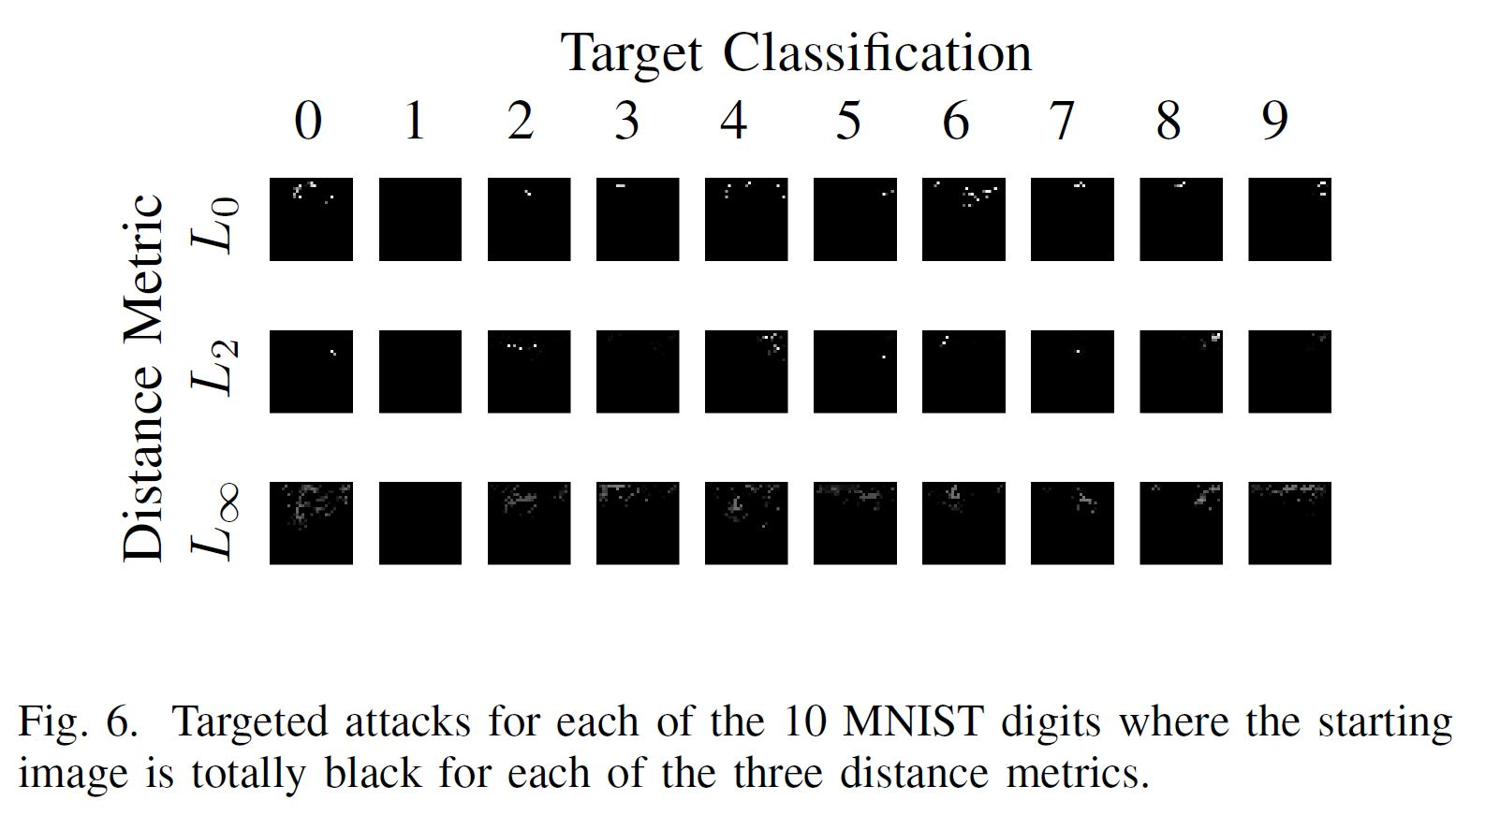
Generating synthetic digits

Slide 24
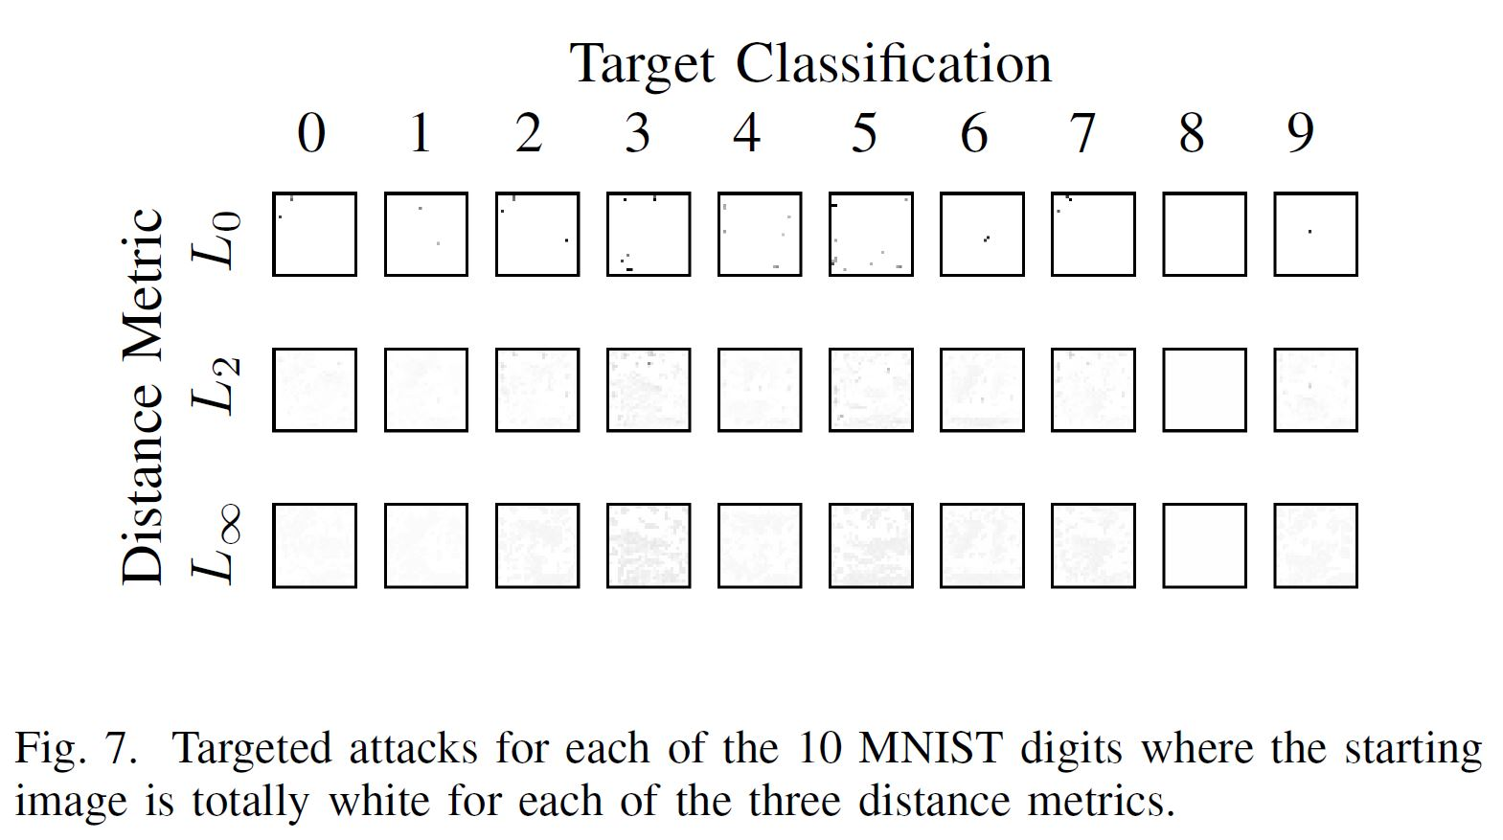
Generating synthetic digits

Slide 25
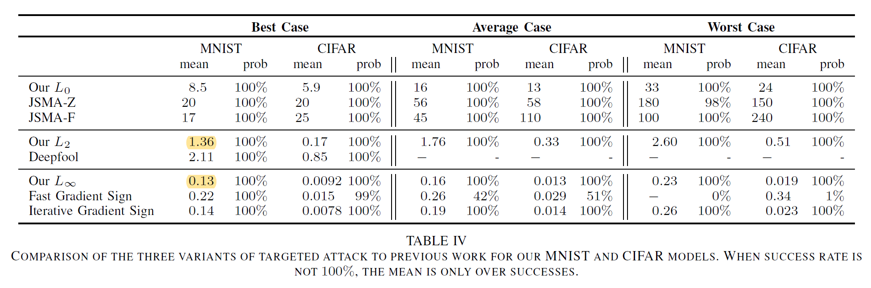
Attacks Evaluation

Slide 26
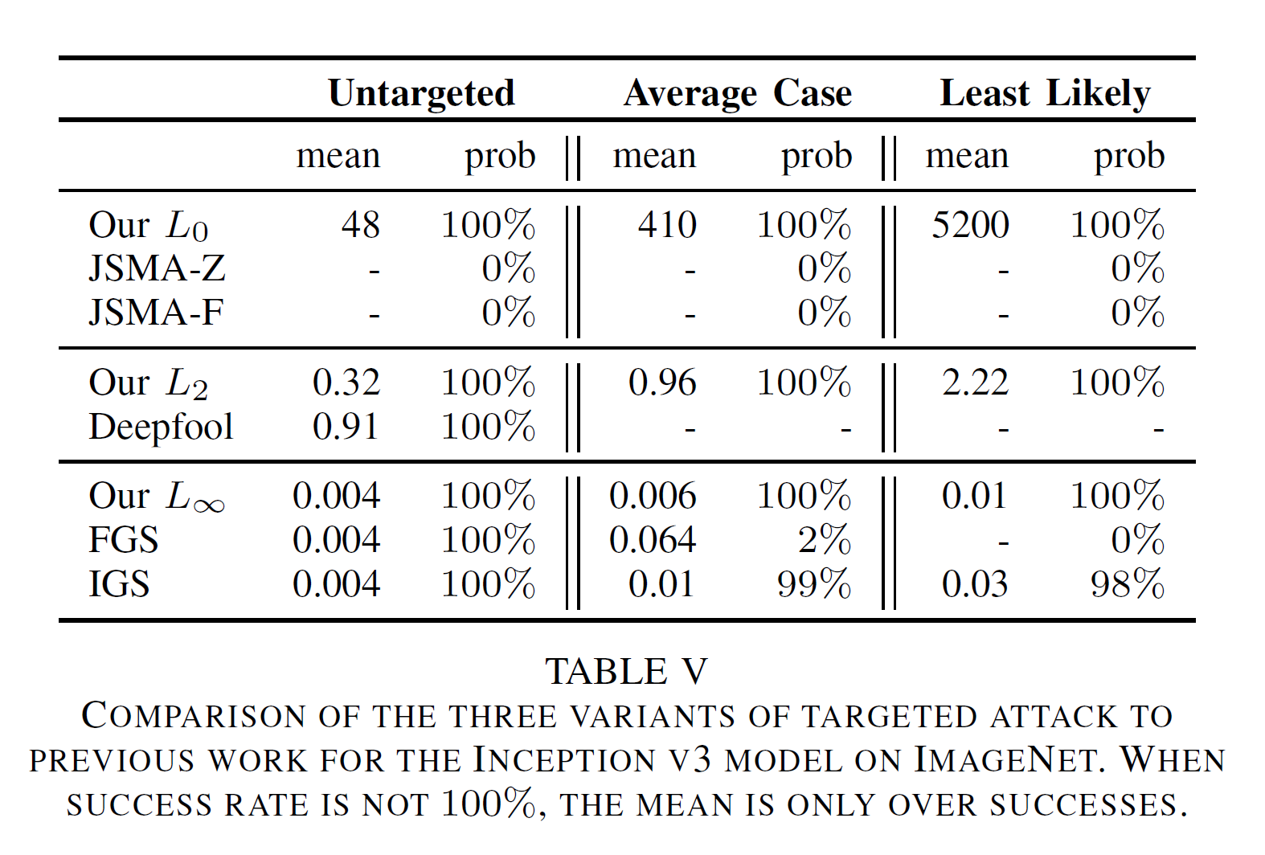
Attacks Evaluation

Slide 27
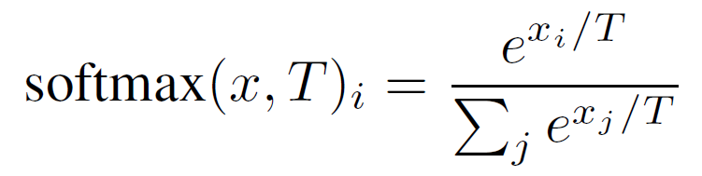
Defensive Distillation
What is distillation?
Differences between regular distillation and defensive distillation:
Defensive distillation does not result in smaller models.
More importantly, defensive distillation uses a large distillation temperature.
Note: Softmax with temperature results in something between uniform and max.

Slide 28
Defensive Distillation
Defensive distillation proceeds in four steps:
Train a network, the teacher network, by setting the temperature of the softmax to T during the training phase.
Compute soft labels by apply the teacher network to each instance in the training set, again evaluating the softmax at temperature T.
Train the distilled network (a network with the same shape as the teacher network) on the soft labels, using softmax at temperature T.
Finally, when running the distilled network at test time (to classify new inputs), use temperature 1.

Slide 29
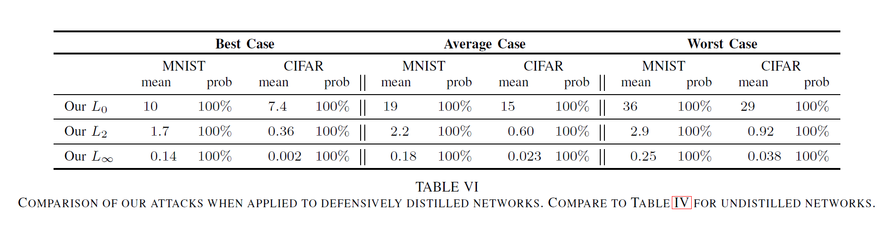
Attacking Defensively Distillated Networks

Slide 30
Other Work in This Area
Detection of adversarial examples using internal representations.
Attacking this robustness method.
Detection of adversarial examples using Auto-Encoders.
Attacking this robustness method.
Robustness techniques using pre-processing.
Optimization based Robustness method.

Slide 31
References
Towards Evaluating the Robustness of Neural Networks. (https://arxiv.org/abs/1608.04644)
Explaining and Harnessing Adversarial Examples. (https://arxiv.org/pdf/1412.6572.pdf)
Intriguing properties of neural networks. (https://arxiv.org/abs/1312.6199)
The Limitations of Deep Learning in Adversarial Settings. (https://arxiv.org/abs/1511.07528)
Towards Deep Learning Models Resistant to Adversarial Attacks. (https://arxiv.org/abs/1706.06083)
A lecture by Nicholas Carlini. (https://www.youtube.com/watch?v=EkY9GGGCLhA&list=PLkFD6_40KJIxH03tTW2HNSHbgcfTDGKV1&index=2&t=0s)

