Slide 1

IVUL GPU Computing Cluster
Crash Course By Fabian Caba Heilbron

Slide 2
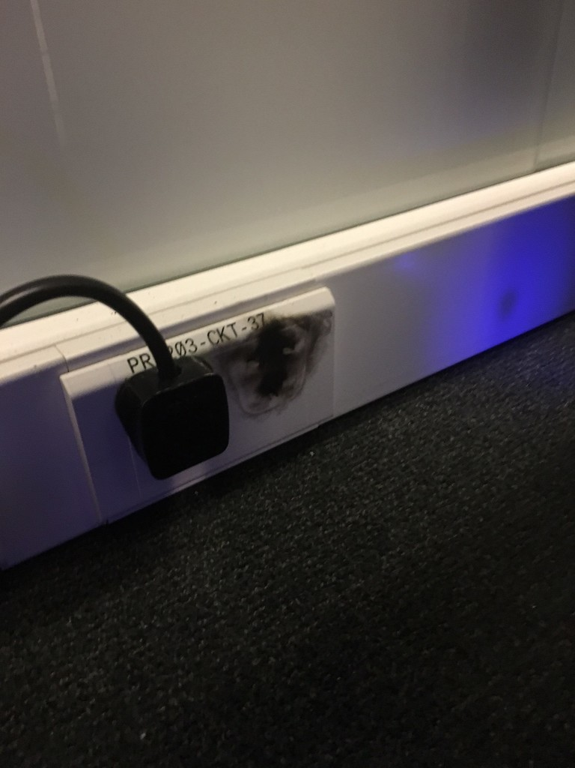
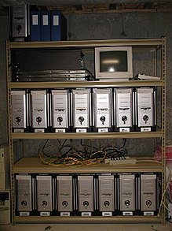

Slide 3
Who is Skynet for
All IVUL members
If your task requires GPUs
Training Neural Networks: useful for massively finding hyperparameters

Slide 4

Who should use Skynet?
All IVUL members
If your task requires GPUs
Training Neural Networks: useful for massively finding hyper parameters.

Slide 5
Who should use Skynet?
All IVUL members
If your task requires GPUs
Training Neural Networks: useful for massively finding hyper parameters.
Extracting features from pre-trained models for large datasets

Slide 6
Accessing Skynet
The way to go is by Secure Shell aka ‘ssh’
Linux: don’t worry you must have an ssh client installed in your machine ☺
MacOS: don’t worry you must have an ssh client installed in your machine ☺

Slide 7
Accessing Skynet
The way to go is by Secure Shell aka ‘ssh’
Linux: don’t worry you must have an ssh client installed in your machine ☺
MacOS: don’t worry you must have an ssh client installed in your machine ☺
Windows: you may need to search for clients like Putty ☹ -- @bibia may have a better alternative

Slide 8
Accessing Skynet
Summary: you need an SSH client!
Skynet Hostname: skynet.cbrc.kaust.edu.sa
ssh username@skynet.cbrc.kaust.edu.sa

Slide 9
Copying Files to Skynet
Use Secure Copy (SCP)
To copy folder use –R flag
For advanced options read the docs ☺
Use rsync (useful when transferring large number of files and huge files)
For advanced options read the docs ☺

Slide 10
Skynet Architecture
Head Node: skynet.cbrc.kaust.edu.sa
Submit jobs
Centralized Storage (24 TB): save results, bmodels, etc → /vcc/datasets/ ; /vcc/software/
Compute Nodes: access through SLURM
Run jobs on GPUs
6 Compute Nodes
21 GPUs in total: Titan X mix of Pasc. & Maxw.

