Slide 1
Introducing Python
Module 1

Slide 2
Module Objectives
Use the Python interactive shell to write simple programs
Write and run simple Python scripts
Write and run dynamic scripts that take arguments from the command line
Use variables and describe the different types of values that variables can be assigned
Get user input from the keyboard for your Python programs
Explain the importance of comments and write them in Python
Explain the importance of whitespace and indentation in Python

Slide 3
What is Python?
Python is a popular programming language. It was created by Guido van Rossum, and released in 1991.
It is used for:
web development (server-side),
software development,
mathematics,
system scripting.

Slide 4
What can Python do?
Python can be used on a server to create web applications.
Python can be used alongside software to create workflows.
Python can connect to database systems. It can also read and modify files.
Python can be used to handle big data and perform complex mathematics.
Python can be used for rapid prototyping, or for production-ready software development.

Slide 5
Why Python?
Python works on different platforms (Windows, Mac, Linux, Raspberry Pi, etc).
Python has a simple syntax similar to the English language.
Python has syntax that allows developers to write programs with fewer lines than some other programming languages.
Python runs on an interpreter system, meaning that code can be executed as soon as it is written. This means that prototyping can be very quick.
Python can be treated in a procedural way, an object-orientated way or a functional way.

Slide 6
What is Python?
General Purpose Interpreted Object-Oriented
Python is a general purpose programming language. That means you can use Python to write code for any programming tasks. Python are now used in Google search engine, in mission critical projects in NASA, in processing financial transactions at New York Stock Exchange.

Slide 7
What is Python?
General Purpose Interpreted Object-Oriented
Python is interpreted, which means that python code is translated and executed by an interpreter one statement at a time. In a compiled language, the entire source code is compiled and then executed altogether.

Slide 8
What is Python?
General Purpose Interpreted Object-Oriented
Python is an object-oriented programming language. Data in Python are objects created from classes. A class is essentially a type that defines the objects of the same kind with properties and methods for manipulating objects. Object-oriented programming is a powerful tool for developing reusable software.

Slide 9
Python’s History
created by Guido van Rossum in Netherlands in 1990
Open source

Slide 10
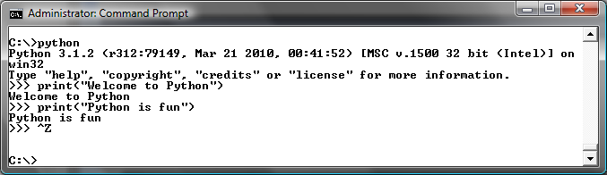
Launch Python

Slide 11
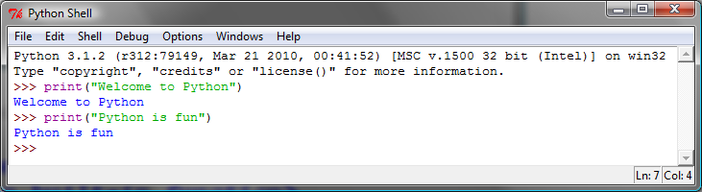
Launch Python IDLE

Slide 12
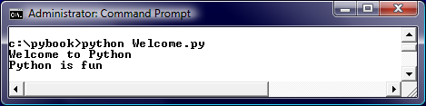
Run Python Script

Slide 13
A Simple Python Program
Listing 1.1
# Display two messages
print("Welcome to Python")
print("Python is fun")

Slide 14

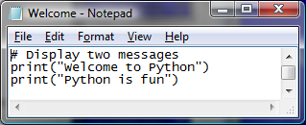
Creating and Editing Using Notepad
To use Notepad, type
notepad Welcome.py
from the DOS prompt.

Slide 15
Trace a Program Execution
animation
Execute a statement
# Display two messages
print("Welcome to Python")
print("Python is fun")

Slide 16
Trace a Program Execution
animation
Execute a statement
# Display two messages
print("Welcome to Python")
print("Python is fun")

Slide 17
Anatomy of a Python Program
Statements
Comments
Indentation

Slide 18
Lesson 1.1: Working with the Python Interactive Shell
Python Interactive Shell:
Open at command line using command: python
Interfaces with Python interpreter.
Allows user to run Python commands at command line.
Sample command: print("Message")
Anything typed into shell is echoed back.
Can even do calculations.

Slide 19
Lesson 1.2: Writing and Running Simple Scripts (1 of 2)
Can also run code saved in files.
The files are called modules.
A script is a module that can be run.
File extension used is: .py
Execute script using command: python filename.py
Sample script, test1.py, is shown in Snippet 1.6.
Run using command: python test1.py

Slide 20

Lesson 1.2: Writing and Running Simple Scripts (2 of 2)
Snippet 1.6

Slide 21
Lesson 1.2.1 Running a File Containing Invalid Commands
Invalid commands in script will cause errors.
Output will be stack trace (also called traceback).
Gives error info such as where, what kind, and what other calls were triggered.
Read from bottom to top.

Slide 22
Lesson 1.3.1: Variables (1 of 6)
Variables can reference values of different data types.
They don’t need to be declared before use.
Value and type can change during runtime.
Use type function to check type.
Example: type(7)

Slide 23
Python Variables

Slide 24
Creating Variables
Variables are containers for storing data values.
Unlike other programming languages, Python has no command for declaring a variable.
A variable is created the moment you first assign a value to it.
Example
x = 5 y = "John" print(x) print(y)

Slide 25
Variables do not need to be declared with any particular type and can even change type after they have been set.
Example
x = 4 # x is of type int x = "Sally" # x is now of type str print(x)

Slide 26
String variables can be declared either by using single or double quotes:
Example
x = "John" # is the same as x = 'John'

Slide 27
Variable Names
A variable can have a short name (like x and y) or a more descriptive name (age, carname, total_volume). Rules for Python variables:A variable name must start with a letter or the underscore character
A variable name cannot start with a number
A variable name can only contain alpha-numeric characters and underscores (A-z, 0-9, and _ )
Variable names are case-sensitive (age, Age and AGE are three different variables)

Slide 28
Example
#Legal variable names: myvar = "John" my_var = "John" _my_var = "John" myVar = "John" MYVAR = "John" myvar2 = "John" #Illegal variable names: 2myvar = "John" my-var = "John" my var = "John"
Remember that variable names are case-sensitive

Slide 29
Assign Value to Multiple Variables
Python allows you to assign values to multiple variables in one line:
Example
x, y, z = "Orange", "Banana", "Cherry" print(x) print(y) print(z)
And you can assign the same value to multiple variables in one line:
Example
x = y = z = "Orange" print(x) print(y) print(z)

Slide 30
Output Variables
The Python print statement is often used to output variables.
To combine both text and a variable, Python uses the + character:
Example
x = "awesome" print("Python is " + x)
You can also use the + character to add a variable to another variable:
Example
x = "Python is " y = "awesome" z = x + y print(z)

Slide 31
For numbers, the + character works as a mathematical operator:
Example
x = 5 y = 10 print(x + y)
If you try to combine a string and a number, Python will give you an error:
Example
x = 5 y = "John" print(x + y)

Slide 32
Lesson 1.3.1: Variables (2 of 6)
Numeric Values—Integers
Integers are whole numbers that are either positive or negative.
Arithmetic operations can be performed on them.
String Values
Strings are sequence of characters between two quotation marks.
Can use either double or single quotes.
Can contain letter, numbers, or symbols.

Slide 33
Lesson 1.3.1: Variables (3 of 6)
Type Conversion
Can convert integer to string.
Example: str(7)
Can convert string to integer.
Example: int("100")
Will get error if trying to convert string that doesn’t contain integer.

Slide 34
Lesson 1.3.1: Variables (4 of 6)
Assigning Variables
To assign value to variable use equal sign.
Example: number = 7
Error is raised if trying to use variable before it is assigned value.
Can use + to concatenate two strings.
Variables are not deeply linked.
Multiple Assignment
Can assign multiple variables in one statement.
Example: a, b, c = 1, 2, 3

Slide 35
Lesson 1.3.1: Variables (5 of 6)
Naming Identifiers and Reserved Words
Some rules for variables and other identifiers:
Can consist of upper and lowercase letters, underscores, unicode identifiers, and digits 0 to 9.
Cannot begin with digit.
No other characters can be in identifiers.
Module names with spaces should be avoided.
Python reserved words or keywords can’t be used.
Identifier names are case sensitive.

Slide 36
Lesson 1.3.1: Variables (6 of 6)
Python Naming Conventions
Compound variable names should be written in snake case notation.
Example: snake_case
Constant names should be in all caps.
Avoid lowercase L or uppercase O as single character names.

Slide 37
Statement
A statement represents an action or a sequence of actions. The statement print("Welcome to Python") in the program is a statement to display the greeting "Welcome to Python“.
# Display two messages
print("Welcome to Python")
print("Python is fun")

Slide 38
Programming Errors
Syntax Errors
Error in code construction
Runtime Errors
Causes the program to abort
Logic Errors
Produces incorrect result

Slide 39
Lesson 1.4: User Input, Comments, and Indentations (1 of 4)
User Input from the Keyboard
Use input() function to get user input from keyboard.
Example: message = input()
Program execution halts until user inputs value and presses Enter key.

Slide 40
Lesson 1.4: User Input, Comments, and Indentations (2 of 4)
Passing in a Prompt to the Input Function
Syntax: input("Insert prompt here")
Using Different Input Data Types in Your Program
The input() function always returns string.
Use built-in int() function to convert to integer.

Slide 41
Special Symbols

Slide 42
Programming Style and Documentation
Appropriate Comments
Proper Indentation and Spacing Lines

Slide 43
Appropriate Comments
Include a summary at the beginning of the program to explain what the program does, its key features, its supporting data structures, and any unique techniques it uses.
Include your name, class section, instructor, date, and a brief description at the beginning of the program.

Slide 44
Lesson 1.4: User Input, Comments, and Indentations (4 of 4)
Indentation
Block is group of statements meant to be executed together.
Python uses whitespace to denote blocks.
Blocks are indented within other blocks.
Any indented statement forms new block.
Outdenting ends block.
Standard indentation is four spaces.

Slide 45
Lesson 1.4: User Input, Comments, and Indentations (3 of 4)
Comments
Block
Start with # sign.
Comes on line before statement it annotates.
Placed at same indent level as statement.
Inline
Start with # sign.
Placed on same line as statement it annotates.
Documentation String (docstrings)
String wrapped in triple (double or single) quotation marks.
Module docstrings should be at beginning of file.
Can be used for multiple line comments.

Slide 46
Indentation
The indentation matters in Python. Note that the statements are entered from the first column in the new line. It would cause an error if the program is typed as follows:
# Display two messages
print("Welcome to Python")
print("Python is fun")

Slide 47
Proper Indentation and Spacing
Indentation
Indent four spaces.
A consistent spacing style makes programs clear and easy to read, debug, and maintain.
Spacing
Use blank line to separate segments of the code.

Slide 48
Summary
In this module:
We have looked at two ways of running Python programs.
Python interactive shell or running saved scripts.
We have also covered the Python syntax in detail.
Variable assignment, the different types of values Python variables can be assigned to, the syntax for assigning them, as well as the importance of reserved keywords.
We then looked at the built-in input function and how it enables us to take input from a user keyboard.
We looked at the different ways of writing comments in Python code, and then finished the module by looking at the importance of indentation in writing readable, maintainable Python code.

