Slide 1
COMPSCI 221 Advanced Java
HTML

Slide 2
Web Platform Documents
Web Platform Docs is a community-driven site that aims to become a comprehensive and authoritative source for web developer documentation.
Web Platform Documents URL
https://docs.webplatform.org/wiki/Main_Page
HTML tags, CSS, JavaScript, Beginner Information
Currently working on HTML 5. HTML 4.1 is the current stable version – published in 1999
HTML 5 Document – 10/28/2014
http://www.w3.org/TR/html5/

Slide 3
Hypertext Transfer Protocol
A set of rules for exchanging files such as text, graphic images, sound, video, and other multimedia files on the Web.
Web browsers send HTTP requests for web pages and their associated files.
Web servers send HTTP responses back to the web browsers.

Slide 4
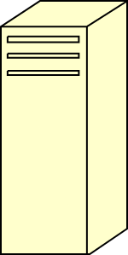
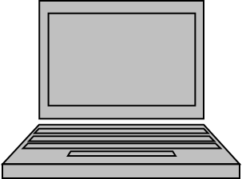
Hypertext Transfer Protocol
HTTP Request
HTTP Response

Slide 5
HTTP -- Request Phase
Generic format
HTTP method domain part of URL HTTP ver.
Header fields
blank line
Message body
An example of the first line of a request:
GET /cs.uccp.edu/degrees.html HTTP/1.1

Slide 6
HTTP -- Request Phase
Most commonly used methods:
GET - Fetch a document
POST - Execute the document, using the data in
body
HEAD - Fetch just the header of the document
PUT - Store a new document on the server
DELETE - Remove a document from the server

Slide 7
HTTP -- Request Phase
Four categories of header fields:
General, request, response, and entity
Common request fields:
Accept: text/plain
Accept: text/*
If-Modified_since: date

Slide 8
HTTP -- Response Phase
Generic Format
Status line
Response header fields
blank line
Response body
Status line format:
HTTP version status code explanation
Example: HTTP/1.1 200 OK

Slide 9
HTTP -- Response Phase
Example: HTTP/1.1 200 OK
(Current version is 1.1)
Status code is a three-digit number; first digit specifies the general status
1 => Informational
2 => Success
3 => Redirection
4 => Client error
5 => Server error
The header field, Content-type, is required

Slide 10
- An example of a complete response header:
HTTP/1.1 200 OK
Date: Sat, 25 July 2009 20:15:11 GMT
Server: Apache /2.2.3 (CentOS)
Last-modified: Tues, 18 May 2004 16:38:38 GMT
Etag: "1b48098-16a-3dab592dc9f80"
Accept-ranges: bytes
Content-length: 364
Connection: close
Content-type: text/html, charset=UTF-8
Both request headers and response headers must be followed by a blank line

Slide 11
HTML
Hypertext Markup Language – hypertext -- non-linear reading of text – From a book around 1950.
Markup codes called elements or tags
Tag are enclosed in angle bracket
Most tags come in pairs <html> … </html> -- <p> .. </p>called container tags – opening and closing pair.
Some tags are used alone <hr > -- horizontal rule (line)

Slide 12
Index.html
<!DOCTYPE html">
<html lang="en"> lang="en” is an attribute
<head>
<title>Page Title Goes Here</title>
<meta charset="utf-8">
</head>
<body>
... body text and more HTML tags go here ...
</body>
</html>

Slide 13
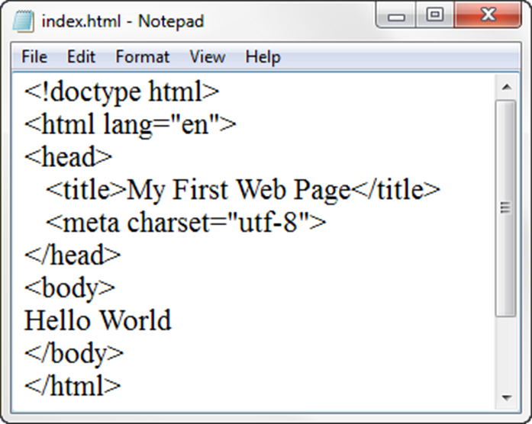
First line is Document Type Definition (DTD).
DTD – describes the markup language syntax – version of html used. The line above is for HTML 5.
HTML element– contains the web page document
Head element – contains the head section The head section contains information that describes the
web page document
Title element– Text displays in title bar of window
Meta element – describes the character encoding
Body element – contains the body section
The body section contains the text and elements that display in the browser viewport.

Slide 14
HTML
Not all tags have content
If a tag has no content, its form is <name /> in XHTML or <name> in html
The container and its content together are called an element
If a tag has attributes, they appear between its name and the right bracket of the opening tag
Comment tag: <!– Your comment here -->

Slide 15
HTML
- Browsers ignore comments, unrecognized tags,
line breaks, multiple spaces, and tabs
- Tags are suggestions to the browser, even if they
are recognized by the browser
- In XHTML, element and attribute names must be in
all lowercase letters
- In HTML, they can be any combination of uppercase
and lowercase

Slide 16
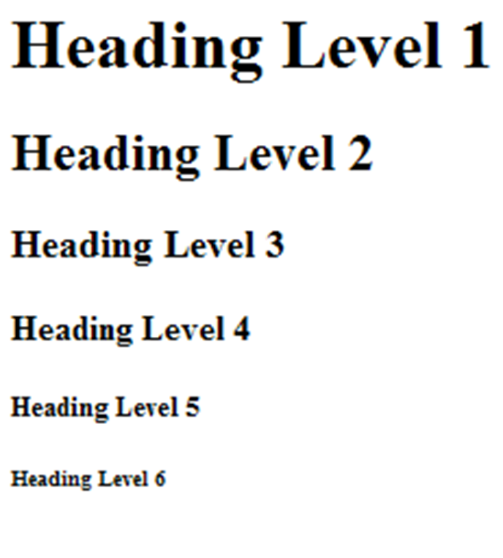
Heading
<h1>Heading Level 1</h1>
<h2>Heading Level 2</h2>
<h3>Heading Level 3</h3>
<h4>Heading Level 4</h4>
<h5>Heading Level 5</h5>
<h6>Heading Level 6</h6>

Slide 17
Paragraph
Paragraph element
<p> …paragraph goes here… </p>
Groups sentences and sections of text together.
Configures empty space above and below the paragraph

Slide 18
Line Break
Line Break element
Stand-alone tag
Called a void element in HTML5
…text goes here <br> This starts on a new line….
Causes the next element or text to display on a new line

Slide 19
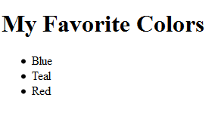
Unordered List -- Bullet Points
<h1>My Favorite Colors</h1>
<ul>
<li>Blue</li>
<li>Teal</li>
<li>Read</li>
</ul>

Slide 20
Ordered List
Conveys information in an ordered fashion
Ordered List Element
<ol> Contains the ordered list
type attribute determines numbering scheme of list
default is numerals
List Item Element <li> Contains an item in the list

Slide 21
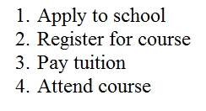
Ordered List
<ol>
<li>Apply to school</li>
<li>Register for course</li>
<li>Pay tuition</li>
<li>Attend course</li>
</ol>

Slide 22
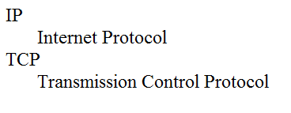
Descriptive List
<dl>
<dt>IP</dt>
<dd>Internet Protocol</dd>
<dt>TCP</dt>
<dd>Transmission Control Protocol</dd>
</dl>

Slide 23
Special Entity Characters
Display special characters such as quotes, copyright symbol, etc.
Character Code
© &copy;
< &lt;
> &gt;
& &amp;
&nbsp;

Slide 24
Char. Entity Meaning
" &quot; Double quote
' &apos; Single quote
¼ &frac14; One quarter
½ &frac12; One half
¾ &frac34; Three quarters
° &deg; Degree
(space) &nbsp; Non-breaking space
€ &euro; Euro

Slide 25
<!DOCTYPE html>
<!-- image.html
An example to illustrate an image
-->
<html lang = ″en″>
<head>
<title> Images </title>
<meta charset = ″utf-8″ />
</head>
<body>
<h1> Aidan's Airplanes </h1>
<h2> The best in used airplanes </h2>
<h3> "We've got them by the hangarful"
</h3>
<h2> Special of the month </h2>
<p>
1960 Cessna 210 <br />
577 hours since major engine overhaul
<br />
1022 hours since prop overhaul
<br /><br />
<img src = "c210new.jpg"
alt = "Picture of a Cessna 210"/>
<br />
Buy this fine airplane today at a
remarkably low price <br />
Call 999-555-1111 today!
</p>
</body>
</html>

Slide 27
<!DOCTYPE html>
<!-- link.html
An example to illustrate a link
-->
<html lang = ″en″>
<head>
<title> Links </title>
<meta charset = ″utf-8″ />
</head>
<body>
<h1> Aidan's Airplanes </h1>
<h2> The best in used airplanes </h2>
<h3> "We've got them by the hangarful"
</h3>
<h2> Special of the month </h2>
<p>
1960 Cessna 210 <br />
<a href = "C210data.html">
Information on the Cessna 210 </a>
</p>
</body>
</html>

Slide 28
The div element <div>
Purpose:
Configure a specially formatted division or area of a web page
Block display with empty space above and below the div
Can contain other block display and inline display elements

Slide 29
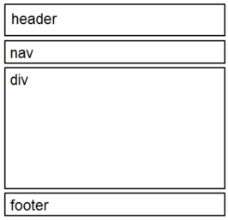
HTML 5 Structure
Header Element
<header></header> Contains the web page document’s headings
Nav Element
<nav></nav> Contains web page document’s main navigation
Footer Element
<footer></footer> Contains the web page document’s footer

Slide 30
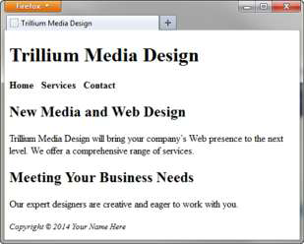
Example
Example:
<body>
<header> document headings go here </header>
<nav> main navigation goes here </nav>
<div> main content goes here </div>
<footer> document footer information goes here </footer>
</body>

Slide 31
Anchor Element
The anchor element
Inline display element
Specifies a hyperlink reference (href) to a file
Text between the <a> and </a> is displayed on the web page.
<a href="contact.html">Contact Us</a>
href Attribute
Indicates the file name or URL Web page document, photo, pdf, etc.

Slide 32
Links
Absolute link
Link to other websites
<a href="http://yahoo.com">Yahoo</a>
Relative link
Link to pages on your own site
Relative to the current page
<a href="index.html">Home</a>

Slide 33
Links
The target attribute on the anchor element opens a link in a new browser window or new browser tab.
<a href="http://yahoo.com" target="_blank">Yahoo!</a>

Slide 34
mailto
Automatically launch the default mail program configured for the browser
If no browser default is configured, a dialog box is displayed
<a href="mailto:me@hotmail.com">me@hotmail.com</a>

Slide 35
A table is a matrix of cells, each possibly having
content
- The cells can include almost any element
- Some cells have row or column labels and
some have data
- A table is specified as the content of a <table>
tag
- In HTML5, tables do not have lines between the
rows or between the columns
- We can add those with Cascading Style Sheets,
as will be discussed in Chapter 3
- Tables are given titles with the <caption> tag,
which can immediately follow <table>

Slide 36
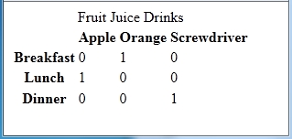

A table can have two levels of column labels
- If so, the colspan attribute must be set in the
<th> tag to specify that the label must span
some number of columns
<tr>
<th colspan = "3"> Fruit Juice Drinks </th>
</tr>
<tr>
<th> Orange </th>
<th> Apple </th>
<th> Screwdriver </th>
</tr>

Slide 37
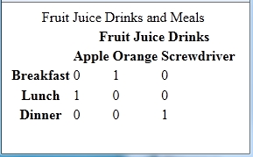
- If the rows have labels and there is a spanning
column label, the upper left corner must be
made larger, using rowspan
<table>
<tr>
<td rowspan = "2"> </td>
<th colspan = "3"> Fruit Juice Drinks
</th>
</tr>
<tr>
<th> Apple </th>
<th> Orange </th>
<th> Screwdriver </th>
</tr>
…
</table>

Slide 38
Uses of Tables
- In the past, tables were used to align elements in
rows and columns – general layout
- That use of tables is now frowned upon
- Use Cascading Style Sheets to place elements in
rows and columns – general layout
- Use tables only when the information is naturally
tabular

Slide 39
px unit
The px unit is the magic unit of CSS. It is not related to the current font and also not related to the absolute units. The px unit is defined to be small but visible, and such that a horizontal 1px wide line can be displayed with sharp edges (no anti-aliasing). What is sharp, small and visible depends on the device and the way it is used: do you hold it close to your eyes, like a mobile phone, at arms length, like a computer monitor, or somewhere in between, like a book? The px is thus not defined as a constant length, but as something that depends on the type of device and its typical use.

Slide 40
Use em or px for font sizes?
CSS inherited the units pt (point) and pc (pica) from typography. Printers have traditionally used those and similar units in preference to cm or in. In CSS there is no reason to use pt, use whichever unit you prefer. But there is a good reason to use neither pt nor any other absolute unit and only use em and px.
The magic unit of CSS, the px, is a often a good unit to use, especially if the style requires alignment of text to images, or simply because anything that is 1px or a multiple of 1px wide is guaranteed to look sharp.

Slide 41
Styles
Sequence in which styles are applied
Styles from external style sheet (first listed to last listed)
Embedded Styles
Inline styles.

Slide 42
The div element <div>
Purpose:
Configure a specially formatted division or area of a web page
Block display with empty space above and below the div
Can contain other block display and inline display elements

Slide 43
HTML 5 Structure
Header Element
<header></header> Contains the web page document’s headings
Nav Element
<nav></nav> Contains web page document’s main navigation
Footer Element
<footer></footer> Contains the web page document’s footer

