Slide 1






Analog Clock Reader
As part of the CVIT Workshop '23
Presented by Siddharth Mangipudi,CSE
siddharth.mangipudi@students.iiit.ac.in

Slide 2
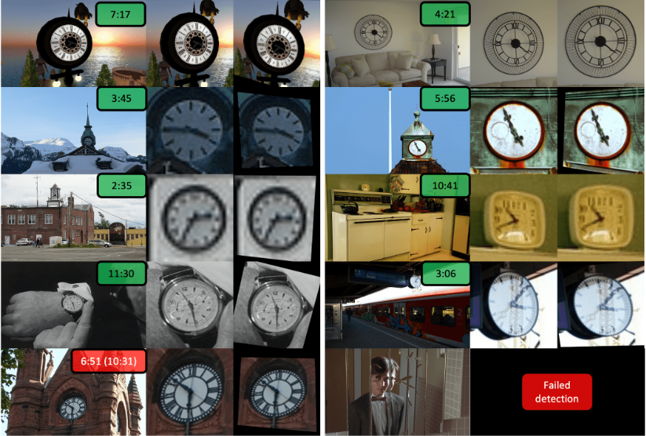
What is the Project about?
In this mini Project, we implemented a recent paper put out by the researchers at Oxford , wherein they developed a framework to read analog clocks in natural images and videos.
*grabbed from [1]

Slide 3

What is our Motivation Behind this?
Nowadays, Clocks come in two main types - analog and digital. It has been shown that digital clocks can be read with relative ease using text spotting methods, however analog clocks come in various different shapes,sizes and color, thus making it difficult for the machine to train on a set of data.

Slide 4

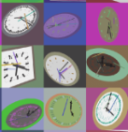
How are the inputs designed?
In order to generalize real clocks, we designed a synthetic clock generator with modifiable paramters, like size shape,etc.
In doing so we can mimic the difficulties faced in recognising real clocks, such as artefacts, shadows, etc.
We genereated a dataset of 720 images (12 hours * 60 minutes)

Slide 5
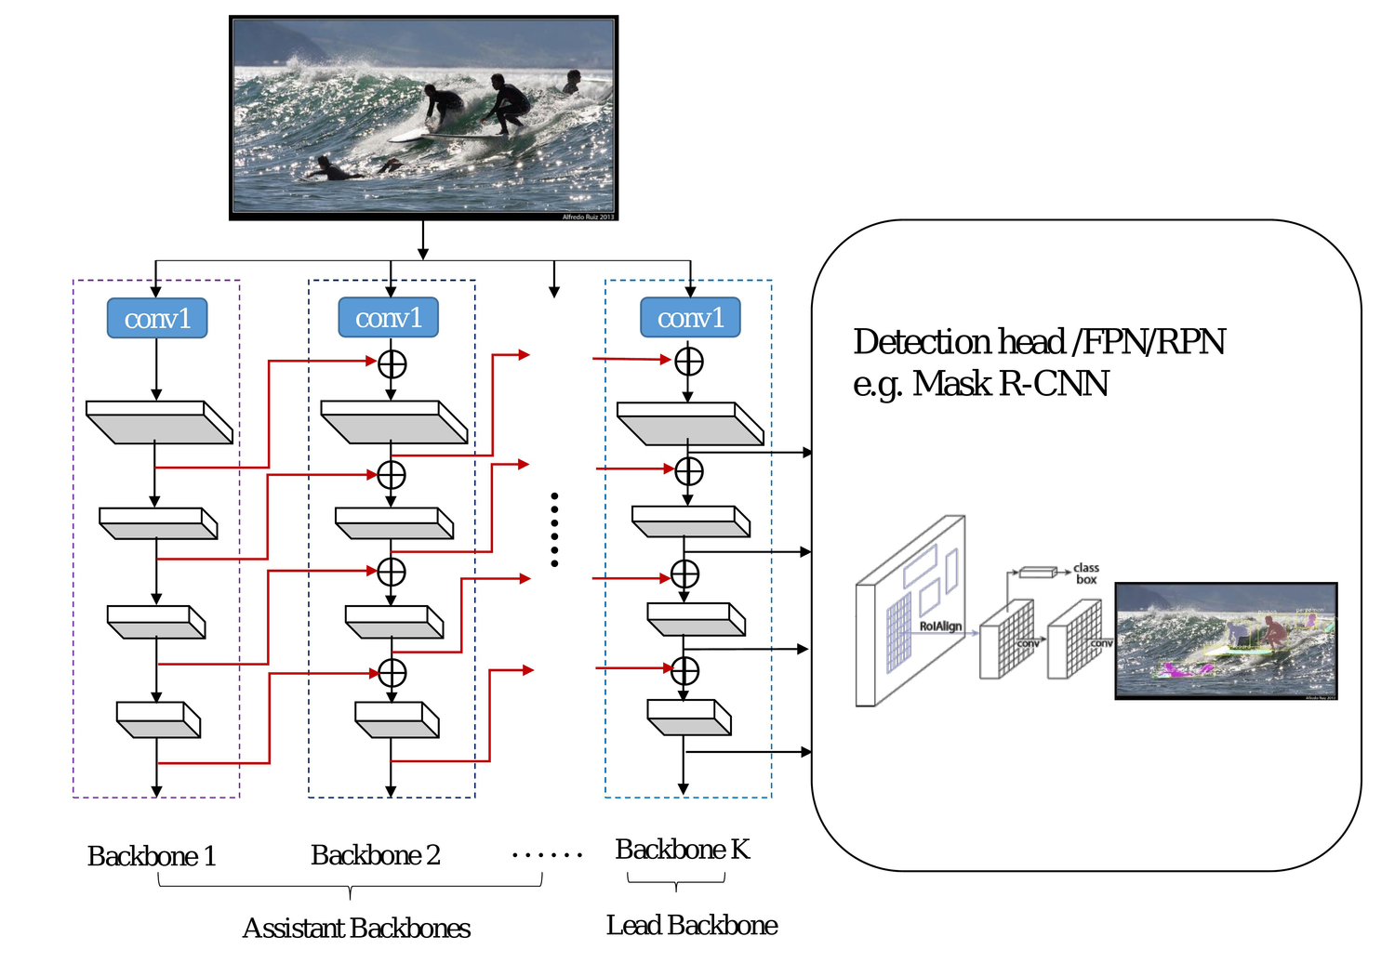

What Model have we used?
The Paper uses an off-the-shelf detector CBNetV2 for the localisation stage and is trained on COCO, acheieviung state-of-the-art performance on COCO.

Slide 6
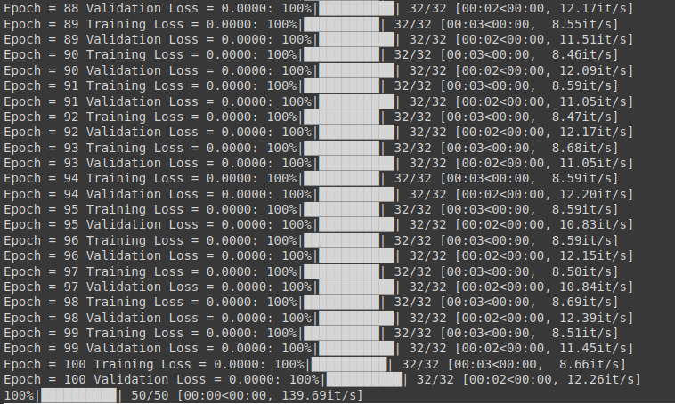
The Challenges Faced in doing this project
The main challenge faced by me during the making of this project which persists is the fact that the model does not really get trained well enough
After 100 Epochs, it gives out a very good loss but gives a pretty terrible accuracy on the validation set.
This could be owing to the fact that the hyperparameters used until now are not very good, and hence will need to be further looked into after the end of this presentation.
Another, more obvious reason could be the fact that the model is overfitted, in which case reducing the number of epochs will solve the problem effectively.

Slide 7


Conclusion
In this project we designed a framework for clock reading in real images and videos, and also a method to mitiagte the lack of training data with the help of the Synthetic Clock Generation.

Slide 8
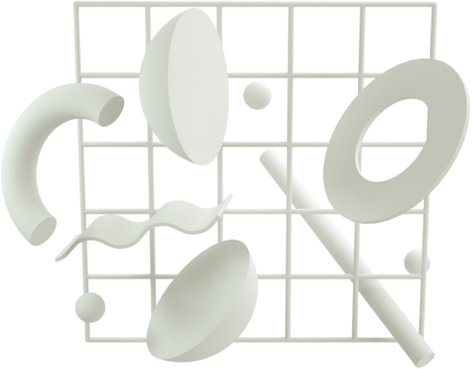
References
[1] Charig Yang, Weidi Xie, Andrew Zisserman. It's About Time : Analog Clock Reading in the Wild. https://openaccess.thecvf.com/content/CVPR2022/papers/Yang_Its_About_Time_Analog_Clock_Reading_in_the_Wild_CVPR_2022_paper.pdf
[2] Victor Suarez Vara. Reading analog clocks with
neural networks. https : / / github . com /
VictorSuarezVara/Reading- analog- clocks-
with-neural-networks, 2021.

