Slide 1
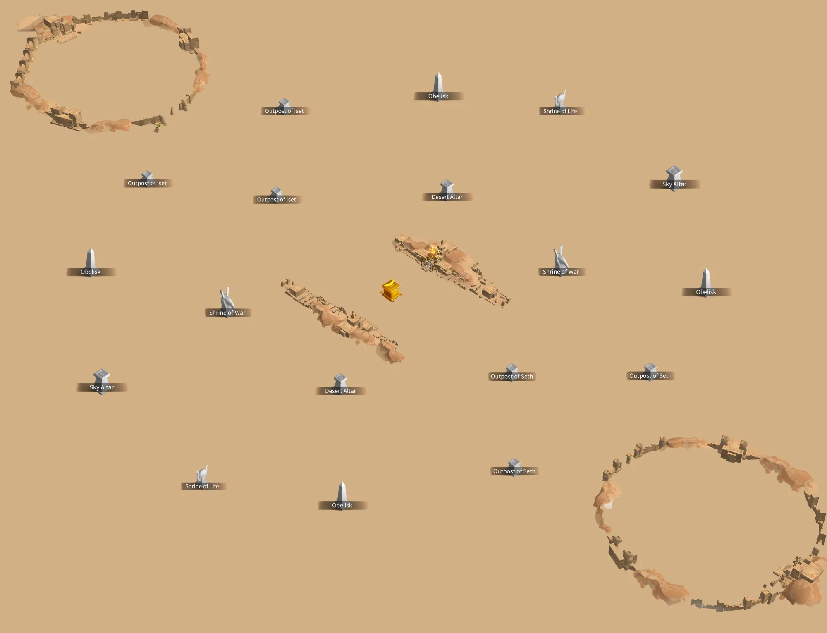
Start
Top Lane:
Fluffy Team
Middle Lane:
Michael, Fluffy Prince
Bottom Lane:
Suntzu’s Team
Enemy

Slide 2
Enemy
Top Lane:
ByAnil’s Team
Middle Lane:
Fluffy, Older, Stellara, Bun
Start
Bottom Lane:
Suntzu Team

Slide 4
1 | 2 | 3 | 4 | 5 | 6 | 7 | 8 | 9 | 10 | 11 | 12 | 13 | 14 | 15 | 16 | 17 | 18 | 19 | 20 | 21 | 22 | 23 | 24 | 25 | 26
2
3
4
5
6
7
8
9
10
11
12
13
14
15
16
17
18
19
20

