Slide 1

POWER BI FOR BEGINNERS
FLIPKART E-COMMERCE SALES ANALYTICS DASHBOARD (SIMPLILEARN)
Presented by
Abhishek Rawat
Roll No: 2401010038 | 5th Semester, 3rd Year
Deptt. of Computer Science & Engineering
Uttaranchal Institute of Technology (UIT)
Faculty Coordinator
Mr. Arpit Goel
HOD, 3rd Year
Deptt. of Computer Science & Engineering
Uttaranchal University

Slide 2
Outline
1. Introduction
2. Motivation
3. Review of Literature
4. Gap Analysis
5. Objectives
6. Proposed Methodology
7. Conclusion
8. References

Slide 3
1. Introduction, Motivation & Objectives
1. Introduction (Power BI & Simplilearn)
• Microsoft Power BI: Enterprise analytics platform for end-to-end e-commerce business intelligence.
• Course Completion: 'Power BI for Beginners' certification completed via Simplilearn SkillUp.
• Ecosystem: Power Query (ETL) + Power BI Desktop (Modeling) + DAX metric calculations.
2. Motivation & E-Commerce Scale
• Real-World Retail Data: Kaggle ‘Superstore Sales’ dataset spans multiple categories, regions and customer segments.
• Manual Analysis Gap: Spreadsheet-based analysis makes it hard to spot category and regional sales trends quickly.
• Practical Skill-Building: Apply Power BI skills on real data, styled after a familiar Indian e-commerce brand (Flipkart).
3. Core Project Objectives
🎯 Automated ETL: Import and clean the Superstore sales dataset (nulls, data types) via Power Query.
🎯 Data Modeling: Structure the dataset as a clean single-table model ready for DAX measures.
🎯 DAX KPIs: Build Total Sales, Total Orders and Average Order Value measures.
🎯 Interactive Dashboard: Design a single-page, Flipkart-themed dashboard with Category, Region and Date slicers.

Slide 4
2. Review of Literature & Gap Analysis
Review of Literature & E-Commerce Landscape
• Self-Service Analytics Evolution: Transitioning from rigid static tables to dynamic multi-axis visual dashboards.
• Industry Recognition: Microsoft Power BI is consistently ranked among the leading BI platforms by industry analysts.
• Prior Research: Yadav et al. (2024) and Murugan et al. (2024) show Power BI dashboards speed up retail decision-making versus manual analysis.
Traditional Spreadsheets (Excel)
✖ Row Limitations: Freezes and crashes when analyzing multi-table sets exceeding 1M rows.
✖ Manual Consolidation: VLOOKUP chains break easily upon modifying schema columns.
✖ No Cross-Filtering: Charts do not dynamically interact or synchronize filter contexts.
Modern Power BI Solution
✔ VertiPaq Engine: Highly compressed in-memory columnar storage scaling to millions of rows.
✔ Automated Power Query: Repeatable ETL steps automate data transformation upon refresh.
✔ Context-Aware DAX: Dynamic calculations across multiple visual filter contexts in milliseconds.

Slide 5
3. Methodology & Conclusion
Proposed Methodology
1. Data Ingestion: Importing the Kaggle Superstore sales dataset (CSV) as the analysis source.
2. Power Query (M): Cleaning nulls and correcting data types before loading.
3. Data Modeling: Structuring the dataset into a clean single flat table (train) ready for analysis.
4. DAX Logic: Authoring Total Sales, Total Orders and Average Order Value measures.
5. Canvas Design: Building a single-page, Flipkart-themed interactive dashboard.
Dashboard Implementation
📊 Project: Flipkart E-Commerce Sales & Customer Analytics Dashboard.
📊 Key Performance Cards: Total Sales, Total Orders and Average Order Value.
📊 Interactive Visuals: Category-wise bar chart, regional map, and monthly sales trend line.
📊 Advanced Features: Slicers for Category, Region and Order Date, with a custom yellow-and-blue Flipkart-style theme.
Conclusion & References
Conclusion: Gained practical expertise in building large-scale e-commerce business intelligence dashboards.
Future Scope: Real-time data integration, sales forecasting, and publishing to Power BI Service.
References:
• Yadav, Lakshmi & Alekya (2024) – Retail Insights: E-commerce Dynamics with Power BI
• Microsoft Power BI Documentation
• Kaggle – Superstore Sales Dataset

Slide 6
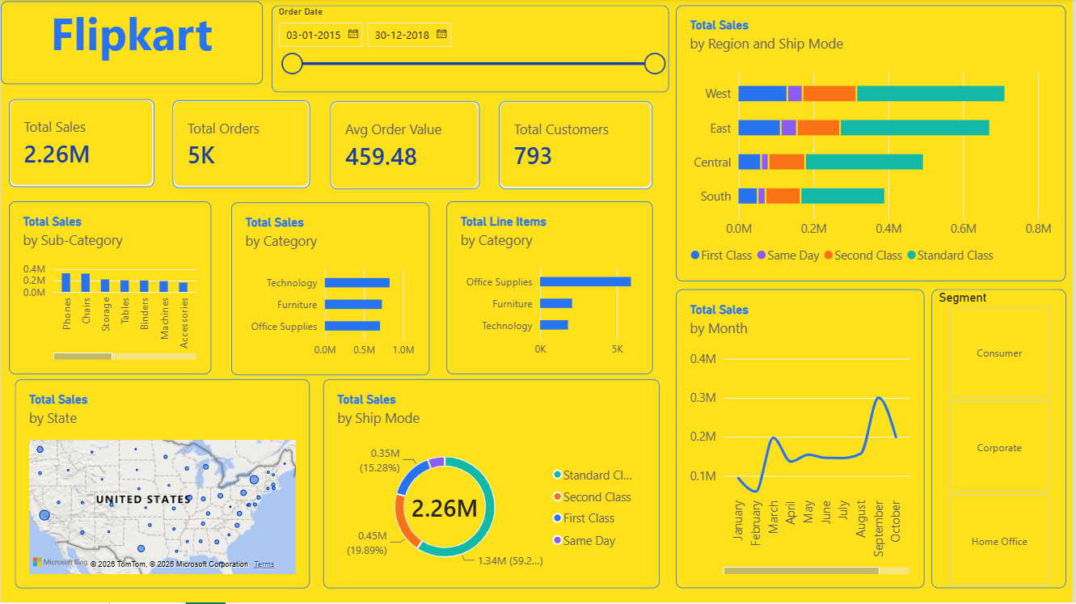
Dashboard Walkthrough

Slide 7
Thank You
Questions & Discussion
POWER BI FOR BEGINNERS | SIMPLILEARN SKILLUP
Presented by: Abhishek Rawat | Submitted to: Mr. Arpit Goel (HOD, 3rd Year)
Deptt. of Computer Science & Engineering • Uttaranchal University

