Slide 1
技术

Slide 2
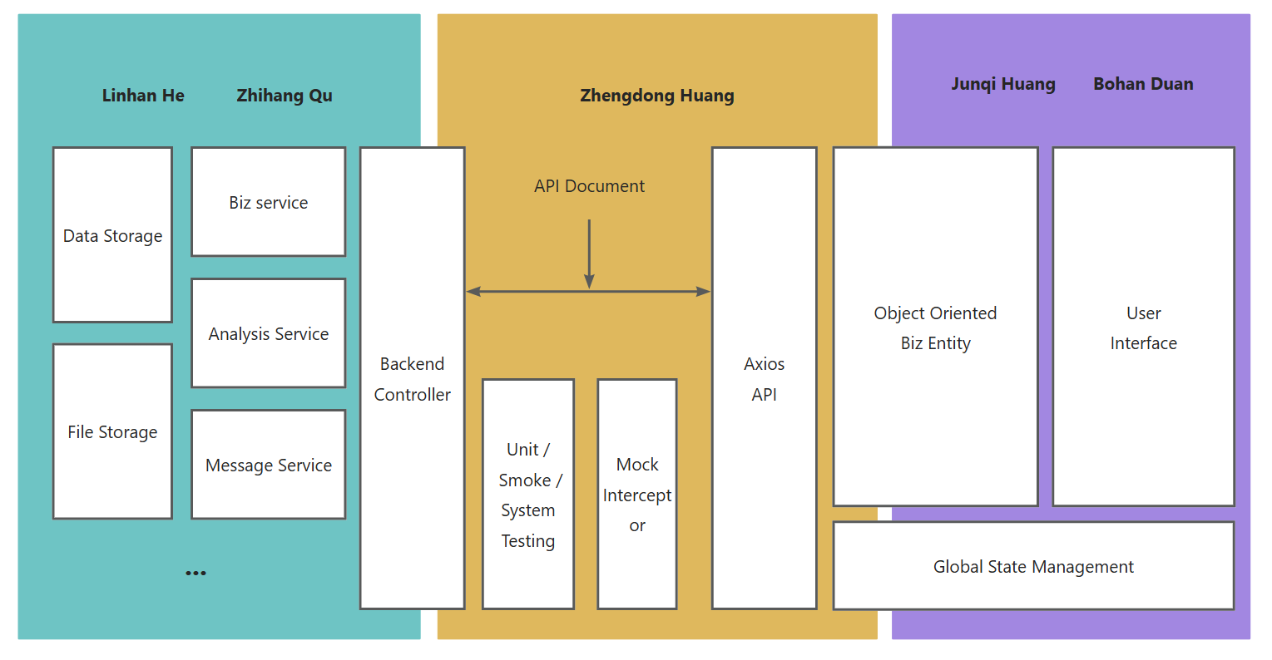
Core developing Process

Slide 3
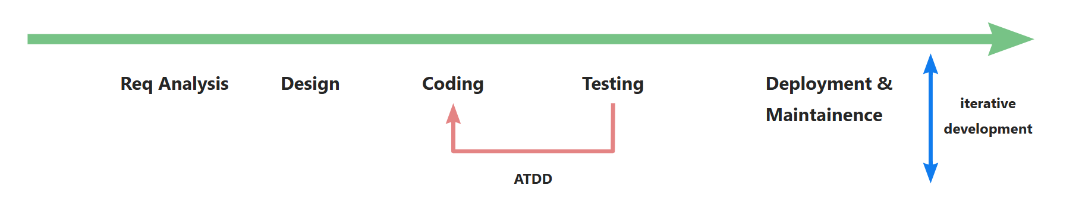
Developing Cycle
Agile Development
Iterative development
Incremental development
Acceptance Test Driven Development (ATD)
Unit Testing, Smoke / System Testing to ensure software quality
Early Requirement Analysis
Analyze project documents to determine requirements in a timely manner
Sufficient Design
Using Class Diagram and flow chart to demonstrate and sync. design
此处应有一个类图

Slide 4
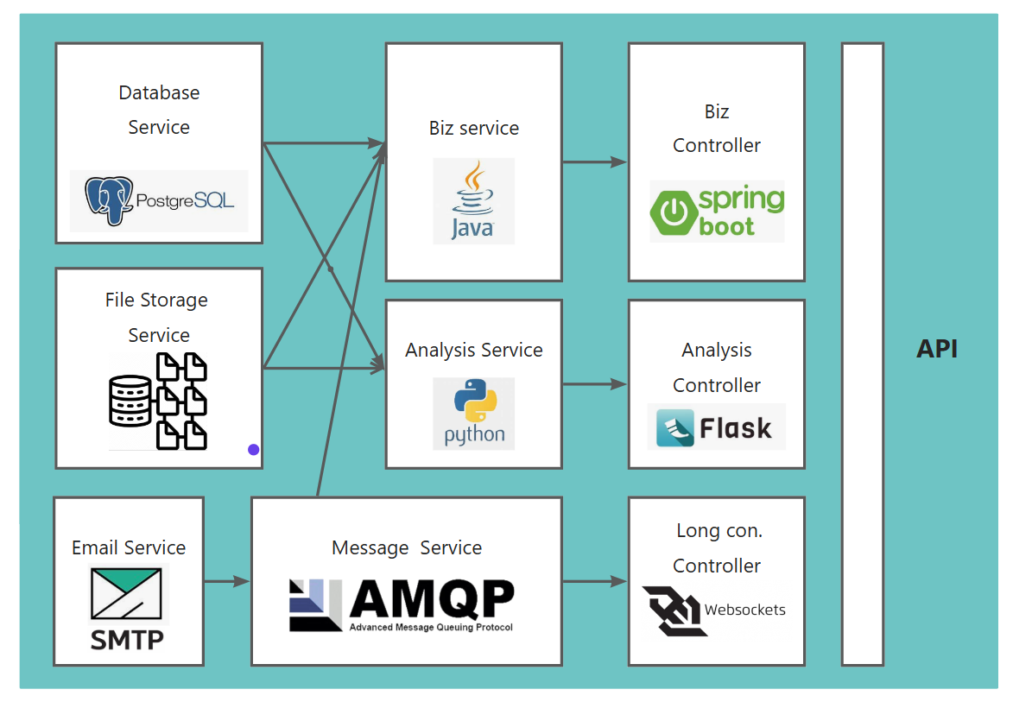
MVC model & Multiple-Service Arch.
Backend:
RESTful API design
GET/PUT/POST/DELETE/PATCH
Functionality Splitting
Decoupling
Possibility to deploy on multiple server
Robustness
Three Layer Arch.:
Controller-Service-Mapper

Slide 5
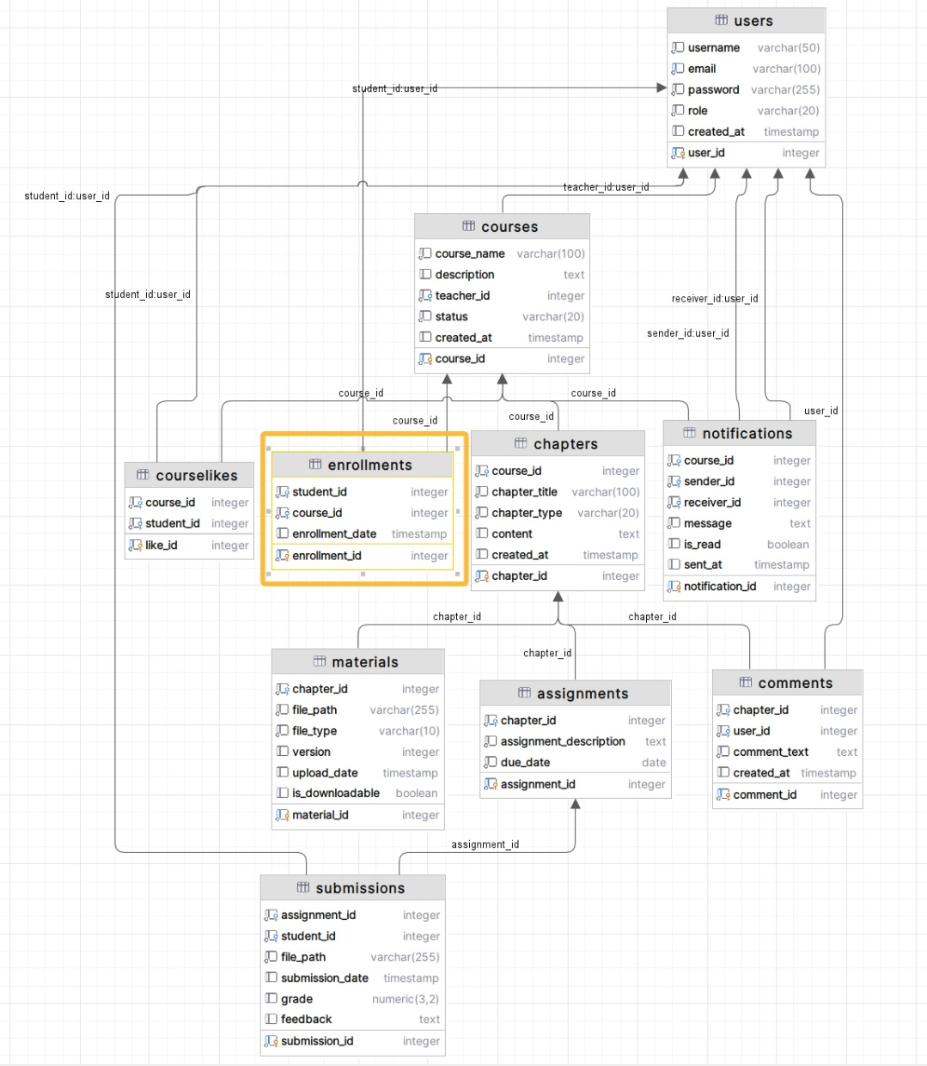
Database
Backend:
Entity-Relationship Graph
Illustrating the relationship between entities
Data management
Indexing
Trigger
Maintain data consistency at functionality layer

Slide 6
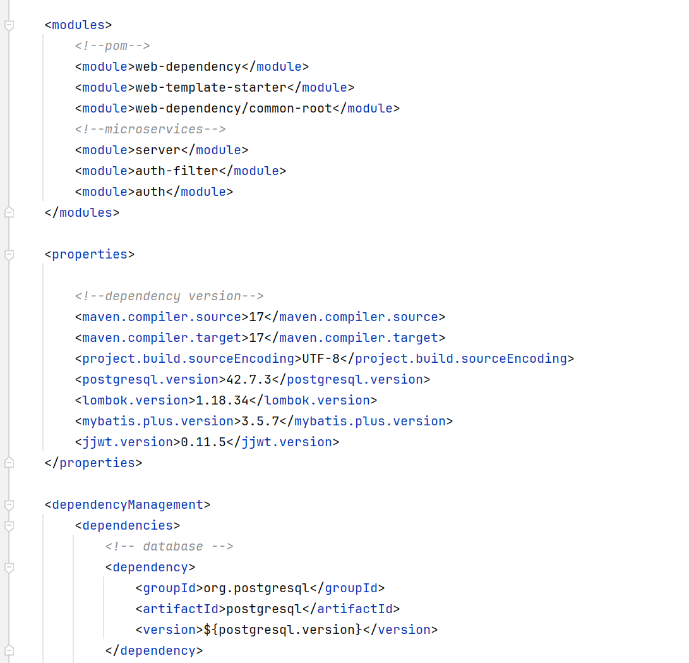
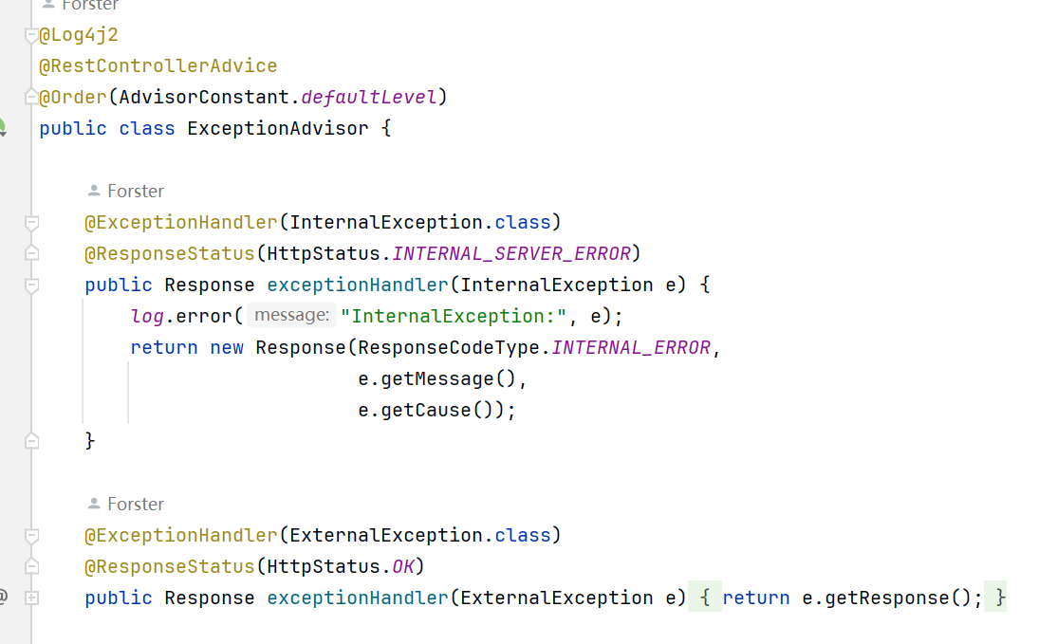
Controller & Service
Backend:
Module splitting based on maven
Dependency Management
Inheritance
Support developing cycle
Leveraging design pattern to maintain code quality
Aspect oriented programming
Spring & Annotation for IoC / DI
Factory Pattern, Adapter Pattern, Registry Pattern …

Slide 7
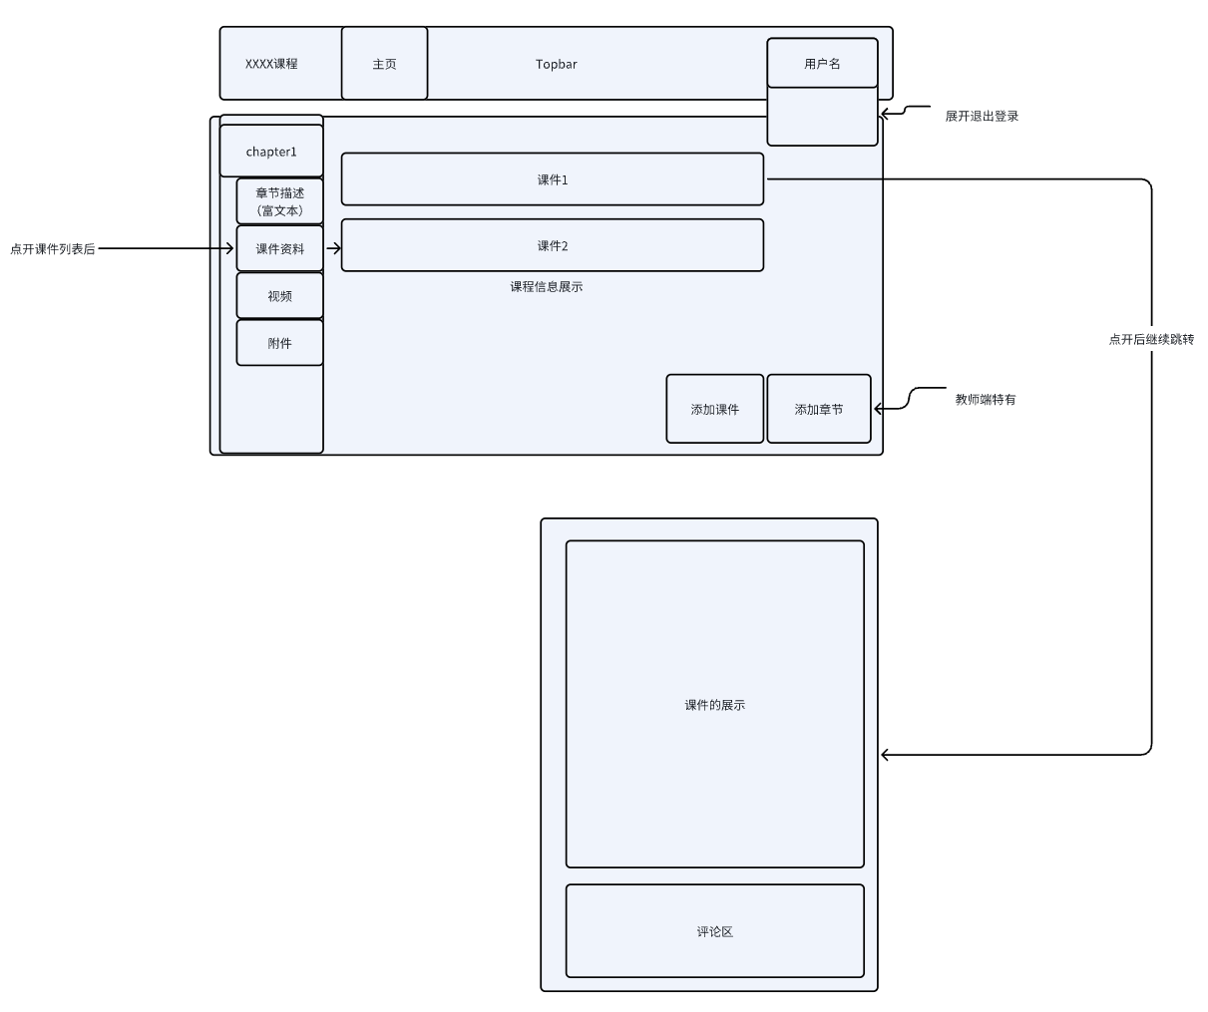
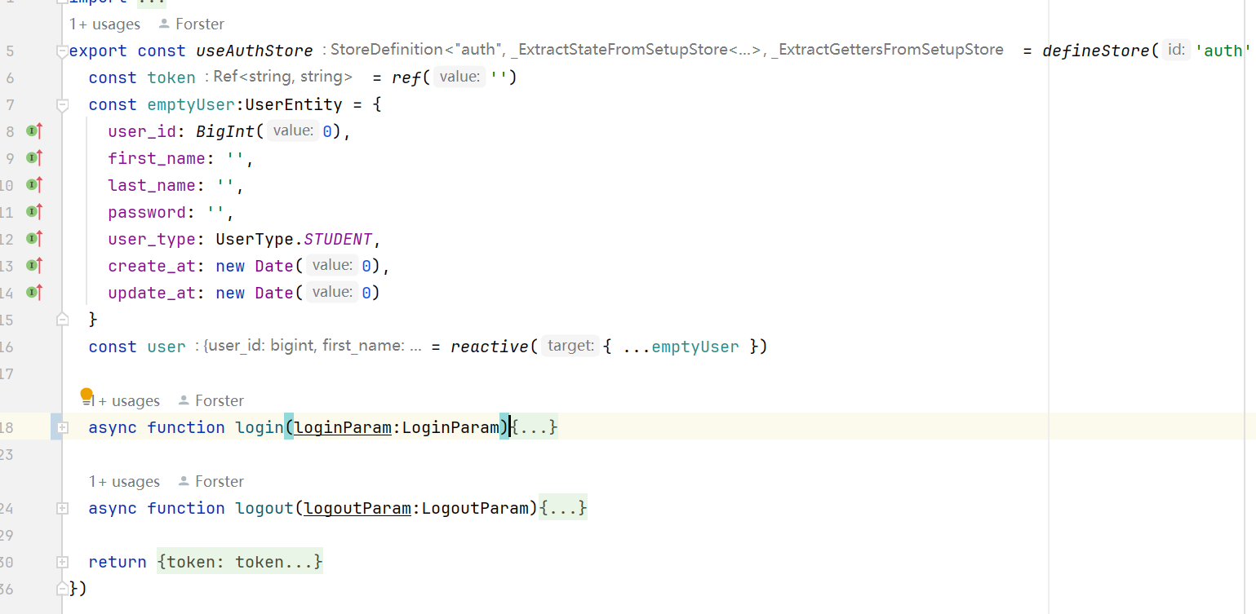
Frontend
Prototyping using sketches
Quick idea validation
Vue3+Axios+UI Dependency
Object Oriented & Singleton
Encapsulate API calls as JS objects
Singleton & Pinia for global data management
Pinia的logo

Slide 8
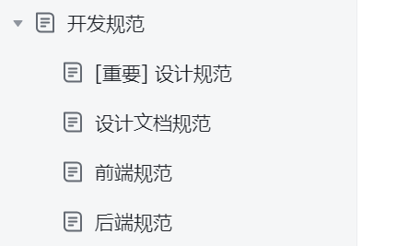
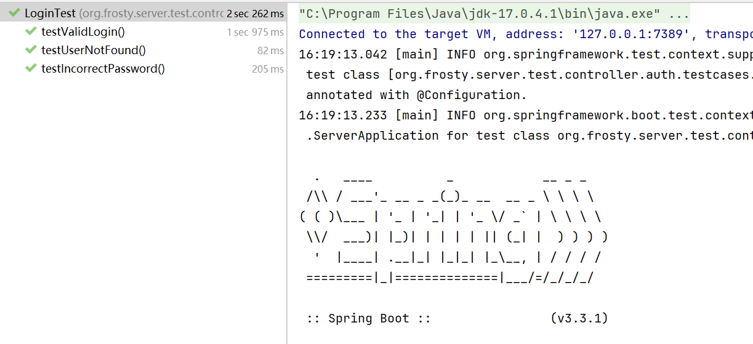
Quality Ensuring
Code Style Regulation
Based on Alibaba code specification
Functionality Testing
Unit Testing
Smoke Testing
System Testing

Slide 9
Objective
Functionality
Performance
Robustness & fault tolerant
Security
Compability
Easy deployment &maintenance
Code Quality

Slide 10
Timeline

Slide 11
Timeline
Week 1 – 3 Learning and Requirement Analysis
Week 4 – 6 Course-related functionality dev. & test.
Week 7 – 9 File-related functionality dev. & test
Week 10-11 Data analysis-related functionality dev. & test
Week 12-13 Live-Stream & other functionality dev. & test
Week 14-16 Testing, deployment and demonstration preparing

