Slide 1
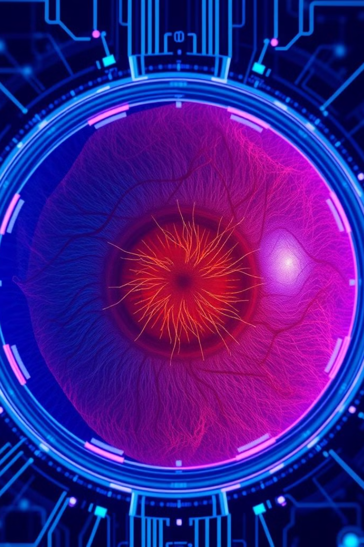
AI-Powered Diabetic Retinopathy Detection

Slide 2
Project Introduction – AI-Powered Diabetic Retinopathy Detection
Problem Statement
Our Solution
Diabetic Retinopathy (DR) is a leading cause of blindness worldwide.
AI-powered system that automatically detects & classifies DR from fundus images.
Early detection is crucial, but traditional screening is slow, expensive, and requires skilled doctors.
Uses deep learning to provide rapid, cost-effective, and scalable screening.
Rural areas suffer from a shortage of ophthalmologists, making diagnosis inaccessible.
Social Impact
Early diagnosis can prevent vision loss.
Bridges the healthcare gap for underprivileged regions.
Statistic: DR affects 450M diabetics worldwide.

Slide 3

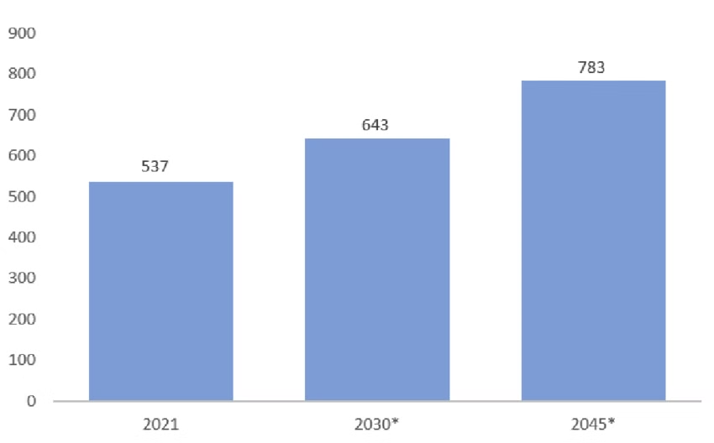



The Need for AI in Diabetic Retinopathy Screening
Global DR Statistics
Challenges in Traditional Screening
1 in 3 diabetics develops DR.
By 2045, over 700M people will have diabetes.
Limited number of trained ophthalmologists.
Expensive equipment required for manual diagnosis.
Delayed diagnosis leads to irreversible blindness.
How AI Solves This
Automates diagnosis, reducing time & cost.
Scalable to reach remote areas with limited medical resources.
More consistent & objective than human evaluation.

Slide 4



Core Technology & Innovations
Dataset & Data Strategy
Hybrid dataset approach: Combining APTOS, Messidor, EyePACS for improved generalization.
Class balancing techniques: Weighted loss function, oversampling, undersampling, and augmentations.
Preprocessing Enhancements
CLAHE (Contrast Limited Adaptive Histogram Equalization) to enhance visibility of lesions.
Image Normalization & Augmentation techniques to enhance model adaptability .
Training Innovations
Base Model: EfficientNet-B4 Transfer Learning (Pretrained on ImageNet, optimized for medical imaging).
Progressive Unfreezing → Unlocking EfficientNet layers gradually for optimal learning.
Dynamic Augmentations → Prevents overfitting by varying augmentations per batch.
Adaptive Dropout & Learning Rate Scheduling → Ensures smooth convergence.

Slide 5
Model Breakdown
1
Why EfficientNetB4?
2
Base Model
3
Classification
EfficientNetB4 achieves a higher accuracy compared to ResNet and Inception models, while utilizing significantly fewer parameters. This makes it computationally efficient and suitable for deployment on devices with limited resources.
The model is pretrained on ImageNet, a large dataset of diverse images, allowing it to capture high-level image features efficiently. This pretraining significantly reduces training time and improves generalization performance on the Diabetic Retinopathy detection task.
The model classifies the severity levels of Diabetic Retinopathy into five categories: No DR, Mild, Moderate, Severe, and Proliferative DR. Each level corresponds to specific characteristics observed in the fundus images, allowing for nuanced diagnosis and treatment planning.

Slide 6
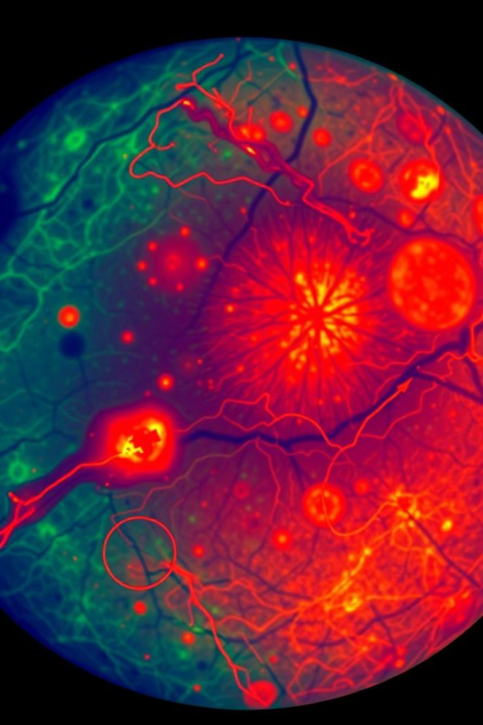
Model Performance & Validation
Metric
Value
Comparison
Accuracy
85-90%
Higher than baseline
Precision-Recall
Balanced
Accounts for class imbalance
AUC-ROC Score
0.92
Higher than naive CNNs
Model Architecture
Explainability & Trust
EfficientNet-B4 as Backbone (Pretrained on ImageNet).
Grad-CAM Visualizations → Highlights what parts of the retina AI is focusing on.
Final Layers: Global Average Pooling → Fully Connected Layer → Softmax (5-class prediction).
Doctor-in-the-loop approach → AI assists doctors but doesn't replace them.
Comparisons
AI-based DR detection outperforms standard CNN models in accuracy and consistency.

Slide 7






Future Vision & Expansion
Multi-Disease AI Platform
One unified AI diagnosis system
Beyond Retinopathy
Heart Disease, Brain Tumors, Bone Fractures
Enhanced DR Detection
Ensemble Models, Lesion Segmentation, NLP Analysis
Upcoming Features:
Ensemble Models → Combining multiple CNNs for higher accuracy.
Real-Time Data from Hospitals → Continuous model improvement & retraining.
Lesion Segmentation Model → Pinpoint exact lesion locations for doctors.
NLP-Based Symptom Analysis → Patients describe symptoms → AI suggests tests.
Collaboration Plans: Partnering with hospitals & research labs for real-world validation.

Slide 8




Conclusion & Call to Action
Why This Matters
Why We Can Achieve This
AI can revolutionize DR screening and improve global healthcare.
Even as students, we've built a sophisticated, scalable AI model backed by strong technical innovations.
Call to Action
Next Steps
Seeking mentorship & resources to improve AI performance.
Real-world testing with medical experts.
Our solution is backed by strong technical innovations.
Additional next steps include:
Deploying the model for hospital use.
Publishing research findings on AI in DR.
Collaboration with hospitals for clinical validation.
Computational limitations: EfficientNet-B6 could improve results, but we need more resources.
"AI + Healthcare = A Future Without Preventable Blindness."

