Slide 1

ETHICAL HACKING PROJECT
Spring 2018 CS378 Ethical Hacking
GROUP 10: JESSE THADEN,
VIET TRAN,
WENJIE YANG,
WESLEY CHUNG

Slide 2


MOTIVATION
-- Feel anxious to crack Wi-Fi passwords?
-- To provide a easier way to steal Wi-Fi passwords

Slide 3
What Is Evil Twin?
An “evil twin” is a kind of rogue AP. It is a fraudulent Wi-Fi access point, which tries to hook clients to connect to the fake network to steal information.

Slide 4

WHAT WE USED:
Hostapd
It is used to create a wireless hotspot.
Dnsmasq
Lightweight DNS/DHCP server. It is used to resolve dns requests from/to a machine and also acts as DHCP server to allocate IP addresses to the clients.
Apache
Runs our fake website that users get redirected to locally.
Airodump-ng, Airmon-ng, Aireplay-ng

Slide 5
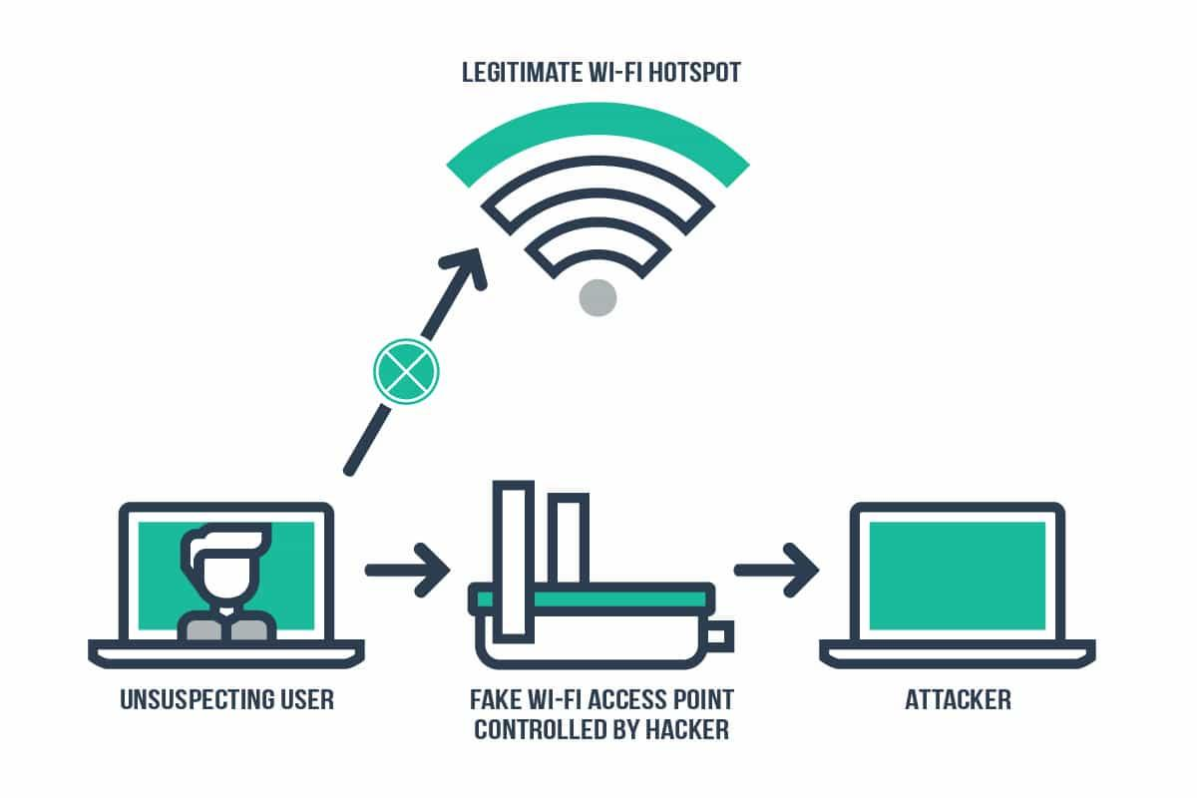
OVERVIEW
Notes:
User will get deauthed from their actual network and when they try to connect back, they might stumble upon ours and connect to it. Once they are connected to ours, they try to visit some HTTP site and get redirected to our fake website, which steals their credentials. We can then use their credentials to log onto the network to verify it works, then perhaps run some internal scan over the network.

Slide 6
STEP 1: CHOOSE THE TARGET ACCESS POINT
Run airmon-ng and airodump-ng to get a list of access points.
Let the user type in the AP they want to attack

Slide 7
STEP 2: SET UP THE EVIL TWIN
Set up a fake access point by creating a hostapd configuration file
Set up DHCP server by creating a dnsmasq configuration file
Configure iptables to reroute traffic

Slide 8
STEP 3: CREATE FAKE WEBSITE
Start the Apache server to run fake website
Wait for user to type in credentials

Slide 9
STEP 4: USE THE STOLEN CREDENTIALS
HTTP form will POST to php file that writes credentials to a file
With the stolen credentials, log into actual network and scan that network

Slide 10
PROBLEMS ENCOUNTERED
Unable to make sure our fake AP is closer or stronger than the real one
Unable to make victims automatically connect to our fake AP
Need two wireless adapters (one for deauth, other for hostapd)

Slide 11
IMPROVEMENTS
We can use some database to store credentials for future use
We can try to redirect HTTPS traffic too
Make it more deceiving

Slide 12

DEMO

