Slide 1

Spring 2018 CS378 Ethical Hacking
Group 10: Jesse thaden,
viet tran,
wenjie yang,
Wesley chung

Slide 2


Motivation
-- Feel anxious to crack Wi-Fi passwords?
-- To provide a easier way to steal Wi-Fi passwords

Slide 3
What Is Soft AP? Rogue AP? Evil Twin?
A “soft access point” can be set up on a Wi-Fi adapter. It enables a computer which hasn’t been specially made to be a router into a wireless access point.
A “rogue access point” is a wireless access point that has been installed on a secure network without explicit authorization from a local network administrator.
An “evil twin” is a kind of rogue AP. It is a fraudulent Wi-Fi access point, which tries to hook clients to connect to the fake network to steal information.

Slide 4

How to set up a fake access point?
Hostapd
It is used to create a wireless hotspot.
Dnsmasq
Lightweight DNS/DHCP server. It is used to resolve dns requests from/to a machine and also acts as DHCP server to allocate IP addresses to the clients.
Apache
Basically, it acts as a web server to the victim.

Slide 5
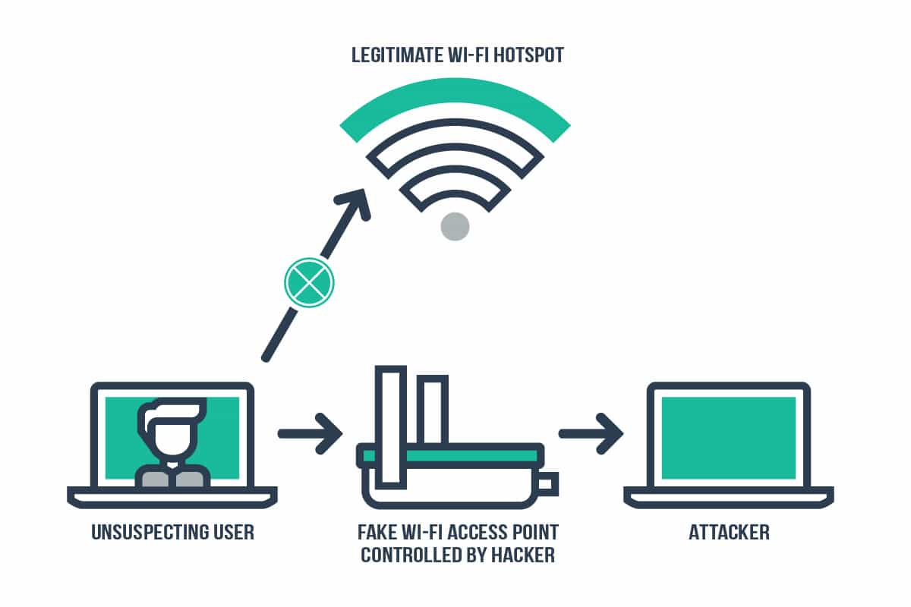
Overview

Slide 6
Step 1: Choose the target access point
Scan a network and find the router. Run airmon-ng and airodump-ng to get a list of access points.
Let user types in Access Point name

Slide 7
Step 2: Set up the evil twin
Set up a fake access point by creating a hostapd configuration file
Set up DHCP server by creating a dnsmasq configuration file
Configure iptables to reroute traffic

Slide 8
Step 3: Create fake website
Start the Apache sever to run fake website and ask victim for actual WPA2 key to the real access point.

Slide 9
Step 4: Steal WIFI PASSWORD
Redirected form to our server and store the submitted Wifi password
With the stolen credentials, log into actual network and scan that network

Slide 10
Problems Encountered
Unable to make sure our fake AP is closer or stronger than the real one
Unable to make victims automatically connect to our fake AP

Slide 11
Improvements
We can use mySQL database to store credentials for future use
We can boost our AP to the maximum power legally allowable in US.
We can use Wireshark to sniff the traffic.
We can use Ettercap to conduct a man-in-the-middle attack.

Slide 12

Demo

