Slide 1
summer camp
Project #51
Mykhailo Dubas

Slide 2
IDEA
Create a web freelancing platform
Employers would hire project teams and freelancers would organize teams

Slide 3
problem
Employer
complicated team building
responsible for control a team of freelancers
individual communication with each freelancer
integration of work of each freelancer
Freelancer
work with unfamiliar freelancers
difficult to enter a team
lack of a common way to organize work

Slide 4
Solution
Employer
Delegate to a team manager
project control
responsibility for finishing the project
communication with a project team
Freelancer
work under a common technology
work according to the team rules
reputation inside a team guarantee a future cooperation

Slide 5

competitors
 | Upwork | Kabanchik | SummerCamp
Hire a project team
Organize team
Vacancies in a team
Individual orders for freelancers
Platform
Feature

Slide 6
market
Our part of the market is 5% of the market of the salary, what is $3,500,000 per year
Service income is 10% of wages of freelancers at our platform, what is $350,000 per year

Slide 7
Marketing strategy
Marketing goal: 5% of the market
To reach this we will do:
Advertisement in services for employers
Advertisement in cooperation services
Articles in web-communities like habrahabr and dou
Cooperation with job search services
Affiliate program for customers and freelancers

Slide 8
Current state
Have run the survey among the target audience
Server side complition 60%, user interface 25%
Developed: customer and freelancer pages, registration, authorization, team managing and project creation services

Slide 9
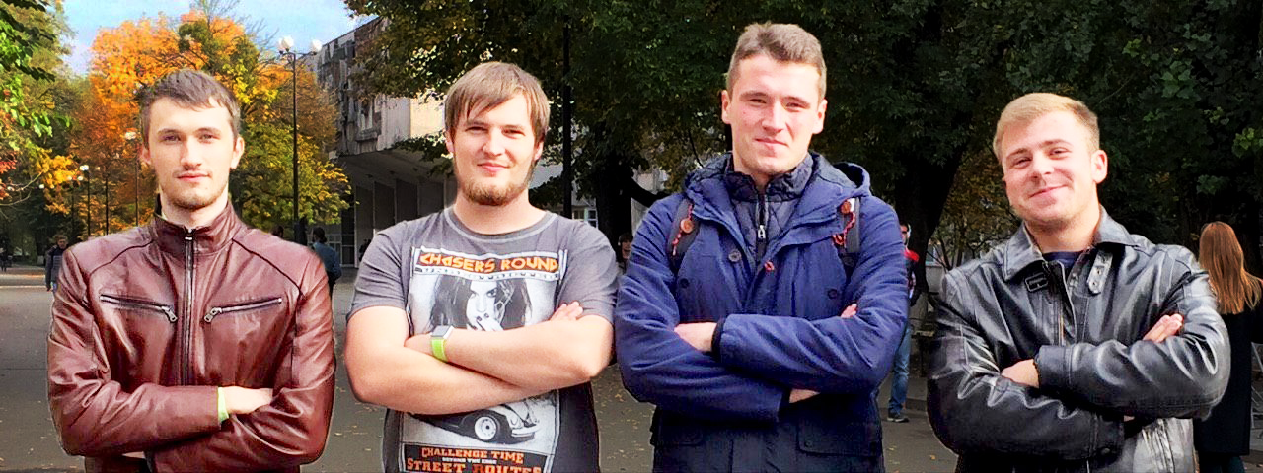
Project team
Maksym Hilliaka
Developer
Yaroslav Mytsio
Leader
Developer
Oleh Holovko
Developer
Mykhailo Dubas
PR-manager
Marketing
Team work experience — more than 3 years
Freelancing experience – more than 2 years

Slide 10
Offer for investors
MVP development (6 months):
design | $3,000
interface development | $5,000
Sum: $8,000
Market entrance (6 months):
testing | $4,000
marketing company | $20,000
servers | $1,000
conferences, fairs | $11,000
Sum: $36,000

