Slide 1
Quatrefoil
Corey Medland (P2716681)

Slide 2
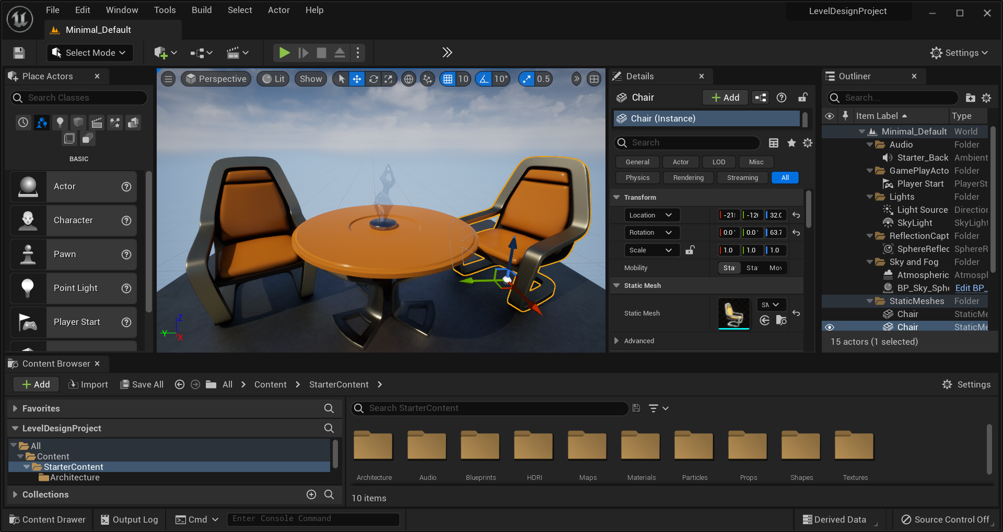

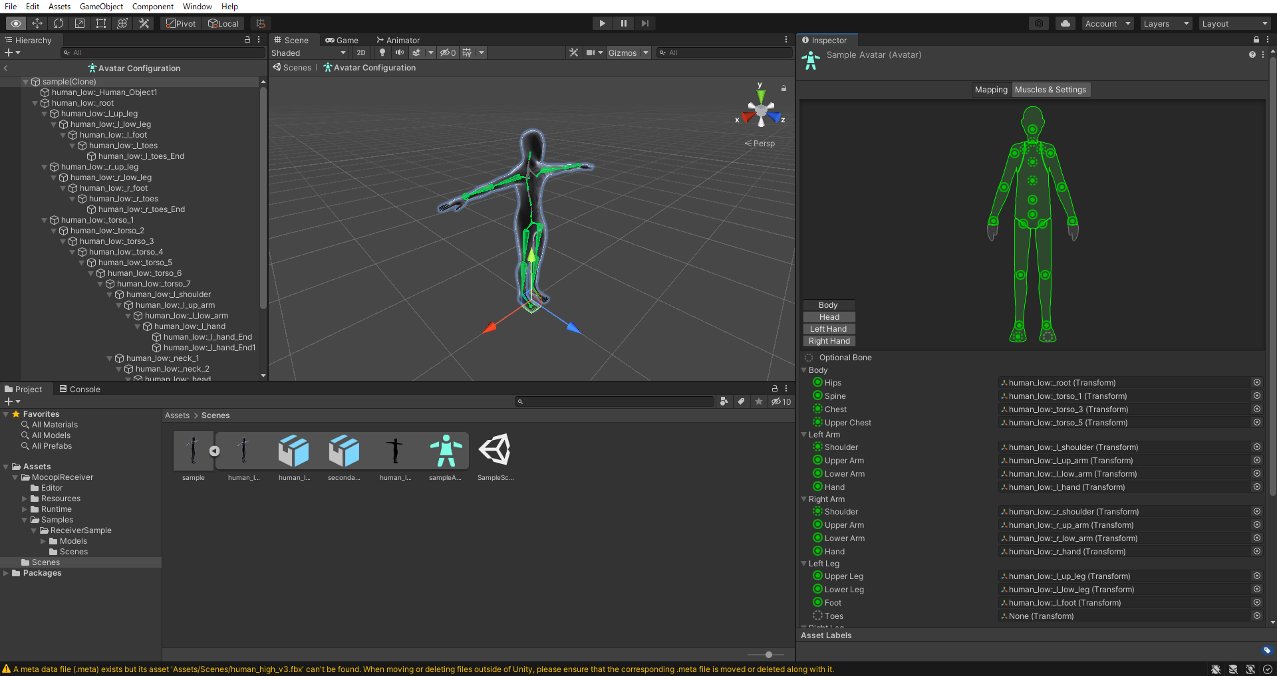

What is a code first game engine?
Game engine that prioritizes coding as the primary method of interacting with and customizing the engine.
Contrary to traditional game engines.

Slide 3
Why make a code first engine? - 3 reasons
Maximum control
Learning
Flexibility
Having everything manipulatable in code, there are no limits to what can be added or changed. If the user wants to add something highly specific, it can be done.
Making a code first engine truly allowed me to understand how and game engine is ran behind the scenes.
Being driven purely by code and no fancy GUI, this does mean that it is viable for any project, whether it is 2D, 3D, shader driven, or more!

Slide 4

What is Opengl?
An API for rendering 3D and 2D graphics.
Allow the use of a GPU to accelerate graphic rendering.

Slide 5
Features of quatrefoil
ECS (entity component system)
Shader Support
The whole engine is built around an ECS. This allows for easy access to all entities and more flexibility with code. Limits the potentiality of having hundreds of classes.
Utilizes shaders to allow the GPU to be used. This helps performance greatly, and can also allow for post processing.
Texture loading
GUI support
Using stb_image.h, a popular image loading header file, textures can be used and loaded In game.
While still being a code first engine, having debug ui is massively helpful. Using dear ImGui, debugging tools can be used during runtime to edit member variables , and access vital information that can only be tested at runtime.

Slide 6
Engine structure.
Engine Core.
This is what handles the main loop of the project and also loads all necessary packages.
Renderer.
This is what is used to draw all entities to the screen, via the Renderable component.
Game Layer.
The heart of the game and where the logic is made, this attaches to the engine , where its code is ran every frame.

Slide 8
COMPANY OVERVIEW

Slide 9
BUSINESS MODEL
ABSTRACT
We based our research on market trends and social media
DESIGN
We believe people need more products specifically dedicated to this niche market
RESEARCH
Minimalist and easy to use

Slide 10
MARKET OVERVIEW
£3 Billion
£1 Billion
£2 Billion
Freedom to invent
Selectively inclusive market
Serviceable available market
Opportunity to build
Fully inclusive market
Total addressable market
Few competitors
Specifically targeted market
Serviceable obtainable market

Slide 11
Market comparison
£3B
£2B
£1B
Opportunity to build
Freedom to invent
Few competitors
Addressable market
Serviceable market
Obtainable market

Slide 12
OUR COMPETITION
CONTOSO
COMPETITORS
Our product is priced below that of other companies on the market
Design is simple and easy to use, compared to the complex designs of the competitors
Affordability is the main draw for our consumers to our product
Company A Product is more expensive
Companies B & C Product is expensive and inconvenient to use
Companies D & E Product is affordable, but inconvenient to use

Slide 13
Our competition
Convenient
Contoso
Competitor A
Affordable
Expensive
Competitor D
Competitor C
Competitor B
Competitor E
Inconvenient

Slide 14
Growth strategy
Feb 20XX
Roll out product to high profile or top-level participants to help establish the product
Mar 20XX
Release the product to the general public and monitor press release and social media accounts
Oct 20XX
Gather feedback and adjust product design as necessary

Slide 15
TRACTION
Forecasting for success
Key Metrics
 | Clients | Orders | Gross revenue | Net revenue
20XX | 10 | 1100 | £10,000 | £7,000
20XX | 20 | 200 | £20,000 | £16,000
20XX | 30 | 300 | £30,000 | £25,000
20XX | 40 | 400 | £40,000 | £30,000
REVENUE BY YEAR

Slide 16
TWO-YEAR ACTION PLAN
DRAFT BLUEPRINTS
GATHER FEEDBACK
DELIVER TO CLIENT
20XX
JAN
FEB
MAR
APR
MAY
JUN
JUL
AUG
SEP
OCT
NOV
DEC
20XX
JAN
FEB
MAR
APR
MAY
JUN
JUL
AUG
SEP
OCT
NOV
DEC
RUN FOCUS GROUPS
TEST DESIGN
LAUNCH DESIGN

Slide 17
FINANCIALS
 | Year 1 | Year 2 | Year 3
INCOME
Users | 50,000 | 400,000 | 1,600,000
Sales | 500,000 | 4,000,000 | 16,000,000
Average price per sale | 75 | 80 | 90
Revenue @ 15% | 5,625,000 | 48,000,000 | 216,000,000
GROSS PROFIT | 5,625,000 | 48,000,000 | 216,000,000
Expenses
Sales & marketing | 5,062,500 | 38,400,000 | 151,200,000 | 70%
Customer service | 1,687,500 | 9,600,000 | 21,600,000 | 10%
Product development | 562,500 | 2,400,000 | 10,800,000 | 5%
Research | 281,250 | 2,400,000 | 4,320,000 | 2%
TOTAL EXPENSES | 7,593,750 | 52,800,000 | 187,920,000

Slide 18




MEET THE TEAM
TAKUMA HAYASHI​
MIRJAM NILSSON​
FLORA BERGGREN​
RAJESH SANTOSHI​
President
Chief Executive Officer
Chief Operations Officer
VP Marketing

Slide 19








MEET THE TEAM
TAKUMA HAYASHI
MIRJAM NILSSON​
FLORA BERGGREN​
RAJESH SANTOSHI
President
Chief Executive Officer
Chief Operations Officer
VP Marketing
GRAHAM BARNES
ROWAN MURPHY
ELIZABETH MOORE
ROBIN KLINE
VP Product
SEO Strategist
Product Designer
Content Developer

Slide 20
FUNDING
£14,000
£12,000
£82,000
£32,000
ANGEL INVESTMENTS
PROPERTY
SHARES
CASH
Amount obtained through other investors
Revenue obtained from property rentals
Number of shares converted into USD
Liquid cash we have on hand

Slide 21
SUMMARY
At Contoso, we believe in giving 110%. By using our next-generation data architecture, we help organisations virtually manage agile workflows. We thrive because of our market knowledge and great team behind our product. As our CEO says, "Efficiencies will come from proactively transforming how we do business.”

Slide 22
THANK YOU
Mirjam Nilsson​
206-555-0146
mirjam@contoso.com
www.contoso.com

