Slide 1
Predicting DEM label-free

Slide 2
Part 1
Problem and approach

Slide 3
Same physics, different training signal
Solvers (BP, ElasticNet) run one optimisation per pixel: accurate, but slow at full resolution.
Supervised
learns the solver's DEMs
Observed AIA
6 channels
Model
DEM
18 bins
Solver's DEM
label
loss
Label-free (unsupervised)
learns the solver's objective implicitly
Observed AIA
6 channels
Model
DEM
18 bins
Predicted AIA
via response R
Observed AIA
6 channels
loss
We never train on the solver's DEMs; we use them only to evaluate.
Notes:
The audience knows the inverse problem. This slide only says what is different about our training signal. BP and ElasticNet solve one optimisation per pixel. A supervised network learns to reproduce the solver's DEMs, so it needs them as labels. Ours learns to minimise the solver's objective directly, so it never sees a solver DEM; we use those only to evaluate.

Slide 4
The model: a small MLP feeding a fixed forward model
Observed AIA
6 channels
MLP
176k params
Basis weights
54, same as solver
DEM
18 bins, logT 5.5–7.2
Predicted AIA
via response R
Loss: the solver's objective, predicted against observed AIA
6 log-intensities in; 4 hidden layers of 232, SiLU; 54 non-negative basis weights out.
BP and ElasticNet solve for the same 54 weights (at each of 18 bins, a spike and Gaussians 0.1 and 0.2 dex wide), and their L1 term acts on those weights.
DEM = B·w over 18 bins; predicted AIA = R·DEM. B and R are fixed; only the MLP is learned.
176k parameters; one forward pass per pixel.
Notes:
The solvers never solve for the 18 bins directly: both solve for weights on a fixed basis, a spike and two Gaussians at each bin, and report DEM = B times x. We predict the same weights, so the network searches the same space of DEMs the solver does, and BP's sparsity criterion means the same thing for both. Only the MLP is learned. Per pixel: six log-intensities in, four hidden layers of 232 with SiLU, 54 non-negative basis weights out; DEM = B times w over 18 bins, logT 5.5 to 7.2; predicted AIA = R times DEM. 176k parameters, one forward pass per pixel.

Slide 5
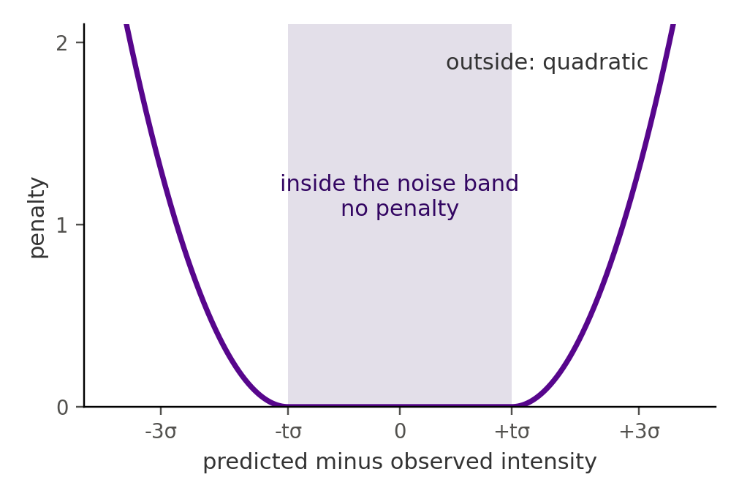
The loss is the solver's own objective
BP track
L = Σ_{c} [ max(0, |ŷ_{c} − o_{c}| − tσ_{c}) / tσ_{c} ]² + Σ_{k} w_{k}
Zero inside the noise band (t = 1.4), quadratic outside.
Then the L1 term picks the sparsest DEM that fits: BP's criterion.
ElasticNet track
L = (1/2C) Σ_{c} [ (ŷ_{c} − o_{c}) / tσ_{c} ]² + αλ Σ_{k} w_{k} + ½α(1−λ) Σ_{k} w_{k}²
The solver's settings: α = 0.001, λ = 0.5, C = 6.
The BP band penalty for one channel.
In both: ŷ = R·B·w, with w ≥ 0.
Notes:
BP track: the penalty is zero anywhere inside the noise band, o plus or minus 1.4 sigma, and quadratic outside, scaled by the band width. There is no fit term inside the band, so any DEM within noise is equally good, and the L1 term on the basis weights then picks the sparsest one: BP's own criterion. ElasticNet track: the solver's ElasticNet objective with its settings, alpha 0.001, l1 ratio 0.5, C equal to the six channels, using the same noise scaling. In both, y-hat is R times B times w, and w is non-negative.

Slide 6
Data: two years of full-disk AIA, split in time
Train
917 images
Validation
153
Test
153
Jan 2014
Jun 2015
Sep 2015
Dec 2015
SDO/AIA, 6 EUV channels, about two images a day in 2014–2015: 1,223 full-disk images.
PSF-deconvolved (Hofmeister); a noise σ per pixel and channel from the AIA error model; DEMs on a 2048² grid.
Our model trains on AIA and σ only: each training image is cut into 64 blocks of 256×256 per image. Each epoch draws 512 random pixels from each of the 58,688 blocks(917*64), for 40 epochs.
Solver DEMs (BP, ElasticNet) for every image: labels for the supervised model, evaluation only for ours.
Test: ~700M pixel DEMs per solver, the clean solve plus 4 noise re-solves(only supervised).
Notes:
The split is chronological, so every test image is later than anything seen in training. Each epoch draws 512 pixels from each of 58,688 training blocks: 917 images times 64 blocks of 256 squared. The test set uses 64 random 128-squared blocks of each test image per solver target, five targets per image: one clean solve and four re-solves under simulated photon noise of the same observation. Pixels where deconvolution clamped a bright channel to zero, about 5%, are excluded.

Slide 7
Part 2
Finding a trainable objective

Slide 8
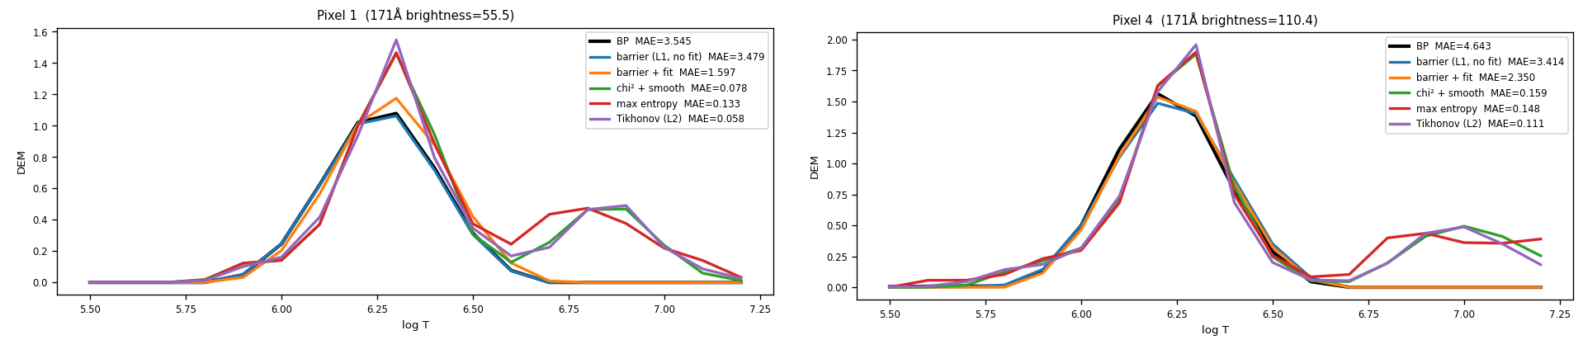
Six channels underdetermine the DEM: the regulariser picks it
Before any network: five losses optimised directly, pixel by pixel, on 4 timestamps, each compared with BP.
Fit-only losses (χ² + smoothness, max entropy, Tikhonov) reconstruct AIA ~12x better than BP, yet land ~5x further from its DEM.
BP's own terms (noise band + L1) land on BP's DEM: MAE 0.03 vs 0.18–0.20.
Two example pixels; BP in black. Legend MAE is AIA reconstruction error.
So the network has to train on the solver's objective, not on fit.
Notes:
Before any network, five losses optimised directly per pixel on 4 timestamps. Averages: AIA MAE against the observation, BP 5.2, barrier 5.0, barrier plus fit 2.6, fit-only 0.40 to 0.44. DEM MAE against BP: barrier 0.034, barrier plus fit 0.043, fit-only 0.18 to 0.20. W1 on the brightest 5% of pixels: 0.030 and 0.033 against 0.15 to 0.18. Six equations, eighteen unknowns: many DEMs fit within noise, so whatever breaks the tie decides the shape. L-BFGS and Adam reach the same curves; SGD often fails to converge.

Slide 9
Part 3
Architecture on small data

Slide 10
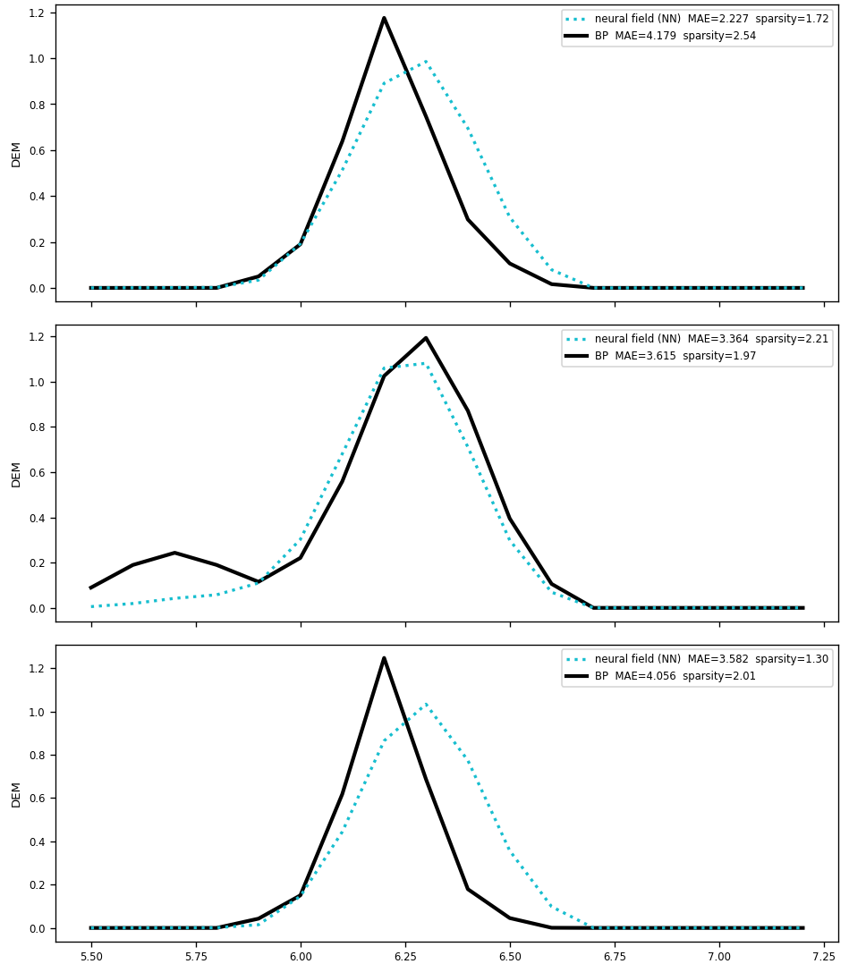
A per-pixel MLP drew noisy DEMs; a patch CNN fixed it
First try: the 6 intensities of one pixel → MLP (213k params) → 54 weights, trained on the BP loss over ~221k pixels. The loss converged, but per-pixel curves oscillated.
Patch CNN: a 9×9 neighbourhood → CNN (~1.5M params) → 54 weights. Smooth, single-peaked curves at BP's temperatures, sparsity close to BP's on held-out pixels.
Trained on one image, then on all 4 jointly; zeroing the neighbourhood for 10% of batches kept it usable on a single pixel.
Patch CNN (dotted) vs BP, X2.1 flare image.
Notes:
All of Part 3 uses four images: two X-class flares, quiet Sun and moderate activity. The first MLP is the same architecture as today's production model, four hidden layers with SiLU and a softplus output, at width 256 with raw intensities as input. Its noise was put down at the time to the overlapping basis amplifying small weight errors, and to the problem's non-uniqueness. Its checkpoint was not kept, so there is no figure of it.

Slide 11
Ablation: the noise was capacity, not missing context
BP 1.79
Patch CNN
1.70
Shuffled-patch CNN
1.88
Centre-pixel MLP
1.89
Flat-patch MLP
1.95
1.6
1.7
1.8
1.9
2.0
Effective number of active basis weights, mean over 4 images (lower = sparser).
Four variants at ~1.45M params, same BP loss, same 4 images.
A centre-pixel MLP this size was smooth too: the first MLP's noise was not about the neighbourhood.
The patch CNN was sparsest, but measured on held-out pixels of the training images.
Notes:
The shuffled-patch CNN applies a fixed random permutation to the 81 patch pixels and nearly matches the CNN, so the gain came from neighbouring values more than from geometry. The flat-patch MLP was erratic across images: 1.61 on the X2.1 flare, 2.27 on quiet Sun. Capacity and setup were never fully separated: the 213k MLP took raw intensities, and at full scale a 176k MLP on log1p inputs is smooth.

Slide 12
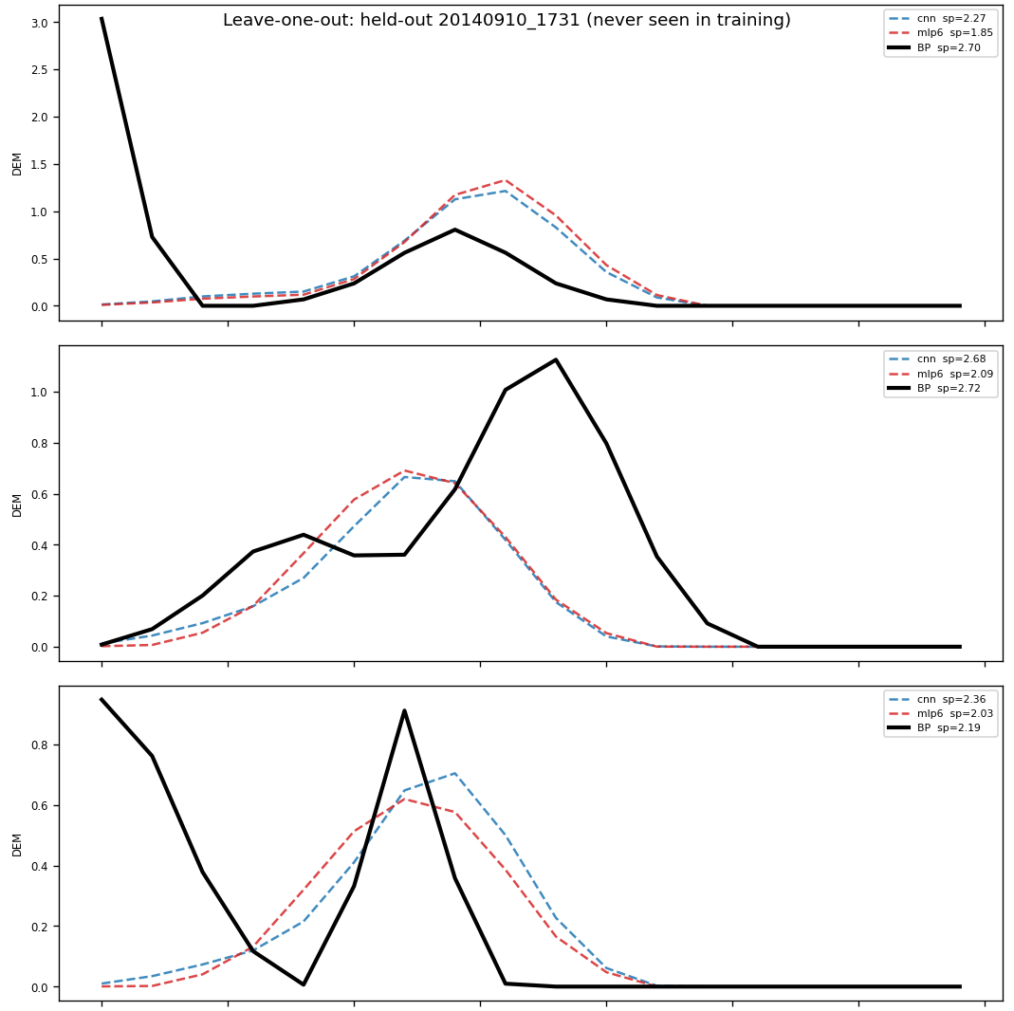
On unseen days, the patch CNN's edge disappeared
Leave one image out: train on 3, test on the 4th; patch CNN and centre-pixel MLP, 4 folds.
Held-out sparsity: CNN lower on 1 day, MLP on 2, tied on 1; the MLP fit AIA better on 3 of 4.
Little overfitting (held-out within ±0.2 of in-sample on 3 folds), except the X1.6 flare: peaks too cool (logT ~6.1 vs BP ~6.4), with one other flare image in training.
Carry the simpler centre-pixel MLP forward, and get more flare data → scaling.
Held-out X1.6 flare image: CNN and MLP (dashed) vs BP.
Notes:
Held-out sparsity by fold, MLP against CNN, with BP in brackets: X2.1 flare 1.59 vs 1.64 (1.97); quiet Sun 1.78 vs 1.61 (1.67); moderate 1.83 vs 1.83 (1.82); X1.6 flare 1.96 vs 2.31 (1.71). The ablation's in-sample edge, 1.70 vs 1.89, came from scoring pixels of images the model trained on. Four folds is a small sample; scaling is the real test.

