Slide 1
Predicting DEM label-free
A neural DEM inversion trained on the solver's objective, not its labels
Progress update · October 2026
Notes:
What we built since June, what each experiment taught us, how it compares with the supervised model, and the one failure mode that remains.

Slide 2
Outline
1
2
3
4
Approach
What we tried
How it compares
Where it fails
Train on the solver's objective
Losses, architectures, scale, model size
Matched test against the supervised model
Bright pixels, traced to flare cores
Notes:
Four parts. Most of the time goes to parts 3 and 4.

Slide 3
Approach: learn the solver's objective, not its answers
Observed AIA
6 channels
MLP
176k params, per pixel
Basis weights
54, all ≥ 0
DEM
18 bins, logT 5.5–7.2
Predicted AIA
via response R
Loss = the solver's objective on predicted vs observed AIA
BP: fit within the noise band + L1 sparsity · ENet: ElasticNet
Solver DEMs are never used in training, only to evaluate.
1,223 timestamps, split by day: 917 train, 153 validation, 153 test.
Notes:
Same physics as the solvers. The network maps each pixel's six AIA intensities to 54 non-negative basis weights; the fixed basis gives an 18-bin DEM (logT 5.5 to 7.2); the AIA response projects it back to six intensities. The loss is the solver's own objective: for BP a barrier version of the tolerance band |RDx - o| <= t sigma plus an L1 term; for ENet the ElasticNet objective. Solver DEMs are never used in training, only to evaluate. Data: 1,223 Hofmeister-deconvolved timestamps, split by timestamp 917 / 153 / 153.

Slide 4
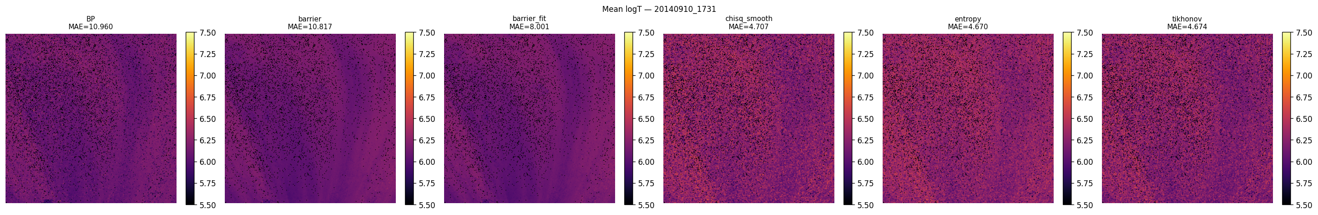
Barrier-style losses reproduce BP; fit-only losses do not
Optimised 5 differentiable losses directly per pixel, against BP.
Fit-only losses reconstruct AIA better but lose BP's sparse shape.
Lesson: the sparsity term, not the AIA fit, makes a DEM BP-like.
Mean logT maps, X1.6 flare timestamp. Left to right: BP, barrier, barrier-fit, χ² smooth, entropy, Tikhonov.
Notes:
June. Direct per-pixel optimisation of five differentiable losses on four timestamps, compared with BP. Barrier and barrier-fit track BP's temperature structure and were closest to BP on MAE and Wasserstein distance. Chi-square smooth, entropy and Tikhonov reconstruct AIA better but drift from BP's shape because they lack its sparsity term. L-BFGS and Adam reach the same curves; SGD often fails to converge.

Slide 5
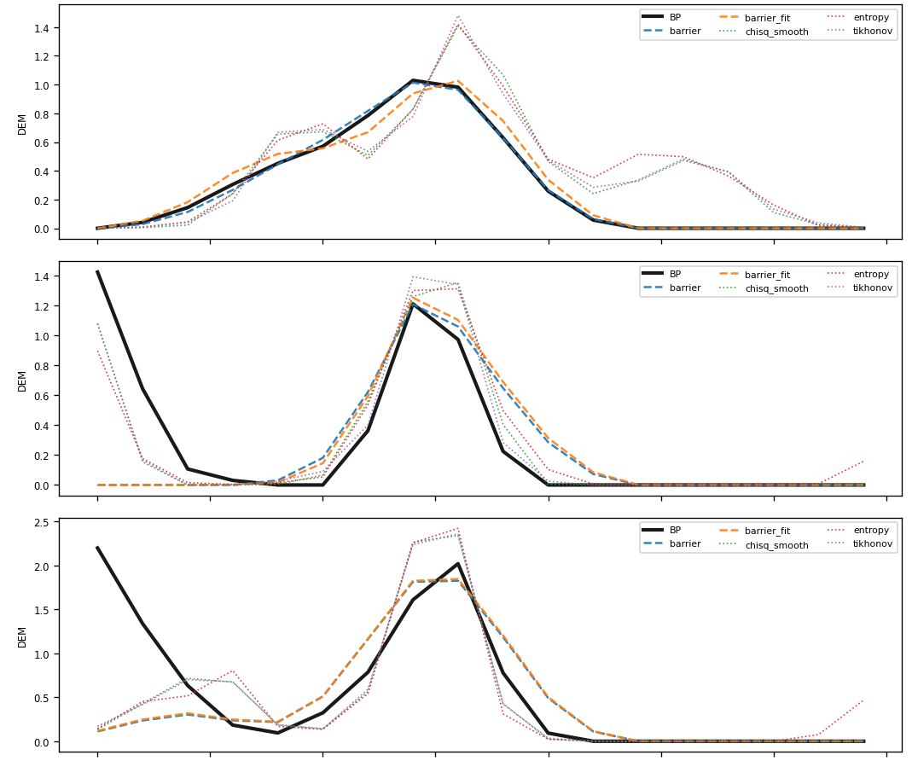
A 6-channel network fit the loss but drew noisy DEMs
Trained on the barrier loss over ~221k pixels from 4 timestamps.
The loss converged, yet per-pixel curves oscillated.
Six numbers constrain 18 bins: small basis errors become wiggles.
Next question: does spatial context help?
BP (black) against the network and direct optimisation, X2.1 flare.
Notes:
Mid-June. A per-pixel network from the six intensities, trained directly on the barrier loss over about 221k pixels from four timestamps. The loss converged, but individual curves oscillated compared with BP and with direct optimisation. Six numbers constrain eighteen bins, so small errors in the overlapping basis functions show up as wiggles. This is what pushed us toward giving the network spatial context.

Slide 6
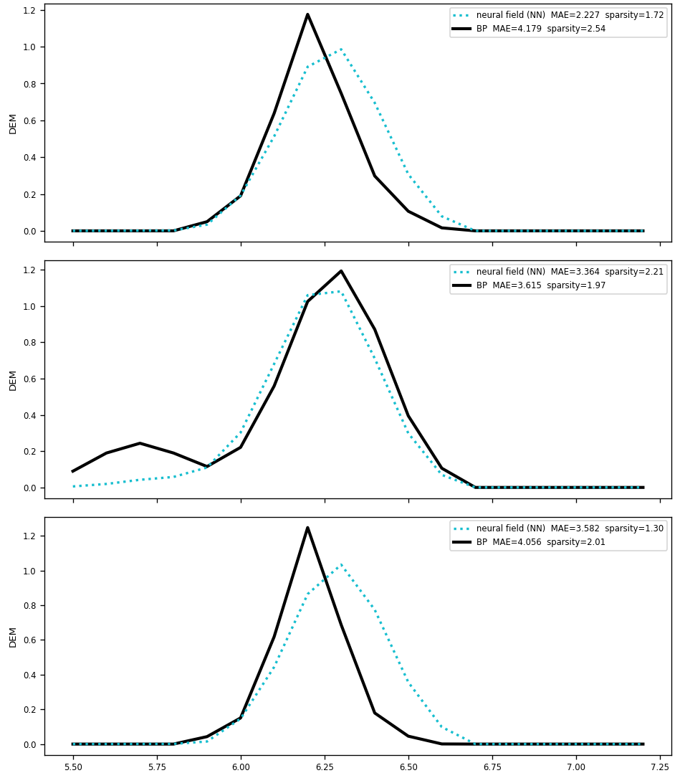
Seeing the neighbourhood gave smooth, BP-like curves
Patch CNN: each pixel sees its 9×9 neighbourhood.
One image, then 4 timestamps, then neighbourhood masking.
Caveat: held-out pixels of seen images, not unseen days.
Timestamp | Network | BP
X2.1 flare | 1.84 | 1.97
Quiet Sun | 1.58 | 1.67
Moderate activity | 1.47 | 1.82
X1.6 flare | 1.86 | 1.71
Sparsity of basis weights on held-out pixels; lower is sparser.
BP (black) and the patch CNN, X2.1 flare.
Notes:
Late June. The patch CNN sees each pixel's 9x9 neighbourhood. Built in three steps: one image, then amortised across four timestamps, then with neighbourhood masking (10% best). Curves became smooth and single-peaked at the right temperatures, with sparsity close to BP's. Caveat at the time: validation pixels came from the same four images, so this was not yet a test on unseen days.

Slide 7
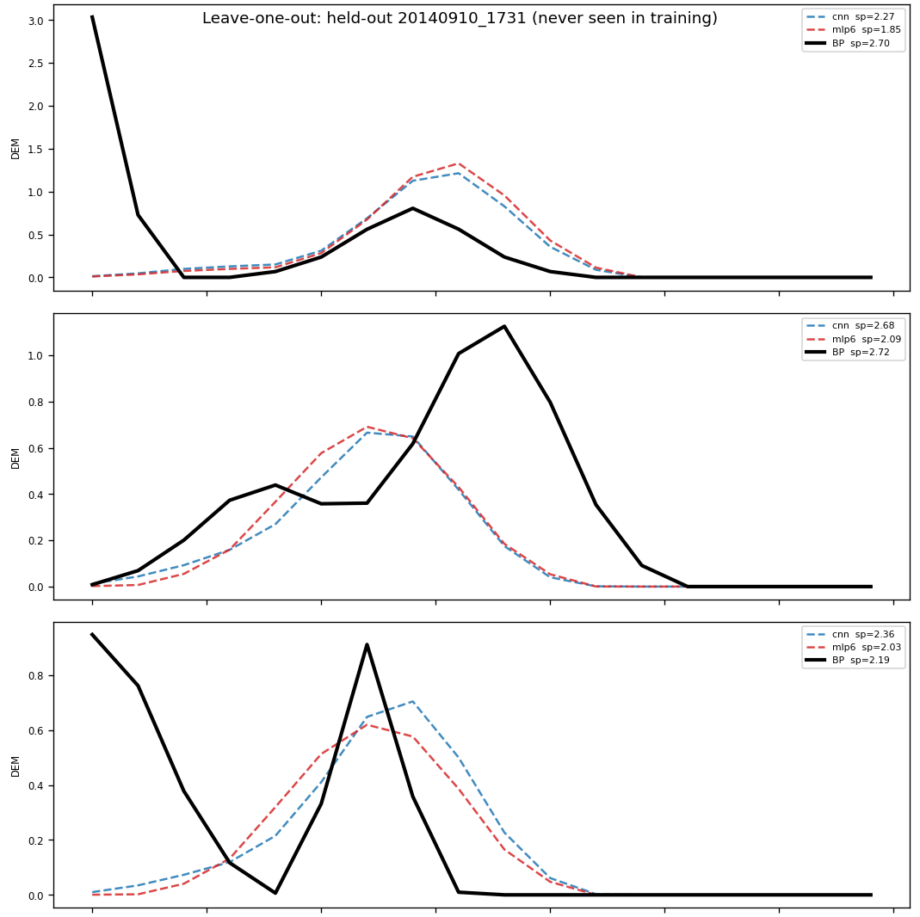
On unseen days, the patch CNN's advantage disappeared
Capacity-matched ablation: a centre-pixel MLP is smooth too.
Leave one day out: MLP wins 2 of 4, ties 1, incl. the flare.
Lesson: in-sample scores flattered the CNN.
Held-out day | Patch CNN | Centre MLP
X2.1 flare | 1.64 | 1.59
Quiet Sun | 1.61 | 1.78
Moderate activity | 1.83 | 1.83
X1.6 flare | 2.31 | 1.96
Held-out sparsity, lower is sparser; BP is about 1.8.
X1.6 flare held out: BP (black), CNN and MLP (dashed).
Notes:
July. Capacity-matched ablation (~1.5M params): a centre-pixel MLP also gave smooth curves, so the old noise was largely a capacity effect. In-sample the CNN looked best (1.70 vs MLP 1.89, BP 1.79). Leave-one-timestamp-out reversed that: the MLP won 2 of 4 held-out days, including the hard X1.6 flare, tied one, lost the quiet Sun. Lesson: test on unseen days. The flare fold showed peak shifts to lower temperature, a first sign of the bright-pixel weakness we analyse later.

Slide 8
Scaling to full disk: one silent failure, one fix
10.2% → 0.02%
5 × 10¹³
Unsolved BP pixels
Loss at step 0 of the first full-disk run
Restoring BP's tolerance relaxation recovered the active-region and flare pixels it was dropping.
Six decades of input range killed the output layer; the networks predicted zeros. Fixed with a log input, warmup and a safe output init.
Lesson: a short smoke test never saw the bright pixels that broke training.
Notes:
End of July. Generated BP and ENet labels for 1,223 deconvolved timestamps, for evaluation only. BP's --zerochill flag disabled its tolerance relaxation, leaving 10.2% of pixels unsolved, mostly bright active-region and flare pixels; removing it gave 0.02%. The first full-disk training runs then predicted identically zero: intensities span six decades, the first forward pass overshot the band by orders of magnitude, and the softplus output died (zero gradient). Fixes: log input, LR warmup, a softplus floor that keeps a gradient, a small output-layer init, and a guard that stops on collapse. A 64-block smoke test never drew the bright pixels that triggered it.

Slide 9
At scale the simple MLP won, and the mean loss misled
153 unseen test days: test matched validation to 3 decimals.
The MLP beat the CNN at every percentile of the objective.
One pixel in 5 million was 94% of the MLP's mean loss.
Lesson: report percentiles, not means.
BP objective, test split | Centre MLP | Patch CNN
Sparsity (BP 1.79) | 1.91 | 1.98
Median loss | 0.98 | 1.01
99th percentile | 17.9 | 18.8
99.99th percentile | 148 | 255
Mean loss | 44.3 | 11.3
Lower is better. The mean ranks them backwards.
Notes:
August 2. 153 unseen test timestamps, about 5M pixels. Test reproduced validation to the third decimal, so no overfitting. The centre-pixel MLP beat the patch CNN at every percentile of the training objective; the CNN's apparent win on the mean came from one pixel that was 94% of the MLP's mean. Since then we report percentiles and per-band results, never a bare mean. The MLP became the production architecture.

Slide 10
176k parameters suffice; more capacity doesn't help
Swept 10k to 11.2M parameters.
Below 176k the multi-peaked pixels are lost while averages barely move.
Above it, nothing we report improves.
176k became production: 8× smaller.
Notes:
August 3 to 7. Swept the MLP from 10k to 11.2M parameters on both losses, scored on the test split. Averages barely move across sizes, but recall of BP's multi-peaked pixels collapses below 176k (26% to 8%), which is what decided the size. Above 176k nothing we report improves: recall peaks at 2.8M, precision stays near 81%, sparsity creeps toward BP while AIA fit slowly worsens. 176k became production: 8x smaller than the 1.43M model.

Slide 11
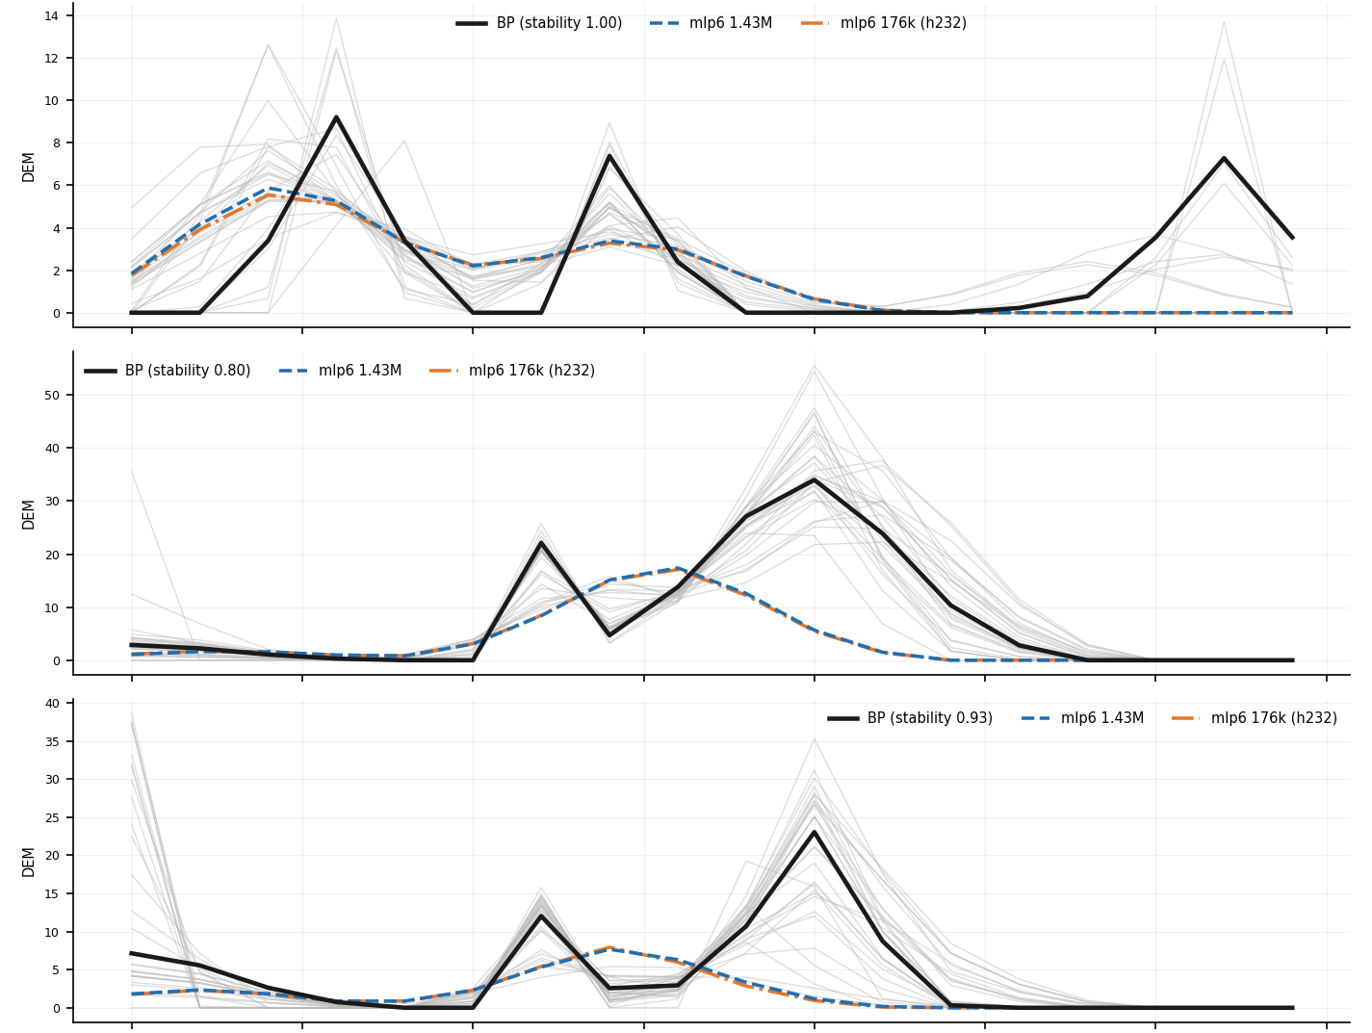
Multi-peaked DEMs: precise but partial, and mostly noise
14%
80%
of test pixels have two interior BP peaks
precision when the model draws two peaks
~30%
0.98×
of BP's double peaks recalled
model–BP gap vs BP's own scatter under noise
Most of the bimodal gap is the label's own noise.
BP (black), its noisy re-solves (grey), networks (dashed).
Notes:
August. 14% of test pixels have two interior BP peaks (rising to 30% in the brightest decile). When the model draws two peaks it is right 80% of the time against a 14% base rate, but it recalls only about 30%; misses are mostly close, unequal peaks. Re-solving BP 30 times under photon noise moves BP's own answer as much as our prediction differs from it (ratio 0.98 at bimodal pixels, 0.69 at unimodal ones). So most of the bimodal gap is the label's own irreproducibility. Caveat for claims: detecting peaks is not reproducing curves.

Slide 12
Versus supervised: worse DEM MSE, better W1 and AIA MSE
Track | Model | DEM MSE | EM error % | W1 (dex) | AIA MAE | AIA MSE
BP | Supervised | 0.906 | 14.3 | 0.133 | 2.95 | 156.7
BP | Label-free | 4.191 | 20.2 | 0.085 | 4.32 | 82.6
ENet | Supervised | 0.318 | 18.0 | 0.121 | 6.32 | 597.8
ENet | Label-free | 0.588 | 13.5 | 0.118 | 0.67 | 193.4
Lower is better. 153 held-out days, same pixels for both models.
Label-free: lower W1 and AIA MSE on both tracks; on ENet, better on all but DEM MSE.
The BP DEM MSE gap is what the rest of this talk explains.
Notes:
September. Matched comparison with the supervised BP and ENet models on the full shared test set: 153 held-out timestamps, the same pixels and the same Bright mask for both. The label-free ENet model was retrained with the matched objective (alpha = 0.001). Label-free has the better W1 and AIA MSE on both tracks and is better on everything except DEM MSE on ENet. The BP DEM MSE gap (4.19 vs 0.91) is what the rest of the talk explains. Live viewer: triborough.cs.nyu.edu/hsr3649/demdemo/webapp/compare.html

Slide 13
The mean and the median tell opposite stories
BP track | Label-free | Supervised
DEM MSE (website mean) | 4.19 | 0.906
Median pixel error | 0.026 | 0.112
Median, Quiet pixels | 0.016 | 0.085
Median, Bright pixels | 2.82 | 1.78
Error held by worst 1% of pixels | 97.8% | 95.2%
4.6× worse
on the mean (website number)
~4× better
on the typical pixel (median)
A few pixels decide the mean. Which ones?
Notes:
BP track. The website mean says label-free is 4.6x worse; the median pixel says it is about 4x better. Both are true because squared error lets a few huge errors dominate: the worst 1% of pixels hold 97.8% of label-free's error, and Bright pixels hold 98.8%. On the typical Bright pixel label-free is still worse (2.82 vs 1.78), so there is a real Bright weakness, but the mean exaggerates it enormously.

Slide 14
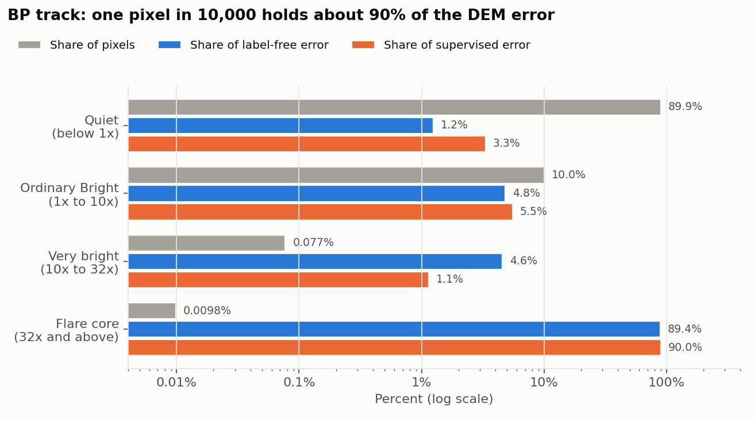
Flare cores, 1 pixel in 10,000, hold ~90% of the error
Brightness: largest channel over its top-5% cutoff.
Same for both models: it's the metric meeting huge DEMs.
The 4.6× headline gap is the gap on this bucket.
Is label-free also worse relative to DEM size?
Notes:
Pixels sorted by brightness: the largest of the six channel ratios, observed over that channel's top-5% cutoff (1x is the Bright line). The 69,283 pixels at 32x or more, 0.01% of 705M, hold 89.4% of label-free error and 90.0% of supervised error. Their DEMs are thousands of times larger than typical, and squared error grows with that square, so they dominate any squared-error score. The headline 4.63x gap equals the gap on this bucket (4.59x). These pixels are over the cutoff in all six channels, usually led by 94 A.

Slide 15
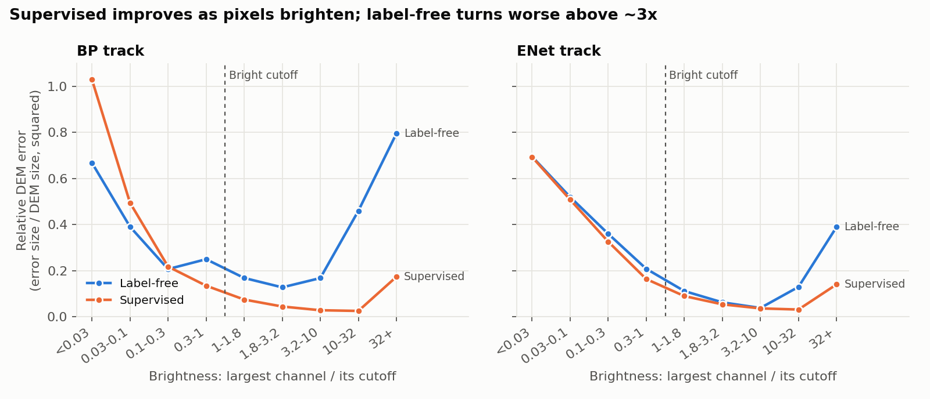
Relative to DEM size, the gap grows with brightness
Faint half of the Sun: label-free equal or better. Flare cores: genuinely worse, not just bigger numbers.
Notes:
Relative error per band: total squared error over total squared solver DEM, so the size effect cancels. Supervised gets relatively better as pixels brighten; label-free improves to about 3x, then turns worse (0.46 at 10-32x, 0.80 at 32x+). On the faint half of the Sun label-free is better on BP. ENet is within 27% of supervised in every band below 10x.

Slide 16
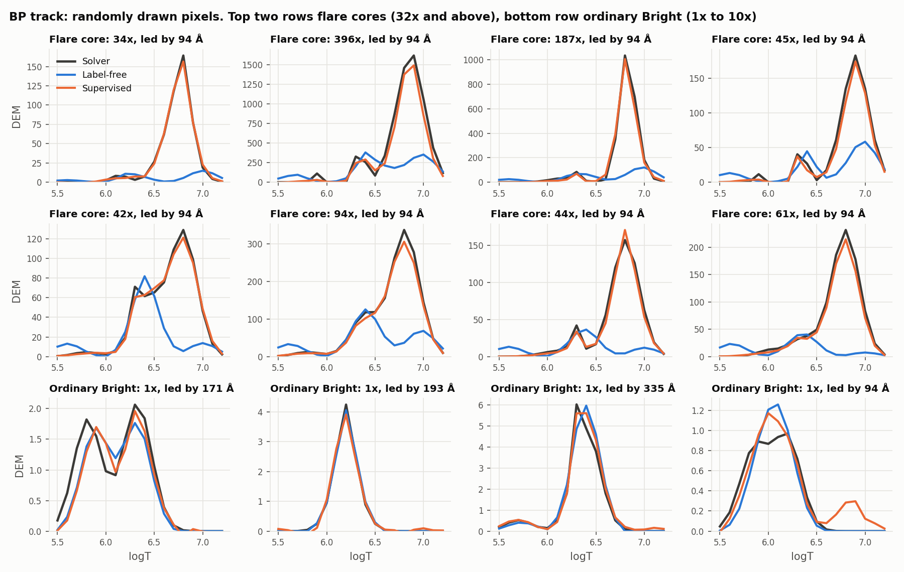
At flare cores, label-free misses the hot plasma
41%
of the solver's emission
0.24×
of its peak height
83%
of curves split into humps
Notes:
Randomly drawn pixels from a seeded sample, not hand-picked. Top two rows are flare cores (32x and above), bottom row ordinary Bright pixels. Solver and supervised both have a tall hot peak near logT 6.8 to 6.9; label-free nearly misses it, with a small bump near 6.3 and a low tail near 7.0. At these pixels label-free predicts 41% of the solver's emission, a quarter of its peak height, 0.17 dex cooler, multi-peaked 83% of the time (solver 18%).

Slide 17
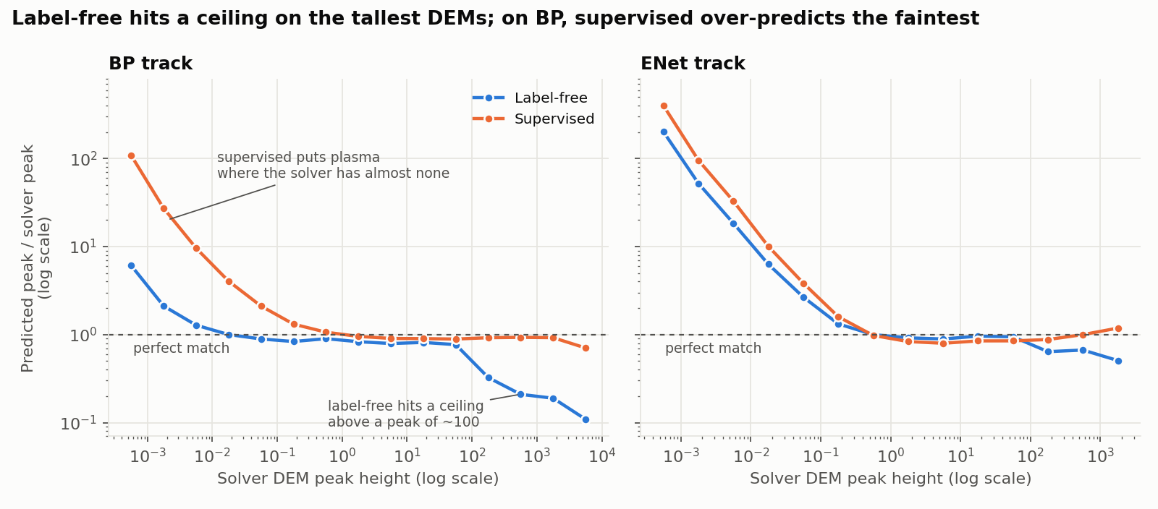
It tracks the solver up to peak ~100, then saturates
Not regression to the mean: a ceiling at the tallest DEMs.
Notes:
Predicted peak over solver peak, by solver peak height; 1 is a perfect match. Label-free holds 0.8 to 0.9 up to a solver peak of about 100, then falls to 0.33, 0.21, 0.19 and 0.11. Supervised stays near 0.9. So this is saturation at the top end, not regression to the mean. On BP, supervised has its own weak end: it over-predicts the faintest DEMs, which is why label-free wins on faint pixels. Those values are near zero, so they carry little error.

Slide 18
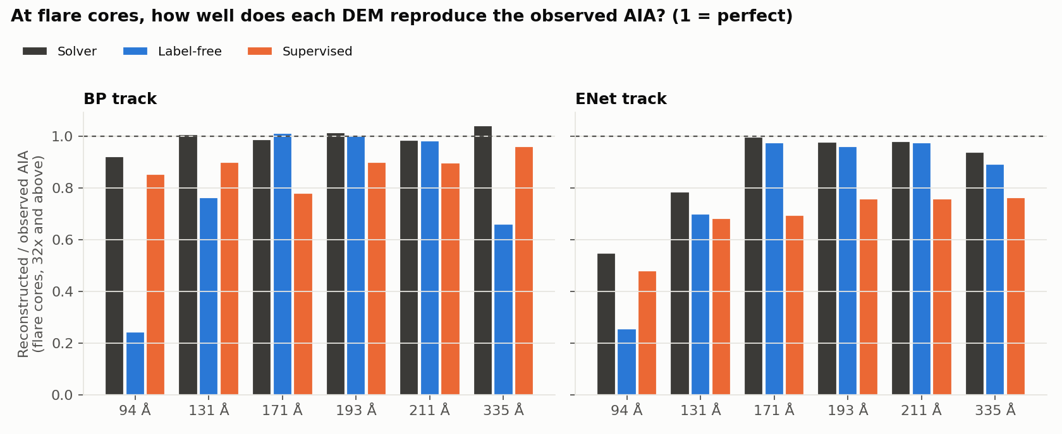
At flare cores label-free fails its own objective
BP solver: all six channels within 8%.
Label-free: cool channels fit, 94 Å only 24%.
The objective asks for the right answer; training misses it.
Notes:
Each DEM projected through the AIA response and compared with the observation at flare cores. The BP solver reproduces all six channels within 8%, so a DEM that fits exists. Label-free fits 171, 193 and 211 A to 2% but reproduces only 24% of 94 A, 76% of 131 A and 66% of 335 A; 98% of flare-core pixels fall short in 94 A by more than 10%. The loss asks for the right answer and training does not deliver it on these rare pixels: a training problem. ENet is murkier, since the ENet solver itself reaches only 55% of 94 A there.

Slide 19
Not solver noise, not missed double peaks
0.4%
~1%
of the Bright error is solver noise
of the error from missing BP's second peak
BP's own scatter across noisy re-solves explains almost none of it (supervised 1.5%).
Extra peaks at flare cores cost more: 22% of label-free's error, 0.9% of supervised's.
The Bright gap is real model error, concentrated in flare cores.
Notes:
Solver noise: where a block was re-solved 2 to 5 times, the spread of BP's answers is an unavoidable floor. It explains 0.4% of label-free's Bright error on BP (1.5% for supervised; 5.7% and 9.1% on ENet). Double peaks: missing BP's second peak costs about 1% of the error. Drawing extra peaks where BP has one costs label-free 22% of its BP error and supervised 0.9%, because label-free's extra peaks sit on the huge flare-core DEMs.

Slide 20
What we learned
1
The sparsity term, not the AIA fit, makes a DEM BP-like.
2
Test on unseen days: in-sample scores flattered the CNN.
3
Means of squared errors hide everything: use percentiles and per-band results.
4
176k parameters suffice; more capacity doesn't recover multi-peaked DEMs.
5
The remaining gap is narrow and diagnosed: flare cores, a training problem.
Notes:
The five lessons, in the order we learned them.

Slide 21
Next
Running now
Then
For discussion
Production model with the supervised input path: √intensity + Fourier features.
Target: flare-core 94 Å fit from 0.24 toward 0.92.
If needed, oversample or up-weight flare-core pixels.
Report by brightness band plus the median.
Should the headline stay plain MSE?
Do flare cores matter for the science use?
Notes:
Running now: the production BP model with the supervised model's input path, square root of the intensities plus Fourier features at 12 frequencies. Our model uses log1p, which squeezes a flare core (~1e4) and a bright active region (~500) to 9.2 vs 6.2; the square root keeps them at 100 vs 22. Success: flare-core 94 A fit rising from 0.24 toward 0.92 without losing the faint half. If it is not enough, show the model flare-core pixels more often or weight them more. Either way, report by brightness band plus the median.

