Slide 1
Analyzing Inverse Problems with Invertible Neural Networks[1]
Ardizzone et al., 2019
Presenter : Yuxuan, Zhongxiang

Slide 2
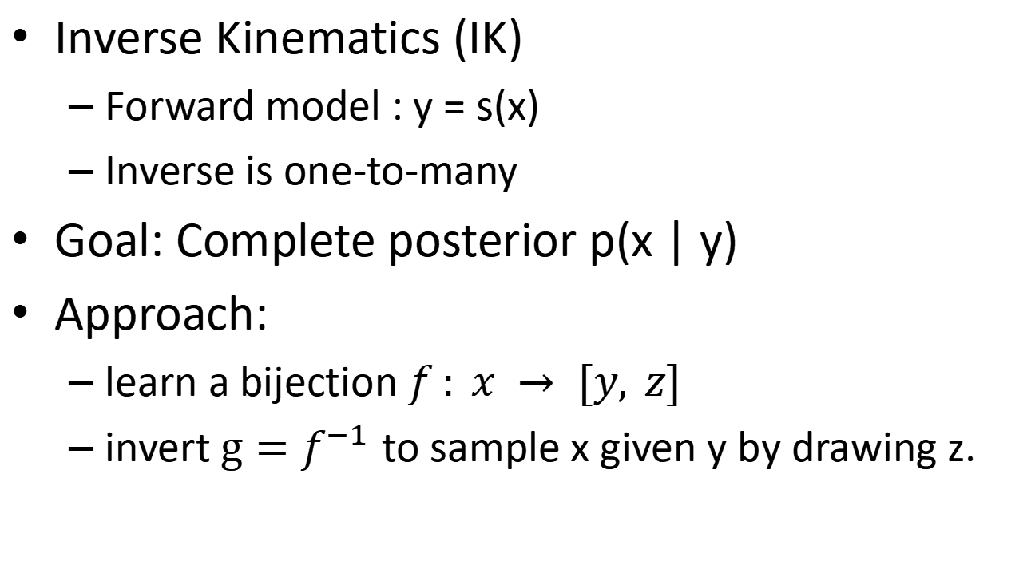
Inverse Problems
Inverse Kinematics (IK)
Forward model : y = s(x)
Inverse is one-to-many
Goal: Complete posterior p(x | y)
Approach:
learn a bijection $f : x → [y, z]$
invert $g=f^{−1}$ to sample x given y by drawing z.

Slide 3
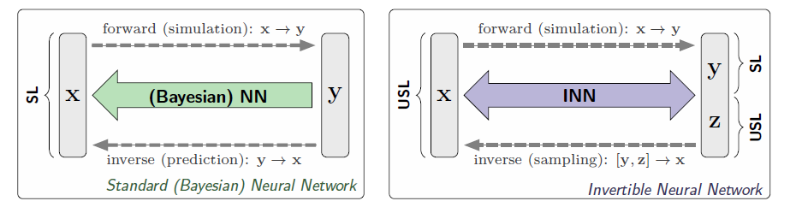
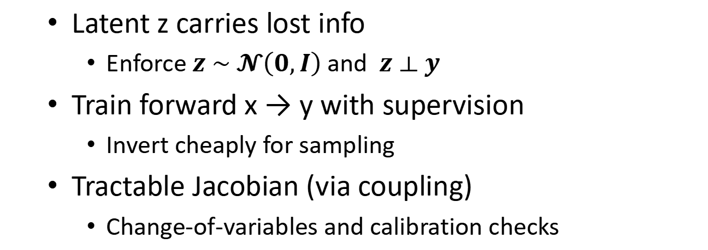
Invertible Neural Networks
Latent z carries lost info
Enforce $z \sim 𝓝\left(0,I\right)$and $z ⟂ y$
Train forward x → y with supervision
Invert cheaply for sampling
Tractable Jacobian (via coupling)
Change-of-variables and calibration checks

Slide 4
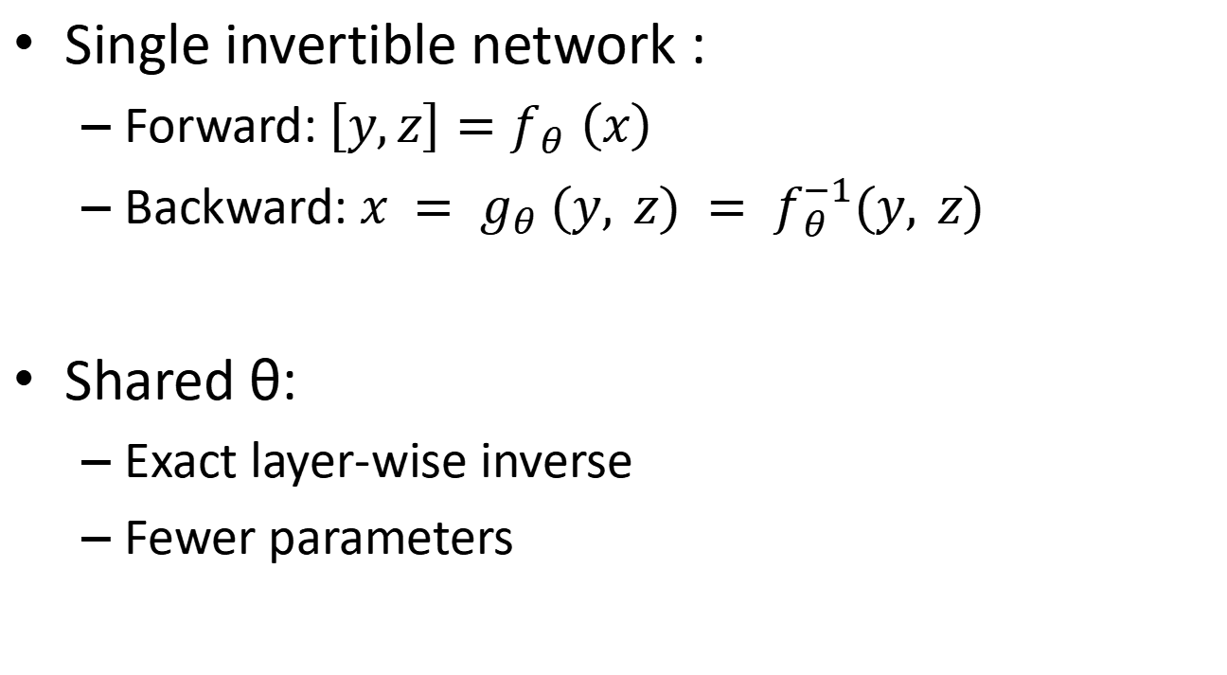
Problem Specification
Single invertible network :
Forward: $\left[y,z\right]=f_{θ} \left(x\right)$
Backward: $x = g_{θ} (y, z) = f_{θ}^{−1}(y, z)$
Shared θ:
Exact layer-wise inverse
Fewer parameters

Slide 5

Problem Specification
Dimensions
Dim(z) = Dim(x) – Dim(y)
Zero padding
INN Posterior & Jacobian
Triangular, log |det| = sum of scale outputs

Slide 6
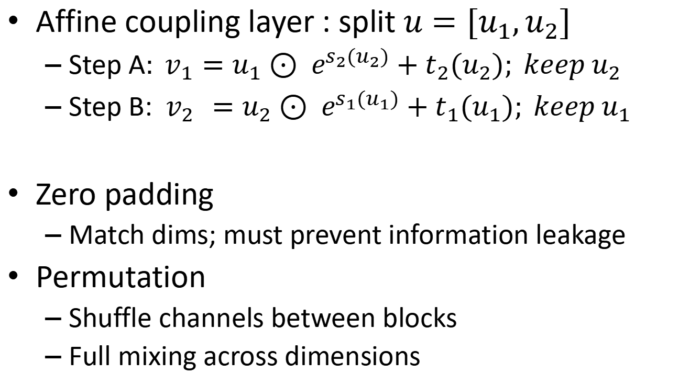
Invertible Architecture
Affine coupling layer : split $u=[u_{1},u_{2}]$
Step A$: v_{1}=u_{1}⊙ e^{s_{2}(u_{2})}+t_{2}(u_{2}); keep u_{2}$
Step B: ${ v}_{2 }=u_{2}⊙ e^{s_{1}(u_{1})}+t_{1}(u_{1}); keep u_{1}$
Zero padding
Match dims; must prevent information leakage
Permutation
Shuffle channels between blocks
Full mixing across dimensions

Slide 7
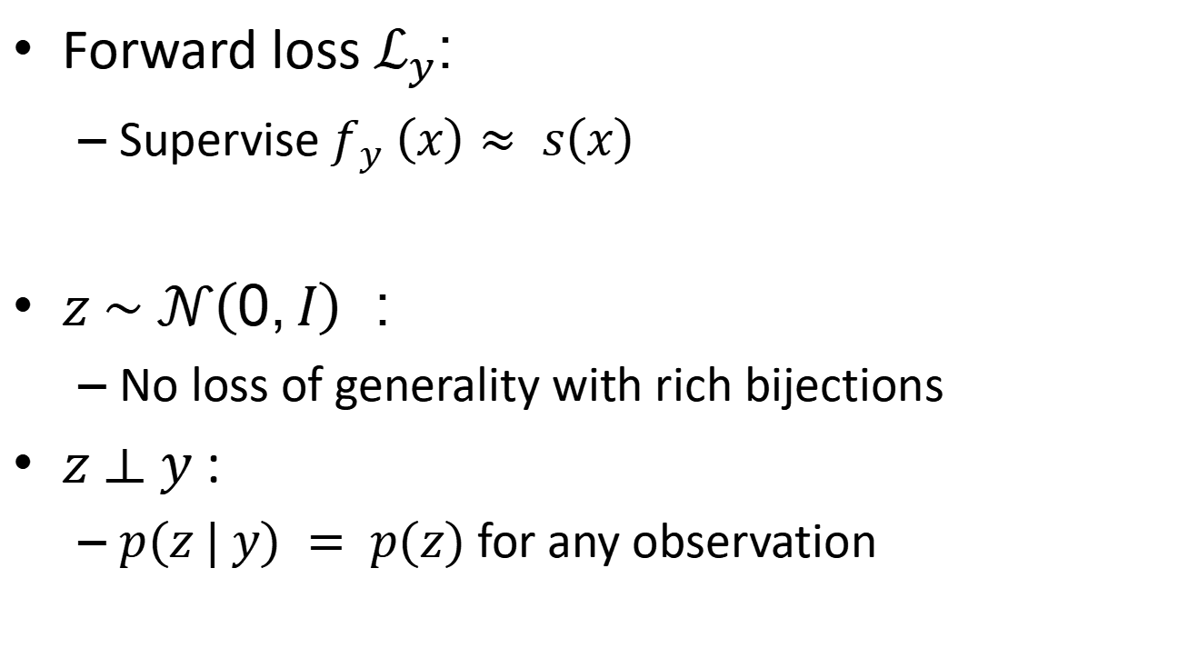
Bi-directional Training
Forward loss $ℒ_{y}$:
Supervise $f_{y} \left(x\right)≈ s\left(x\right)$
$z \sim 𝒩\left(0,I\right)$:
No loss of generality with rich bijections
$z ⟂ y$:
$p(z | y) = p(z)$ for any observation

Slide 8

Maximum Mean Discrepancy
MMD: kernel-based method
IMQ : $k(x;x^{′}) = 1/(1 +{\left\|\frac{x−x^{′}}{h}\right\|}_{2}^{2} )$
Stable, cheap

Slide 9
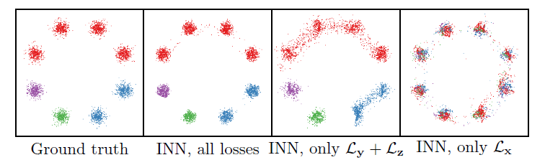
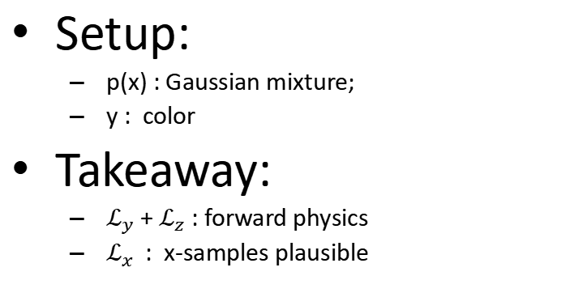
Viability of INN a basic inverse problem
Setup:
p(x) : Gaussian mixture;
y : color
Takeaway:
$ℒ_{y}$ + $ℒ_{z}$ : forward physics
$ℒ_{x}$ : x-samples plausible

Slide 10
Demo: Finger inverse kinematic[2]
a supervised regression model
a reinforcement learning method (DDPG)

Slide 11
Regression model
Key idea: “We treat inverse kinematics as a supervised learning problem.”
Show code parts:
regress_model.py: neural net definition (inputs = target position, outputs = joint angles).
train.py --model_type 0: trains using supervised loss (MSE).
test.py --model_type 0: runs demo, OpenCV shows finger moving to target.
Say while showing: “This model learns a direct mapping from target position → joint configuration. It’s fast, but it struggles when multiple joint configurations can achieve the same end-point (multi-modality).”
Notes:
the idea is pretty straightforward: we point to a position (x, y) on a plane, and it immediately tells you “how many degrees each of the three joints should be bent” so that your fingertip reaches exactly that point.
Just to be clear—what I’m showing here is an inverse neural network, not to be confused with invertible neural networks from the paper.
The target function is basically the position we want the finger to reach—that’s the grey dot you see in the demo visualization.
In our regression model, we set two key dimensions:
2 is the number of joint angles to predict.
8 number of input features from the environment (current pose/config + target info).
θ0 – current base joint angle
θ1 – current middle joint angle
x_end – current end-effector x (normalized)
y_end – current end-effector y (normalized)
dx – (target_x − x_end)
dy – (target_y − y_end)
target_x – normalized
target_y – normalized
So you can think of the input as a snapshot of where the arm is now, where the target is, and the relative difference.
During training, the network takes these 8 features as input and predicts joint angles. Those predicted angles are passed through forward kinematics—that’s just trigonometry using link lengths—to compute the fingertip position (x_pred​,y_pred​)
we compare that predicted fingertip position with the target position , The mean squared error measures the squared distance between this predicted fingertip position and the target point. By minimizing this error, the model gradually learns a mapping from input state to angles that makes the fingertip land on the target.
With every training step, the model adjusts its weights so that its fingertip prediction gets closer to the target. Over time, the network essentially learns the inverse function of forward kinematics. You can think of it like building a lookup table that can interpolate: given a target position, it remembers what joint angles usually work to reach it.
So when we test , it basically looking back our fingertip should be.
The regression model just tries to learn a direct, one-to-one mapping from the desired position to the angles.
But as you know from inverse kinematics, one target position doesn’t always correspond to one unique solution.
Often, there are infinitely many joint angle configurations that can reach the same point.
May give imperfect or unstable solutions.

Slide 12
DDPG model[3][4][5]
Key idea: “Instead of direct regression, here we use reinforcement learning. The agent interacts with the finger environment (env.py), gets rewards, and learns a policy.”
Explain DDPG briefly (no deep math):
Actor network: proposes an action (joint movement).
Critic network: evaluates the action (Q-value).
Replay buffer + target networks stabilize training.
Show code parts:
ddpg.py: Actor–Critic structure, update functions.
train.py --model_type 1: agent trains with rewards from environment.
test.py --model_type 1: demo shows improved reaching after training.
Say while showing: “The RL agent doesn’t need paired (X,Y) data—it learns by trial and error. Over time, the finger learns to reach the target smoothly. But training takes longer than regression.”
Notes:
Now, let’s look at the reinforcement learning approach.
Unlike the regression model, which directly learns to map a target position to joint angles, the DDPG approach learns by trial and error.
Basically, the neural network tries different actions—different joint movements—and gets feedback in the form of rewards. The reward tells the network if it’s getting closer to the target or not.
So over time, the DDPG model learns a policy—a strategy—for how to move the finger joints to reach the target. Instead of minimizing a direct error, it’s learning from the environment by receiving rewards. If it moves closer to the target, it gets a positive reward. If it moves away, it gets a lower reward.
So in the demo, you’ll see the DDPG model initially exploring different angles.
Over training, it learns a more efficient way to reach the target.
It’s a bit slower to train than the regression model,
but it can handle more complex situations and doesn’t need explicit pairs of inputs and outputs.
---
DDPG stands for Deep Deterministic Policy Gradient
It’s a reinforcement learning algorithm designed for problems with continuous action spaces, like controlling joint angles.
It’s based on the actor–critic framework:
The Actor network proposes an action—for example, how much to bend each joint.
The Critic network evaluates how good that action is by estimating the Q-value, which is the expected future reward.”

Slide 13
Wrap-up
Regression is fast and direct but limited when multiple solutions exist.
DDPG is flexible and data-driven, but slower and more complex.
Both highlight the challenges of inverse problems and different ways to tackle them.
Notes:
“So, to sum up:
Regression learns a direct mapping with MSE. It’s fast, but it struggles when there are multiple valid solutions.
DDPG learns by interaction and reward. It takes longer to train, but it’s more flexible and can handle the one-to-many nature of inverse kinematics.
In the demo you’ll see that contrast: regression is quick but limited, while DDPG explores, learns from rewards, and eventually develops a stable reaching strategy.”

Slide 14
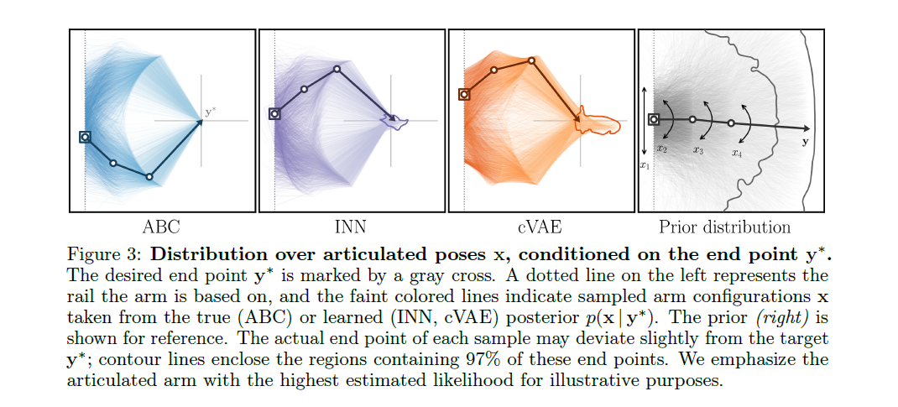
Appendix A

Slide 15
Q&A

Slide 16
Reference & Graphs
[1] https://arxiv.org/abs/1808.04730
[2]https://github.com/qianyuez/finger_inverse_kinematic
[3] https://arxiv.org/abs/1509.02971
[4] https://medium.com/@amaresh.dm/how-ddpg-deep-deterministic-policy-gradient-algorithms-works-in-reinforcement-learning-117e6a932e68
[5] https://spinningup.openai.com/en/latest/algorithms/ddpg.html

