Slide 1


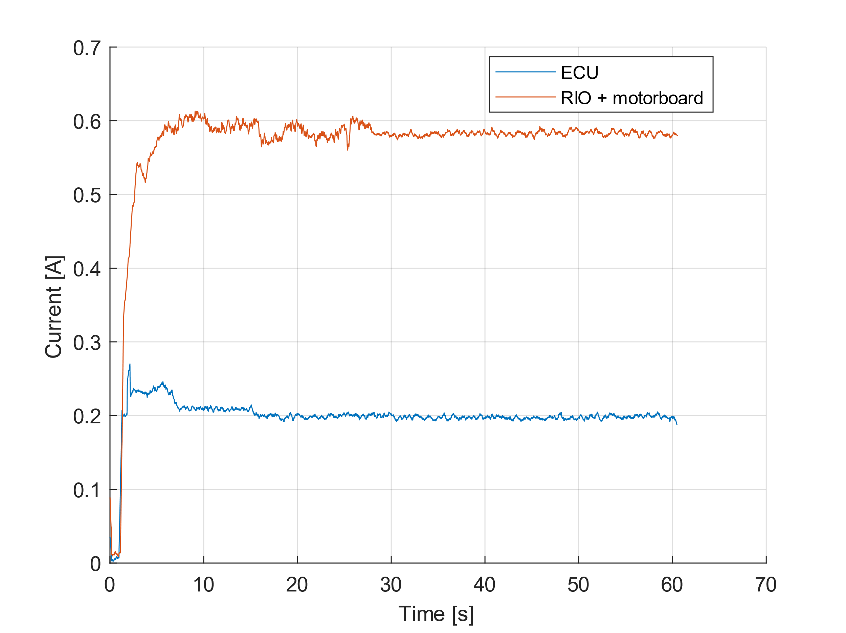
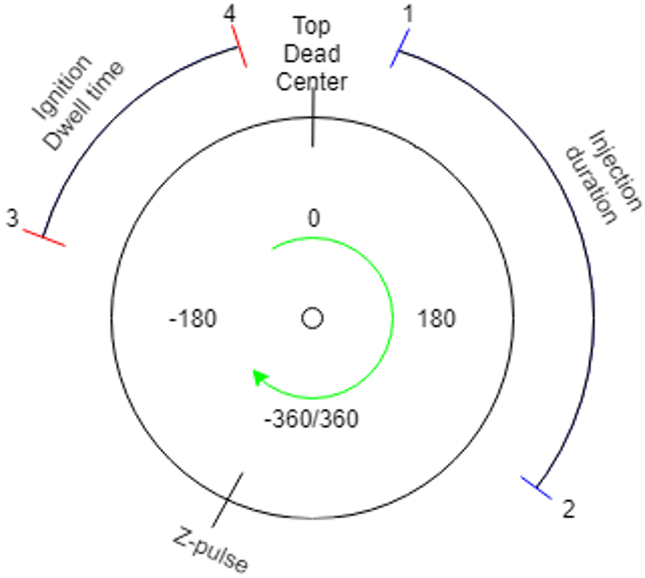
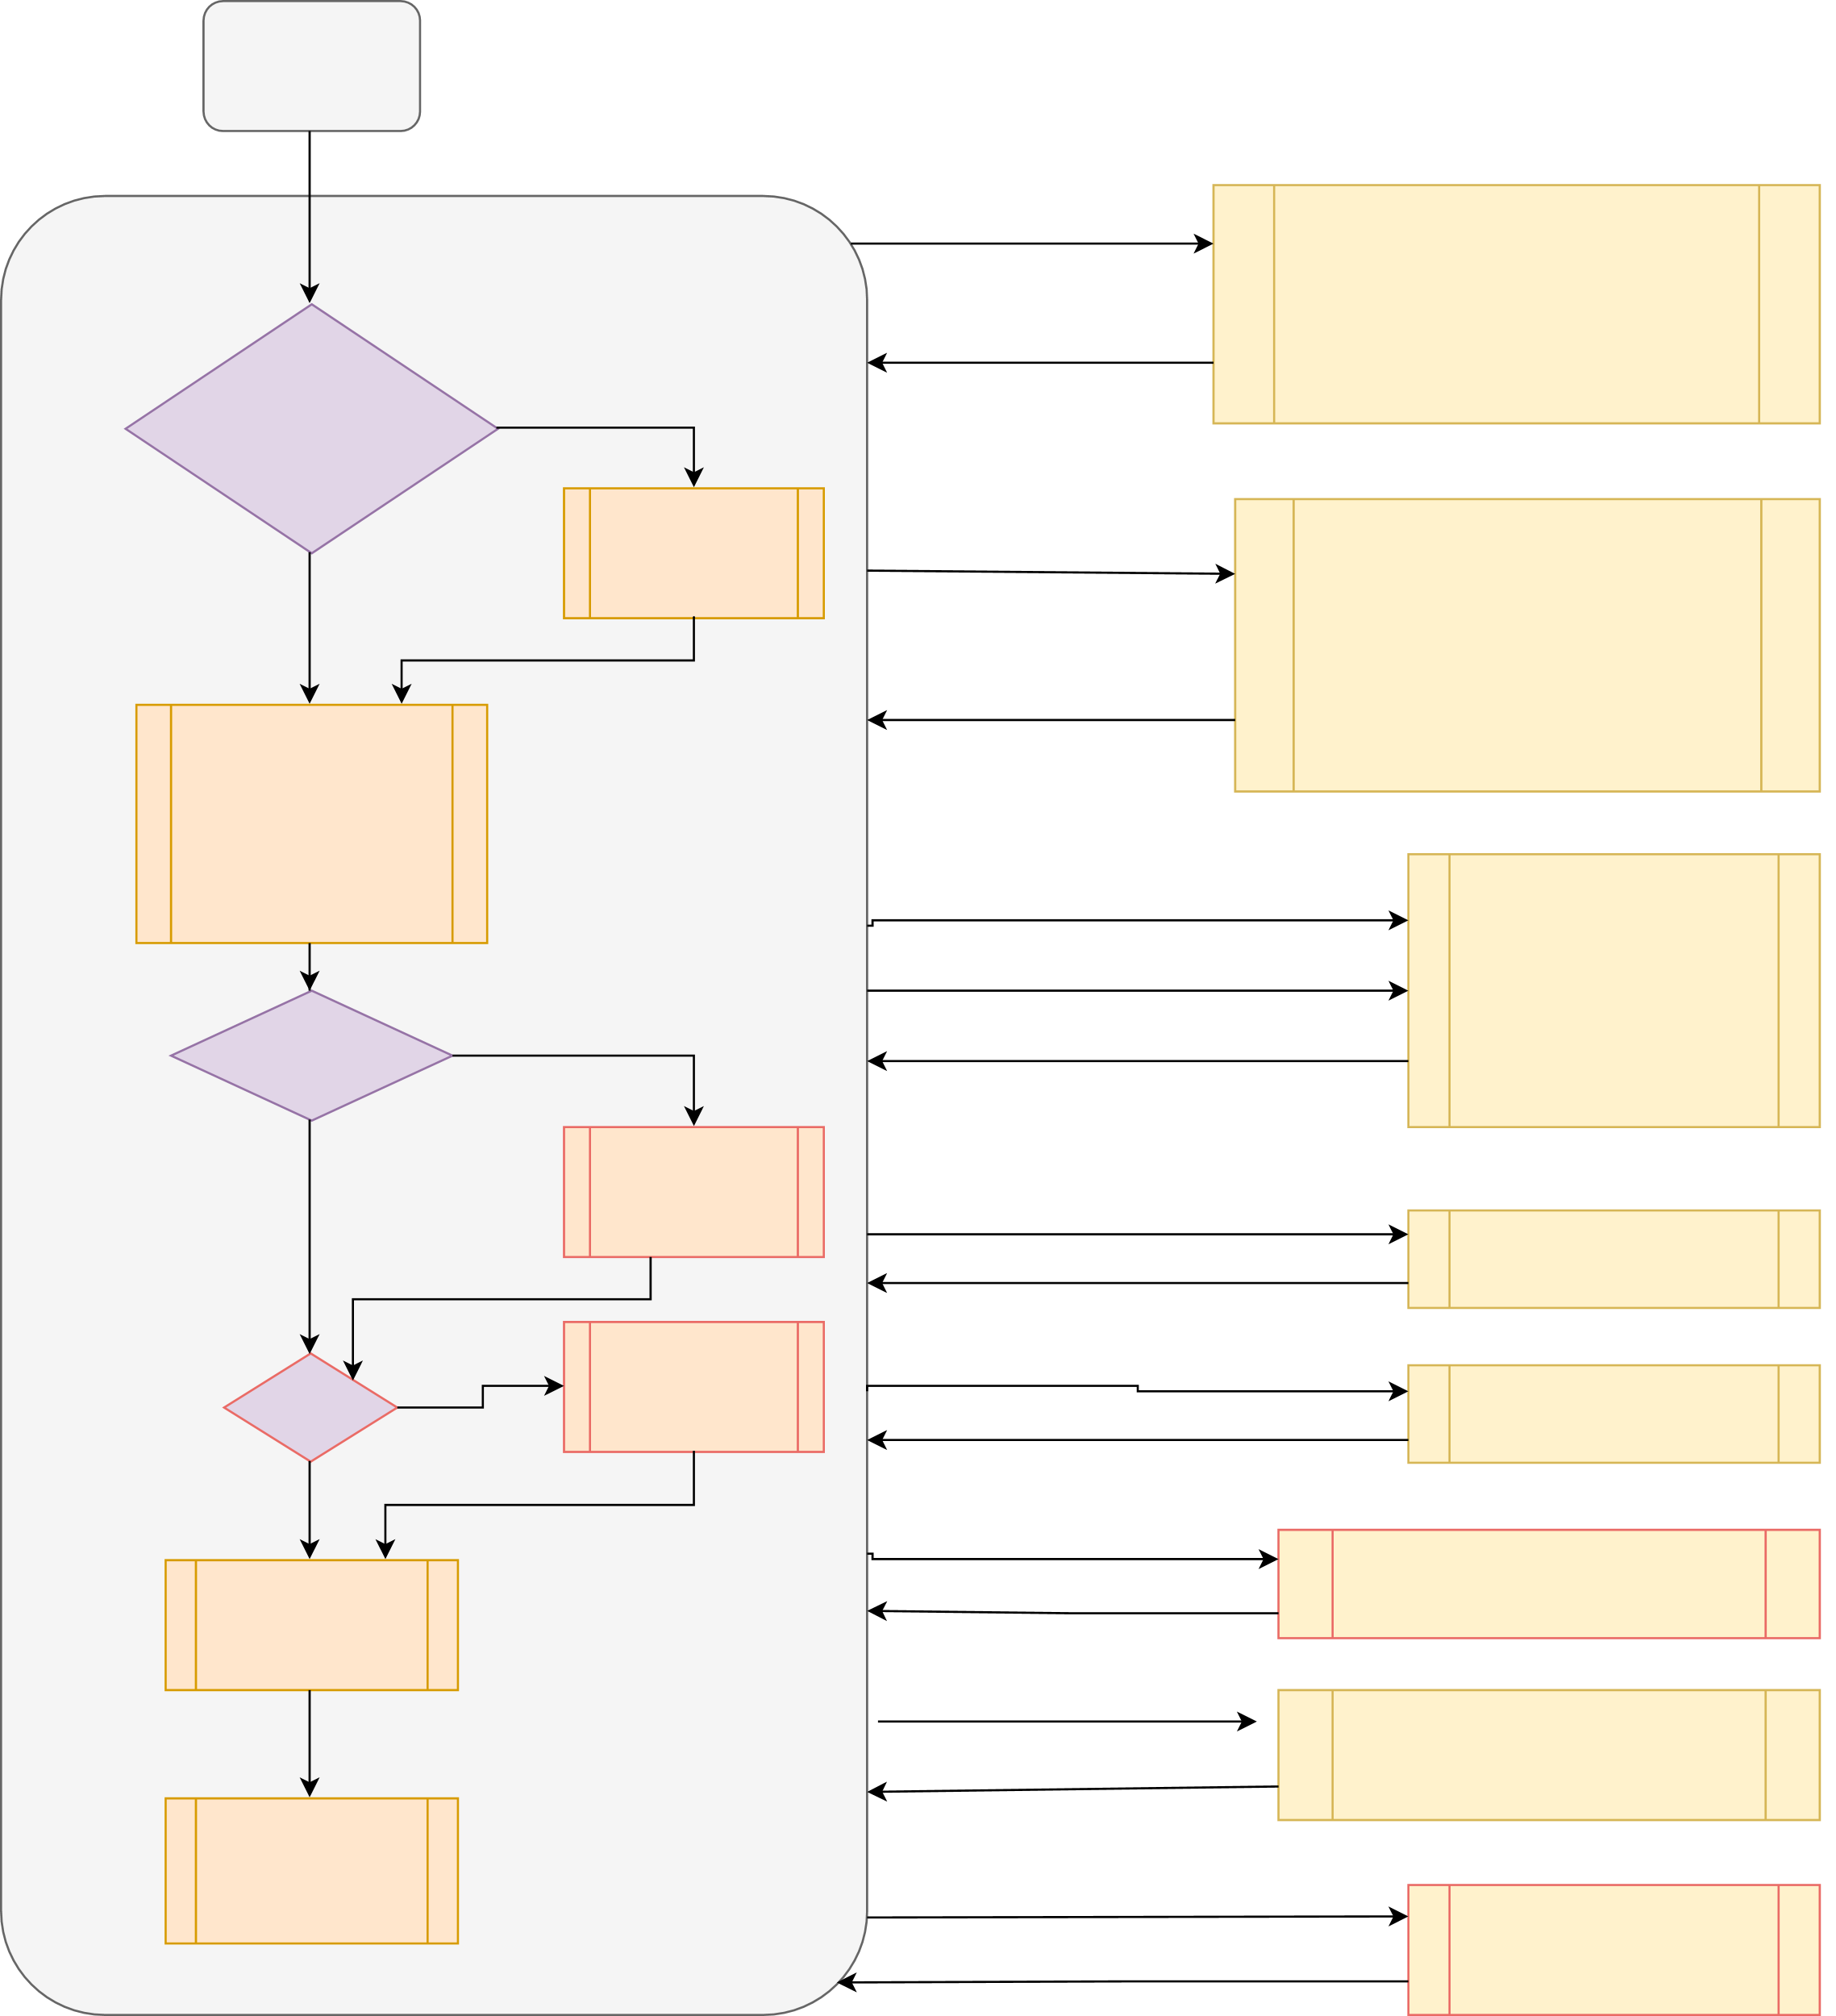

Implementing motor control with embedded electronics
Group 01.03: Asger Kühl, Berk Gezer, Frederik Ettrup Larsen, Irene Danvy
Abstract: For the first time this year, the Shell EcoMarathon competition takes electrical energy used into account, an aspect of the DTU Roadrunners EcoCar which hasn't been optimized at all. Our approach to lowering the EcoCar's power consumption was to replace the current, power inefficient motor control with our own embedded electronics, using only one microcontroller, and removing no functionalities of the car. This resulted in our engine control unit (ECU), which uses less power while having the same functionality as the old motor control.
Specifications
In order to replace the RIO, we had to implement the following features:
Calculating ignition and injection timing
Make the starter motor run until the engine is ready to take over
Control gear
Monitor and calculate values such as speed and temperature
Communicate over CANbus
Communicate with a computer through USB
Log data on SD card
Have an emergency stop
Only drive when a continuous signal is received from the driver
Injection and Ignition
The injection and ignition of fuel is the most time critical aspect of the car. In figure 1 a representation of a motor cycle, as read on the encoder can be seen.
Code
We wrote this project in the Arduino language, which is based on C++, with the Teensyduino extension necessary for compiling code the Teensy can run. When we found the standard functions insufficient we found and adapted open source libraries, or created our own.
An overview of our code structure can be seen in figure 3.
Initialize
Color code
Red = legacy code
Black = our code
Figur 2 The current going into the ECU and the RIO
1ms has passed
ecuTimerCallback()
Power savings
The main power saving is done by the replacement itself, as the integrated electronics is very barebone and therefore does no unneeded operations. A comparison between the current usage of the two systems can be seen on figure 2
Main loop
- Calculate start and stop angle for ignition and injection
- Control autogear
- Control starter engine
Emergency situation?
Yes
encoderInterruptHandler()
No
Emergency Stop Procedure
Z pulse
Reset motor quadrature decoder
Attach compare inturrupts to ignition and injection start angle and injection start angle
Figure 1: A representation of a motor cycle, as read on the encoder.
Communication: - with CANbus - with Bluetooth - with PC UI
ftm2_isr()
The numbers refer to the following:
Start of fuel injection.
Stopping fuel injection.
Ignition coil begins to charge.
Ignition coil discharges, giving a spark and igniting the fuel.
Note that the Z-pulse is placed at an arbitrary angle.
Motor angle = injection angle
- Injection or ignition started -Injection or ignition or ignition stop timer
Hardware
This project was written on a Teensy 3.6, which controlled a PCB with various outlets to hook up the board to the rest of the car. The board was stored in a chassis which we 3D-printet
Emergency?
Yes
Motor angle = ignition angle
No
Sing emergency
song
Injection stop time out
InjectionDelayCallback()
Stop injection
Party?
Yes
Sing party song
Ignition stop time out
IgnitionDelayCallback()
No
Stop ignition
Input from wheel tachometer
ISR_WHEEL(1)
Datalogging to SD card
Increment distance count
10ms has passed
ioTimerCallback()
Toggle LED to indicate end of loop
- Calculate distance
- Filter noise from tachometer
Sing has been called and 10ms has passed
tunesTimer()
Play next tone in song
Figur 3 The main loop of our code, the big circle represents the code which is continously running in the main loop, while all the boxes to the right represent the various interrupt service rutines, with the labels on the arrows referring to the condition that triggers the interrupt

