Slide 1

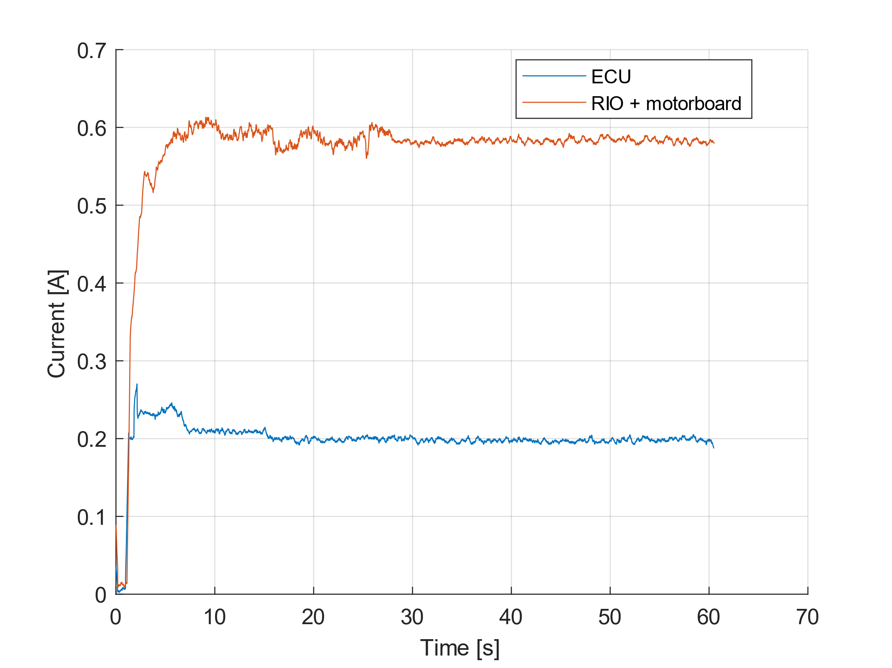
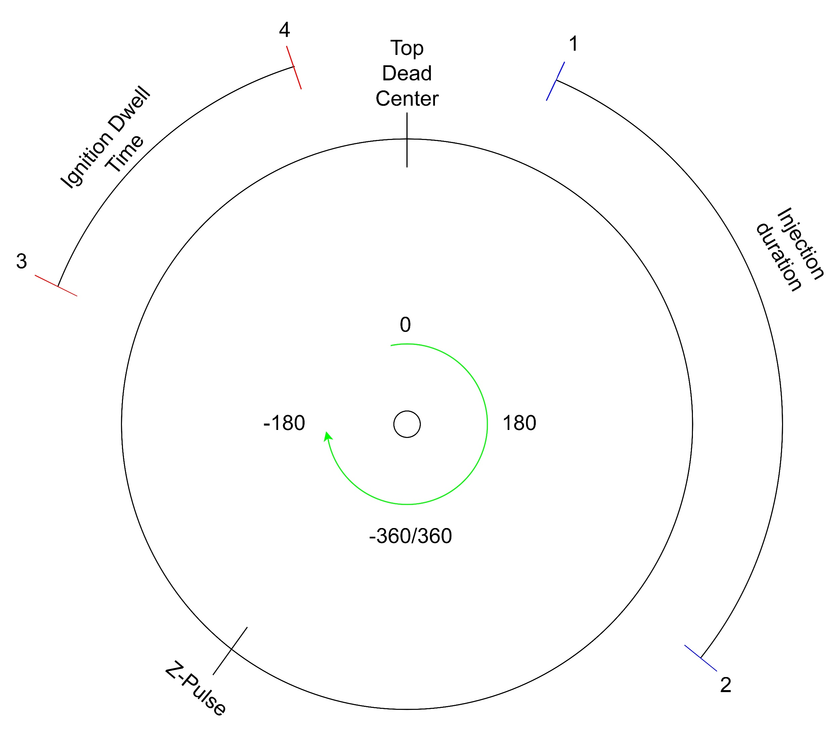
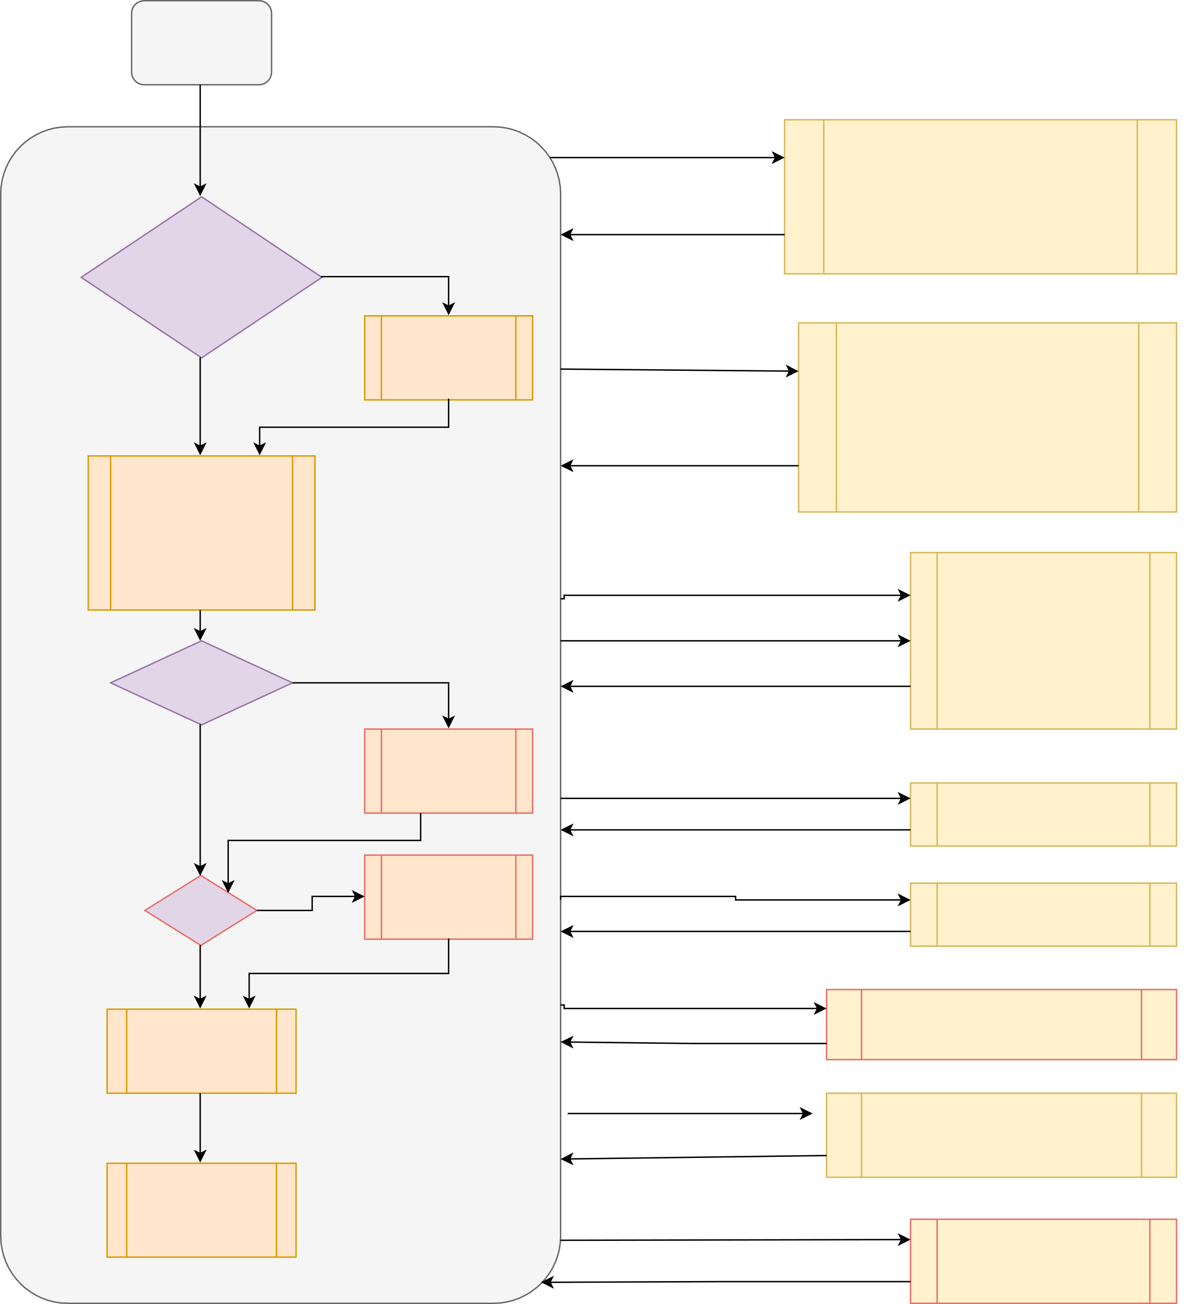

Lowering Energy Consumption by Implementing a Custom Engine Control Unit in Place of a General Purpose Controller
Group 01.03: Asger Kühl, Berk Gezer, Frederik Ettrup Larsen, Irene Danvy
Abstract: We replaced the generic engine control unit in the fuel efficient `EcoCar’ with special-purpose embedded electronics and lowered its energy consumption by two thirds, providing an extra 23.5 km/l in nominal conditions, when converting electrical energy to an equivalent amount of fuel. The component in the car which consistently consumes the most energy is the current engine control unit. In order to replace it, we used embedded electronics, which was made using only one microcontroller, and removed no functionalities of the car.
Specifications
In order to replace the existing engine control unit, we had to implement the following features:
Calculating ignition and injection timing
Control the starter motor until the engine is ready to take over
Control the gear
Monitor sensor values, such as battery voltage and temperature
Communicate over CAN-bus
Communicate with a computer through USB
Log data on a SD card
Have an emergency stop
Halt the engine when no signal is received from the driver
Injection and Ignition
The most time critical aspect of the car is the injection and ignition of fuel. In figure 1 a representation of a motor cycle can be seen.
Code
We wrote this project in the Arduino language, which is based on C++, with the Teensyduino extension necessary for compiling code the Teensy can run.
The main part of the code is run sequentially, while critical parts of the program was prioritized using interrupt service routines.
An overview of our code structure can be seen in figure 3.
Initialize
Color code
Red = legacy code
Black = our code
Figure 2: The current going into the old system, called RIO + motorboard, and the current going into our embedded system.
1ms has passed
ecuTimerCallback()
Power savings
The main power saving is done by the replacement itself, as the embedded electronics is very optimized and therefore does not perform any unneeded operations. A comparison between the current going into the two systems can be seen on figure 2.
On average, the embedded system use 0.195A and the old system use 0.585A. This is a 66.67% decrease in electrical energy usage for the engine control.
Main loop
- Calculate start and stop angle for ignition and injection
- Control autogear
- Control starter engine
Emergency situation?
Yes
encoderInterruptHandler()
No
Emergency Stop Procedure
Z pulse
Reset motor quadrature decoder
Attach compare inturrupts to ignition and injection start angle and injection start angle
Figure 1: A representation of a motor cycle, as seen by the encoder
Communication: - with CANbus - with Bluetooth - with PC UI
ftm2_isr()
The numbers on figure 1 refer to the following:
Start of fuel injection.
Stopping fuel injection.
Ignition coil begins to charge.
Ignition coil discharges, giving a spark and igniting the fuel.
Note that the Z-pulse position can change based on how the encoder was mounted on the engine.
This displacement is accounted for in the calibration of the engine.
Motor angle = injection angle
- Injection or ignition started -Injection or ignition or ignition stop timer
Emergency?
Yes
Motor angle = ignition angle
No
Sing emergency
song
Injection stop time out
InjectionDelayCallback()
Stop injection
Party?
Yes
Sing party song
Ignition stop time out
IgnitionDelayCallback()
No
Stop ignition
Hardware
This project was programmed for a Teensy 3.6, which controlled a custom designed PCB, connected through various outlets to the rest of the car. The custom PCB also features a built-in OLED screen and a buzzer, both used for debugging.
Input from wheel tachometer
ISR_WHEEL(1)
Datalogging to SD card
Increment distance count
10ms has passed
ioTimerCallback()
Toggle LED to indicate end of loop
- Calculate distance
- Filter noise from tachometer
Sing has been called and 10ms has passed
tunesTimer()
Play next tone in song
Figure 3: The main loop of our code. The big circle represents the code which is continuously running in the main loop, while all the boxes to the right represent the various interrupt service routines, with the labels on the arrows referring to the condition that triggers the interrupt

