Slide 1

SMART INDIA HACKATHON 2026
SatQuery AI
Problem Statement ID – 26167
Problem Statement Title – SatQuery AI: An Interactive Vision-Language Assistant for Multimodal Remote Sensing Image Analysis through Text Queries
Theme – Space Technology
PS Category – Software
Team ID – to be filled
Team Name – [Team Name]
Notes:
TITLE SLIDE — fill Team ID and Team Name exactly as registered on the SIH portal. The Problem Statement Title is verbatim from the official PS; do not shorten it. The "SatQuery AI" line replaces the template's "TITLE PAGE" label — keep or remove.

Slide 2
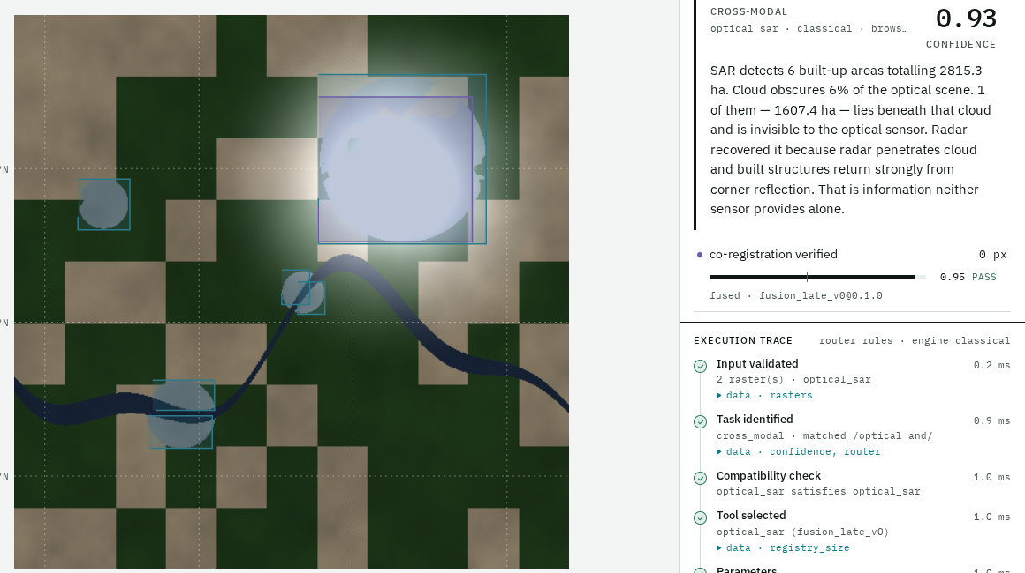




SatQuery AI — Ask Satellite Imagery a Question
[Team Name]
Proposed Solution (Describe your Idea/Solution/Prototype)
THE PROBLEM
PROTOTYPE — WORKING TODAY
No interface accepts a question — every remote-sensing tool is single-task and needs a GIS expert.
One image is often not enough — cloud blocks optical sensors; change needs two dates.
Generic AI chatbots invent numbers and cannot show why they answered.
OUR SOLUTION — HOW IT ADDRESSES IT
Upload GeoTIFF imagery — one image, an optical + SAR pair, or two dates — and ask in plain English.
An agentic router classifies the task, checks the inputs, and runs the right specialist from a fixed tool registry.
Returns an answer + map evidence (lat/long) + calibrated confidence + execution trace + report.
Specialists for VQA, grounding, change analysis and optical–SAR fusion; adapted AI model: see model section.
Query: “Use the optical and SAR images together to identify built-up regions.”
SAR finds 2,815 ha built-up; 1,607 ha of it lies under cloud, invisible to the optical sensor.
Confidence 0.93 · every step in the trace.
Synthetic demo scene — disclose on the slide
Also live: refusal with no model run · two-date change detection · GeoJSON + report export · real GeoTIFF upload.
INNOVATION & UNIQUENESS
Refuses the impossible
No model runs if the uploads cannot answer the question
Sees under clouds
Radar + optical fusion measures what the camera misses
Facts before words
Answer written only from measured evidence — never invented
Auditable & offline
Trace of exactly what ran; no internet needed
Notes:
IDEA SLIDE — keep the three template pointers: explanation, how it addresses the problem, innovation. Improve: (1) swap the screenshot for a fresh one from the latest build; (2) the numbers under it come from the built-in SYNTHETIC scene — keep the disclosure; (3) fill the model line from the separate model document. Source: docs/11_Presentation_Guide.md §1, §4, §14.

Slide 3








TECHNICAL APPROACH
[Team Name]
Technologies to be used
Methodology and process for implementation
Backend
Python · NumPy · Pillow · FastAPI
INPUT
GeoTIFF + a question
single · optical+SAR · two dates
1 · Validate inputs
count · sensor · CRS · alignment
2 · Classify the task
VQA · grounding · change · cross-modal
Web app
React 19 · TypeScript · Vite · Tailwind
REFUSE — say why + what to upload
no model is run
✗ no
3 · Inputs can answer it?
3D + maps
three.js sensor stack · GeoJSON (EPSG:4326)
Geospatial
GeoTIFF / TIFF · geotiff.js · CRS checks
✓ yes
4 · Select from a fixed tool registry — threshold is the only permitted parameter
Image analysis
Lee filter · Otsu · NDVI/NDWI · change vector analysis
rs_vqa
questions about one image
grounding
“highlight the water body”
change_vqa
what changed, and where
optical_sar
radar + optical fusion
AI model & training
Fill from the model document
5 · Fuse evidence
conflicts recorded,
confidence lowered
6 · Confident enough?
OUTPUT
answer · map (lat/long) · confidence
execution trace · report
✓
Prototype: link
Demo video: YouTube link
Code: GitHub link
✗ ABSTAIN — “not confident enough to answer”
Notes:
TECHNICAL APPROACH — left: technologies; right: the real pipeline order from satquery/pipeline.py. Improve: add logos instead of icons if you prefer the winners' style; fill the AI model box and links; keep the REFUSE and ABSTAIN branches — they are our differentiator. Source: guide §5–§7.

Slide 4


FEASIBILITY AND VIABILITY
[Team Name]
Analysis of the feasibility of the idea | Potential challenges and risks | Strategies for overcoming these challenges
Technical — built & running | AI model not yet connected to every specialist | Model “socket” built and tested; classical path answers today and the trace labels which engine ran
Data — robust | ISRO/SAC test set is hidden; Cartosat/RISAT data is not public | Input validation, calibrated confidence and abstention — built for data we have never seen
Trust — verifiable | AI answers that sound right but are wrong | Refuse before any model runs; answer phrased only from measured evidence; full trace
Operational — demo-safe | Venue Wi-Fi, limited GPU | Fully offline; only the model runtime needs a GPU; pre-computed demo results clearly labelled
MEASURED TODAY — on synthetic test scenes
VIABILITY
1.00
0.996
0.945
Technically viable — open-source stack; every capability measured, not assumed
Water grounding IoU
Vegetation IoU
SAR built-up F1
Economically feasible — free open datasets and tools; runs on a laptop
0.770
0.033
~90 ms
Operationally practical — browser app, drag-and-drop GeoTIFF, downloadable report
Change detection F1
Calibration error (ECE)
Cross-modal query
Notes:
FEASIBILITY — column headers are the template's three pointers, verbatim. The six numbers are measured by `python -m satquery.cli eval` on SYNTHETIC scenes — keep that label. Do not add router accuracy (not a real metric yet). Add model numbers only from the model document. Source: guide §13, §17.

Slide 5








IMPACT AND BENEFITS
[Team Name]
Potential impact on the target audience
Benefits of the solution
District & disaster officers — flood, damage and construction questions without a GIS expert
Social — faster, evidence-backed answers in disasters; wider access to space data
Agriculture & water departments — vegetation and water-body extent from imagery
Economic — less specialist time per question; open-source, no licence cost
Urban planners — built-up growth between two dates, mapped
Environmental — monitor vegetation, water and land-use change over time
ISRO / SAC analysts — routine questions faster, with an auditable trace
Governance — every answer traceable to a measurement — fit for official use
Students & researchers — remote sensing without specialist software
Capability | Single-task RS tool | Generic AI chatbot | SatQuery AI
Ask in plain language | ✗ | ✓ | ✓
Picks the right analysis automatically | ✗ | ✗ | ✓
Checks inputs, refuses impossible questions | ✗ | ✗ | ✓
Optical + SAR together (sees under cloud) | ◐ | ✗ | ✓
Every number traceable to a measurement | ✓ | ✗ | ✓
Works where the camera can’t
Radar sees through cloud and at night. Fusing it with optical turns a cloudy scene into a measured answer.
Add one real-world number here, with its source
Notes:
IMPACT — two template pointers as the two panels. The comparison table is qualitative: ✓ = does it, ✗ = does not, ◐ = partly. Improve: add ONE sourced statistic (e.g. cloud cover over India in monsoon, or an official figure on flood mapping delays) with its citation on slide 6. Never invent a number.

Slide 6
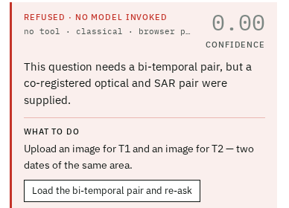


RESEARCH AND REFERENCES
[Team Name]
Details / Links of the reference and research work
Aspect | Conventional RS tools / generic VLMs | SatQuery AI
Interface | GIS software, expert-only | Plain-language question
Model choice | Manual, one task per tool | Automatic, from a fixed registry
Input checking | Assumed | Validated — impossible questions refused
Sensors & time | One image, one sensor | Optical + SAR fusion; two-date change
Explainability | Free text or a score | Evidence + confidence + execution trace
PROJECT RESOURCES
Prototype: link
Demo video: link
GitHub: link
Refusal demo — no model invoked
DATASETS NAMED IN THE PS
References
[1] SIH 2026, PS26167 “SatQuery AI”, ISRO — official problem statement.
[2] BigEarthNet.txt — named in the PS: arxiv.org/abs/2603.29630
[3] VRSBench, remote-sensing vision-language benchmark — huggingface.co/datasets/xiang709/VRSBench
[4] S. Lobry et al., “RSVQA: Visual Question Answering for Remote Sensing Data,” IEEE TGRS, 2020.
[5] CDVQA, change-detection visual question answering benchmark — named in the PS.
[6] J.-S. Lee, “Digital image enhancement and noise filtering by use of local statistics,” IEEE TPAMI, 1980.
[7] N. Otsu, “A threshold selection method from gray-level histograms,” IEEE Trans. SMC, 1979.
Add model papers from the model document
BigEarthNet.txt
Sentinel-1 SAR + Sentinel-2 optical, with text — adaptation
VRSBench · RSVQA
single-image VQA, grounding, captioning — evaluation
CDVQA
change-based question answering — evaluation
ISRO/SAC set
Cartosat-2S + RISAT pairs, answers hidden — final scoring
Notes:
REFERENCES — [1]–[3] come from our repo and the PS. [4], [6], [7] are standard citations: open each and confirm before submitting. [5] needs its full citation added. Add the model papers from the model document. Replace every orange [[...]] placeholder. Export as PDF — the portal accepts PDF only.

