Slide 1



UML
© Maurizio Morisio, Marco Torchiano, Luca Ardito 2024

Slide 2
UML
Unified Modeling Language
Standardized by OMG
Several diagrams
Class diagrams
Activity diagrams
Use Case diagrams
(Sequence diagrams)
(Statecharts)
Conceptual modeling
Process modeling
Functional modeling

Slide 3
Class diagram

Slide 4
Language composed of
Class
Instance / object
Attribute
Operation
Association

Slide 5
Object
Model of item (physical or within the software system)
ex.: a student, an exam, a window
Characterized by
identity
attributes (or properties)
operations it can perform (behavior)
messages it can receive

Slide 6
Example

Slide 7
Class
They describe set of objects
Common properties (attributes, behaviours)
Autonomous existence
E.g. facts, things, people
An instance of a class is an object of the type that the class represents.

Slide 8
Class - Examples

Slide 9
Attribute
Elementary property of classes
Name
Type
An attribute associates to each object a value of the corresponding type
Name: String
ID: Numeric
Salary: Currency

Slide 10
Usage of class diagram
Model of concepts (glossary)
Model of system (hw + sw) == system design
Model of software classes (software design)

Slide 11
Class in conceptual model (UML class diagram)
Ex Employee class
Corresponding entities in software application
Data layer: Employee table in RDB
Business logic layer: Employee class in Java / C++, C#
Presentation layer: form to enter employee data, form to show employee data, and more

Slide 12
Before doing a class diagram,
DECIDE WHAT YOU WANT TO MODEL

Slide 13
Classes in conceptual diagram
Where to look for
Physical entities: Person, Car,
Roles: Employee, Director, Doctor,
Social / legal / organizational entities: University, Company
Events: Sale, Order, Request, Claim, Call
Time intervals: Car rental, Booking, Course, Meeting
Geographical entities: City, Road, Nation
Reports, summaries: weather report, bank account statement

Slide 14
Classes in software design
Same as above,
+ software specific classes:
Collections
String, Integer, Float, ..
GUI classes (see AWT, Swing ..)
Beans
...

Slide 15
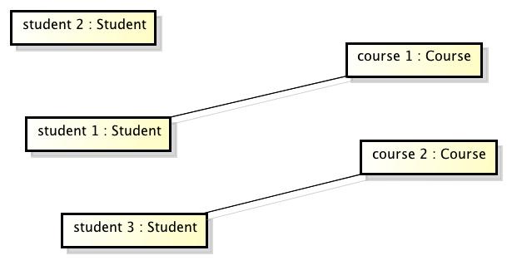
Link
Is enrolled in 11
Is enrolled in 32
Model of property between objects
A property that cannot be represented on one object only

Slide 16
Association
Represent set of links between objects of different classes.
{Is enrolled in 11,
Is enrolled in 32}
Or pairs of objects (one per class):
{student1 – course1,
student1 – course3,
student3 – course2 }

Slide 17
Associations
Class
Student
Association
between classes
Class
Course
Link
between objects

Slide 18
Association - Examples

Slide 19
Association

Slide 20
Role in association
Name of one end of association

Slide 21
Recursive associations

Slide 22
Recursive associations + roles

Slide 23
Style suggestions
Class names
Singular noun
Association name
Verb
Attributes
Type of attribute not needed in conceptual model

Slide 24
Multiplicity
Describe the maximum and minimum number of links in which an object of a class can participate
Should be specified for each class participating in an association

Slide 25
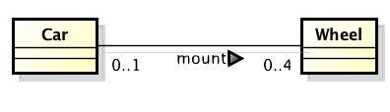
Multiplicity - Example
0..4
Max
Min
A car can mount none, up to four wheels

Slide 26
Multiplicity - Example
0..1
A wheel can be mounted on none or at most one car

Slide 27
Multiplicity
Typically, only three values are used: 0, 1 and the symbol * (many)
Minimum: 0 or 1
0 means the participation is optional,
1 means the participation is mandatory;
Maximum: 1 or *
1: each object is involved in at most one link
*: each object is involved in many links

Slide 28
Multiplicity
Exactly 1
n
Exactly n
*
Zero or more
m..n
Between m and n (m,n included)
m..*
From m up
0..1
Zero or one (optional)

Slide 29
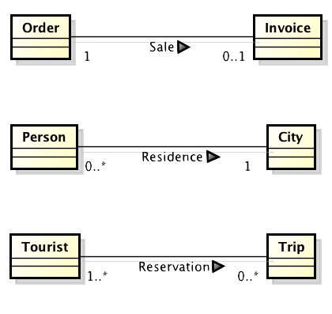
Multiplicity
relates to
lives in
reserves

Slide 30
Associations
There are three special cases of associations
Aggregation
Composition
Specialization

Slide 31
Aggregation
B is-part-of A or
A has B
A
B

Slide 32
Example
Car
Engine
1
power
4
Tyre
1
CD player

Slide 33
Composition
An aggregation where the link part / whole is more strict: lifecycle of both classes is the same
if object Person disappears, so the corresponding 2 objects Leg, Hand

Slide 34
Association Class
The association class allows to attach attributes to the association
A link between two object includes
The two linked objects
The attributes of the link

Slide 35
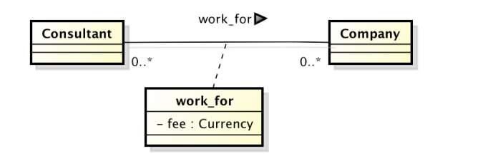
Association Class - Example

Slide 36
Consultant Company fee
--------------------------
consultant1 – company2 – 300
consultant1 – company3 – 200
consultant1 – company3 – 250
consultant2 – company2 – 100
consultant3 – company2 – 300

Slide 37
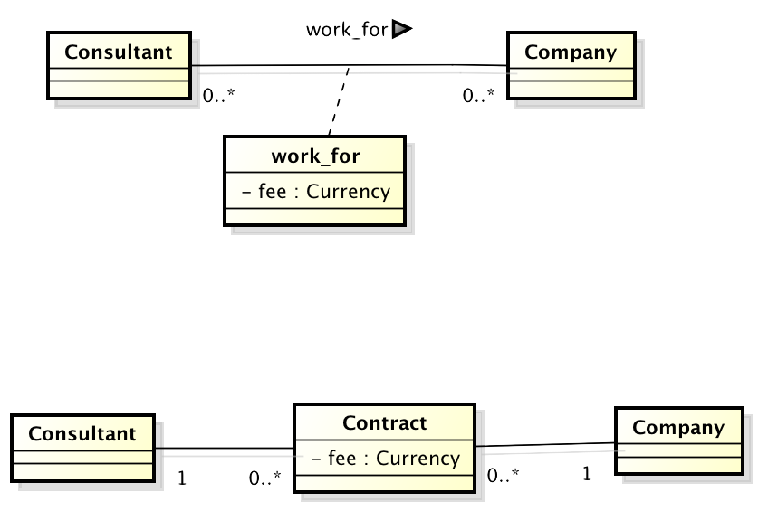
Instead of Association class

Slide 38
Consultant Company Contract
--------------------------
consultant1 – company2 – 300
consultant1 – company3 – 200
consultant1 – company3 – 250
consultant2 – company2 – 100
consultant3 – company2 – 300

Slide 39
The two options are equivalent, except
Intermediate class:
More than one value for a link
Association class:
Only one value for a link

Slide 40
Specialization / Generalization
B specializes A means that objects described by B have the same properties of objects described by A
Objects described by B may have additional properties
B is a special case of A
A is a generalization of B (and possibly of other classes)

Slide 41
Generalization

Slide 42
Specialization can be used only if it is possible to state
B is-a A
Employee is-a Person - yes
Student is-a Person - yes
Head is-a Person – no
Person has-a Head - yes

Slide 43
Inheritance terminology
Class one above
Parent class
Class one below
Child class
Class one or more above
Superclass, Ancestor class, Base class
Class one or more below
Subclass, Descendent class, Derived class

Slide 44
Effects of inheritance
The subclass inherits
All attributes
All associations
Of all ancestors

Slide 45
Employee has properties
First name (inherited)
Last name (inherited)
SSN (inherited)
Salary
Employee
Owns Car (inherited)

Slide 46
Example of inheritance tree
LivingBeing
isAlive
Animal
Vegetal
canMove
CO2 to O2
Human
canThink
Flower
Shopkeeper
Customer
Florist

Slide 47
DOs in Class Diagram
Decide the goal of the model
Conceptual model?
Design model?

Slide 48
Dos – consider:
Physical entities: Person, Car,
Roles: Employee, Director, Doctor,
Social / legal / organizational entities: University, Company, Department
Events: Sale, Order, Request, Claim, Call
Time intervals: Car rental, Booking, Course, Meeting
Geographical entities: City, Road, Nation
Reports, summaries, paper documents: weather report, bank account statement, travel request

Slide 49
DO NOT in class diagrams
Use plurals for classes
Person yes, PersonS no
Forget multiplicities
Forget roles / association classes, when needed

Slide 50
Use of class diagrams
Conceptual model
class diagram with
few domain level classes
Level of detail (#classes)
Design model
class diagram with
key design classes
Source code:
class diagram reverse engineered
from code

Slide 51
DO NOT in class diagrams
Use class as an attribute
If the address has many attributes, it should be modelled as a class, not as an attribute

Slide 52
DO NOT in class diagrams
Use an attribute that represents many objects
‘grades’ is not an attribute but an association with multiplicity *

Slide 53
DO NOT in class diagrams
Use transient (dynamic) relationships that represent events

Slide 54
‘Enters’, ‘exits’
Correspond to events (student enters a classroom)
Avoid them
They clutter the diagrams
They are better represented in scenarios, or activity diagrams, or BPMN (all dynamic models)
even if the information is needed (ex application to trace Covid19 contacts), the association may not be enough
Only one link possible student-x classroom-y
Then use class ‘Entrance log’

Slide 55
DO NOT in class diagrams
Repeat as an attribute of a class a relationship starting from the class
classroomID in Course is redundant (and part of sw design), the association ‘happens’ already conveys the information

Slide 56
DO NOT in class diagrams
Use loops in relationships (normally avoid them unless the information they represent is different over different paths)

Slide 57
Loops
Loop university – office – person
Ok, because ‘works in’ identifies the specific office where a person is, while ‘has’ identifies a larger set of offices

Slide 58
DO NOT in class diagrams
Confound system design, software design, glossary /conceptual model
DO decide the goal of the diagram

Slide 59
DO NOT in conceptual model
Do not model classes that belong to software design
Collections
LinkedList
Array
GUI classes
Window
Button

Slide 60
Be careful
Instance of a subclass cannot become instance of another subclass
Ex: captain cannot be copilot and copilot cannot be captain

Slide 61
Flights must have a captain, and a copilot
Captain John Smith is always captain, cannot be copilot (copilot X Y is always copilot)

Slide 62
Captain and copilot as roles. Pilot john smith can be captain on one flight and copilot on another

Slide 63
Patterns in IS - descriptor
Catalogue vs inventory
Quantity in inventory
N different items

Slide 64
Ex automotive

Slide 65
Ex retail

Slide 66
Patterns in IS - composite (BOM)

Slide 67
Bill of materials (BOM)
Product (A)
3
7
1
Part (1)
Part (2)
Part (3)
2
4
16
6
2
Part (1.1)
Part (1.2)
Part (1.3)
Part (3.1)
Part (3.2)

Slide 68
Composite pattern - BOM

Slide 69
UML Deployment diagram

Slide 70
Goal
design / show the hardware / software configuration of (one, many) applications

Slide 71
Node, association
Node: Physical entity or software entity capable of processing
Association: physical link
Can be nested

Slide 75
Artifact
Source file, executable file, library, db table, ..
In our case, mostly artifact == application
Can be nested

Slide 76
Artifact

Slide 77
Deployment diagram
Which artifact on which node

Slide 78
Using nesting

