Slide 1



Tools & Frameworks
BRENDAN FRY
A year of dealing with RabbitMQ

Slide 2


Queue starts here…
Audience participation
Speed through some queue theory
What is out there?
Define our requirements
Dig a little deeper
Live with our decisions
See how we are doing…

Slide 3

Audience participation
Tell me how I am doing?
https://dc.fryhard.com
Notes:
Need your help to generate some data
Head to this page & click the vote button
Let me know how I am doing
More will be explained during the talk.

Slide 4


Queues
SA 2009 elections in Katlehong
Processing time
Dequeue
Result
Enqueue
Enqueue
time
Waiting time
Notes:
Queue theory
First in –> First out
Enqueue -> DeQueue
Time & Processing to Enqueue
Latency?
Waiting Time = Time spent in queue
Time & processing to dequeue
Latency
Processing time before next message can be dequeued
Result

Slide 5
Choose your queue broker
MSMQ
Microsoft messaging queue
Azure Queues & Service Bus
Hosted in Azure cloud
Amazon Simple Queue Services - aws.amazon.com/sqs/
Hosted with Amazon EC2 services
Rabbit MQ
Installed locally
As a service - CloudAMQP
Many many more… - just look at queues.io
Notes:
Many many options out there!

Slide 6
?? Service Bus ??
Things get even more confusing when you start talking about service buses.
These are generally built on top of a messaging platform, though some come with their own messaging layer built in.
MuleSoft ESB
TIBCO
NServiceBus
Azure Service Bus
Mass Transit
For the purposes of this talk we are going to focus on the messaging or queue layer.
Notes:
Service bus / Enterprise service bus

Slide 7
How do I choose?
What is important for you
Location
Ease of use
Cost
Language API
For us it was Location & Ease of use & Cost
Why send data to an external service?
Easily monitor & configure queues.
Why pay?
Location: Ruled out hosted services like Azure, Amazon, etc.
Ease: Ruled out MSMQ
Cost: Ruled out most ESBs

Slide 8

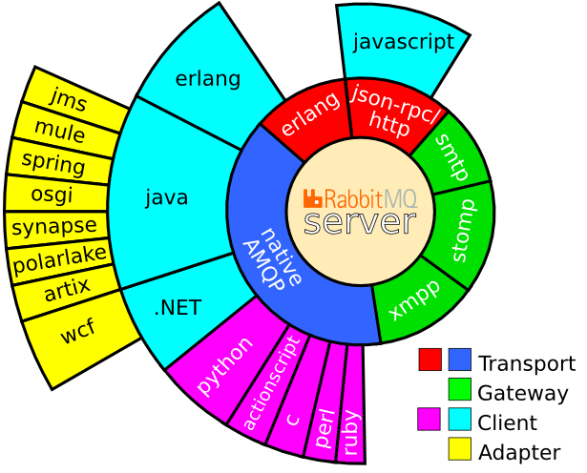
Lets talk Rabbit MQ
Written in Erlang / OTP (Open Telecom Platform)
Concurrency
Parallelism
Built on AMQP messaging Protocol
Advances Messaging Queuing Protocol
http://www.amqp.org/
POC in 2006, First public release 2007
Was 5000, now 12,000 lines of code
Extended by plugins
Notes:
Simon van Dyk – Sorry for the lack of erlang content in this presentation

Slide 9
Core Rabbit MQ concepts
Queues
Queues
Store messages
Exchanges
Route messages
Types
Direct
Fanout
Topic
Header
Binding
Rules used by Exchanges
Tells exchange E to route messages to queue Q
Channels
Allows single connection to Rabbit to be multiplexed
Producer & Consumer
Exchanges
Bindings
Producers
Consumers

Slide 10
Wrappers
Native
EasyNetQ
…

Slide 11
Demo
Save
Web host
Vote
Publish
Good
Bad
Win host
Subscribe
Vote Processed
Publish
Processed
Subscribe
Win host
Web host
Avg Result
Average Result

Slide 12
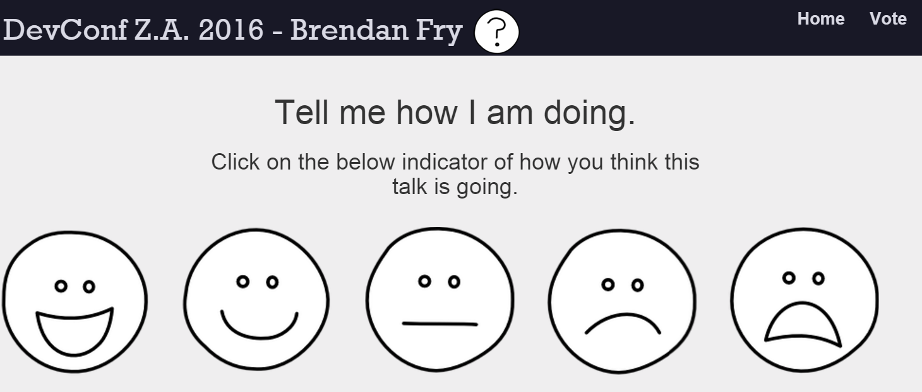
Demo
Vote
Producer

Slide 13
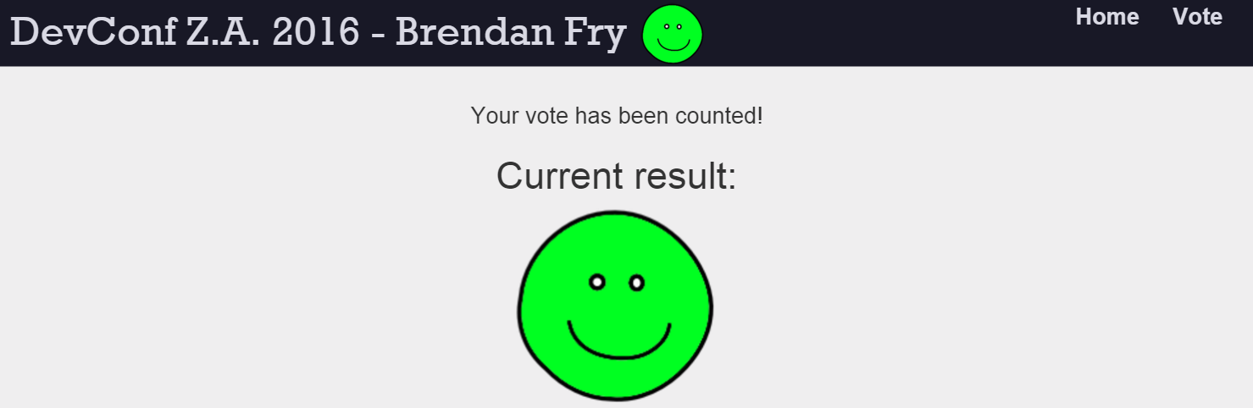
Demo
Consumer
Avg. Result
Consumer
Vote Processed

Slide 14
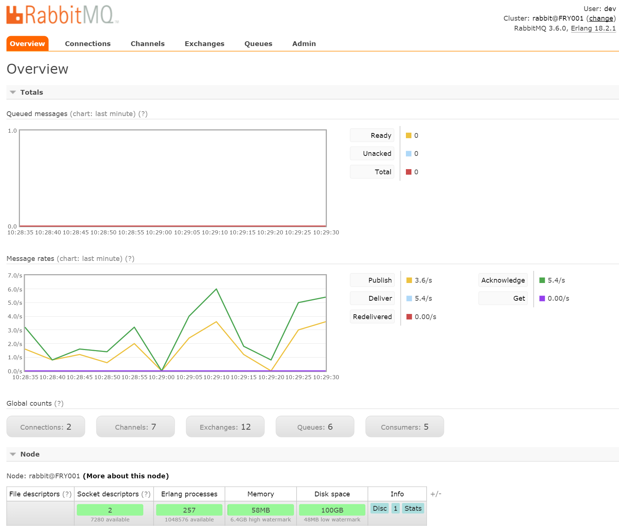
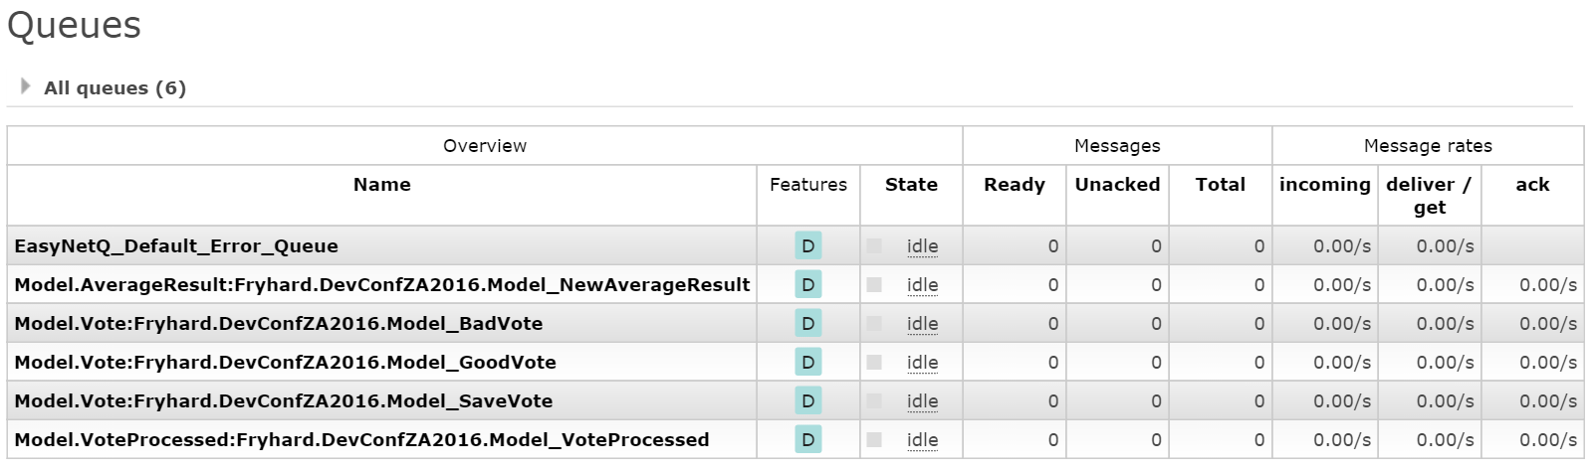

Slide 15

Learnings, lessons, pain, tumble-beasts & homicide

Slide 16


Rabbit != Bottle neck

Slide 17
Beware of big messages

Slide 18
Mnesia DB… right

Slide 19
Sound cloud
Google test 1 trillion, but look at the servers…

Slide 20







So Long, and
Thanks for All the Fish
Brendan Fry
bfry@fryhard.com
0836337634
@Fry_Hard
http://devconf.co.za http://fryhard.com
http://Jagmethod.com
https://www.rabbitmq.com
Code:
https://github.com/Fryhard/DevConfZA2016

