Slide 1



Tools & Frameworks
BRENDAN FRY
A year of dealing with RabbitMQ

Slide 2


Queue starts here…
Audience participation
Speed through some queue theory
Define our requirements
Pick our ideal queue broker
Dig a little deeper
Live with our decisions
See how we are doing…

Slide 3

Audience participation
Tell me how I am doing?
http://dc.fryhard.com

Slide 4

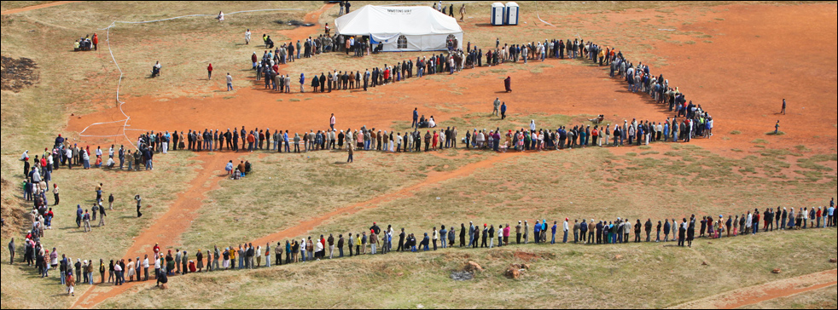
Queues
SA 2009 elections in Katlehong
Processing time
Dequeue
Result
Enqueue
Enqueue
time
Waiting time

Slide 5
Decisions: Location & ease
The core questions that drove our decision were Location & ease
Why send data to an external service when we can keep it in house?
Can we easily monitor & change our queues
This ruled out hosted services from Azure, Amazon, etc.
This also mean we needed a string Management UI

Slide 6
Choose your queue broker
MSMQ
Microsoft messaging queue
Azure Queues & Service Bus
Hosted in Azure cloud
Amazon Simple Queue Services - aws.amazon.com/sqs/
Hosted with Amazon EC2 services
Rabbit MQ
Installed locally
As a service - CloudAMQP
Many many more… - just look at queues.io

Slide 7
Year | Month | LeadsPerMonth | LeadsPerDay | LeadsPerAwakeHour | LeadsPerAwakeMinute
2015 | 1 | 53979 | 1741 | 102 | 1.7
2015 | 2 | 62616 | 2236 | 131 | 2.183333
2015 | 3 | 80051 | 2582 | 151 | 2.516666
2015 | 4 | 76196 | 2539 | 149 | 2.483333
2015 | 5 | 79572 | 2566 | 150 | 2.5
2015 | 6 | 83168 | 2772 | 163 | 2.716666
2015 | 7 | 92049 | 2969 | 174 | 2.9
2015 | 8 | 91808 | 2961 | 174 | 2.9
2015 | 9 | 88697 | 2956 | 173 | 2.883333
2015 | 10 | 88872 | 2866 | 168 | 2.8
2015 | 11 | 73401 | 2446 | 143 | 2.383333
2015 | 12 | 58343 | 1882 | 110 | 1.833333
2016 | 1 | 72291 | 2331 | 137 | 2.283333
2016 | 2 | 50195 | 1730 | 101 | 1.683333

Slide 9






So Long, and
Thanks for All the Fish
Brendan Fry
bfry@fryhard.com
0836337634
@Fry_Hard
http://devconf.co.za http://fryhard.com
http://Jagmethod.com
https://www.rabbitmq.com

