Slide 1
Research task: identify crystal systems from XRD patterns
XRD pattern
Crystal-system identification
→
One of seven crystal systems
Cubic · Tetragonal · Orthorhombic · Hexagonal
Trigonal · Monoclinic · Triclinic
Interim research update
Notes:
左右曲线取自同一 mp-10448 母结构的基准谱与项目已缓存噪声扰动谱，仅作为开篇认知钩子。
[Sources]
- E:/AI4science/xrd_robustness/outputs/public_simulated_test/panel_cache/seed_20260721/level0.npy
- E:/AI4science/xrd_robustness/outputs/public_simulated_test/panel_cache/seed_20260721/ood_noise.npy
- E:/AI4science/xrd_robustness/outputs/public_simulated_test/panel_cache/index.json
- E:\AI4science\xrd_robustness\data\formal_14060\manifests\v9_method_transfer_test_seed_20260721.csv

Slide 2
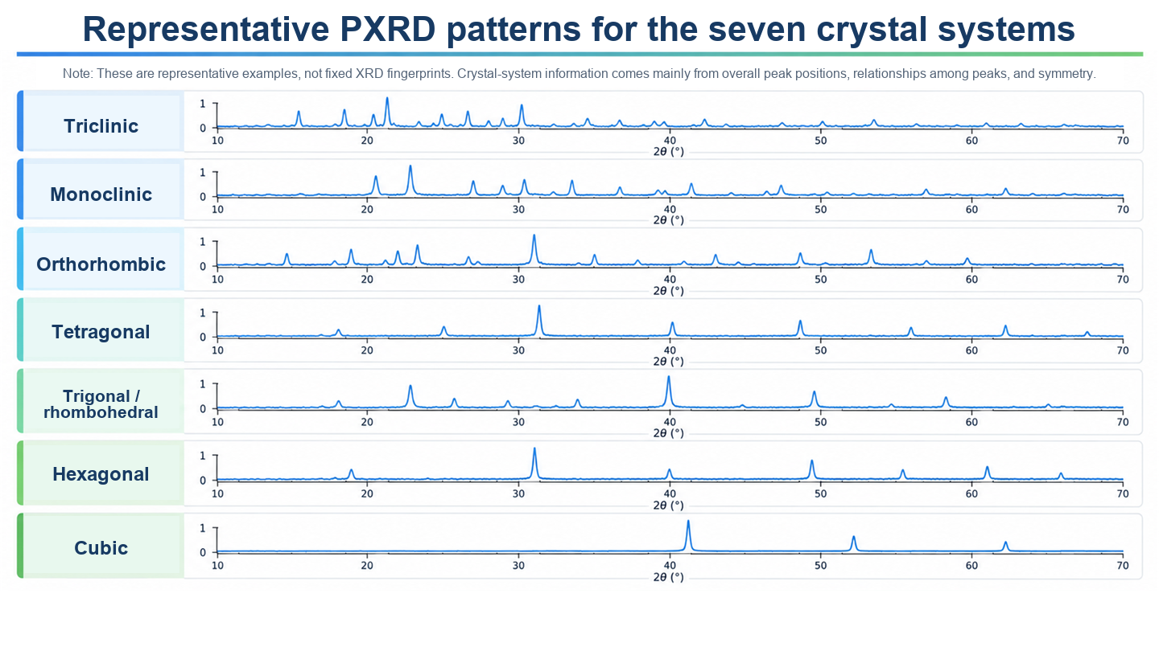

Slide 3
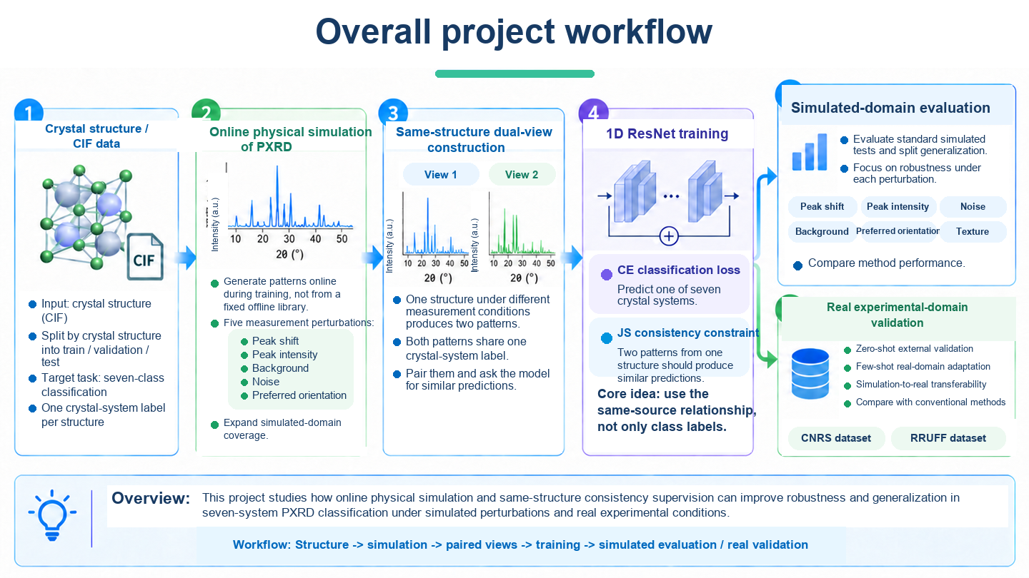

Slide 4
Prior work: randomize measurement perturbations to generate diverse training patterns
02 / 08
Prior work samples parameters for peak shift, broadening, background / noise, and preferred orientation to generate diverse training patterns.
Generate diverse training patterns
Calculate XRD pattern
Randomly sample
perturbation parameters
Training pattern A
Crystal structure
→
→
→
Baseline pattern
Training pattern B
Without measurement perturbations
Peak shift; broadening; background / noise
Preferred orientation
Training pattern C
But patterns generated from the same source are usually still treated as independent training samples.
Selected studies: Oviedo et al. (2019); Szymanski et al. (2021); Lee et al. (2023); Schopmans et al. (2023)
Notes:
讲述提示：前人已经会随机采样峰移、展宽、背景、噪声和择优取向等变化，以扩大训练谱覆盖的实验情况。本页只交代这条已有路线；下一页再说明本工作的新增关系约束。
[Sources]
- https://doi.org/10.1038/s41524-019-0196-x
- https://doi.org/10.1021/acs.chemmater.1c01071
- https://doi.org/10.1002/aisy.202300140
- https://doi.org/10.1039/D3DD00071K

Slide 5
Our improvement: the predictions for the same structure should agree under different perturbations
03 / 08
Same crystal structure
↙
↘
Randomly sampled perturbation A
Randomly sampled perturbation B
↓
↓
Training pattern A
Training pattern B
↓
↓
Crystal-system prediction A
Crystal-system prediction B
↓
↓
Model output
↘
↙
The two predictions should agree
Core idea: encode the physical relation “measurement conditions can change, structure does not” in model training.
Notes:
讲述提示：前人随机生成很多训练谱后，通常把它们作为独立样本。本工作进一步利用生成过程里已经知道的同源关系：若两条谱来自同一晶体结构，模型对晶系的两次判断就应保持一致。

Slide 6
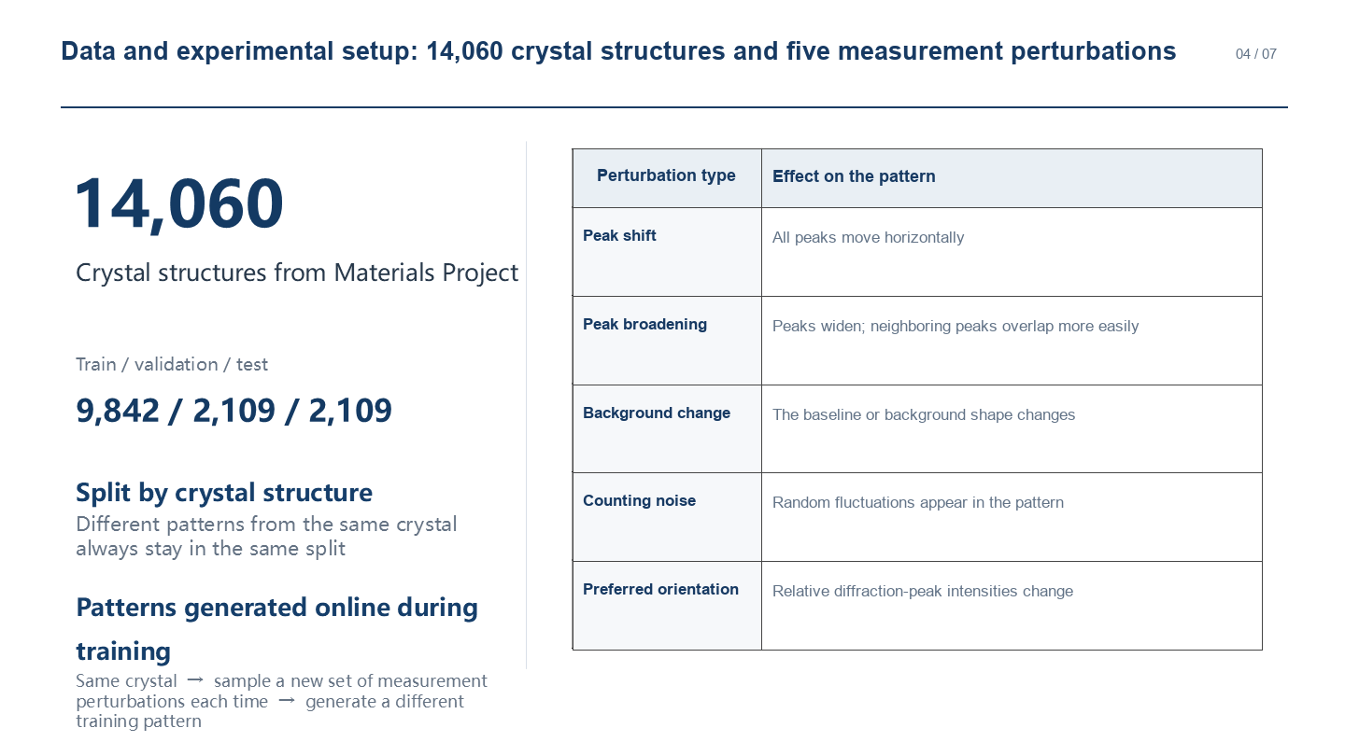
Notes:
本页回答三个问题：使用多少独立晶体结构、模拟哪些测量扰动、训练谱如何生成。
训练时，从同一晶体结构的理想峰表出发，在每个优化步在线采样两组测量条件并即时生成两条扰动谱；随机性由结构、训练轮次、训练步和视图编号共同控制，因此可复现。
验证和测试时冻结每个样本的扰动参数与随机种子，确保不同模型在完全相同的固定谱上比较。
[Sources]
- E:/AI4science/xrd_robustness/configs/experiment.public.json
- E:/AI4science/xrd_robustness/configs/data.method_transfer.structure_split.json
- E:/AI4science/xrd_robustness/data/formal_14060/manifests/split_manifest.json
- E:/AI4science/xrd_robustness/configs/simulation.method_transfer.frozen.json
- E:/AI4science/xrd_robustness/src/xrd_robustness/training/runner.py
- E:/AI4science/xrd_robustness/src/xrd_robustness/online_views.py
- E:/AI4science/xrd_robustness/src/xrd_robustness/view_manifest.py
- E:/AI4science/xrd_robustness/scripts/run_simulated_test.py

Slide 7
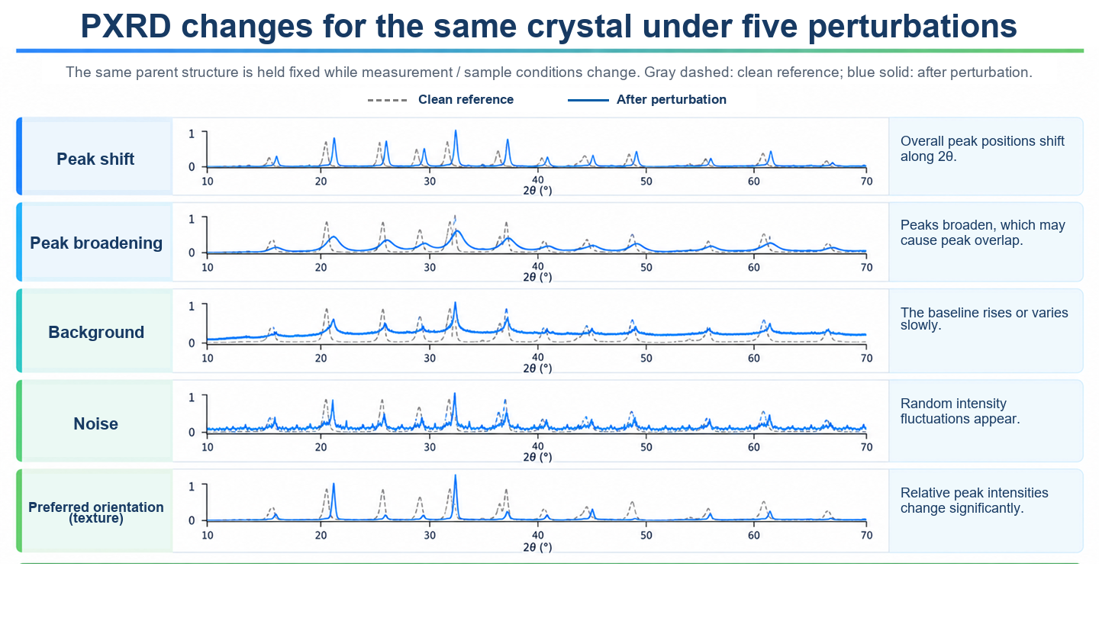

Slide 8
1. Simulated results: improvements in all five training runs
05 / 08
Test set: 2,109 held-out MP structures; test patterns use fixed perturbations outside the training range.
+5.48 pp
+6.14 pp
+4.99 pp
+4.51 pp
+6.18 pp
5 / 5 ↑
Average +5.46 pp
With the same data and training settings, all five repeated runs improved.
Notes:
本页只展示冻结模拟扰动 Test 的 Macro-F1。
重复训练 5 次：数据、模型和训练设置相同，每次只改变随机初始化等随机因素。
5 次重复训练中，一致性训练均优于基线。
重复 1: 0.6390 → 0.6939 (+5.48 pp)
重复 2: 0.6553 → 0.7167 (+6.14 pp)
重复 3: 0.6577 → 0.7075 (+4.99 pp)
重复 4: 0.6517 → 0.6967 (+4.51 pp)
重复 5: 0.6500 → 0.7118 (+6.18 pp)
平均: 0.6507 → 0.7053 (+5.46 pp)
[Sources]
- E:/AI4science/xrd_robustness/reports/simulated_test_results.json

Slide 9
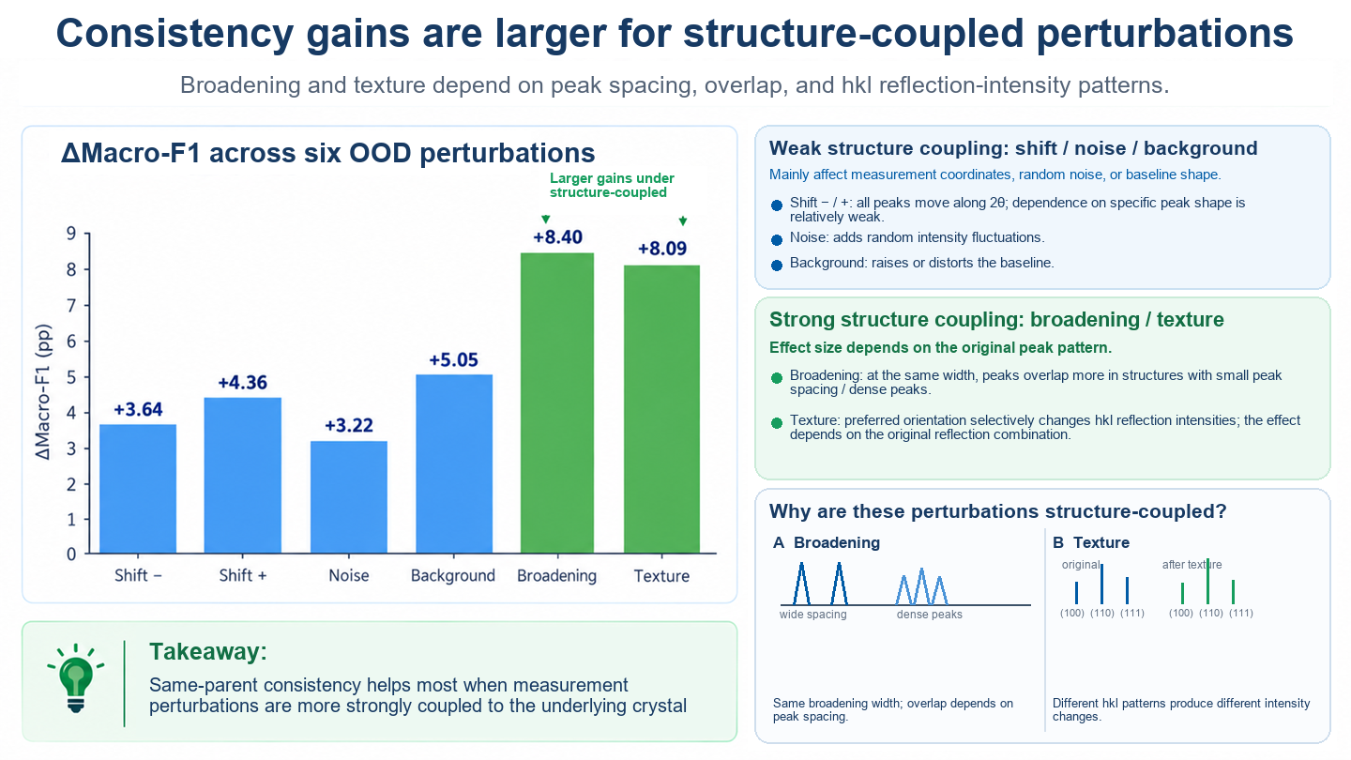

Slide 10
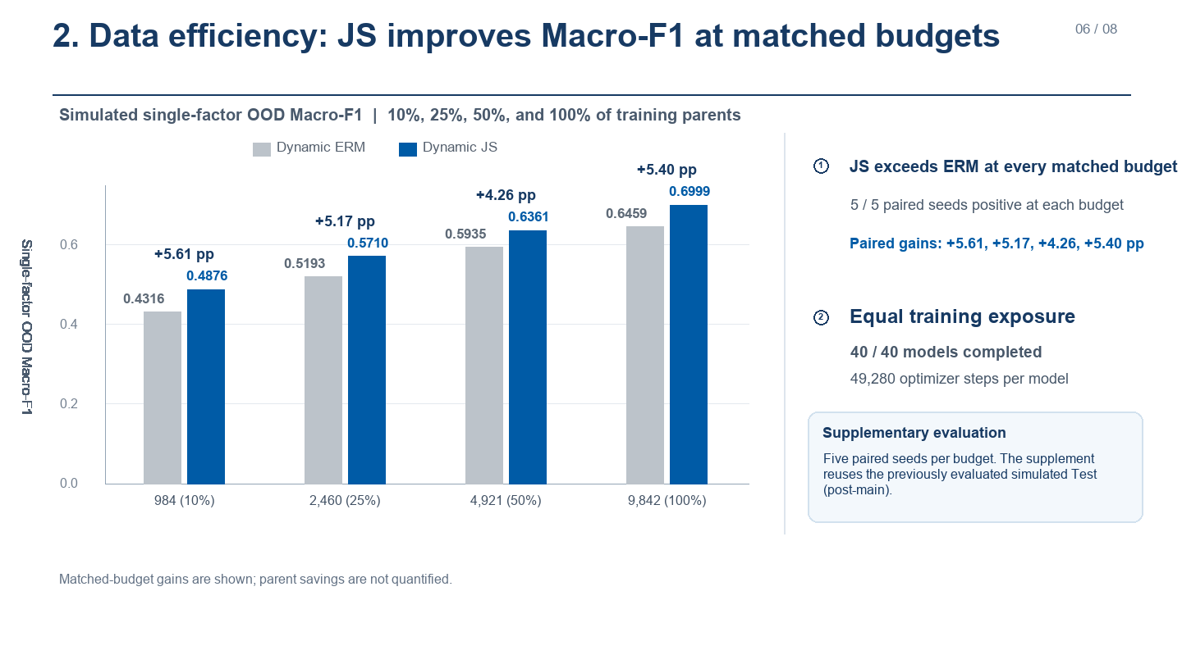

Slide 11
3. RRUFF-301: few-shot fine-tuning with a small number of real patterns
07 / 08
RRUFF-301: 301 experimental patterns | Fine-tune with 1 / 2 / 5 patterns per crystal system
+4.33 pp
+4.60 pp
+5.45 pp
① All three real-label budgets improved
Average gain: about +4.8 pp
② With fewer real patterns, this method reached similar or better performance
This method: 14 patterns ≈ baseline: 35 patterns
0.349 ≈ 0.356
This method: 7 patterns > baseline: 14 patterns
0.328 > 0.303
Notes:
本页核心结论：RRUFF-301 真实谱少样本适配中，仅用 7 条真实谱适配仍提升 +4.33 pp。
RRUFF-301 包含 301 个唯一 RRUFF 实测样本，每个样本对应一条规范化 PXRD 谱；301 不代表 301 种不同矿物。
数据覆盖 7 个晶系，每类 43 条：10 条进入 adaptation pool，33 条进入 locked test。
K=1/2/5 是 labels per class；每个 episode 的支持集因此共有 7/14/35 条真实标注谱。
图中数值为 5 个 pretraining seeds × 5 个 episode seeds 共 25 组配对运行的平均 Macro-F1。
K=1: 0.2847 → 0.3280 (+4.33 pp)
K=2: 0.3026 → 0.3486 (+4.60 pp)
K=5: 0.3555 → 0.4099 (+5.45 pp)
该证据为 retrospectively verified locked-test few-shot 结果，不表述为 provenance-complete prospective confirmatory run。
[Sources]
- E:/AI4science/xrd_robustness/reports/rruff301_fewshot_results.json
- E:/AI4science/xrd_robustness/data/real_xrd/rruff371/contracts/dataset_contract.json
- E:/AI4science/xrd_robustness/data/real_xrd/rruff371/splits/rruff301_manifest.json
- E:/AI4science/xrd_robustness/data/real_xrd/rruff371/manifests/rruff371_master_manifest.csv

Slide 12
4. Independent CNRS-318 zero-shot results: all five runs improved
08 / 08
CNRS-318: an independent set of experimental patterns | Test directly without adapting the model on CNRS data
+1.45 pp
+2.87 pp
+1.29 pp
+1.46 pp
+2.28 pp
5 / 5 ↑
All five repeated runs improved
Average +1.87 pp
The model was tested directly on CNRS data without adaptation and still showed a gain.
Notes:
本页核心结论：模型不使用任何 CNRS 标注数据再训练，直接在 CNRS-318 独立真实实验谱上测试，5 次重复结果全部提升。
重复 1：0.2067 → 0.2212（+1.45 pp）
重复 2：0.1469 → 0.1756（+2.87 pp）
重复 3：0.1842 → 0.1971（+1.29 pp）
重复 4：0.2149 → 0.2295（+1.46 pp）
重复 5：0.1892 → 0.2120（+2.28 pp）
平均：0.1884 → 0.2071（+1.87 pp）
绝对性能仍较低，因此将该结果解释为独立真实谱来源上的直接迁移证据。
[Sources]
- User-provided CNRS-318 five-repeat Macro-F1 values in the current task.

Slide 13
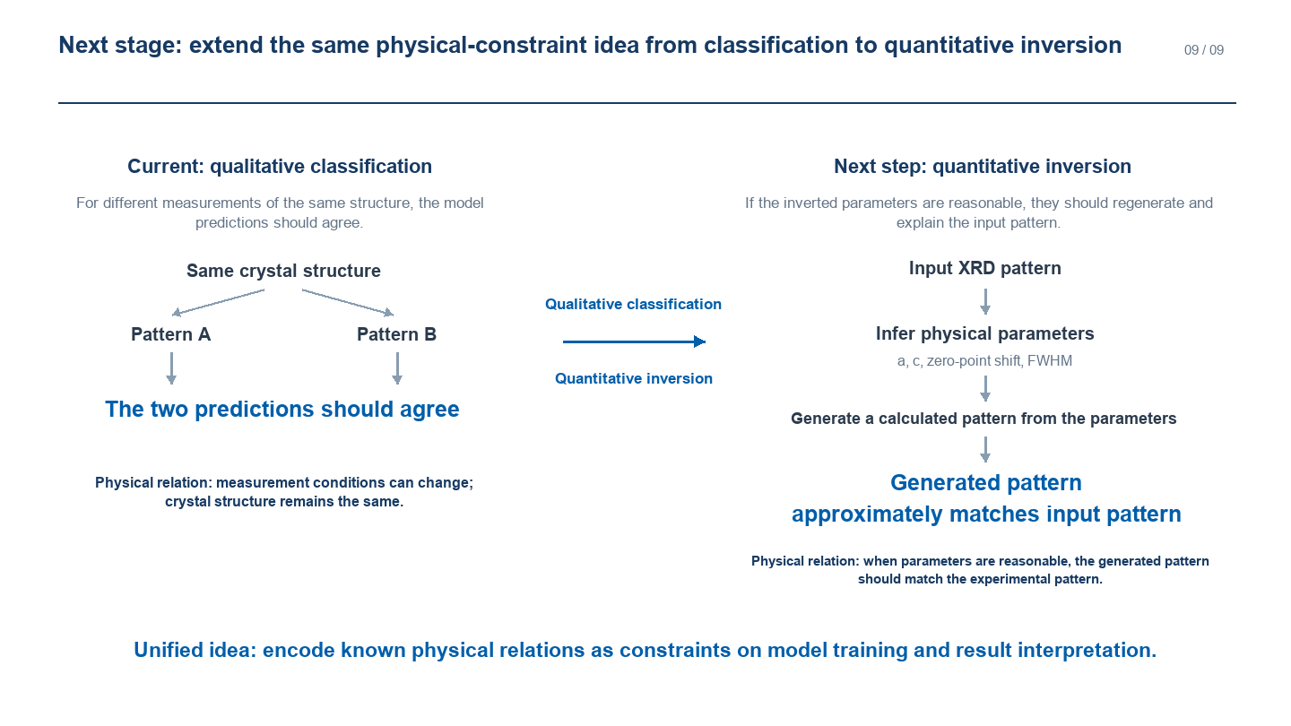
Notes:
本页回答三个问题：使用多少独立晶体结构、模拟哪些测量扰动、训练谱如何生成。
训练时，从同一晶体结构的理想峰表出发，在每个优化步在线采样两组测量条件并即时生成两条扰动谱；随机性由结构、训练轮次、训练步和视图编号共同控制，因此可复现。
验证和测试时冻结每个样本的扰动参数与随机种子，确保不同模型在完全相同的固定谱上比较。
[Sources]
- E:/AI4science/xrd_robustness/configs/experiment.public.json
- E:/AI4science/xrd_robustness/configs/data.method_transfer.structure_split.json
- E:/AI4science/xrd_robustness/data/formal_14060/manifests/split_manifest.json
- E:/AI4science/xrd_robustness/configs/simulation.method_transfer.frozen.json
- E:/AI4science/xrd_robustness/src/xrd_robustness/training/runner.py
- E:/AI4science/xrd_robustness/src/xrd_robustness/online_views.py
- E:/AI4science/xrd_robustness/src/xrd_robustness/view_manifest.py
- E:/AI4science/xrd_robustness/scripts/run_simulated_test.py

