Slide 1
Project Two: Machine Learning
Crypto Investment Analysis & Recommendation
Team:
Anthony Segovia
Josina Baiao
Fabrice Salomon
Chad Burford
Clifford Charles

Slide 2
Project One: Crypto Price Prediction & Technical Analysis
Project Goals:
Use Machine Learning Models to predict future prices of a Crypto Currency – Ripple (XRP)
Code Indicators to perform Technical Analysis for entry/exit recommendations
Automate results using a Bot (AWS Lex) and automated script (AWS Lambda & Sagemaker)
Machine Learning Models:
ARIMA & GARCH
LSTM - Long Short Term Memory
AutoTS – Time Series
NLP Sentiment Analysis
Technical Analysis Indicators:
Fibonacci Retracement
Simple Moving Average - 30 & 200
Bollinger Bands
MACD

Slide 3
Code Approach: Analysis
Price Prediction – Time Series & Sentiment
Pull in data from Yahoo Finance – use Date, Open, High, Low, Close, Adj Close, and Volume
Create Dataframe required for particular model
Scale data if required
Create Train and Test data split if required
Estimate the Model
Fit the Model
Output Summary Results / Evaluate the Model
Technical Analysis Indicators

Slide 4
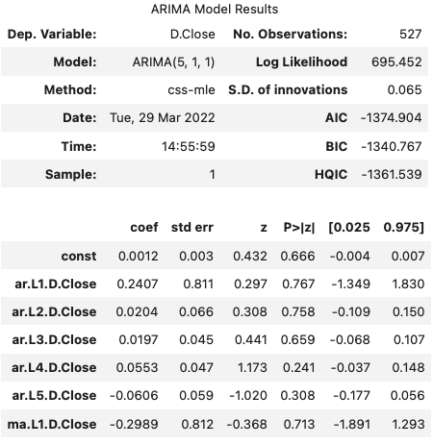
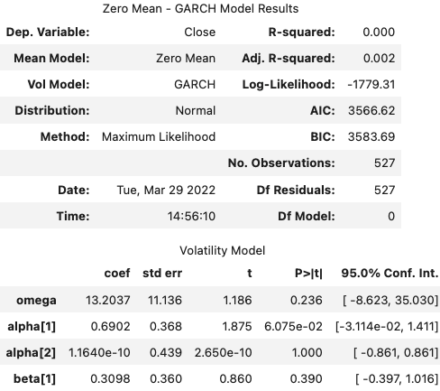
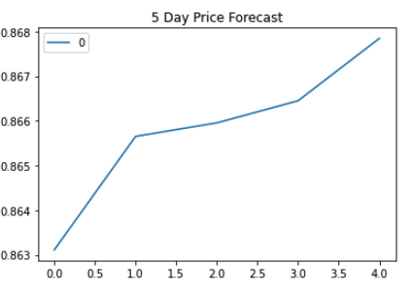
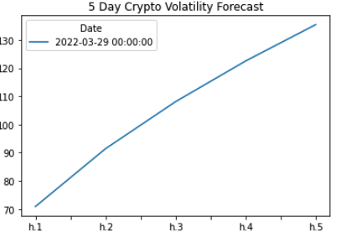
Crypto Price Prediction & Volatility – ARIMA & GARCH

Slide 5
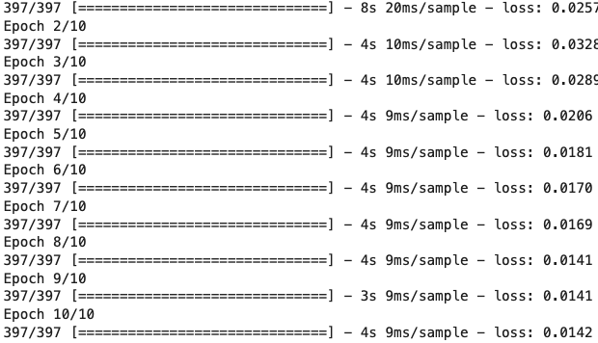
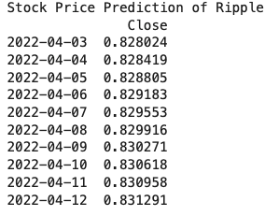
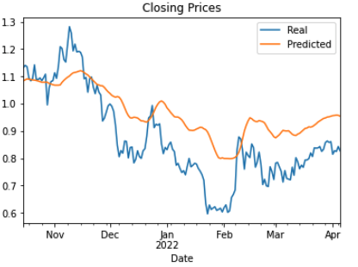
Crypto Price Prediction – LSTM & AutoTS ML Models
Test loss – 0.006283935380162876

Slide 6
Correlation between Population / Average Income and Store Counts

Slide 7
Bollinger Bands
Bollinger Bands are a TA indicator are plotted at a standard deviation level above and below a simple moving average of the price

Slide 8
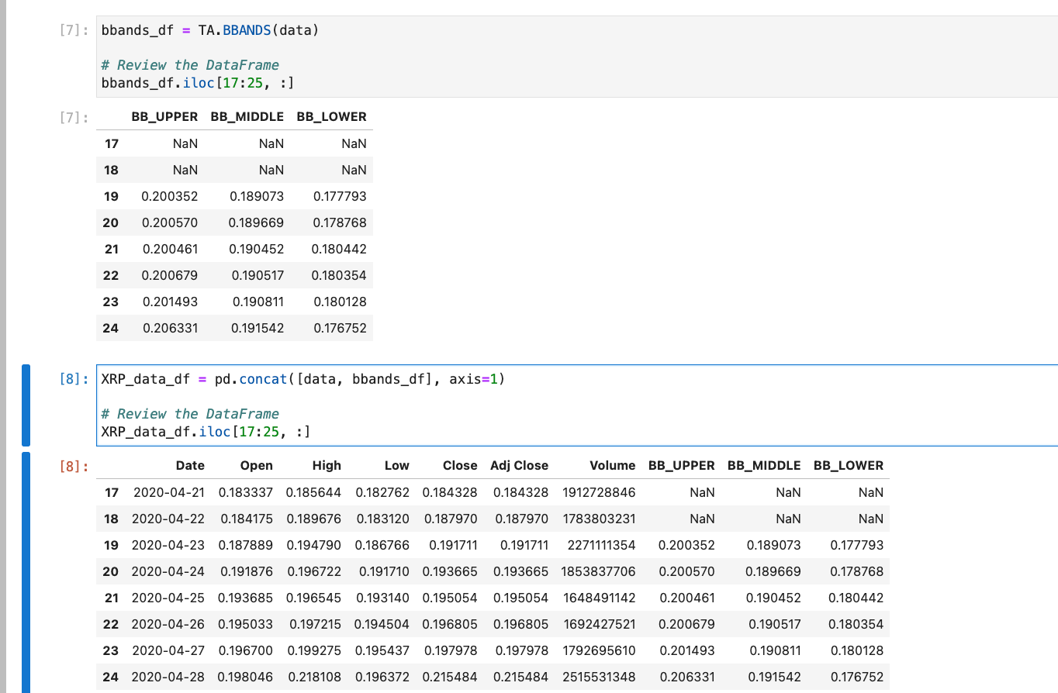
XRP Bollinger Bands

Slide 9
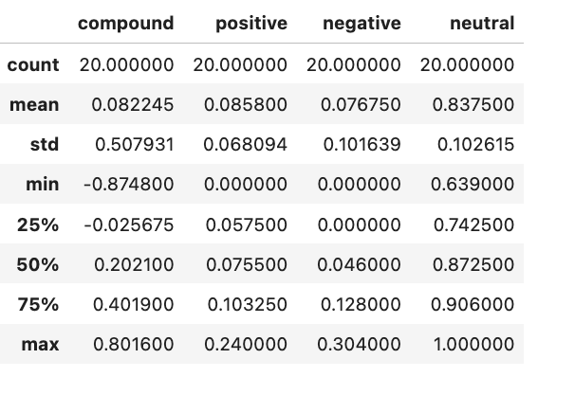
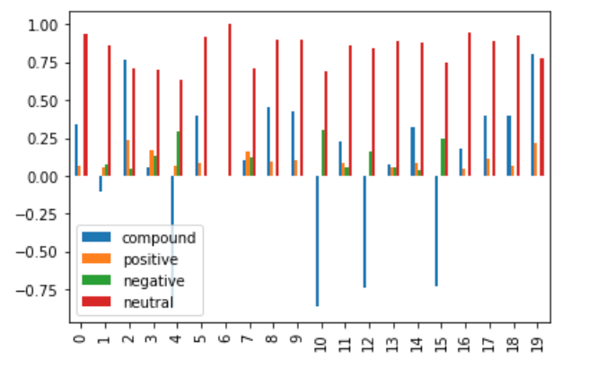
XRP Sentiment Analysis

