Slide 1
故事七步驟 學校故事
Animaze 110ab0009 何彥璟

Slide 2

1.目標
Notes:
https://unsplash.com/photos/investment-specialist-working-in-stock-trading-industry-watching-charts-and-graphs-of-currency-on-smartphone-nzvjsaIKE4Y

Slide 3

2.阻礙
Notes:
https://unsplash.com/photos/laptop-computer-on-glass-top-table-hpjSkU2UYSU

Slide 4

3.努力
Notes:
一張圖分為兩半 中間斜切 一邊是主角在上線上的程式課程 一邊是主角正在參與某種程式設計競賽 主角的形象是一個深藍色頭髮的男大學生 畫風使用明亮開朗一點的

Slide 5

4.結果
Notes:
https://unsplash.com/photos/man-in-gray-dress-shirt-sitting-on-chair-in-front-of-computer-monitor-B6JINerWMz0

Slide 6

4.結果
Notes:
https://unsplash.com/photos/white-arrow-pointing-down-with-declining-bar-graph-on-red-background-downward-trend-in-investment-recession-financial-crisis-inflation-3d-render-illustration-NfYFAvM8dUI

Slide 7

5.意外
Notes:
https://unsplash.com/photos/team-of-stockbrokers-are-having-a-conversation-in-a-dark-office-with-display-screens-analyzing-data-graphs-and-reports-for-investment-purposes-creative-teamwork-traders-DYOsdOV-0JA

Slide 8
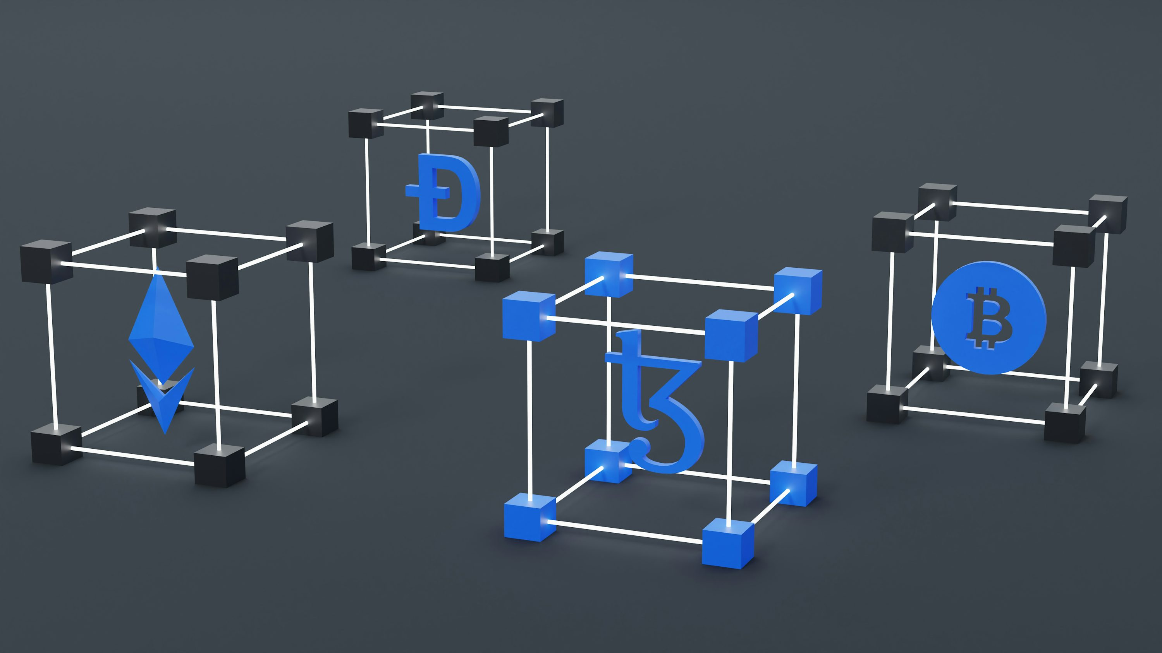
6.轉彎
Notes:
https://unsplash.com/photos/a-set-of-three-blue-and-white-cubes-with-a-bitcoin-symbol-WjVHp7heLWw

Slide 9

7.結局
Notes:
https://unsplash.com/photos/black-android-smartphone-on-macbook-pro-dA0SA67EgOQ

