Slide 1
TM Misspellings
Ted Kwartler

Slide 2
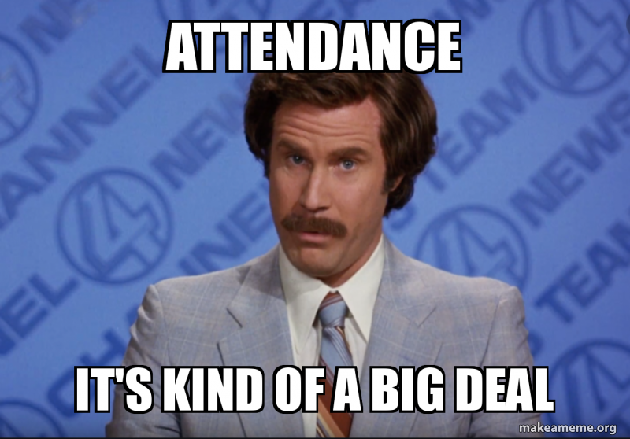

Slide 3
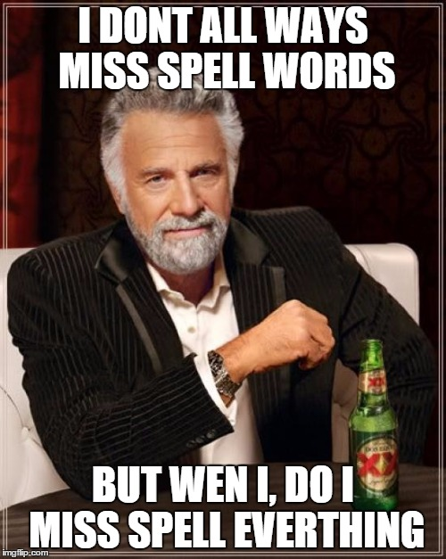
What about misspelling?
Prevalent
Painful to correct
Channel specific

Slide 4
R packages to deal with misspelling
library(qdap)
check_spelling(…)
check_spelling_interactive(…)
Crashes Rstudio.cloud!
Separate the words from a string into individual terms.
Look those words up in a dictionary to find words not recognized/found (considered possibly misspelled).
These misses (possible misspellings) will be what is looked up for suggested replacements and top “n” terms returns. It uses “string distance” the number of characters needed to change the unknown into the known word in the dictionary.

Slide 5
R packages to deal with misspelling
library(hunspell) #https://hunspell.github.io
hunspell_check(…)
hunspell_suggest(…)
hunspell_analyze(…)
Clunky to use!
Check the terms (doesn’t always catch the terms as well as qdap in my exp)
Identify the suggestions
No way to get suggestions easily corrected and inserted!
Same spelling engine used for Chrome/Firefox etc.

Slide 6
R packages to deal with misspelling
Library(spelling)
hunspell_check(…)
hunspell_suggest(…)
hunspell_analyze(…)
We will use in this course but pg 45 of the book has the qdap option
Check the terms
Identify the suggestions
Organize the suggestions into a lexicon
Use a global substitution (gsub) to correct identified misspellings
Still uses the benefit of hunspell but is easier to interact with.

Slide 7
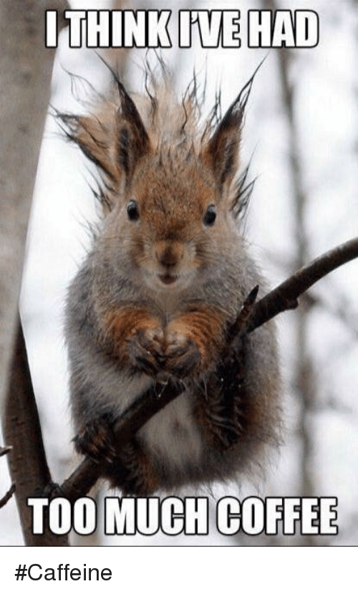
Too much coffee! Open ﻿A_spellCheck.R
Learning Outcome: Identify and correct misspelled words in a text vector.

