Slide 1
Getting a Word Frequency Matrix
beerFreq<-colSums(beerDTMm)
beerFreq<-data.frame(word=names(beerFreq),frequency=beerFreq)
Document Term Matrix
Word Frequency Matrix
 | Term1 | Term2 | Term3 | … | Term_n
Tweet1 | 0 | 1 | 1 | 0 | 0
Tweet2 | 0 | 1 | 0 | 0 | 0
Tweet3 | 0 | 0 | 0 | 3 | 0
… | 0 | 0 | 0 | 1 | 1
Tweet_n | 0 | 0 | 0 | 1 | 0
word | freq
Term1 | 0
Term2 | 2
Term3 | 3
… | 5
Term_n | 2

Slide 2
Open C_text_organization_extraREVIEW.R
Learning Objective: Review text cleaning, organization and the word frequency matrix.

Slide 3
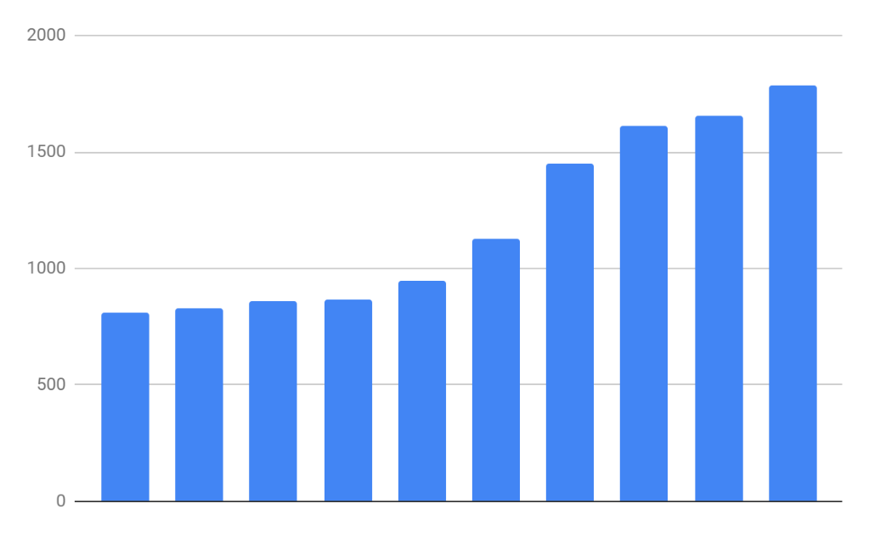
Basic Bar Charts
Rectangles are representative of frequency of term
Word Frequency Matrix
word | freq
Term1 | 0
Term2 | 2
Term3 | 3
… | 5
Term_n | 2

Slide 4
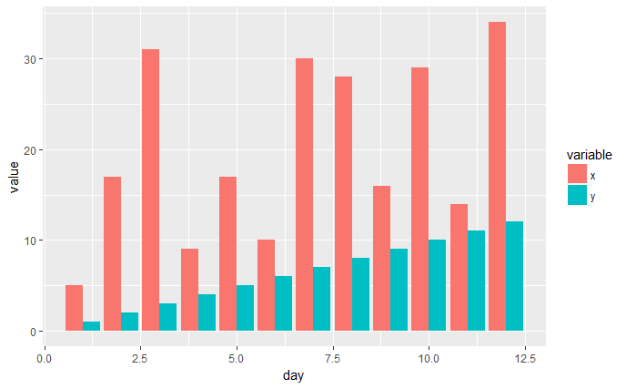
Side by Side Charts
Side by Side bar charts let you compare frequency by category

Slide 5
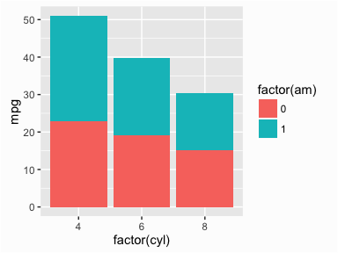
Stacked Bar Charts
Stacked bar charts lets you compare proportion within a category

Slide 6
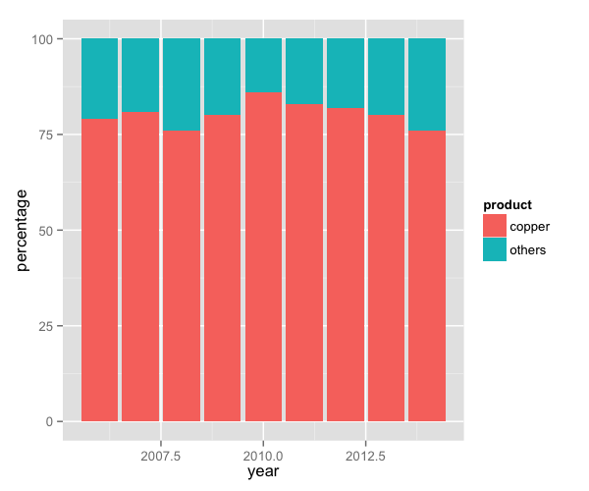
Proportional Stacked Bar Charts
Proportional stacked bar charts let you compare proportion across categories regardless of magnitude

Slide 7
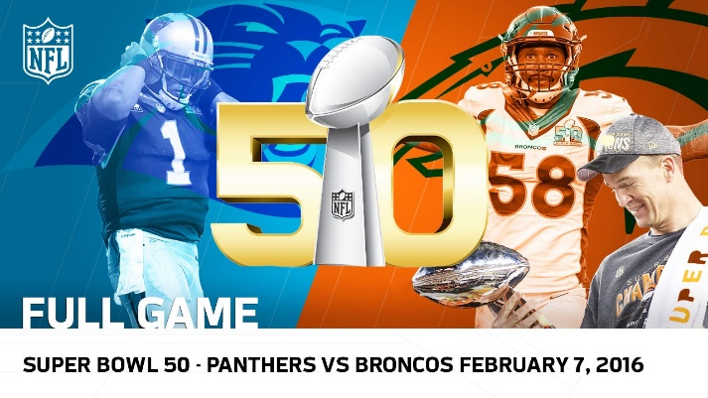
What frequency distribution should we expect?
Many words in natural language but also a steep decline in actual usage. Follows a predictable pattern.

Slide 8
Top 100 terms
This predictable pattern is called “Zipf’s Law”

Slide 9
Zipf’s Law is observed in human behavior
Population density often falls into this type of distribution
Swiss Cities
UK Cities

Slide 10
Zipf’s Law is observed in business
Many industries become natural monopolies. Without this natural maturing the industry is hyper competitive “Coke vs Pepsi”
Insurance - 2016 Direct Premiums Written ($)
Tech – 2018 US Cloud Compute Mkt Share
https://www.insure.com/car-insurance/largest-auto-insurance-companies-by-market-share.html
https://www.canalys.com/newsroom/cloud-market-share-q4-2018-and-full-year-2018

Slide 11
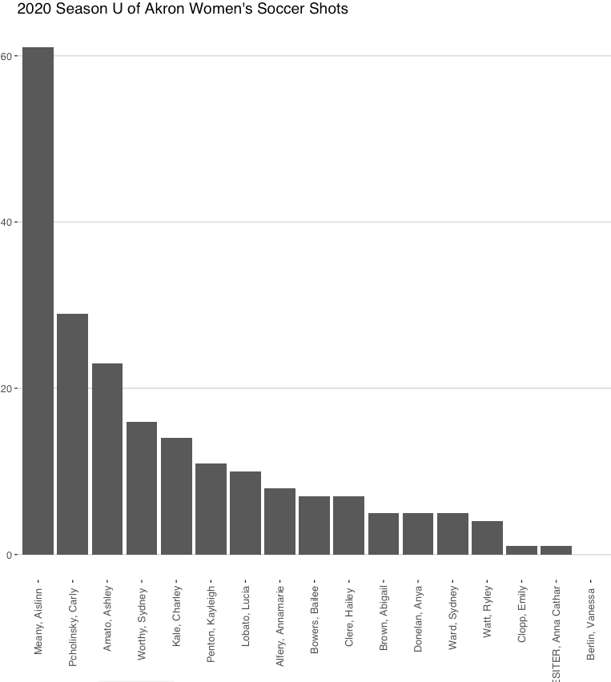
Zipf’s Law: The frequency of a word is inversely related to its rank in a word frequency matrix.
In language this means we should expect coming words to dominate.
Term Rank
Observation or Word A appears N times
Word B is expected to appear N/2
Word C is expected to appear N/3
Word D is expected to appear N/4
…
…
https://www.worlddata.info/average-income.php

Slide 12
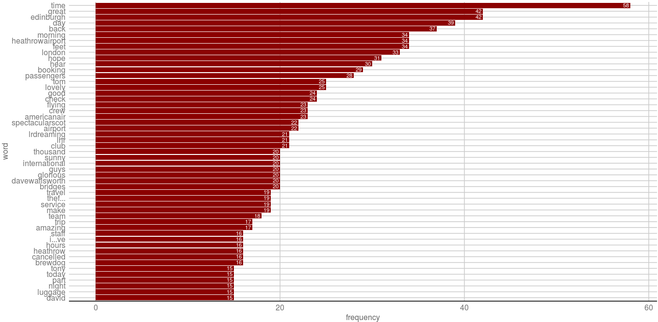

Open D_Frequency_Viz.R
Visualizing the WFM

