Slide 1
Projekt:Online food ordering
Punoi : Tea Lamaj

Slide 2
Pershkrim i pergjithshem:
Projekti konsiston ne dizenjimin dhe analizmin e nje aplikacioni qe i mundeson punonjesve te nje kompanie te porosisin dreken . Pasi logohen ne sistem, punonjesit kane mundesi te aksesojne menune ditore dhe te zgjedhin mes vakteve te ndryshme qe ofron sistemi. Ato marin informacion mbi produktet qe mund te zgjedhin, cmimet dhe sasine.Kane mundesine te shohin porosite e procesuara me heret, si dhe mundesine per te nderruar passwordin.Pjese e rendesishme e sistemit eshte dhe administratori , i cili regjistron user-at ne sistem ,nderton menun ditore,gjeneron porsite ditore,gjenron te dhena(raporte)mbi porosite javore.
Kerkesat e paleve te perfshira:
1. User (employee)
Ndikohen nga cilesia e website-it dhe funksionalitetet e tij. Kerkojne saktesi dhe lehtesi ne veprime si dhe shumellojshmeri zgjedhjesh. Website duhet te jete sa me i thjeshte per tu vizituar ne menyre qe te perdoret lehtesisht .
2. Administratori
Programi duhet te jete i sigurt , ne menyre qe te informacione te rendesishme(psh. te dhena personake te userave) te mos jene te aksesueshme nga persona te tjere.Sistemi te jete i afte te mbaje nje numer te konsiderueshem perdoruesish aktive.Te ndertoje menune ditore,te ndertoje raporte mbi porosite javore te user-ave
Funksionalite te sistemit:
Administratori:
1) Regjistron userat dhe administratoret e tjere te sistemit
2) Krijon menune ditore
3) gjeneron raporte mbi porosite ditore dhe javore te perdorueseve

Slide 3
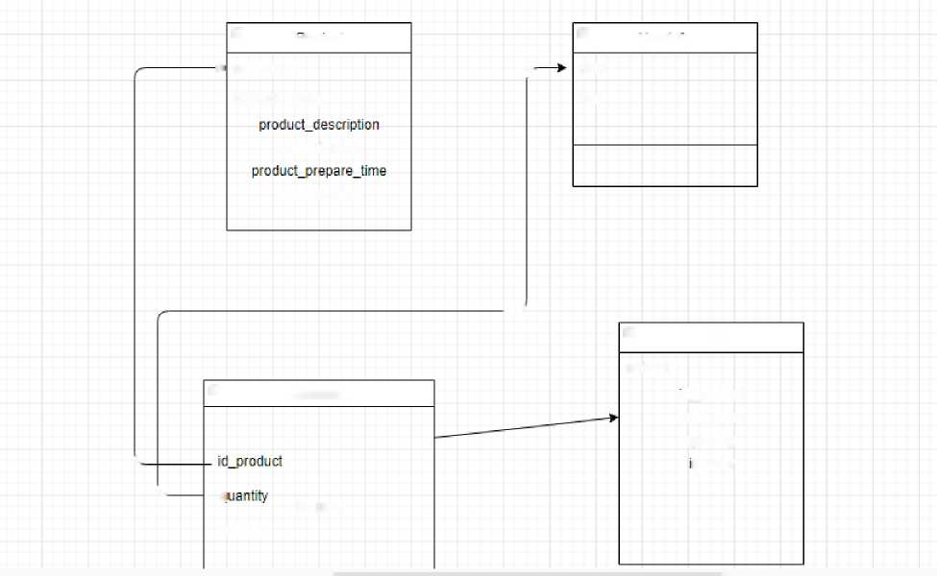
User-i.
1) Njihet me menune ditore
2) Mund te zgjedhe disa nga produktet e menuse
3) Mund te shohe porosite e meparshme te kryera ne app
4) Mund te ndryshoje passwordin
Diagrama Uml
 |  |  |  |  | El |  |  |  |  |  |  |  |  | 0
 |  |  |  |  |  | rroauci |  |  |  |  |  |  |  |  | userinTo
 |  |  |  |  | productjd |  |  |  |  |  |  |  |  | user
 |  |  |  | * |  |  |  |  |  |  |  | f
 |  |  |  |  | product_name |  |  |  |  |  |  |  |  | rol | B
 |  |  |  |  | product_price
 |  |  |  |  |  | create | d_time
 |  |  |  |  |  |  |  |  |  |  | __-
 |  |  |  |  |  |  |  |  |  |  |  |  |  |  |  |  | 0 |  | Order
 |  |  |  |  |  |  |  |  |  |  |  |  |  |  |  |  | orderjd id_product
 |  |  |  |  |  | B |  | Addtocart
 |  |  |  |  |  |  |  |  |  |  |  |  |  |  |  |  |  | total_price quantity
 |  |  | k |  |  |  |  |  |  |  |  |  |  |  |  |  |  |  | d_user
 |  |  |  | k_
 |  |  |  |  |  | G 0 | rdered | id_L | jser

Slide 4
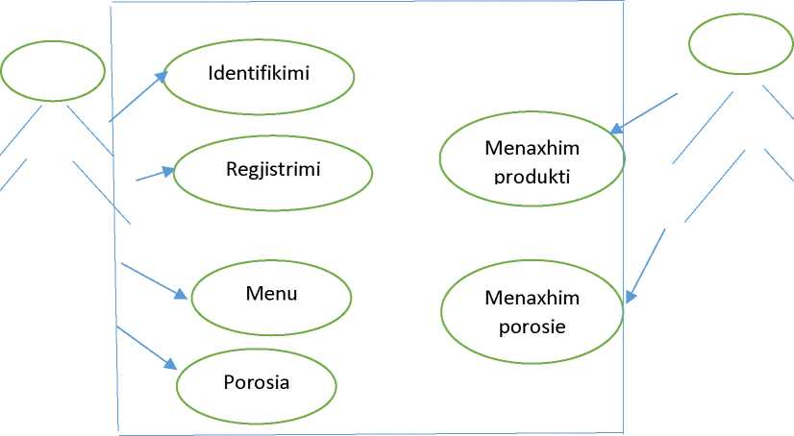
2.Modeli i objekteve(Use Case)
Hapat e krijimit :
• krijimi i folderit ku do te vendoset projekti
• krijimi i mjedisit virtual
• instalimi i django—->pip install django
• krijimi i projektit -^django-admin startproject orders
• runserver -^shohim qe projekti eshte krijiar
• pip freeze > requirements.txt
• krijimi i aplikacionit^python manage.py startapp appi -Fillojme ndertimin e modeleve
from django.db import models
from django.contrib.auth.models import User from django.urls import reverse # Create your models here.
from datetime import date
class UserInfo(models.Model):
CHOICES = [
('admin', 'admin') ,
('suser' , 'suser'),

Slide 5
]
user = models.OneToOneField(User,on delet =models.CASCADE) role = models.CharField(max length =20, choices=CHOICES)
class Product(models.Model):
product id = models.AutoField(primary key=True, unique=True) product name = models.CharField( Lax length=20) product description =
models.CharField( max length=100,blank=True,nul =True) product prepare time = models.IntegerField() product price = models.IntegerField( lefaul =0) created time = models.DateTimeField( defaul =date.today())
def str (self):
"""String for representing the Model object.""" return self.product name
def get absolute url(self):
"""Returns the url to access a detail record for this product.""" return reverse('product-detail', args=[str(self.product id)])
class AddToCart(models.Model):
cart id = models.AutoField( rimary ke =True, unique=True) id product = models.ForeignKey(Product,on delet =models.CASCADE) quantity = models.IntegerField()
id user = models.ForeignKey(User,on delete=models.CASCADE) ordered = models.BooleanField(default=False)
©property
def total cost cart(self):
return self.quantity * self.id product.product price class Order(models.Model):
order id = models.AutoField(primary ke=True, uniqu =True) id product = models.ForeignKey(Product,on delet =models.CASCADE) quantity = models.IntegerField()
id user = models.ForeignKey(User,on delete=models.CASCADE) created time = models.DateTimeField( .efaul =date.today()) total price=models.IntegerField(defaul=0)
©property
def total cost(self):
return self.quantity * self.id product.product price
Ne file-in admin.py vendosim:
from django.contrib import admin

Slide 6
# Register your models here.
from appi.models import UserInfo,Product,AddToCart,Order
admin.site.register(Userlnfo)
admin.site.register(Product)
admin.site.register(AddToCart)
admin.site.register(Order)
me pas krijojme superuser-in dhe bjm runserver-it -python manage.py createsuperuser -python manage.py runserver
Pasi logohemi si superuser ,shohim panelin e admin, shohim qe tabelat jane krijuar ne database , bejme mbushjen e tyre me te dhena dhe percaktojme rolet e userave.me pas krijojme view-t dhe template-t perkatese per ndertimin e web app-it
Ne views.py:
from django.shortcuts import render
from appi.models import UserInfo,Product,AddToCart,Order from django.views import generic from datetime import date
from django.contrib.auth.decorators import login required from django.contrib.auth.mixins import LoginRequiredMixin from django.urls import reverse lazy from django.contrib.auth.views import PasswordChangeView,PasswordResetDoneView
@login required def index(request):
return render(request, 'index.html',{})

Slide 7
class ProductList(LoginRequiredMixin,generic.ListView): model = Product
template name = 'appi/product list.html' context object name = 'products'
def get queryset(self):
return Product.objects.filter(creation time=date.today())
class ProductDetailView(LoginRequiredMixin,generic.DetailView): model = Product
template name = 'appi/product detail.html'
class MypasswordChangeView(PasswordChangeView):
template name = 'registration/password change.html'
success url = reverse lazy('registration/password reset done.html')
class MyPasswordResetDoneView(PasswordResetDoneView):
template name = 'registration/password reset done.html'
class UserOrderView(generic.DetailView): template name='appi/order detail.html' model=Order
context object name=order
def dispatch(self,request,*args,**kwargs): if request.user.is authenticated and UserInfo.objects.filter((user=request.user).exists()) order id=self.kwargs['pk'] order=Order.objects.get[id=order id] if request.user != order.id user: return redirect('/index/')
else:
return redirect('/index/') return redirect('/login/') return super().dispatch(request,*args,**kwargs)
per cdo view ndertojme tempalatet perkatese dhe bjme lidhjen e tyre ne file-in urls.py

Slide 8
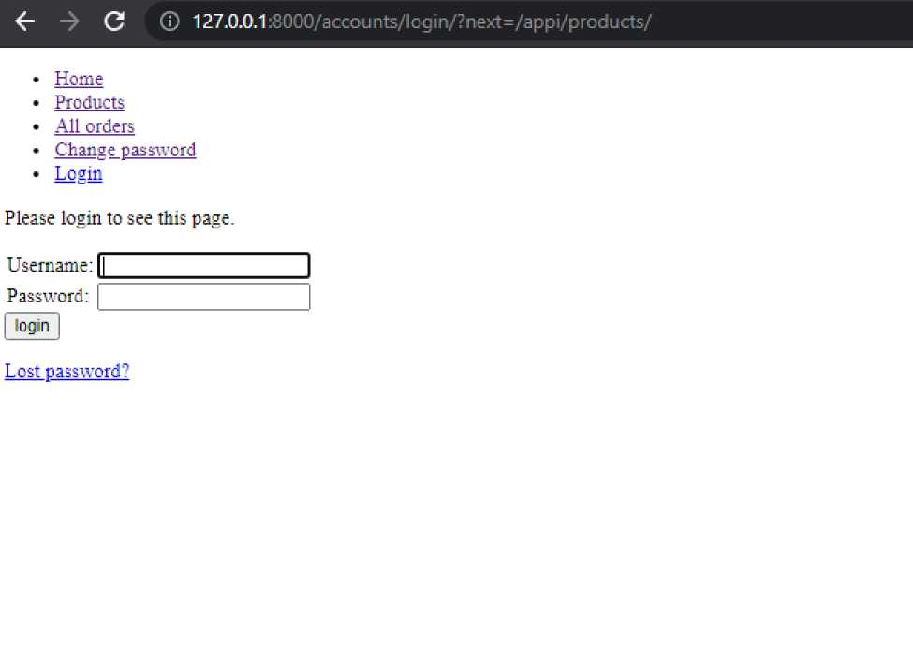
Pamja e sistemit per nje simple user: 1- Forma e log in

Slide 9
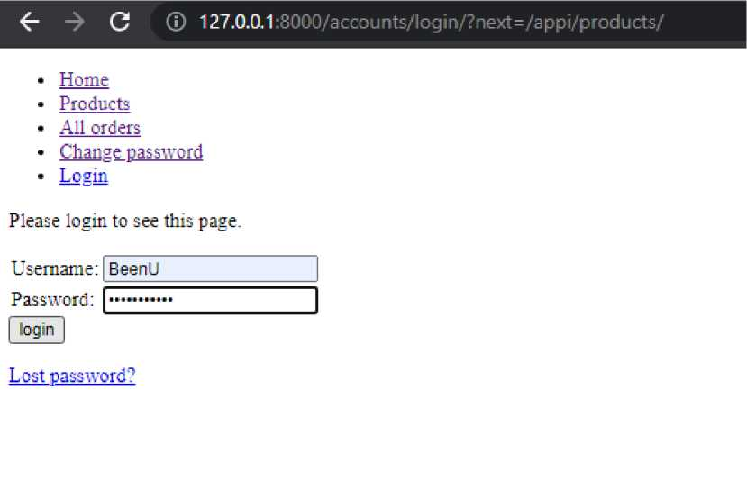
2-Vendosja e te dhenave dhe logimi
3-Home page
• Home
• Products
• All orders
• Change password
• User: BeenU
• Logout
The belly rules the mind!
Part of success is to eat what you like and let the food fight it out inside!

Slide 10
4-Lista e produkteve
<r -> C © 127.0.0.1:8 000/ a p p i/ p ra d u cts/
* Home
* Products
* All orders
* Change password
* User: BeenL"
* Logout
Product List
• Pasta
• Pizza
* Salad
* Soup
• Sandwich
* Chicken Salad
* Caesar Salad
• Rizotto
5-Detajet mbi produktin
<r "> C © 127.0.0.1:8000/appi/product/6
* Home
* P re ducts
* All orders
* Change password
* User: BeenL’
* Logout
Name: Chicken Salad
Prepare tiine:4 min Price: 4 S
Add Tc Cart Order

Slide 11
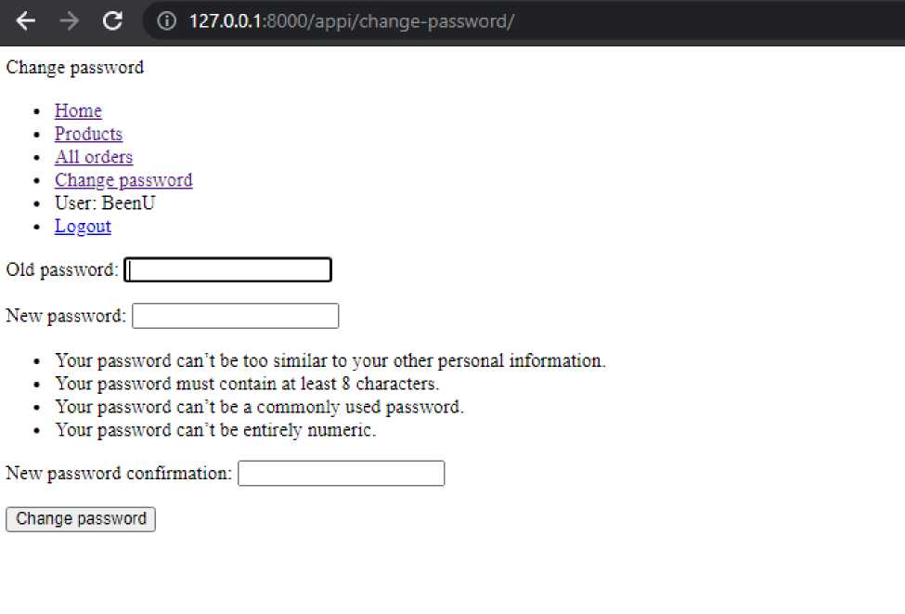
6- Butonat add to Cart dhe Order
7- Change password

Slide 12
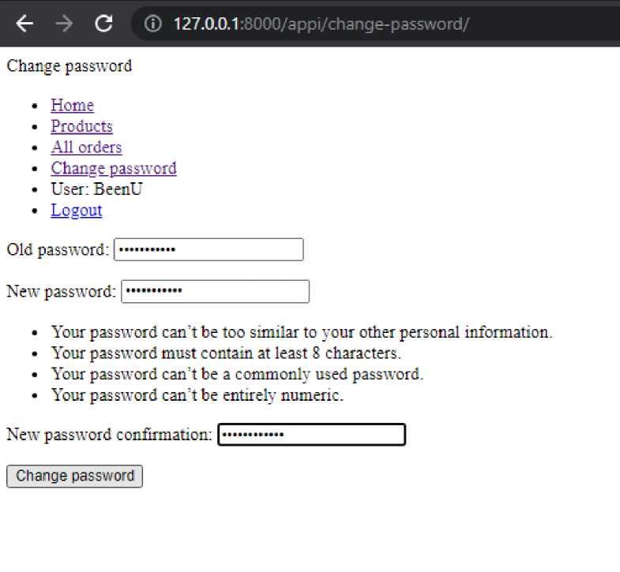
8-Log out
0 Q 127.O.0.1:8OOO/account5/logln/?next=/appi/
* Home
* Predicts
* All orders
* Char.se passwcrd
* Losir.
Please login to see this page.
Username: [_
Password:
[ login |
Lest password?

Slide 13
Admin Pages
## admin pages
class AdminDailyOrderstList(LoginRequiredMixin,generic.ListView): model = Order
template name = 'appi/order list.html' context object name = 'orders'
queryset=Order.objects,filter(created time=date.today())
import datetime
class AdminWeekOrdersListView(generic.ListView): template name = 'appi/weekorders html' date=datetime.date.today()
start week=date-datetime.timedelta(date.weekday()) end week=start week+datetime.timedelta(7) queryset =
Order.objects.filter( created time range=[start week,end week])
class ProductCreate(LoginRequiredMixin, CreateView): model = Product form class=ProductModelForm success url = reverse lazy('product')
def form valid(self, form): print(form.cleaned data)
return super(ProductCreate, self).form valid(form)
class ProductUpdate(LoginRequiredMixin, UpdateView): queryset=Product.objects.all() model = Product fields = ['product price'] template name='appi/product form.html'
def put(self,*args,**kwargs):
json body=json.loads(self.request.body) if Product.objects.filter(id=kwargs.get('pk'))
active product=Product.objects.get(i< =kwargs.get('pk')) for field,value in json body.items():
setattr(active product,field,value) active product.save() message="Product price updated " else:
message="This product does not exist" return HttpResponse(message)

Slide 14
class ProductDelete(generic.DeleteView): template name="product delete.html" queryset=Product.objects.all() model=Product
succes url=reverse lazy('products')
def delete(self,request,*args,**kwargs) print(args,kwargs) message="deleted successfully" return HttpResponse(message)

