Slide 1

CS4225/CS5425 Big Data Systems for Data Science
Coding Assignment 2: Spark
Xinyu Chen, Bingsheng He
School of Computing
National University of Singapore
xinyuc@u.nus.edu
Notes:
.

Slide 2
Outline
Task1: CommonWords
Task2: K-means
Submission requirements

Slide 3
Task1: Commonwords with Spark
You are asked to implement the Commonwords using Spark.
The application description is same as Task1 in assignment1, except that we recommend you to write the program in Scala.
Why Scala? Because it is native in Spark.
Learn Scala here: https://docs.scala-lang.org/learn.html
The input and output requirements are same.

Slide 4
Task 1: Report
You need to summarize Task1 and write a report (up to 2 pages), including at least the following two aspects.
Comparisons on programming with Hadoop and Spark
The difference between your implementation with two programming platforms.
Pros and Cons among Hadoop and Spark
…
Comparisons on runtime execution with Hadoop and Spark
Program performance (in comparison with Hadoop)
Pros and Cons between Hadoop and Spark
…

Slide 5
Task2: k-means
1.The goal of Task2 is to implement a k-means algorithm which clusters some posts according to their scores and domains. Moreover, this clustering should be executed in parallel for different domains.
2.Do not use some libraries like Mllib directly, you need to implement k-means step by step.

Slide 6
Introduction to k-means
k-means is one of the most commonly used clustering algorithms that clusters the data points into a predefined number of clusters.
Given k, the k-means algorithm works as follows:
1. Choose k (random) data points (seeds) to be the initial centroids (cluster centers)
2. Assign each data point to the closest centroid by computing the distances to centroids
3. Re-compute the centroids using the current cluster memberships
4. If a convergence criterion is not met, repeat steps 2 and 3

Slide 7
Problem
Now we have some popular question-answer platforms like Quora, yahoo answers, StackOverflow…
There are a lot of posts there. We can cluster some posts according to their score and domains to find some interesting results.
For example: some questions about "Machine-Learning", "Compute-Science", "Algorithm", "Big-Data", "Security“… and the score is used to evaluate the quality of the answer.

Slide 8
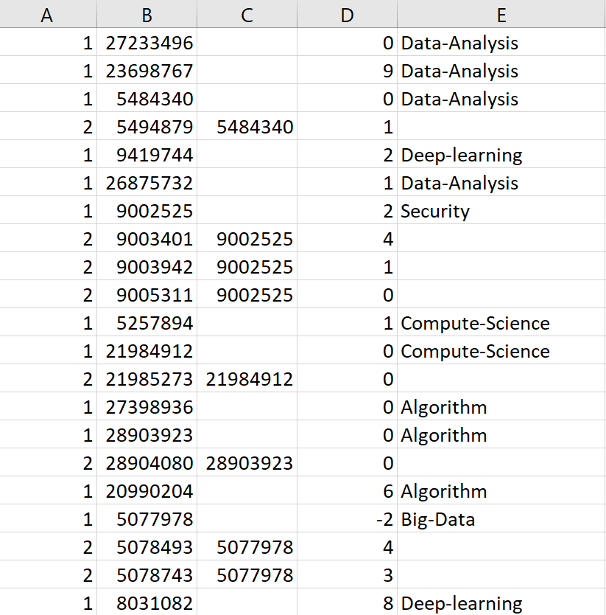
Dataset
Input data Task2_data/QA_data.zip
Data format shown in table
Attributes: PostingType, ID, ParentID, Score, Domains.
PostingType:
PostingType=1: this post is a question.
PostingType=2: this post is an answer.
ID: the id for the post
ParentId: which question it belongs to.
Score: the score of the answer.
Domains: which domain does this question belong to.

Slide 9
Design
You could follow a flow like this:
Group the questions and answers together
Choose the highest score for each question
Design the vectors for clustering with score and domain
Do clustering with the vectors
Output
This flow is shown in the code template in Task2_code folder.

Slide 10
Vector format
There are many ways to create a vector from a post for clustering. In this task, we choose this method:
Given a question from domain A, score S is the highest score from all its answers.
The index of domain A in the domain list (provided in the code template) is X. A predefined parameter DomainSpread D is used to make values for domains far away. Finally, the domain will be represented as D*X.
The two dimensional vector for this question is (D*X, S).

Slide 11
Output
Include the below outputs:
The cluster centroid for every cluster.
The size of every cluster.
The median score of every cluster.
The average score of every cluster.

Slide 12
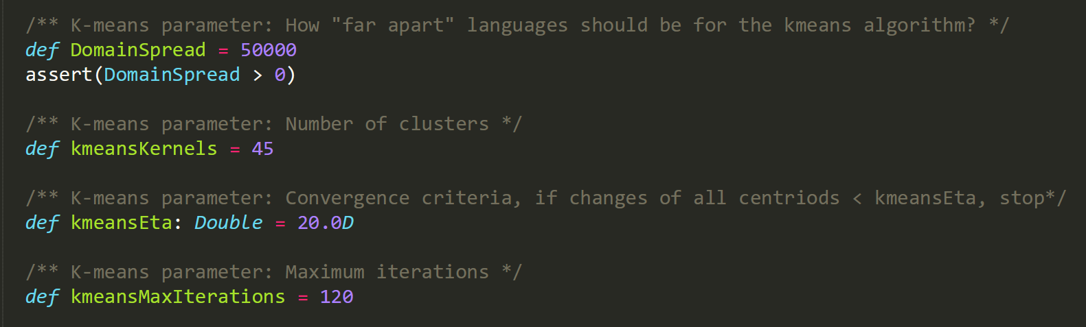
Required parameters
Key parameters in k-means are predefined in the provided code template.

Slide 13
Task2: Report
In Task2, you need to submit a report (2-3 pages), including:
Analyse your result
The insight that you can get from the result of clustering for QA_data.
Analysis of the parameters (in Slide 13) in k-means
how do different parameters impact the performance and clustering results of k-means?
Further discussion on the system performance
How to improve the efficiency?
How to speed up the processing?

Slide 14
Submission requirement
Deadline: Apr 5, 2020 11:59pm
Submit the following:
Task1:
Your source code without the data
Snapshot of the final results which are top-15 outputs of the results in descending order.
The report.(1-2 pages)
Readme on how to run the code on IDE
Task2:
Your source code without the data
Snapshot of the final results which are the clustering results with predefined parameters. (shown in previous slides)
The report.(2-3 pages)
Readme on how to run the code on IDE

Slide 15
Submission requirement
Files should be compressed in a zip file to IVLE, with the name [Your Student ID]-Assignment2.zip

Slide 16
Marking Schemes
Total: 12% of final mark.
Task1 Code & Report: 4%
Task2 Code & Report: 6%
Writing assessment: 2%
The written assessment’s questions depend on your submission. You need to understand your code. For example, please explain some specific lines of your code.

Slide 17
Notice
Please don't consider this homework as the same as ACM-ICPC programming contest (check by exact input-output pairs), we use this to enhance your understanding about the programming using Spark.
Don't need to worry about whether your result "exactly matches" final result.

Slide 18
Questions are Welcome
Email me: xinyuc@u.nus.edu, if necessary.
Or, post your questions in the IVLE forum (preferred).

Slide 19
Hints
You should use pair RDDs. It’s something like a map data structure, and it is similar to a format of key-value paris. Comparing to regular RDDs you get a set of powerful functions which you can apply to exactly to pair RDDs. They give a much easier way to operate with data. For example when you want to group or aggregate a data based on some of its properties. For this purposes, Spark has a special set of functions such as: groupByKey, aggregateByKey, reduceByKey etc.
Small example. If you have an RDD of goods and You want to group these goods by their price. With Spark, you need 1.create a pair RDD, where a role of key will play a price field, a role of value will play an appropriate good. 2.apply groupByKey function to the pair RDD.

