Slide 1

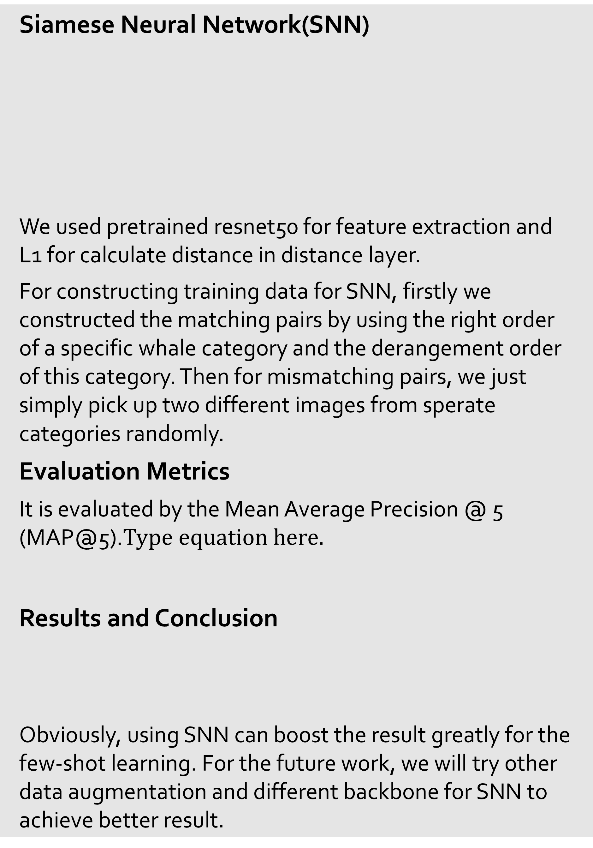
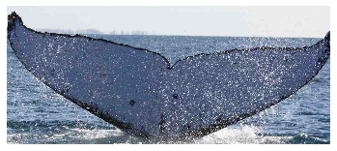
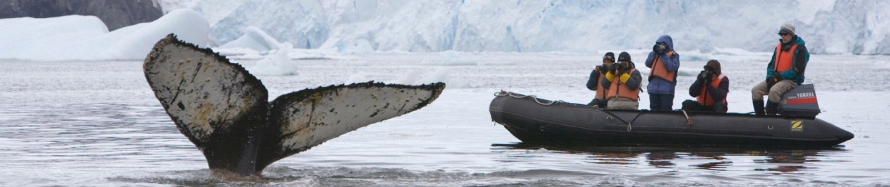
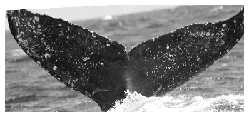
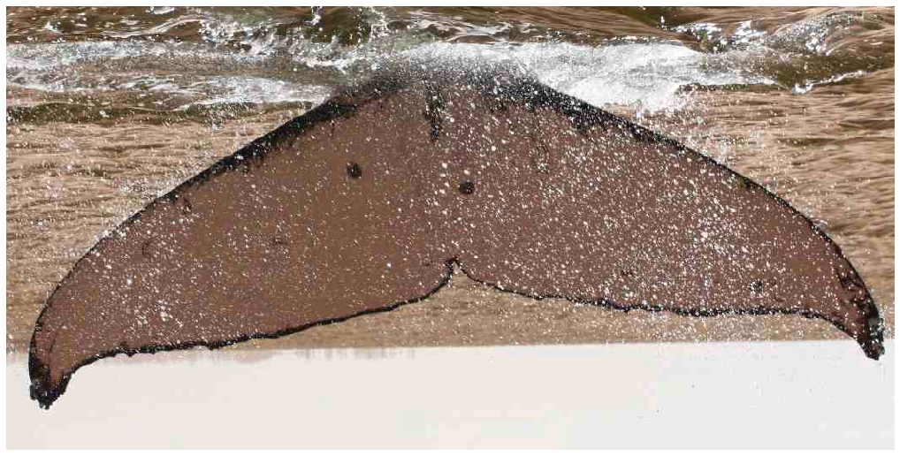
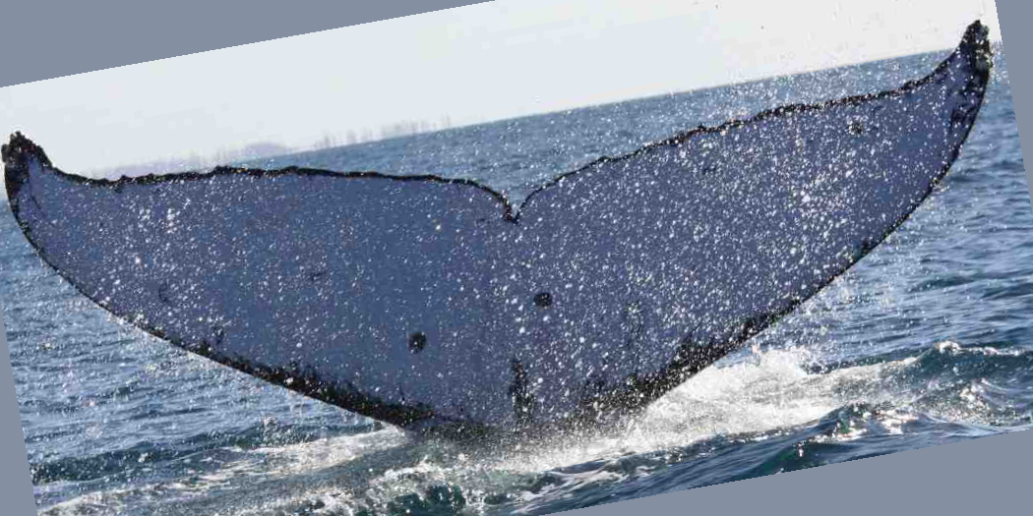
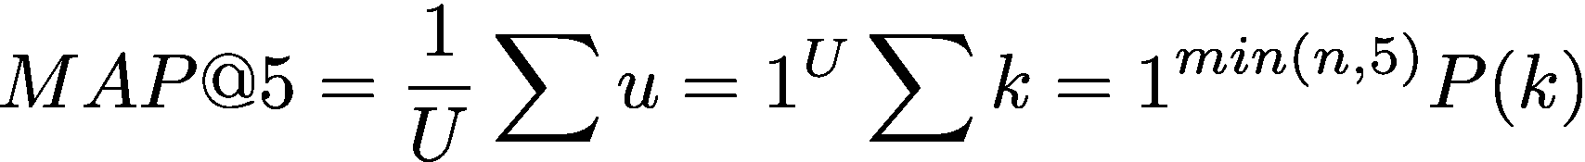
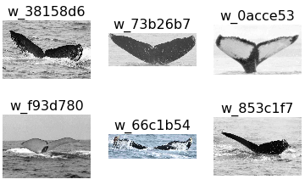
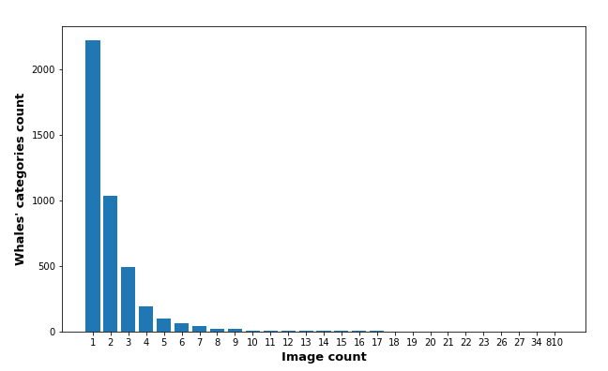
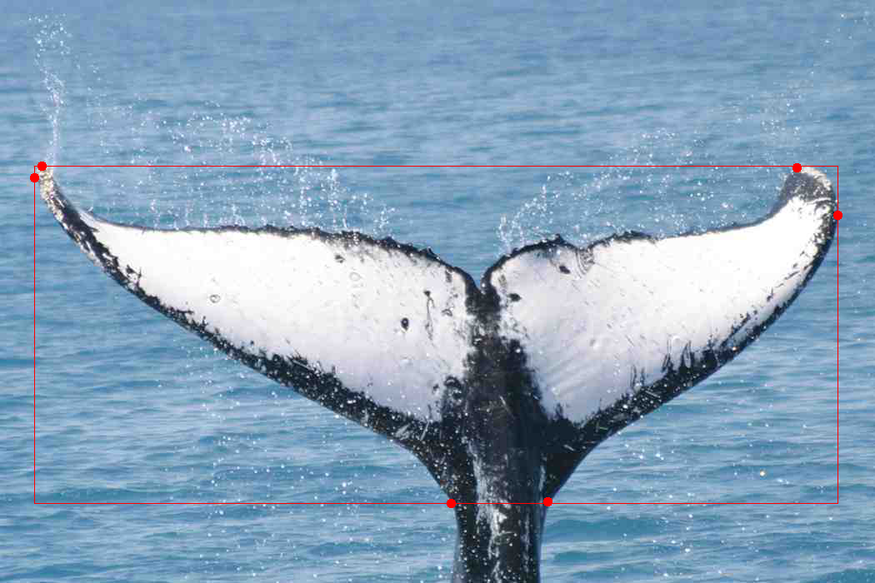
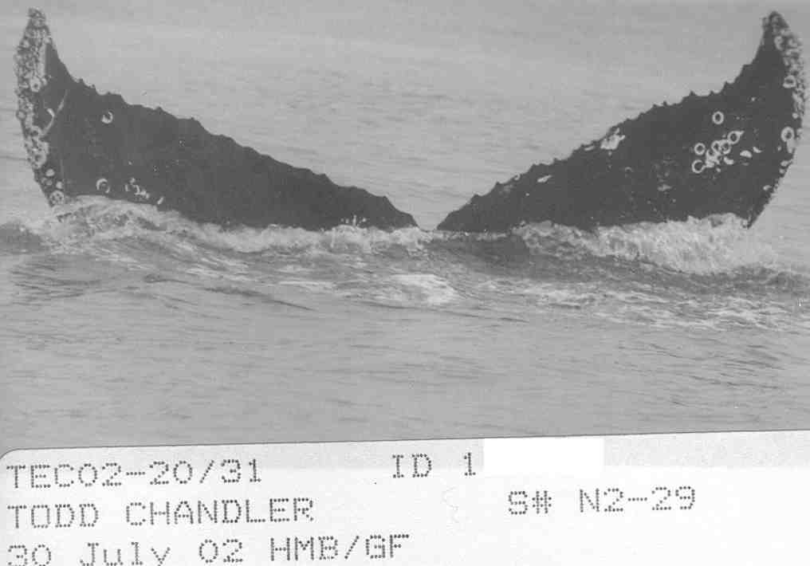
Whale Identification – Few shot learning
Jingkun Zhang & Tianyuan Fu | Computer Vision CSE455 Fall 2019 | University of Washington
Problem Identification
Proposed Solution
Technical Details (con’d)
Scientists are using the photo surveillance system to log the whale activities and tail shape in the them to determine the species. Th manual identification is laborious and lacks accuracy. An automated system is needed to replace the process.
Based on the condition that: 1) the distribution of training data to classes are uneven and the majority of classes only has one training picture; 2) some pictures contains elements other than whale tail details, we propose the usage of 1) Siamese network and 2) Bounding Box Model, to tackle the issues respectively.
Also we tired classical way like Densely Connected Convolutional Networks (DenseNet) to compare the results.
Resnet
Feature vector
Distance Layer
Possibility
Resnet
Feature vector
Dataset Overview and Challenges
Technical Details
The training data contains 9850 distinct pictures of whale tails, paired with 4251 different kinds of whale species. A sample record is like this:
Challenges:
The distribution of picture numbers among whale classes are uneven. For few number of classes, the training data size can be over 2000 while for some there can be only one picture for training. Here is the distribution diagram for all pictures.
Some pictures are given along with notations and comments, which may affect our feature extraction.
Data Preprocessing
Exclude ‘new whale’ class from dataset
Horizontal flip and Affine
Bounding Box Model Network
DenseNet Network
We implemented the pretrained densenet121 network to classify the whale species by images
DenseNet | 0.40514
Siamese Neural Network | 0.59073
Bbox x_min
VGG-16-like Conv Layers
Fully Connected Layer
Bbox x_max
Bbox y_min
Bbox y_max
References
Huang, Gao, et al. "Densely connected convolutional networks." Proceedings of the IEEE conference on computer vision and pattern recognition. 2017.
Koch, Gregory, Richard Zemel, and Ruslan Salakhutdinov. "Siamese neural networks for one-shot image recognition." ICML deep learning workshop. Vol. 2. 2015.
Crooped Image
Densenet 121
Softmax Classifier
Whale’s species
Notes:
Intro
Data

