Slide 1

空白页面

Slide 2



WEEK SHOW
CCTV
WHUT-TV
MR.BEAN

Slide 3
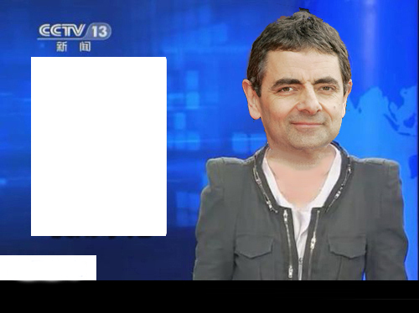
Affront
[rʌb]
v.侮辱；冒犯
It's an affront to human dignity to keep someone alive like this...
如此维持一个人的生命是对人类尊严的冒犯。
#NOTICE#
You may not know this words in the following situations

Slide 4
Automatically
[ˌɔ:tə'mætɪklɪ]
adv.自动地;无意识地;不自觉地;机械地
What was clear was that the children didn't automatically consider kids with glasses to be unattractive.
有一点是清楚的，孩子们不会无意识地认为戴眼镜的孩子没有魅力。
#NOTICE#
You may not know this words in the following situations

Slide 5
Belly
[ˈbeli]
n.肚子，腹部
vt.& vi.膨胀
You'll eat so much your belly'll be like a barrel.
你会吃得肚子鼓鼓的，像个大酒桶。
#NOTICE#
You may not know this words in the following situations

Slide 6
Disgust
[dɪsˈgʌst]
n.反感，厌恶，嫌恶
vt.使反感，厌恶
He spoke of his disgust at the incident
他谈到了他对这件事的厌恶。
#NOTICE#
You may not know this words in the following situations

Slide 7
Full up
[ful ʌp]
1.全满
2.（非正式）吃饱
3.客满
#NOTICE#
You may not know this words in the following situations

Slide 8
Malta
(这个没音标...真没有)
马耳他（地中海的岛国）
#NOTICE#
You may not know this words in the following situations

Slide 9
Rub
[rʌb]
摩擦，抚摸，困难
He rubbed his arms and stiff legs
他按摩着自己的胳膊和僵硬的双腿。
#NOTICE#
You may not know this words in the following situations

Slide 10
SHOW TIME

Slide 11
Thank you for watching
刘裕燊：Bean
付清晨：Simon
张旗顺：Jim

