Slide 1
Scalable Data Center Simulation
and Overview of Future Perspectives

Slide 2
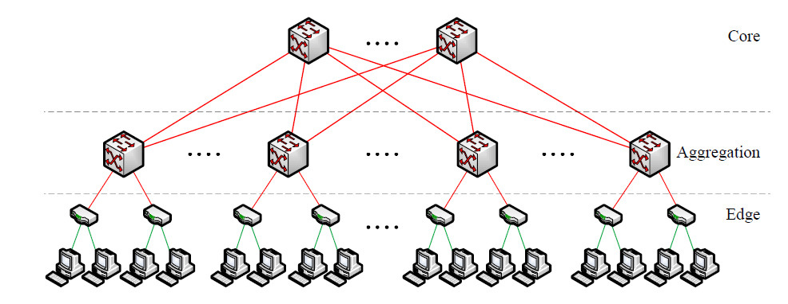
Old Data Center Topology

Slide 3
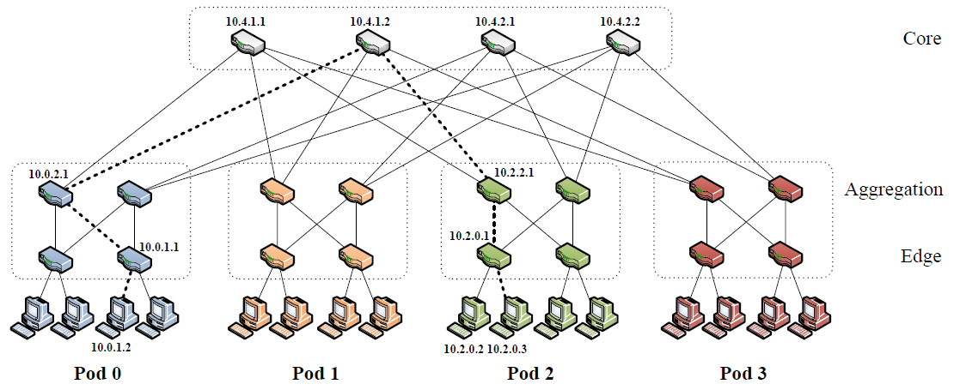
Fat-Tree Data Center Topology

Slide 4
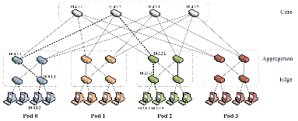
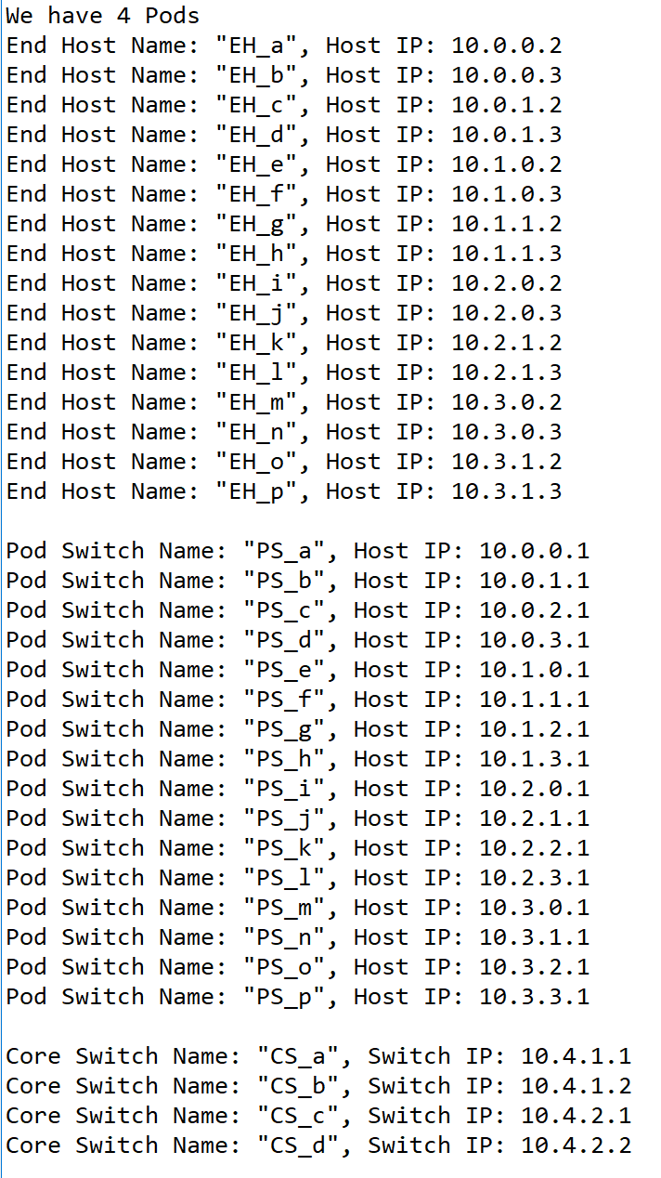
Simulations of Data Center Network(DCN)
In this part, we applied naming rules that the paper mentioned by using Python. We built a same structure as the picture shows. Mainly, we have 4 pods, which contains 4*(4/2)^2 switches, and each Edge-layer switch links to 2 end host, each Aggregation-layer switch links to 2 lower layer switches and two upper layer switches – core switches. Plus, those switches and end hosts’ IP addresses are arranged by the algorithm in the paper. Then we will run some simulations using this DCN.

Slide 5
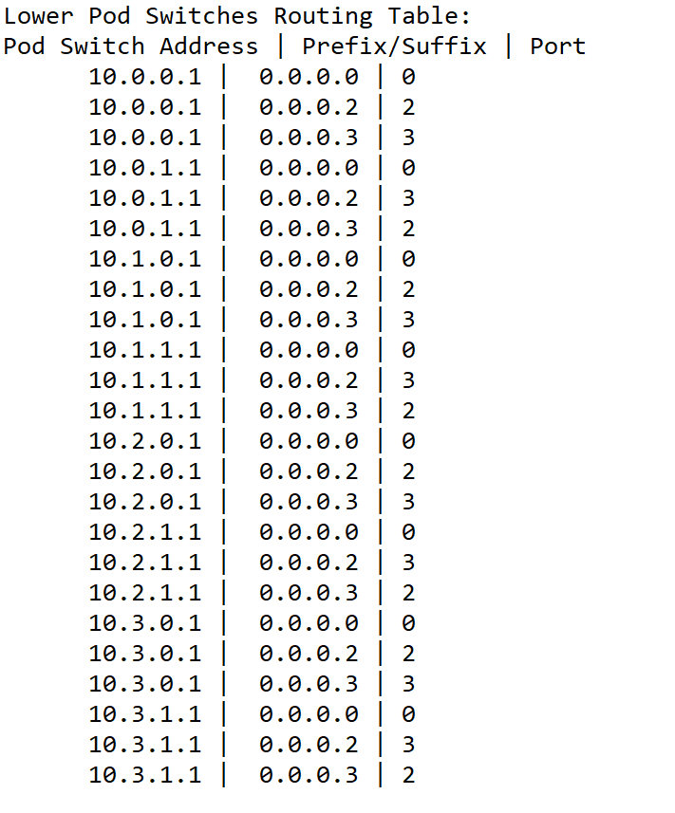
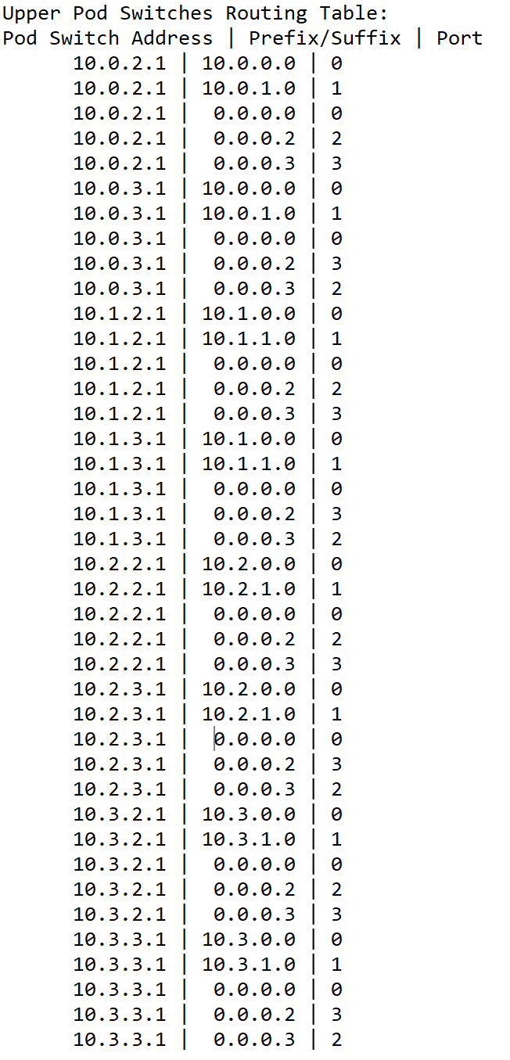
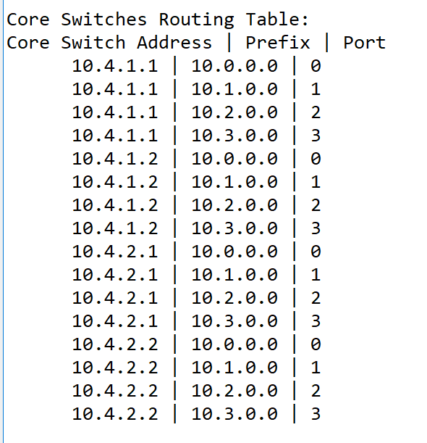
Routing Algorithm(1) Establishment of Routing Tables
This is the routing table in each switch, assigned by specific algorithm. There are some differences between different layers. Each table contains prefix table and suffix table. When one packet comes to one switch, the switch will compare the packet destination IP with the table, then decide which port will the packet export.

Slide 6
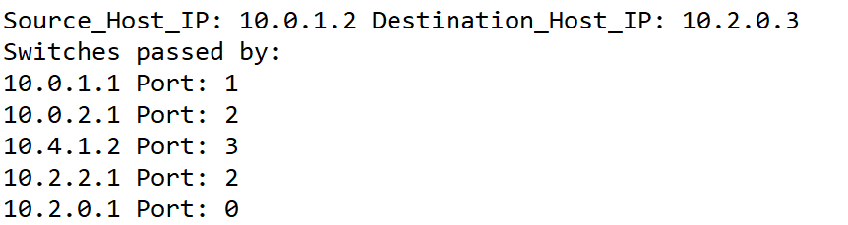

Routing Algorithm(2) Applying Routing Algorithm
We simulated the routing path from 10.0.1.2 to 10.2.0.3 using the routing algorithm mentioned in the paper.
In this case, First, the gateway switch of the source host (10.0.1.1) will only match the packet with the /0 first-level prefix, and therefore will forward the packet based on the host ID byte according to the secondary table for that prefix. In that table, the packet matches the 0.0.0.3/8 suffix, which points to port 2 and switch 10.0.2.1. Switch 10.0.2.1 also follows the same steps and forwards on port 3, connected to core switch 10.4.1.1. The core switch matches the packet to a terminating 10.2.0.0/16 prefix, which points to the destination pod 2 on port 2, and switch 10.2.2.1. This switch belongs to the same pod as the destination subnet, and therefore has a terminating prefix, 10.2.0.0/24, which points to the switch responsible for that subnet, 10.2.0.1 on port 0. From there, standard switching techniques deliver the packet to the destination host 10.2.0.3.

Slide 7
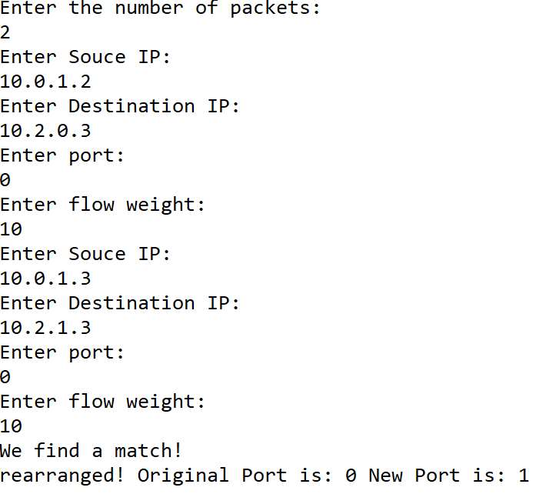
Flow Classification & Scheduling
We also ran several simulations on flow classification.
When there is a new flow coming, we can run the flow classification algorithm in order to :
1.Recognize subsequent packets of the same flow, and forward them on the same outgoing port.
2.Periodically reassign a minimal number of flow output ports to minimize any disparity between the aggregate flow capacity of different ports.

Slide 8
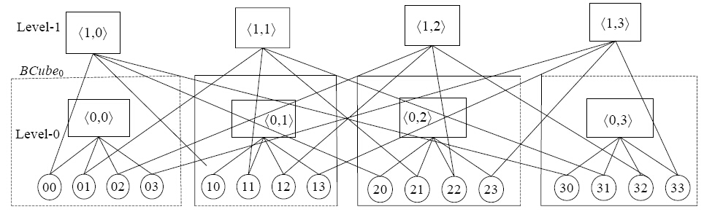
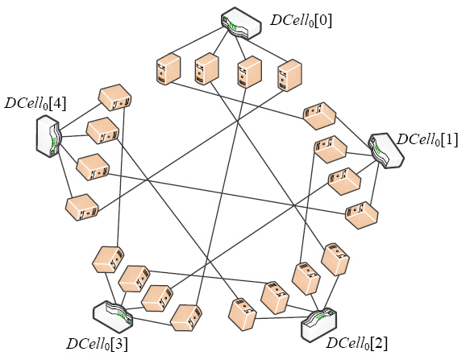
Overview of Future Perspectives
Fat-Tree & VL2: center on switches.
New Architectures: Dcell, FiConn, Bcube: center on server.
Image Source: http://www.jos.org.cn/html/2014/6/4444.htm
Guo C, Lu G, Li D, Wu H, Zhang X, Shi Y, Tian C, Zhang Y, Lu S. BCube: A high performance, server-centric network architecture for modular data centers. In: Proc. of the SIGCOMM. 2009. 63-74 .

