Slide 1
Scalable Data Center Simulation
and Overview of Future Perspectives

Slide 2
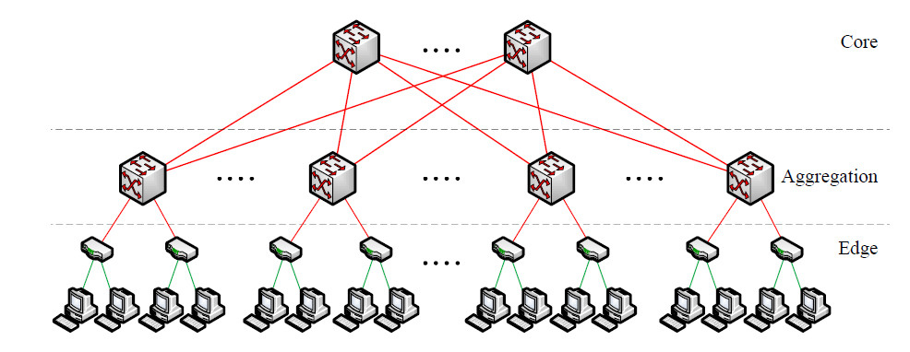
Old Data Center Topology

Slide 3
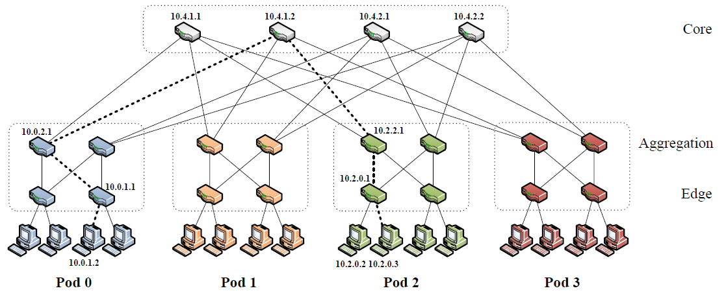
Fat-Tree Data Center Topology

Slide 4
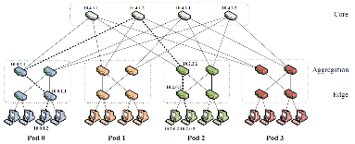
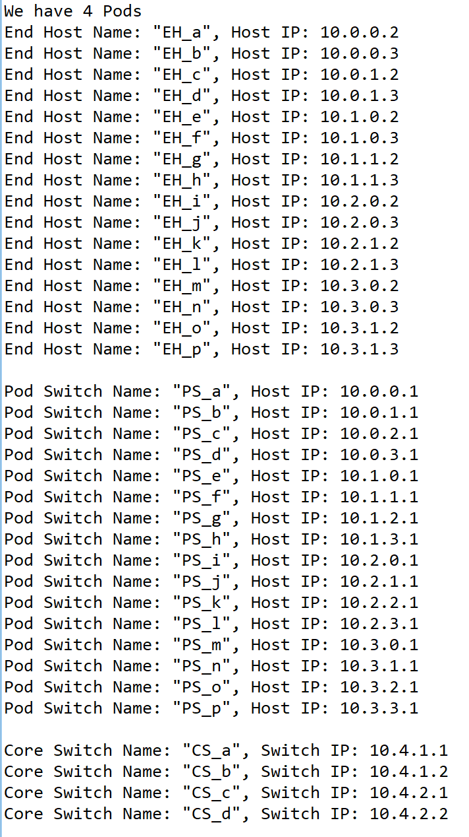
Simulations of Data Center Network(DCN)
In this part, we applied naming rules that the paper mentioned by using Python. We built a same structure as the picture shows. Mainly, we have 4 pods, which contains 4*(4/2)^2 switches, and each Edge-layer switch links to 2 end host, each Aggregation-layer switch links to 2 lower layer switches and two upper layer switches – core switches. Plus, those switches and end hosts’ IP addresses are arranged by the algorithm in the paper. Then we will run some simulations using this DCN.

Slide 5
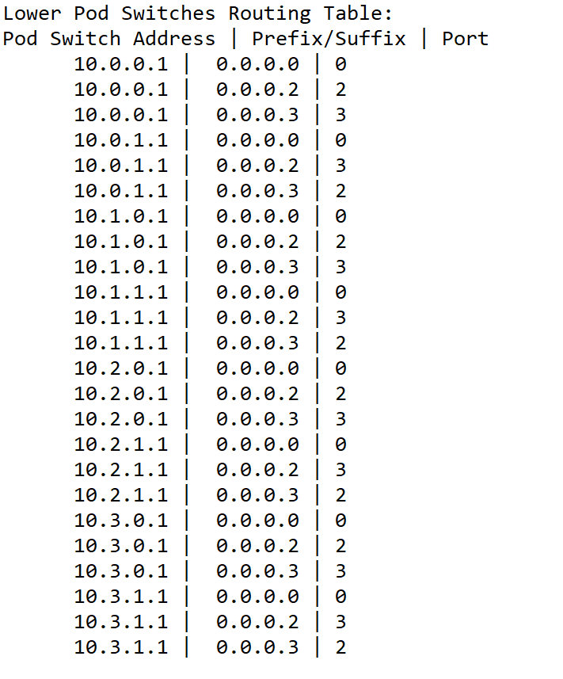
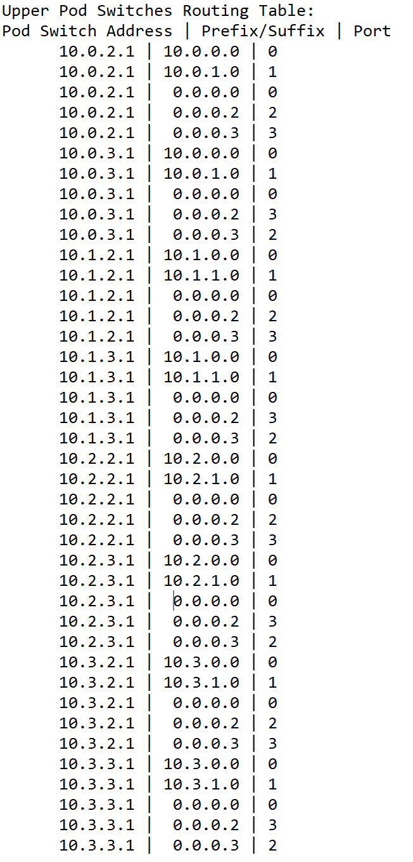
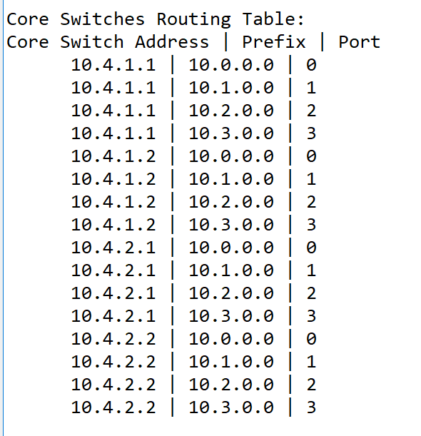
Routing Algorithm(1) Establishment of Routing Tables
By GLH.

Slide 6
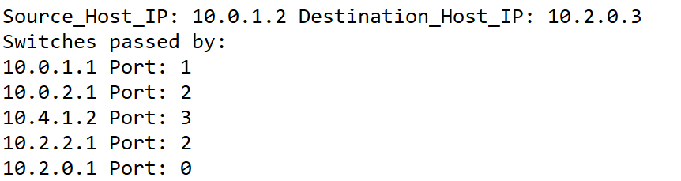

Routing Algorithm(2) Applying Routing Algorithm
We simulated the routing path from 10.0.1.2 to 10.2.0.3 using the routing algorithm mentioned in the paper.
BY GLH.

Slide 7
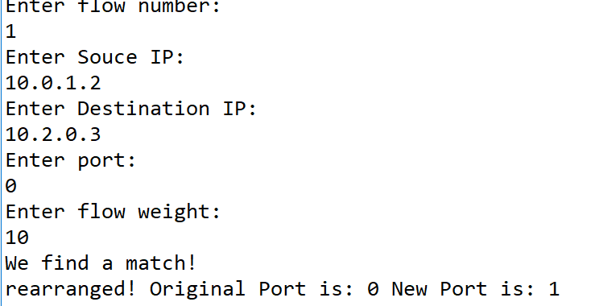
Flow Classification

