Slide 1
Scalable Data Center Simulation
and Overview of Future Perspectives

Slide 2
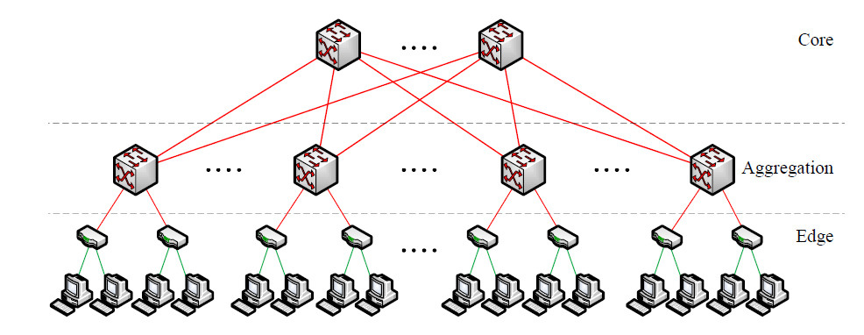
Old Data Center Topology

Slide 3
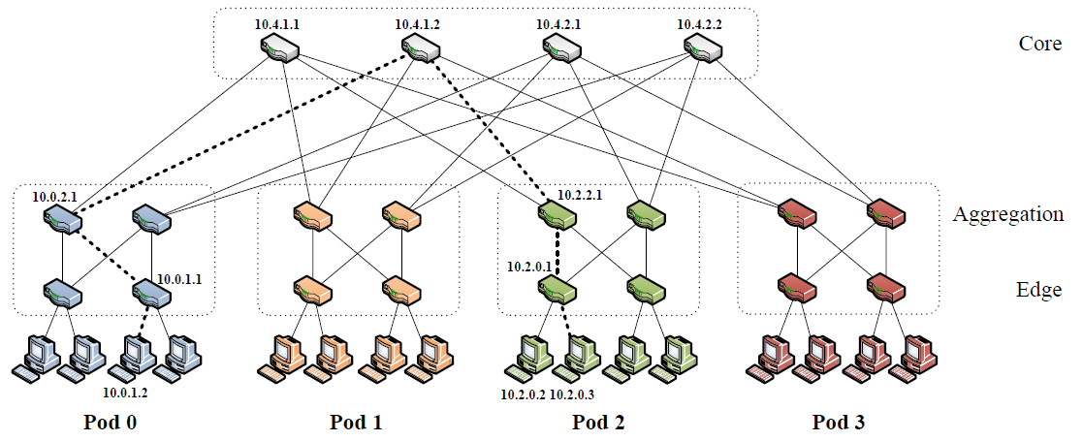
Fat-Tree Data Center Topology

