Slide 1
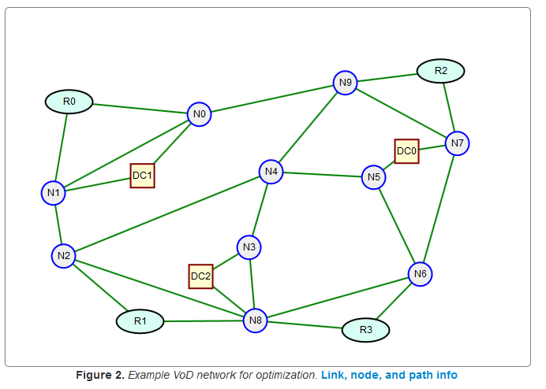
Capacitated Design: Part II
B
Dr. Greg Bernstein
Grotto Networking
www.grotto-networking.com

Slide 2
Outline
Demand splitting across Paths
How does this come about? When is it allowed?
Limited Demand Split (Section 4.2.3)
Link-Path, Node-Link
No splitting
Technologies for Inverse Multiplexing
MLPP, VCAT, But not LAG
Other Constraints
Forbidden links or paths (Example 4.1 page 111)
Bi-directional assignment in Node-Link formulation
Quick Feasibility Checks
Maximum flow between two nodes
Widest Path between two nodes

Slide 3
Demand Splitting
What is it?
It occurs during optimization when flow for a demand is split amongst multiple paths.
Does this represent a valid solution?
It depends on the technologies available.

Slide 4
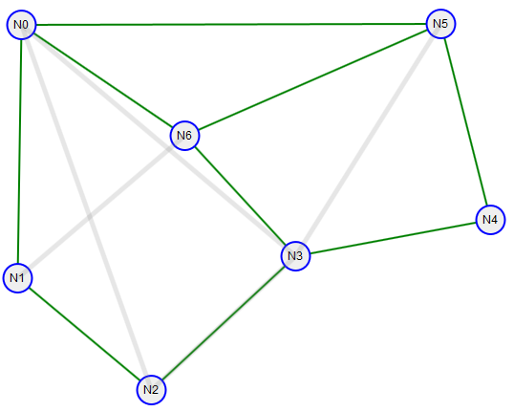
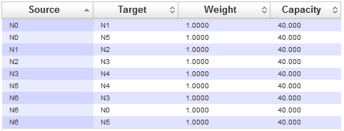
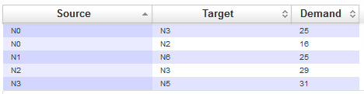
Splitting Example
Capacitated Allocation Problem
Node-Link Formulation with 18 directed links
5 Demands
Links all have same weight and capacity
Links:
Demands:

Slide 5


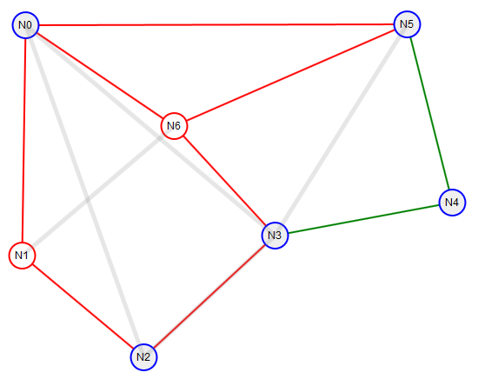
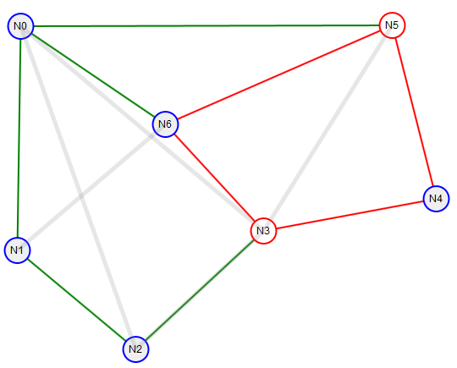
Splitting Example (cont)
Demand <N1, N6> split into 3 paths
Demand <N3, N5> split into 2 paths

Slide 6
Splitting Example (cont)
Why splitting?
Demands <N1,N6>, <N2,N0>, and <N0,N3> might all want to use similar shortest paths
In this optimal solution link loads are: (u'N0', u'N6'): 40.0, (u'N1', u'N0'): 40.0 (saturated)
Seems like splitting is needed for optimality
What about demand <N3, N5>:31 ?
Link loads (N3,N6): 40, (N6,N5): 23; (N3, N4): 17, (N4, N5): 17
Looks like room to put the whole demand on the {N3, N4, N5} path.
Splitting because paths had equal weight

Slide 7
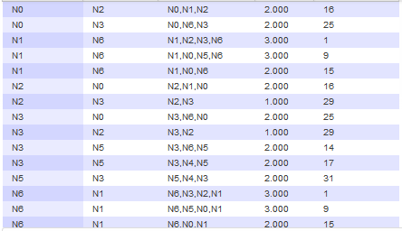
Splitting Example (cont)
Directed Network, Directed Demands
Path chosen not necessarily symmetric!
Technologies such as SONET, SDH, and G.709 require bi-directional symmetry of paths
Symmetric
Not Symmetric

Slide 8
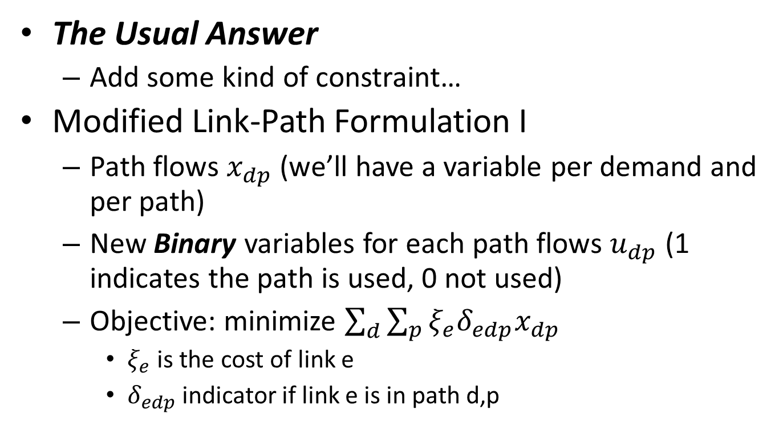
What can be done?
The Usual Answer
Add some kind of constraint…
Modified Link-Path Formulation I
Path flows $x_{dp}$ (we’ll have a variable per demand and per path)
New Binary variables for each path flows $u_{dp}$ (1 indicates the path is used, 0 not used)
Objective: minimize $\sum_{d}{\sum_{p}{{ξ_{e}δ}_{edp}x_{dp}}}$
$ξ_{e}$ is the cost of link e
$δ_{edp}$ indicator if link e is in path d,p

Slide 9
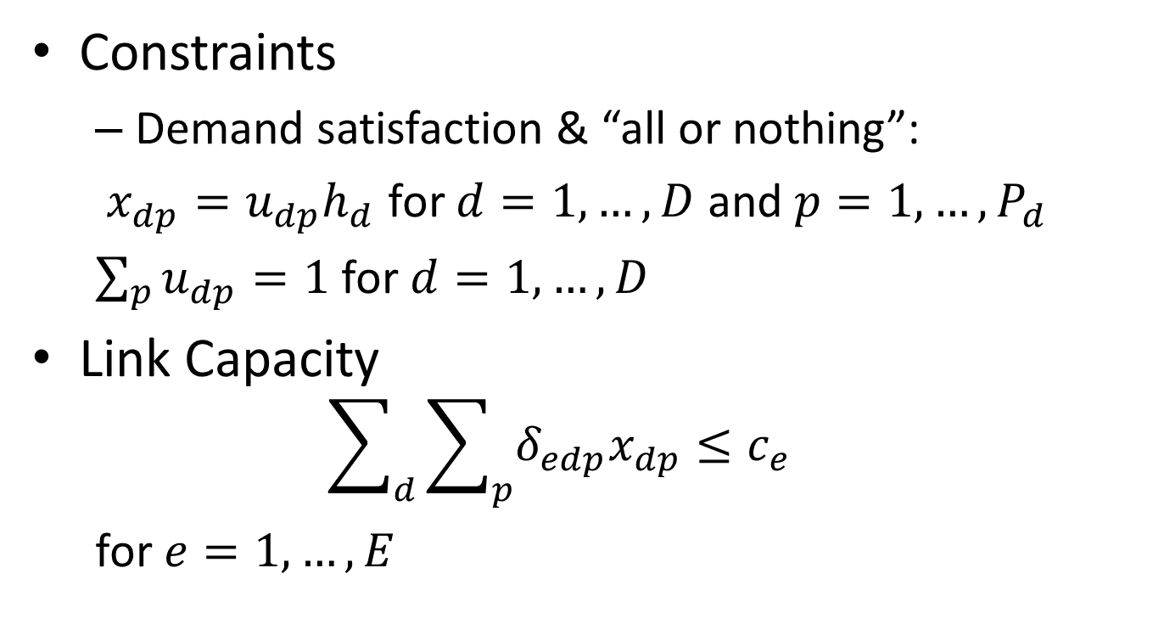
Modified Link Path Formulation I
Constraints
Demand satisfaction & “all or nothing”:
$x_{dp}=u_{dp}h_{d}$ for $d=1,…,D$ and $p=1,…,P_{d}$
$\sum_{p}{u_{dp}=1}$ for $d=1,…,D$
Link Capacity
$$\sum_{d}{\sum_{p}{δ_{edp}x_{dp}≤c_{e}}}$$
for $e=1,…,E$

Slide 10
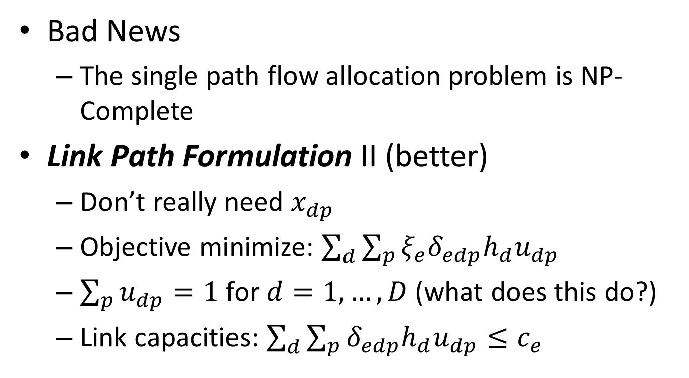
That was easy?
Bad News
The single path flow allocation problem is NP-Complete
Link Path Formulation II (better)
Don’t really need $x_{dp}$
Objective minimize: $\sum_{d}{\sum_{p}{{ξ_{e}δ}_{edp}{h_{d}u}_{dp}}}$
$\sum_{p}{u_{dp}=1}$ for $d=1,…,D$ (what does this do?)
Link capacities: $\sum_{d}{\sum_{p}{δ_{edp}{h_{d}u}_{dp}≤c_{e}}}$

Slide 11
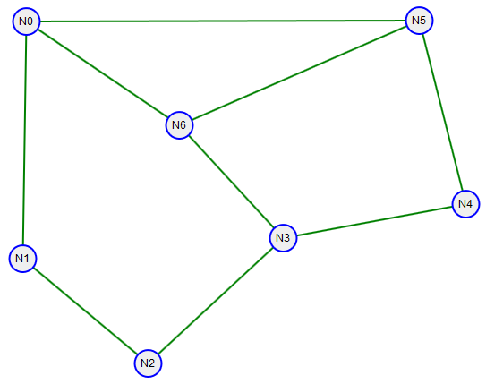
Example: Link-Path (Splitting)
Demands: <N1,N6>:24, <N0", "N3>:: 25, <N2, N3>: 29, <N0", N2>: 16, <N3, N5>: 31
Candidate paths: ["N2", "N3"], ["N2", "N1", "N0", "N6", "N3"], ["N0", "N6", "N3"], ["N0", "N1", "N2", "N3"], ["N1", "N0", "N6"], ["N1", "N2", "N3", "N6"], ["N0", "N1", "N2"], ["N0", "N6", "N3", "N2"], ["N3", "N4", "N5"], ["N3", "N6", "N5"]
Link Capacity: 40 units all links
Solution:
xDN0_N2P_0 = 16.0
xDN0_N2P_1 = 0.0
xDN0_N3P_0 = 20.5
xDN0_N3P_1 = 4.5
xDN1_N6P_0 = 19.5
xDN1_N6P_1 = 4.5
xDN2_N3P_0 = 29.0
xDN2_N3P_1 = 0.0
xDN3_N5P_0 = 31.0
xDN3_N5P_1 = 0.0

Slide 12
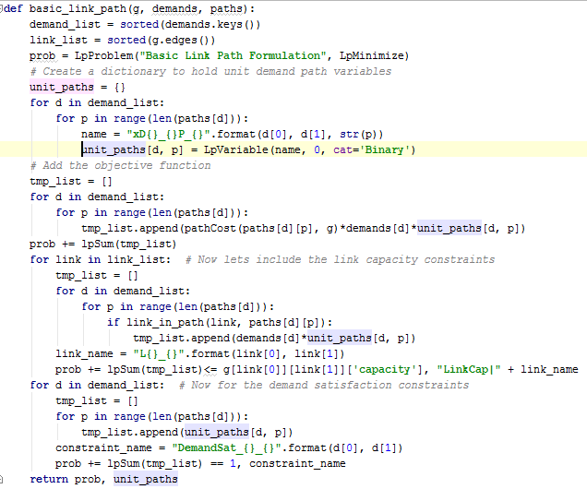
Single Path Link-Path in Python
Note use of “Binary” variables.
From Solver:
Status: Undefined
xDN0_N2P_0 = 1.0
xDN0_N2P_1 = 0.0
xDN0_N3P_0 = 0.82
xDN0_N3P_1 = 0.18
xDN1_N6P_0 = 0.8125
xDN1_N6P_1 = 0.1875
xDN2_N3P_0 = 1.0
xDN2_N3P_1 = 0.0
xDN3_N5P_0 = 1.0
xDN3_N5P_1 = 0.0

Slide 13
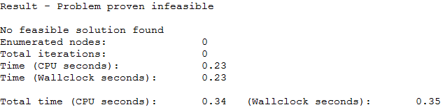
What Happened?
PuLP returned “undefined”
Try CBC from command line:
cbc SPLinkPathEx1Paths2.lp
Problem doesn’t have a solution!!!
What can we do?
Change Network (expensive)
Reduce Demands (loose customers)
Try more paths

Slide 14
Single Path Example (cont.)
More Paths: Use three per demand
<N1,N6>:24, <N0", "N3>:: 25, <N2, N3>: 29, <N0", N2>: 16, <N3, N5>: 31
Status: Optimal
xDN0_N2P_0 = 1.0
xDN0_N3P_0 = 1.0
xDN1_N6P_2 = 1.0
xDN2_N3P_0 = 1.0
xDN3_N5P_0 = 1.0
Actual Paths used:
["N0", "N1", "N2"]
["N0", "N6", "N3"]
["N1", "N0", "N5", "N6"]
["N2", "N3"]
["N3", "N4", "N5"]
Use of 3rd choice path

Slide 15
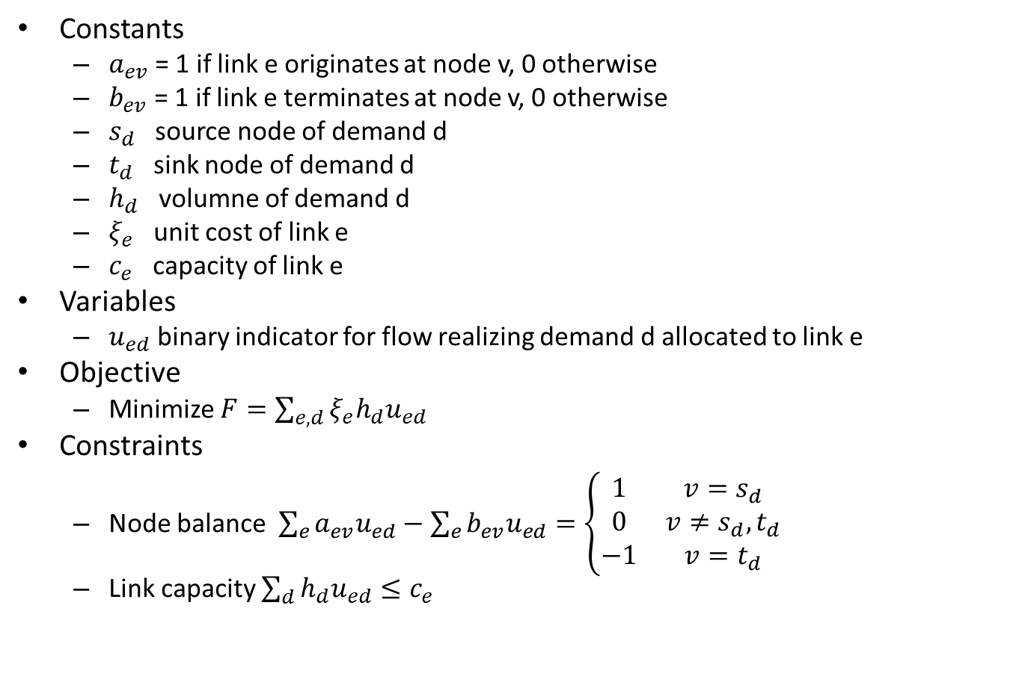
Single Path Allocation Node Link Formulation
Constants
$a_{ev}$ = 1 if link e originates at node v, 0 otherwise
$b_{ev}$ = 1 if link e terminates at node v, 0 otherwise
$s_{d}$ source node of demand d
$t_{d}$ sink node of demand d
$h_{d}$ volumne of demand d
$ξ_{e}$ unit cost of link e
$c_{e}$ capacity of link e
Variables
$u_{ed}$ binary indicator for flow realizing demand d allocated to link e
Objective
Minimize $F=\sum_{e,d}{ξ_{e}h_{d}u_{ed}}$
Constraints
Node balance $\sum_{e}{a_{ev}u_{ed}}−\sum_{e}{b_{ev}u_{ed}}=\left\{\begin{matrix}1 & v=s_{d} \\ 0 & v≠s_{d},t_{d} \\ −1 & v=t_{d}\end{matrix}\right.$
Link capacity $\sum_{d}{{h_{d}u}_{ed}}≤c_{e}$
See page 121 of P&M

Slide 16
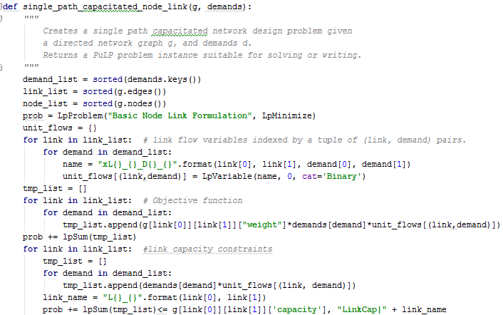
SPA Node-Link in Python I

Slide 17
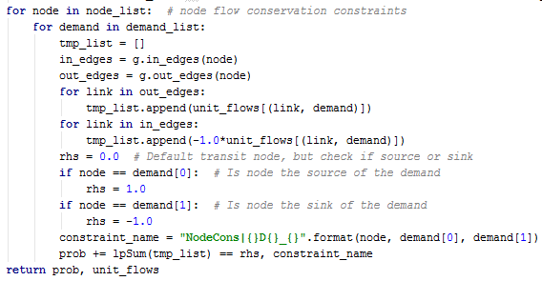
SPA Node-Link in Python II

Slide 18
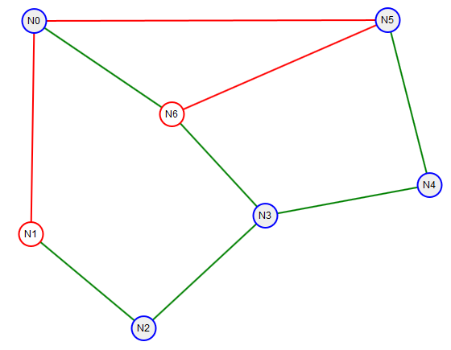
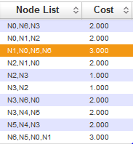
Example SPA Node-Link

Slide 19

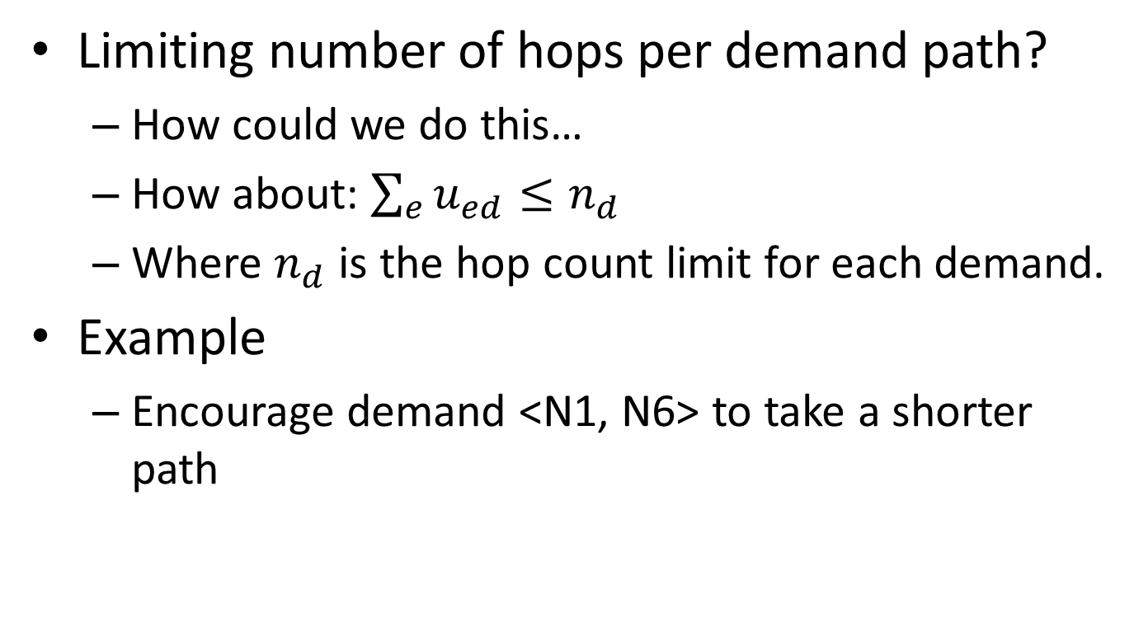
SPA Node-Link Extra Feature
Limiting number of hops per demand path?
How could we do this…
How about: $\sum_{e}{u_{ed}}≤n_{d}$
Where $n_{d}$ is the hop count limit for each demand.
Example
Encourage demand <N1, N6> to take a shorter path

Slide 20
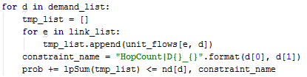
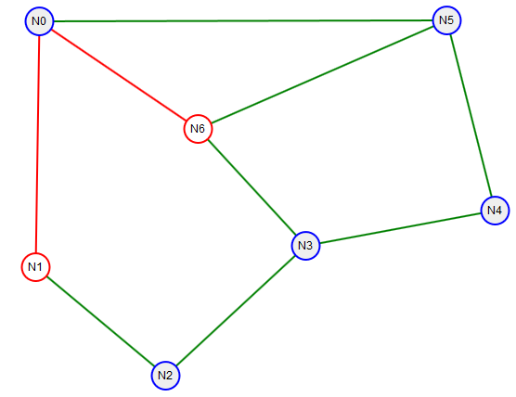
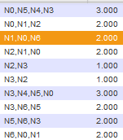
Example Hop Count Limit
This worked, forced other demands to take longer paths!

Slide 21
Inverse Multiplexing
General Notion
The breaking of a high speed stream into several smaller streams and their reassembly at the destination
https://en.wikipedia.org/wiki/Inverse_multiplexing
Virtual Concatenation (SONET, SDH, G.709)
Included in G.707 and G.709, Link Capacity Adjustment Scheme (LCAS) in G.7042
G. Bernstein, D. Caviglia, R. Rabbat, and H. Van Helvoort, “VCAT-LCAS in a clamshell,” IEEE Communications Magazine, vol. 44, no. 5, pp. 34–36, May 2006.
You’ll get to read about this…
Multi-Link PPP (point to point protocol)
https://en.wikipedia.org/wiki/Point-to-Point_Protocol#Multilink_PPP
Rather old technology
May be done at “Application Layer”
How?

Slide 22
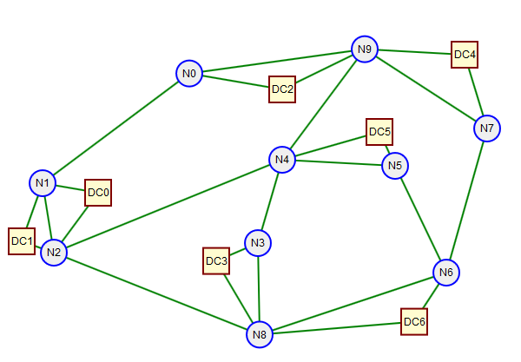
Forbidden Links or Paths
Network Example
Links to data centers are different from other links. Why?
Data centers contain lots of switches but we may not want to treat them as switches. Why?
What happens if we apply k-shortest paths blindly to this network? What about a Node-Link design problem formulation?

Slide 23
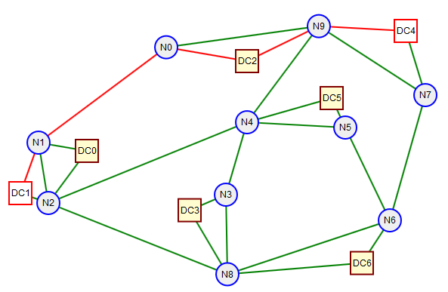
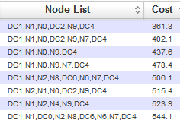
Shortest Paths…
Computing k-shortest paths from DC1 to DC4 as part of a Link-Path formulation, got the path below
Not good, really shouldn’t use DC2 as a “transit” node
How can we avoid this problem?
How can you tell which of the above paths are “bad”?

Slide 24
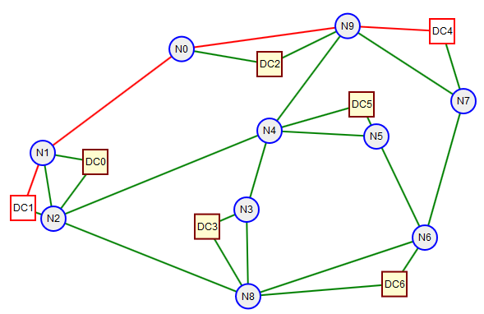
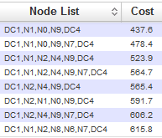
Shortest Paths…
Still using k-shortest paths algorithm for paths from DC1 to DC4 I was able to get the paths shown below
How did I do this?
How can we avoid this problem?

Slide 25
Restrictions on Link Flows
In a Node-Link capacitated allocation problem how can I prevent the flow for the demand <DC2, DC6> from going through DC5? Etc…
Answer:
Add constraints to set the following link flow variables to zero
X_LN4DC5_DDC2DC4 = 0.0
X_LDC5N5_DDC2DC4 = 0.0
Etc…

Slide 26
Bidirectional Assignment with Node-Link Formulation
Node-Link Formulation
Works with directed graphs
Treats all demands as directed too
Some technologies assume bidirectionality
SONET, SDH, PDH (old E1,T1 hierarchies)
How?
Must make the network directed but symmetric
Must make the demands symmetric
Must force the flows traversing a bidirectional link pair for a bidirectional demand pair to be equal.

Slide 27
Feasibility Checks
Necessary versus Sufficient conditions
https://en.wikipedia.org/wiki/Necessity_and_sufficiency
We would like quick checks of allocation feasibility
The assertion that Q is necessary for P is colloquially equivalent to "P cannot be true unless Q is true," or "if Q is false then P is false.“ (wikipedia)
What would be a computationally “easy” check for feasibility for a SPA problem?
For each demand pair check if the capacity of the widest path is less than the demand volume. If it is then the problem is infeasible.

Slide 28
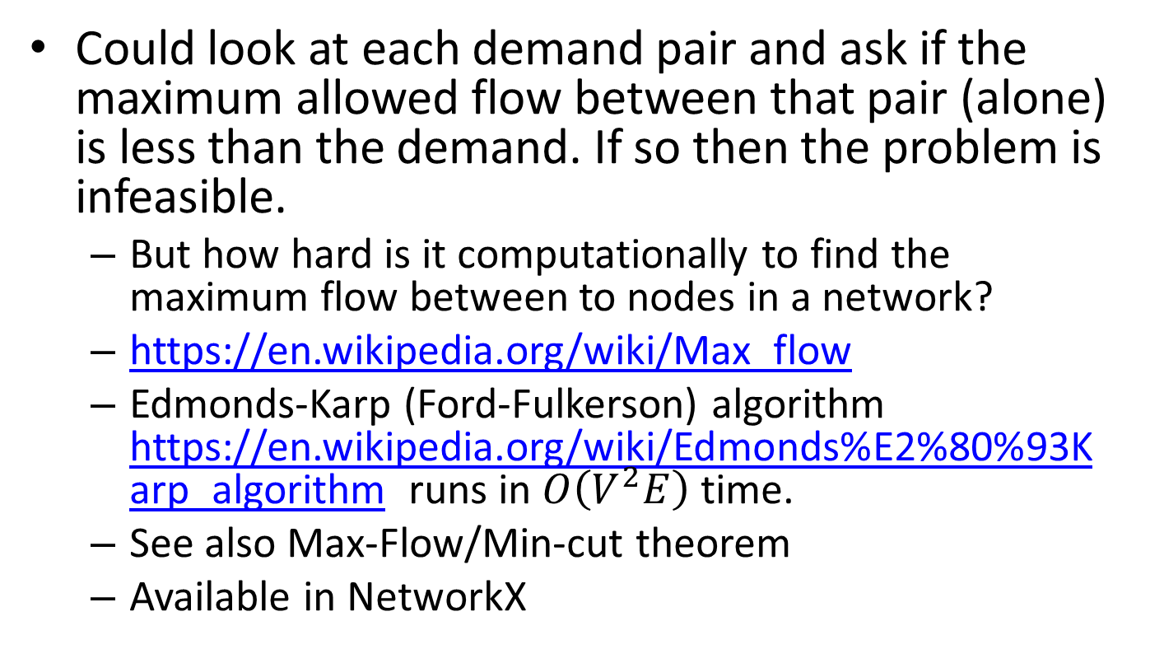
Feasibility Check for Allocation with Splitting?
Could look at each demand pair and ask if the maximum allowed flow between that pair (alone) is less than the demand. If so then the problem is infeasible.
But how hard is it computationally to find the maximum flow between to nodes in a network?
https://en.wikipedia.org/wiki/Max_flow
Edmonds-Karp (Ford-Fulkerson) algorithm https://en.wikipedia.org/wiki/Edmonds%E2%80%93Karp_algorithm runs in $O\left(V^{2}E\right)$ time.
See also Max-Flow/Min-cut theorem
Available in NetworkX

Slide 29
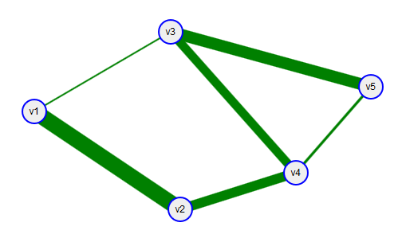
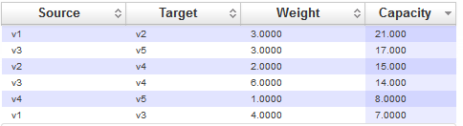
Examples
Widest path v1 to v5 has capacity 14. Why?
Max flow from v1 to v5 is min(28, 25, 46) = 25 by max flow/min cut or Edmonds-Karp
Links

