Slide 1
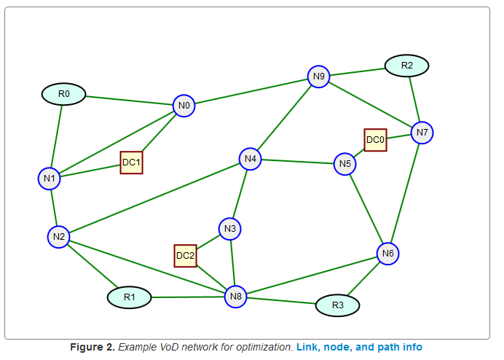
Flows to Paths
B
Dr. Greg Bernstein
Grotto Networking
www.grotto-networking.com

Slide 2
Working with Numerical Results
Fact
Link-Path and Node-Link formulations of network design problems produce a lot of variables whose values are “essentially” zero.
Problem
How do we tell if a floating point number is “essentially” zero?
Never, ever, ever do this:
If x == 0.0: # Bad, Bad, Bad, Terrible, Terrible!!!
Print “X is zero” # WRONG!!!!!!!!

Slide 3

Floating point computations
Will the following loop ever exit?
It adds a smaller and smaller number to 1.0 and then checks if the result is equal to 1.0
Try this in any language you like (this is not a Python specific result)
Theoretically what should the code do?

Slide 4

Floating Point Computations
Loop terminates rather quickly
Result
This is sometimes called the “machine epsilon” (or twice this value).

Slide 5
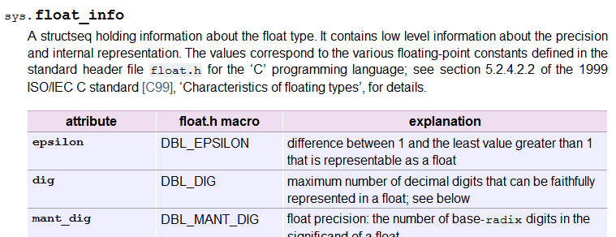
Floating Point in Python
Python (like Java, C, C++) has information on numerical accuracy and limits
See sys.float_info (need to import the sys module)

Slide 6

Quick Check
Flow variable xflow = 0.0001
Is this “essentially” zero?
What if I told you the demand was 10Tbps?
xflow does seem “essentially” zero when compared to the demand.

Slide 7
Floating point comparisons
Never check for equality between floating point numbers!
Absolute error check:
abs(x – y) <= small_number
Where small_number >> machine epsilon
Relative error check:
abs(x-y) <= rel_err*RelatedNumber
abs(x-y) <= rel_err*[abs(x) + abs(y)]
Where rel_err >> machine epsilon

Slide 8
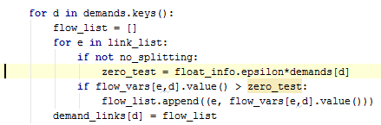
Example from Code
Looking for links used to satisfy a demand
Compare the size of the link flow relative to the demand it should help satisfy (use machine epsilon)

Slide 9
Node-Link Formulation Issue
Does a feasible solution always lead to realizable paths?
Comments in P&M page 111 & exercise 4.2
If so how can we get the paths from the flow variables?
Reference:
D. P. Bertsekas and D. P. Bertsekas, Network Optimization: Continuous and Discrete Models. Athena Scientific, 1998.

Slide 10

Link Flows
$x_{ed}$ a variable for each link and each demand, many are zero in a typical solution
Link capacities $y_{e}$ (we’ll have a variable per link)

Slide 11
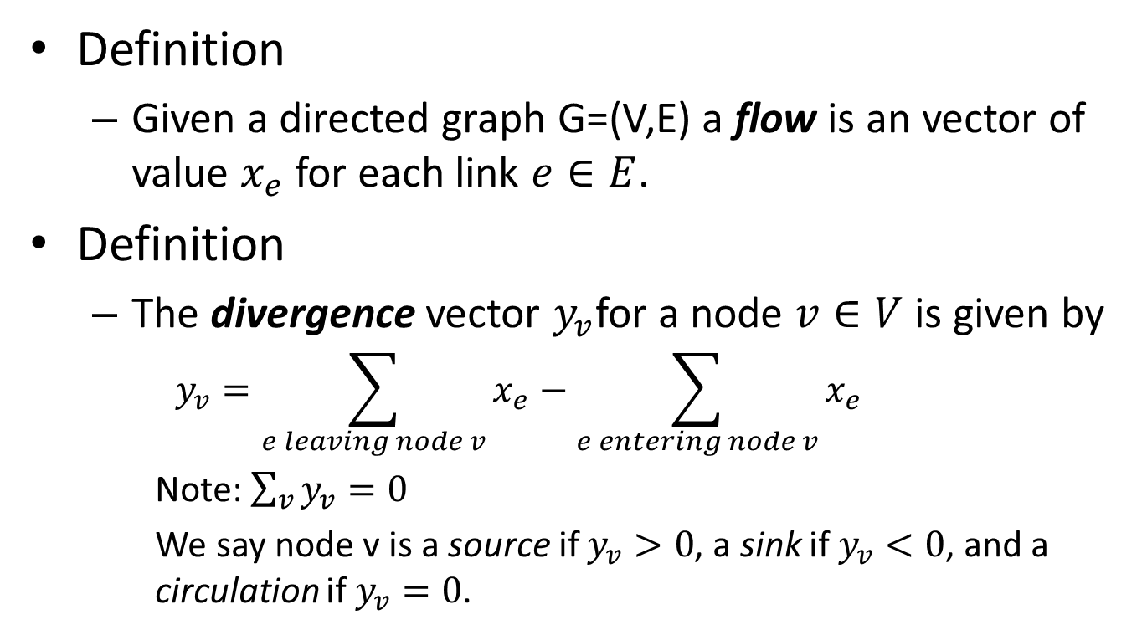
Graph Flows I
Definition
Given a directed graph G=(V,E) a flow is an vector of value $x_{e}$ for each link $e∈E$.
Definition
The divergence vector $y_{v}$for a node $v∈V$ is given by
$$y_{v}=\sum_{e leaving node v}{x_{e}}−\sum_{e entering node v}{x_{e}}$$
Note: $\sum_{v}{y_{v}}=0$
We say node v is a source if $y_{v}>0$, a sink if $y_{v}<0$, and a circulation if $y_{v}=0$.

Slide 12
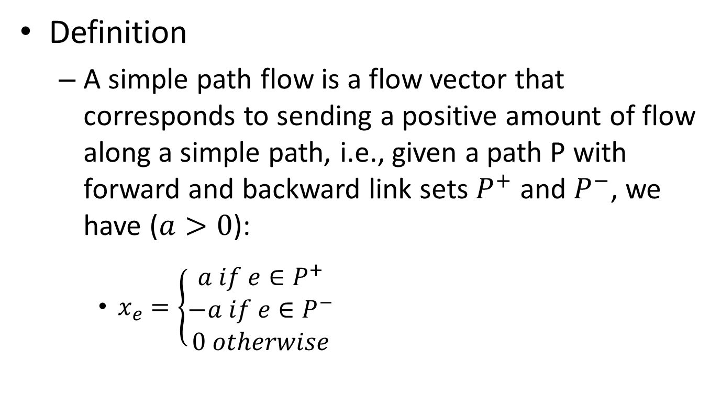
Graph Flows II
Definition
A simple path flow is a flow vector that corresponds to sending a positive amount of flow along a simple path, i.e., given a path P with forward and backward link sets $P^{+}$ and $P^{−}$, we have ($a>0$):
$x_{e}=\left\{\begin{aligned}a if e∈P^{+} \\ −a if e∈P^{−} \\ 0 otherwise\end{aligned}\right.$

Slide 13
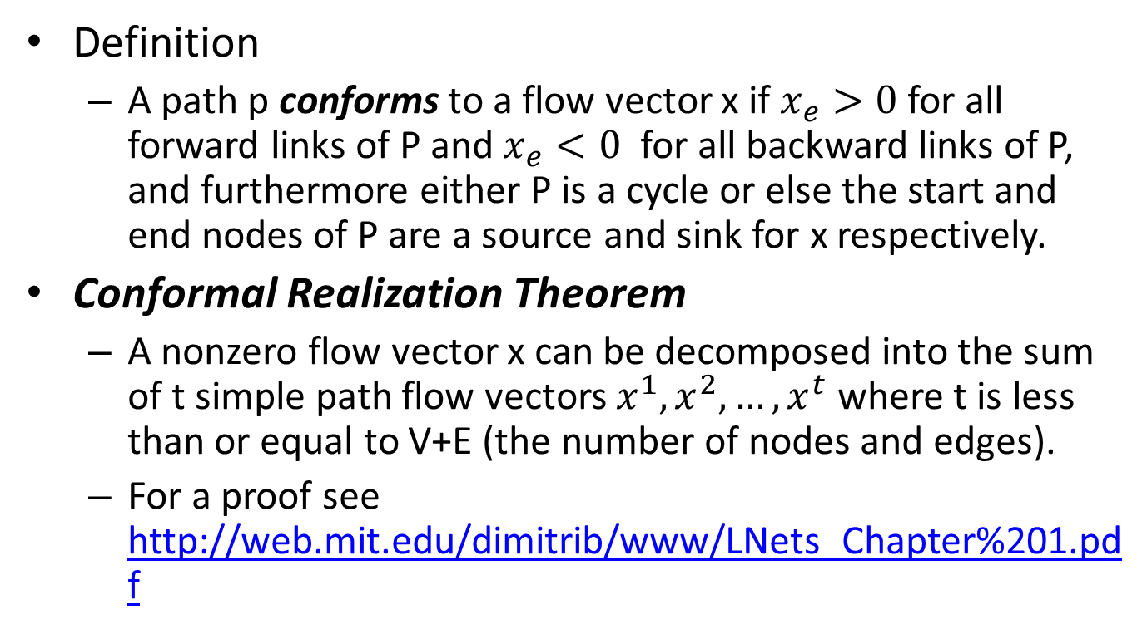
Graph Flows III
Definition
A path p conforms to a flow vector x if $x_{e}>0$ for all forward links of P and $x_{e}<0$ for all backward links of P, and furthermore either P is a cycle or else the start and end nodes of P are a source and sink for x respectively.
Conformal Realization Theorem
A nonzero flow vector x can be decomposed into the sum of t simple path flow vectors $x^{1},x^{2},…,x^{t}$ where t is less than or equal to V+E (the number of nodes and edges).
For a proof see http://web.mit.edu/dimitrib/www/LNets_Chapter%201.pdf

Slide 14
Algorithm Implementation in Python
Finds flows specific to a demand pair (not in general)
File: flow_paths.py
Function flowToPaths(demand, gflow)
demand -- a pair of nodes identifiers indicating the source and sink of the flow.
gflow -- a list of nested tuples (edge, flow value) where edge = (nodeA, nodeB)
returns: a tuple of a list of the paths loads and a list of the corresponding paths

Slide 15
Helper function (Python)
Search the solver solution values of the flow variables for "non-zero" link demand values.
File: flow_paths.py
Function getDemandLinks(demands, link_list, flow_vars, no_splitting=False)
demands -- a demand dictionary indexed by a demand pair and whose value is the volume
link_list -- a list of links (edges) of the network as node tuples.
flow_vars -- a dictionary of link, demand variables. In our case we are working with the solutions that have been returned from the solver. These are of type PuLP LpVariables.
returns: a dictionary indexed by a demand pair whose value is a nested tuple of (link, load) where link is a node pair (tuple).

