Slide 1
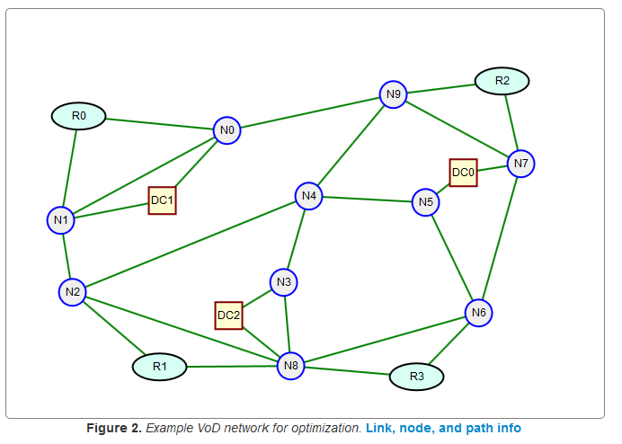
Network Information: Manipulation, Sharing, and Visualization
Dr. Greg Bernstein
Grotto Networking
www.grotto-networking.com

Slide 2
Sharing Network Topology
JSON Format: NetworkX intrinsic
Example (free) drawing tool: Web based editor http://www.grotto-networking.com/GraphEdit.html
JSON is the modern data exchange standard for the web. See: http://www.json.org/
XML Based Format: GraphML
Example (free) drawing tool: http://www.yworks.com/en/products_yed_about.html
Can read with NetworkX but not custom link properties.
Many other formats
GML, LEDA, Pajek, etc… See NetworkX documentation and web

Slide 3
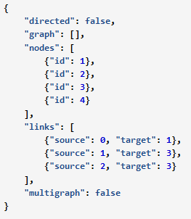
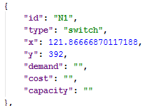
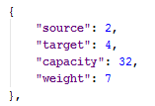
NetworkX JSON Graph format
Minimal Example:
Just a list of nodes and links
Can add attributes to nodes and links
Can add any kind of attributes we need
Node with extra attributes:
Link with extra attributes:

Slide 4

Reading & Writing NetworkX JSON
Crucial import
Documentation
http://networkx.github.io/documentation/latest/reference/readwrite.json_graph.html
Reading from a file example:

Slide 5

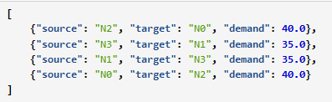
Demand’s in Python & JSON
Demands in Python
Use Python tuple as index to Python dictionary
Demands in JSON
Use a JSON list of JSON objects

Slide 6

Demand conversion: Python⬄JSON
Key import
Documentation
https://docs.python.org/2/library/json.html?highlight=json#json
Need a bit of extra work
See file: jsonconverter.py for two simple helper functions: demands_to_j(obj) and j_to_demands(d_list)
Example usage:

Slide 7
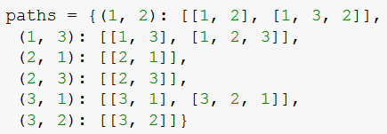
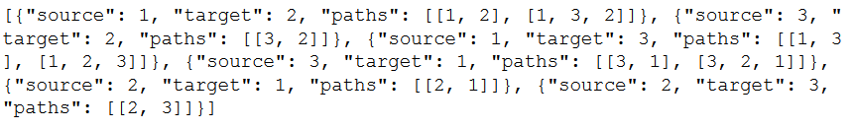
Candidate Paths in Python & JSON
Python
A dictionary indexed by demand pair whose value is a list of paths
JSON
A list of JSON objects, each object containing a list of paths, with each path a list of nodes.

Slide 8
Candidate Paths: Python⬄JSON
Key import
Need a bit of extra work
See file: jsonconverter.py for two simple helper functions: paths_to_j(path_dict) and j_to_path(path_list)
Example usage:
from jsonconverter import paths_to_j, j_to_paths

