Slide 1
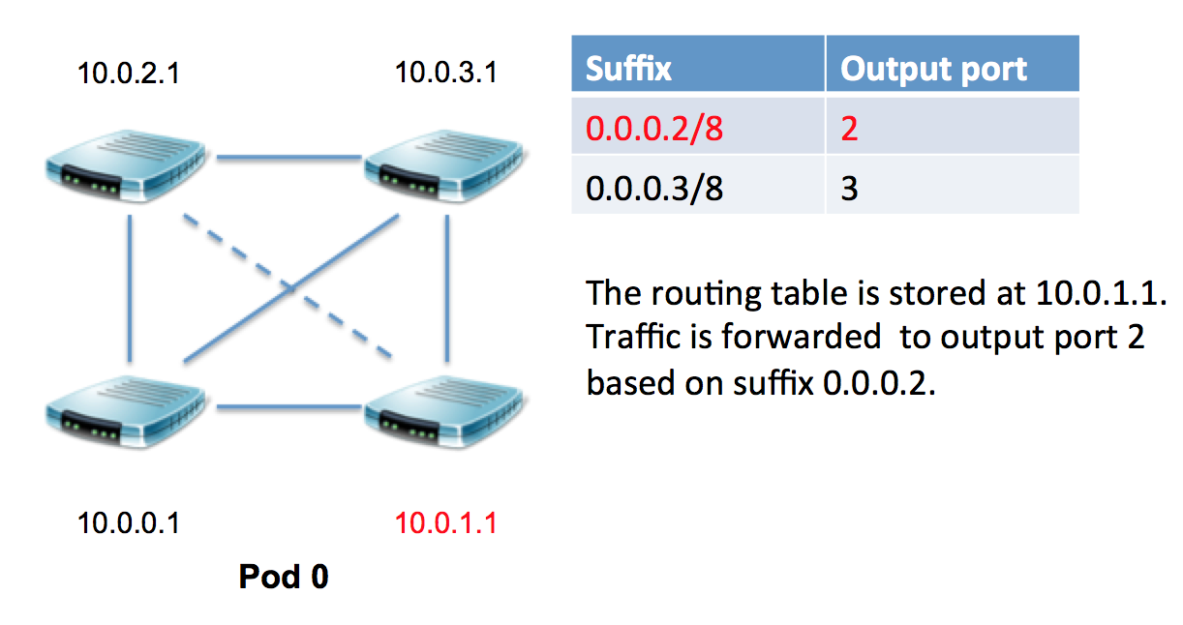
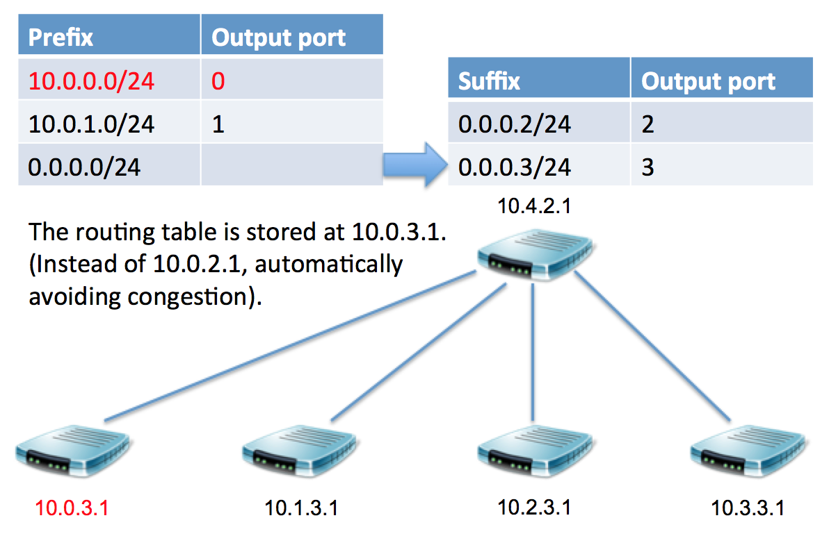
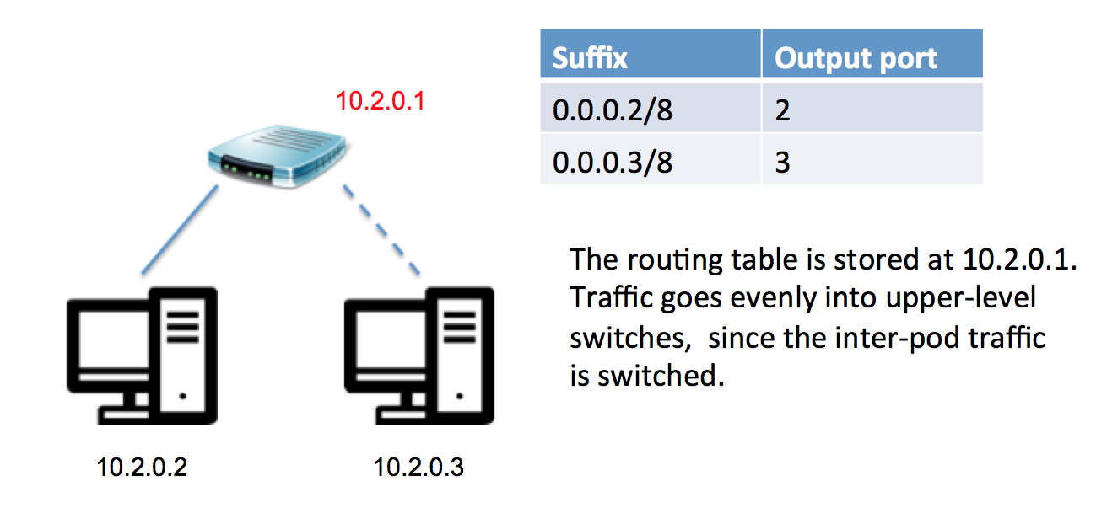
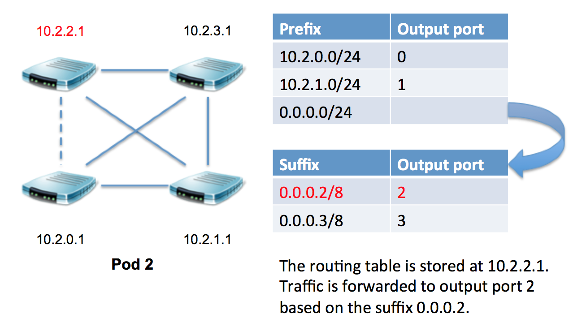
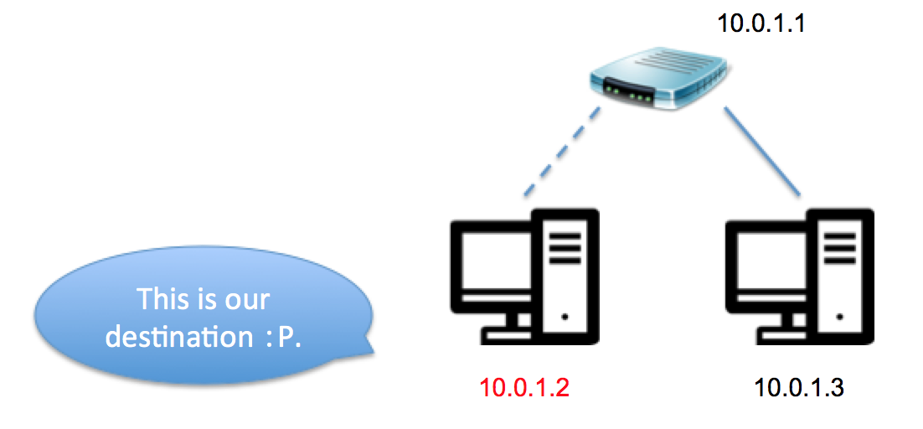
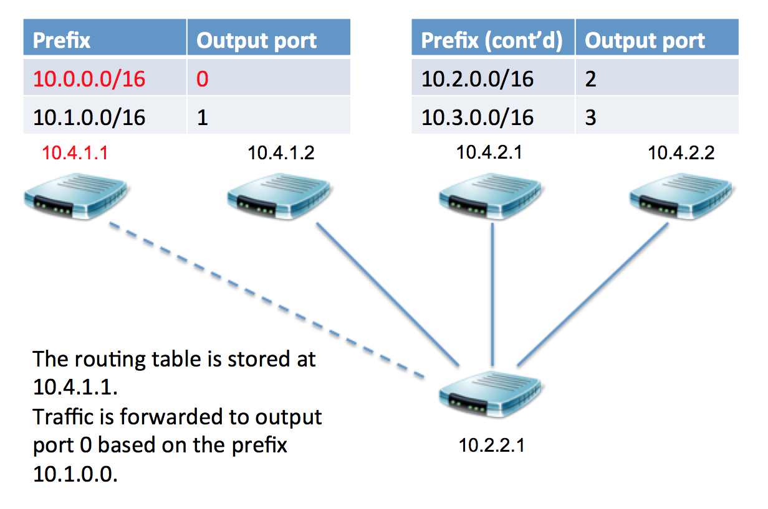
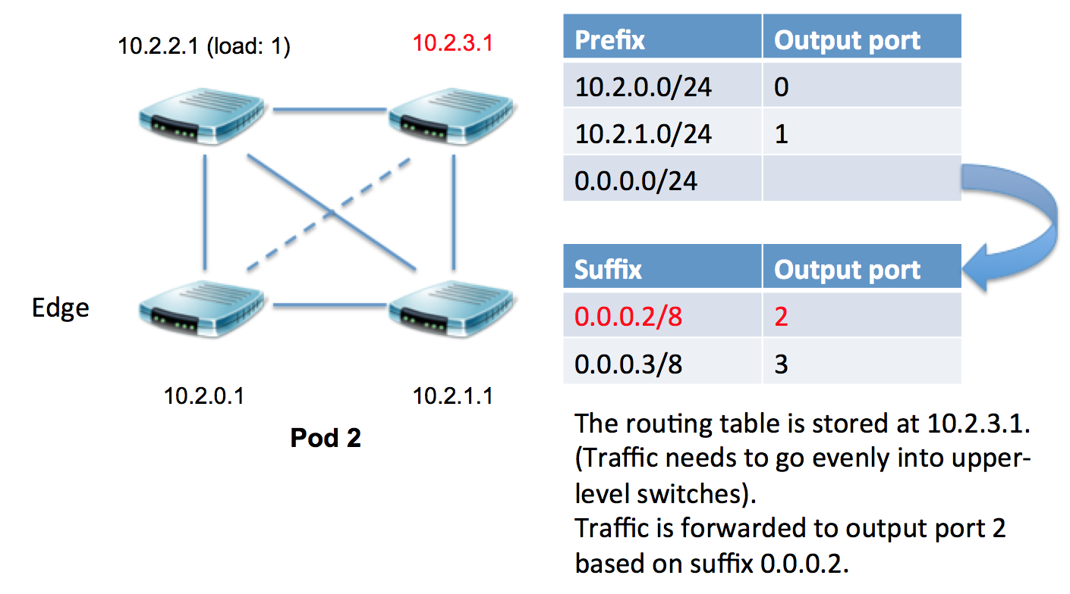
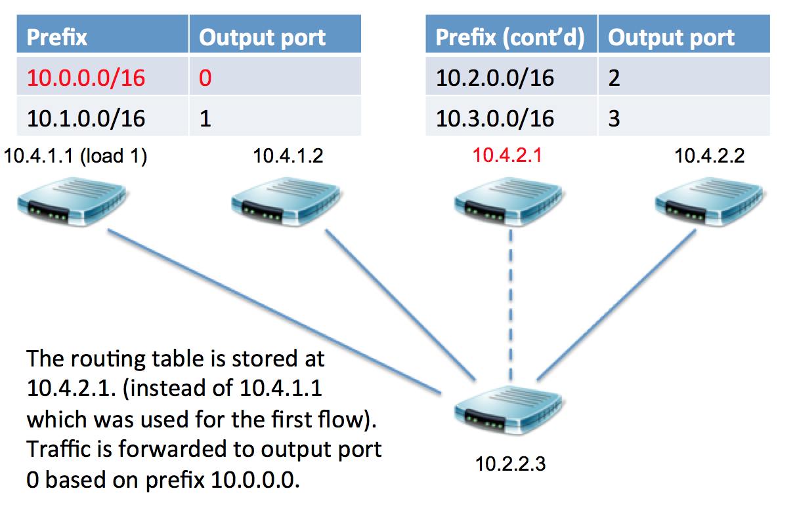
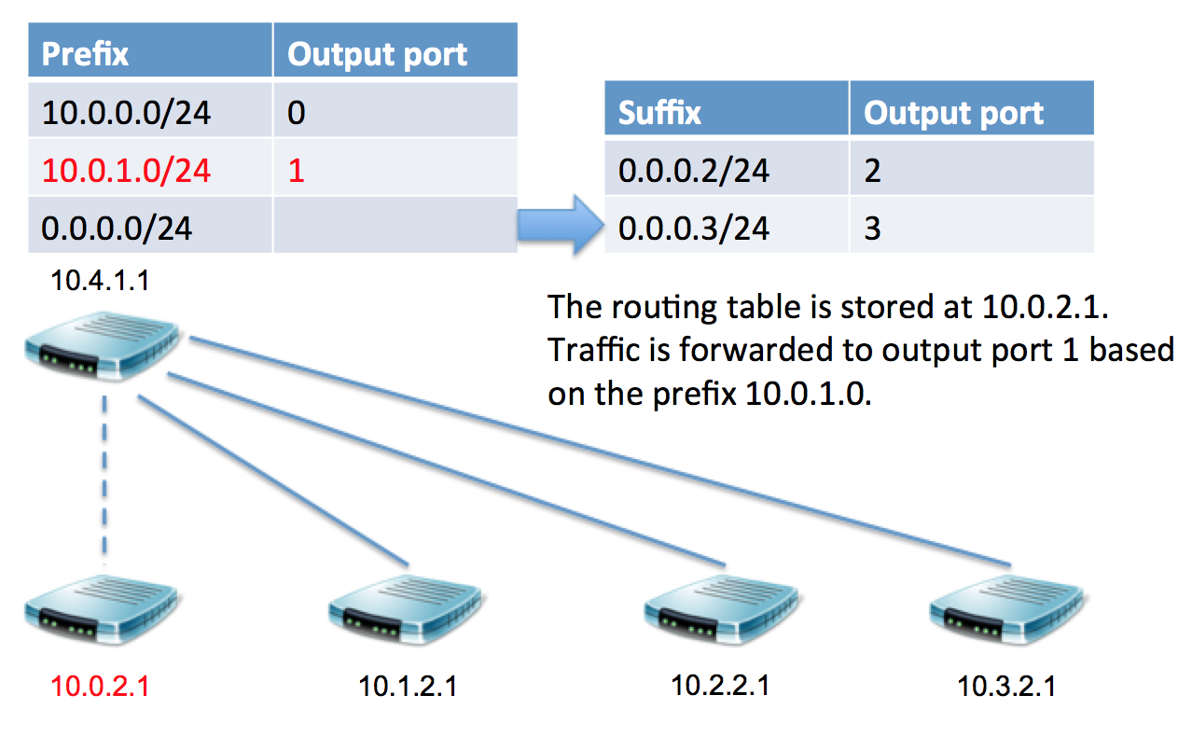
Simulation of a Scalable Commodity Data Center with Fat-Tree
and Exploration of Future Alternatives.
Yilei Fu, Lihang Gong, Yuanfeng Wen
University of California, Berkeley
ABSTRACT
ROUTING ALGORITHM
ROUTING ALGORITHM (CONT’D)
FLOW SCHEDULING (CONT’D)
Today’s data centers may contain tens of thousands of computers with significant aggregate bandwidth requirements. The network architecture typically consists of a tree of routing and switching elements with progressively more specialized and expensive equipment moving up the network hierarchy. [1]
In our team work, we simulated a special data center topology: Fat-Tree and applied its routing algorithm. Also, we applied flow classification and flow rearrangement on this data center topology.
Then, we found the Fat-Tree structure also have some drawbacks, which impelled us to find more new structures and new algorithms. We raise an overview of several future perspectives.
We perform the following simulation of a packet from source IP 10.2.0.3 to destination IP 10.0.1.2:
PURPOSE
References
Our main purpose is to simulate the Fat-Tree data center structure and its routing algorithm. As we mentioned in abstract, we used Python and followed steps mentioned in the paper “A Scalable, Commodity Data Center Network Architecture”. First, we applied addressing algorithm in order to build a basic Fat-Tree data center architecture, named every end host, switch and core switch and allocated their IP addresses. Then, we established a prefix/suffix storing system called “CAM” and “TCAM” structure. Although we cannot simulate the “Accessing Memory” part using Python, we still applied the routing algorithm -- we added prefix tables and suffix tables in order to run query on them when packets are routing, which is, 2-level-table lookup routing algorithm. 2-level-table lookup routing algorithm can help switches find their output ports effectively. When combining with TCAM architecture, the insert complexity can be O(N), and the delete complexity can be O(N^2). N is the length of prefix/suffix. Particularly, we simulated a whole routing path from 10.0.2.3 to 10.0.1.2. Details are mentioned in the “Simulation” part.
In addition, we applied the flow classification algorithm in order to recognize subsequent packets of the same flow, and forward them on the same outgoing port. Also, we are able to periodically reassign a minimal number of flow output ports to minimize any disparity between the aggregate flow capacity of different ports.
Nevertheless, Fat-Tree architecture and 2-level-table lookup routing example are not the only solution for data centers. We also introduced other structures such as VL2, and BCube.[2][3]
[1] Al-Fares M et al (2008), A Scalable, Commodity Data Center Network Architecture
[2]https://www.cs.cornell.edu/courses/cs5413/2014fa/lectures/08-fattree.pdf
[3]https://www.microsoft.com/en-us/research/publication/bcube-a-high-performance-server-centric-network-architecture-for-modular-data-centers/
Suppose we have a new flow coming in at this point, which goes from source IP 10.2.0.3 to 10.0.0.2 (passing through the same pod switches):
FLOW SCHEDULING
You can find our full version of work on GitHub:
http://github.com/Fu-Yilei/EE122Project
E-mail: fuyilei96@berkeley.edu

