Slide 1
Scalable Data Center Simulation
and Exploration of Future Alternatives
Yilei Fu, Lihang Gong, Yuanfeng Wen
Notes:
Single point of failure
• Over subscript of links higher up in the topology – Trade off between cost and provisioning

Slide 2
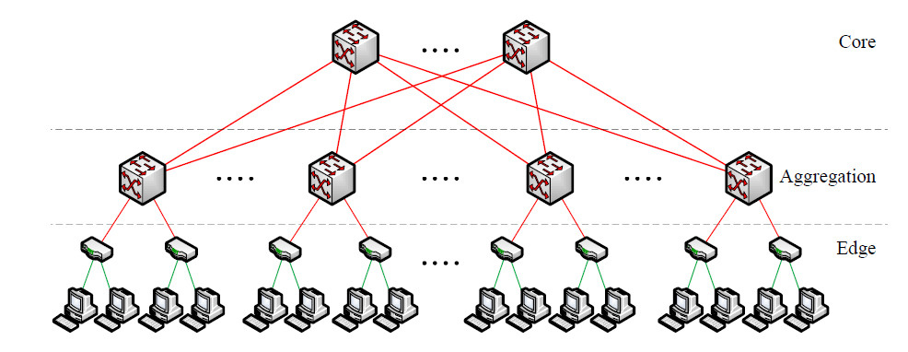
Old Data Center Topology
Notes:
Today’s data centers may contain tens of thousands of computers with significant aggregate bandwidth requirements. The network architecture typically consists of a tree of routing and switching elements with progressively more specialized and expensive equipment moving up the network hierarchy. Unfortunately, even when deploying the highest-end IP switches/routers, resulting topologies may only support 50% of the aggregate bandwidth available at the edge of the network, while still incurring tremendous cost.

Slide 3
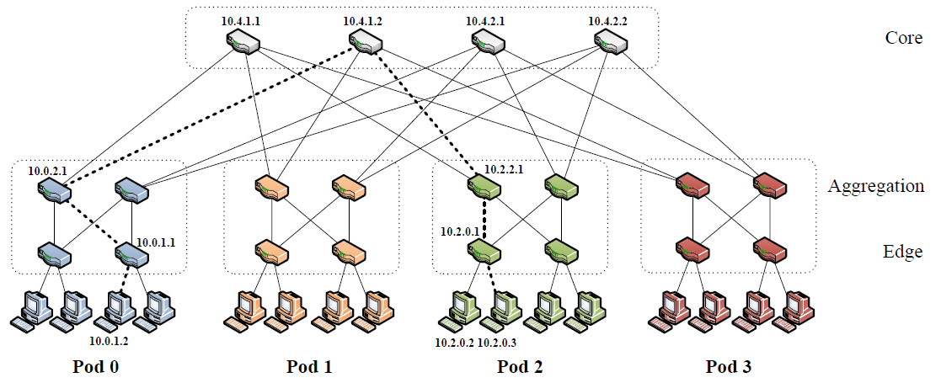
Fat-Tree Data Center Topology
Notes:
Fat tree has identical bandwidth at any bisections – Each layer has the same aggregated bandwidth
• Can be built using cheap devices with uniform capacity
– Each port supports same speed as end host
– All devices can transmit at line speed if packets are distributed uniform along available paths
• Great scalability: k-port switch supports k3/4 servers

Slide 4
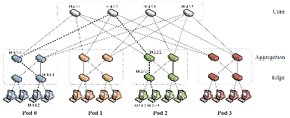
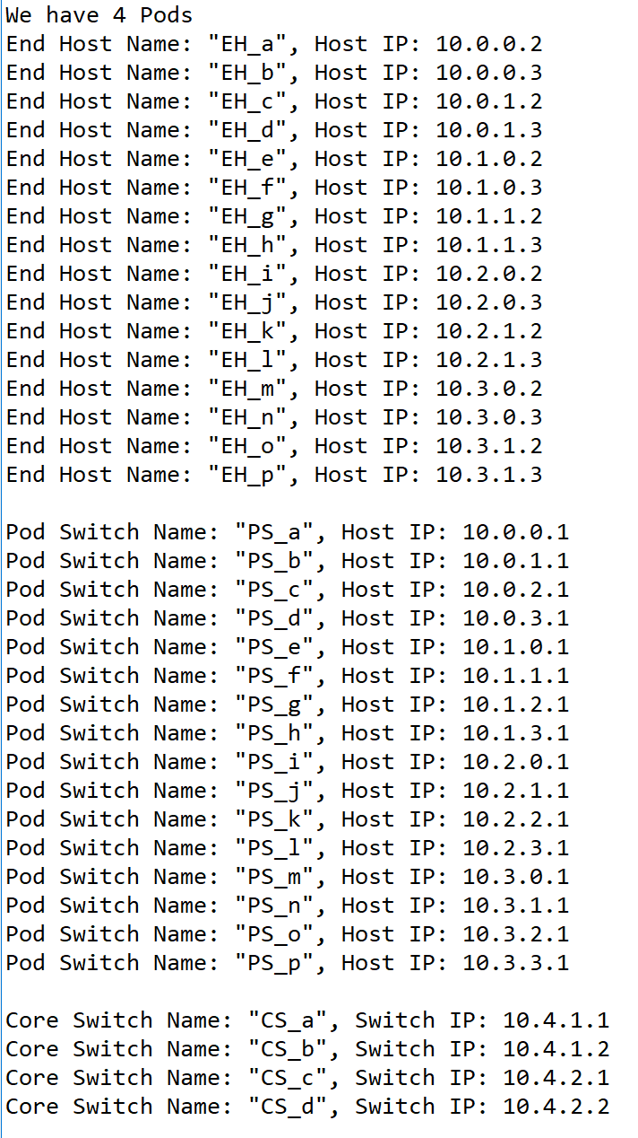
Simulations of Data Center Network(DCN)
In this part, we applied naming rules that the paper mentioned by using Python. We built a same structure as the picture shows. Mainly, we have 4 pods, which contains 4*(4/2)^2 switches, and each Edge-layer switch links to 2 end host, each Aggregation-layer switch links to 2 lower layer switches and two core switches. Switches and end hosts’ IP addresses are arranged by the addressing algorithm in the paper.
We then ran some simulations using this DCN.
Notes:
In this part, we applied naming rules that the paper mentioned by using Python. We built a same structure as the picture shows. Mainly, we have 4 pods, which contains 4*(4/2)^2 switches, and each Edge-layer switch links to 2 end host, each Aggregation-layer switch links to 2 lower layer switches and two core switches. Switches and end hosts’ IP addresses are arranged by the addressing algorithm in the paper.
We then ran some simulations using this DCN.

Slide 5
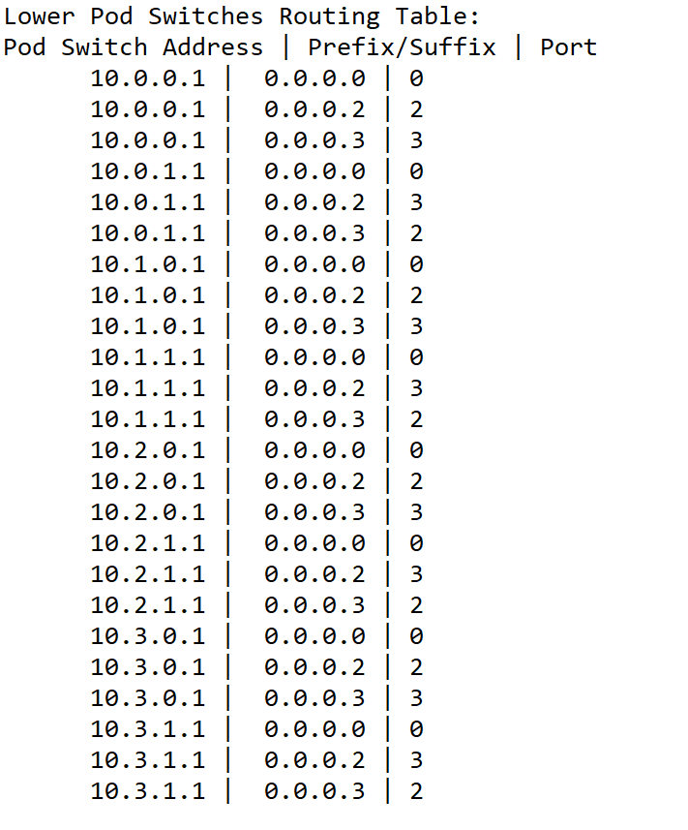
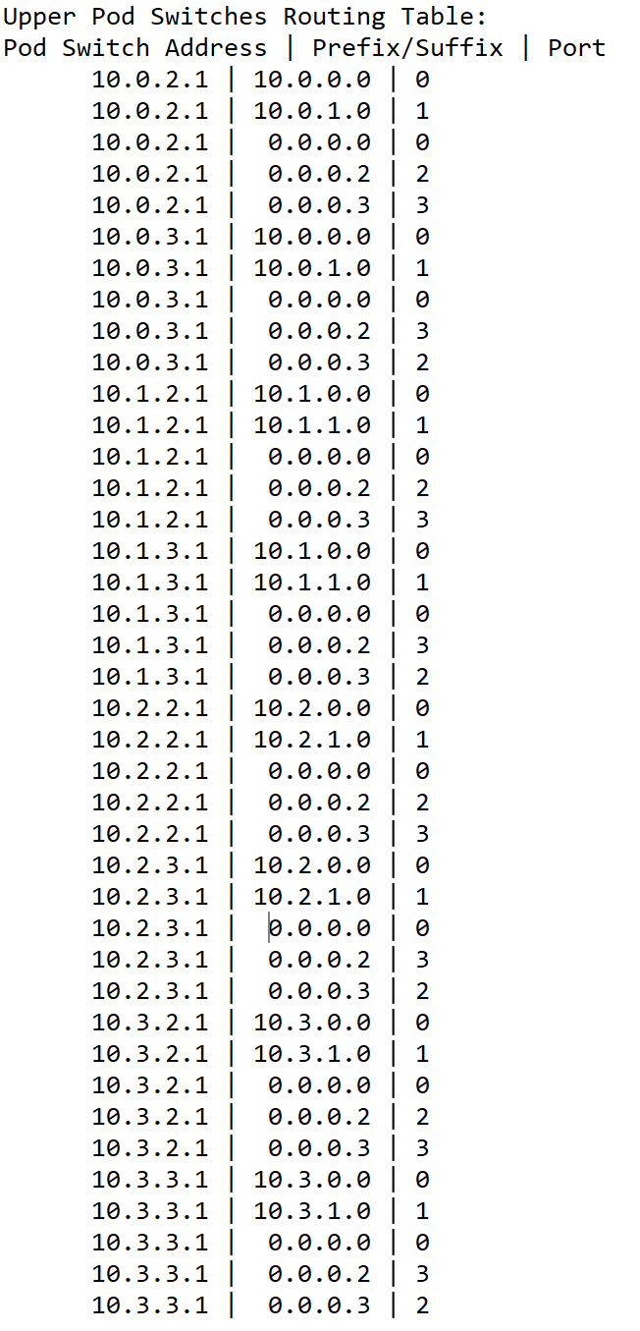
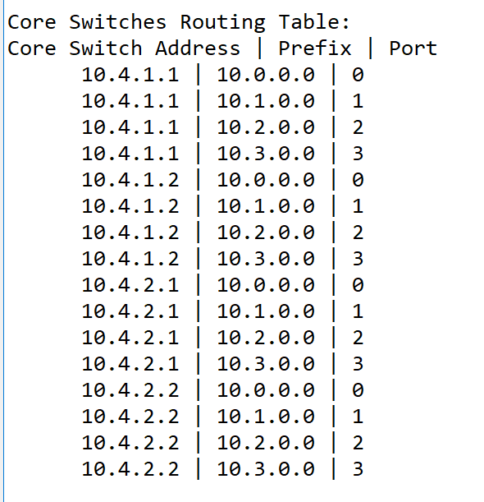
Routing Algorithm(1) Establishment of Routing Tables
This is the routing table in each switch, assigned by specific algorithm. There are some differences between different layers. When one packet comes to one switch, the switch will compare the packet destination IP with the table, then decide which port will the packet export.
Notes:
These three figures show the routing table in each switch, assigned by specific algorithm. There are some differences between different layers. For example, core switches only have prefix tables because packets will not go up any more. When one packet comes to one switch, the switch will compare the packet destination IP with the table, first matches suffix table, then matches prefix table, then decide which port will the packet export. In this way, the response time will be much shorter than traditional way.

Slide 6
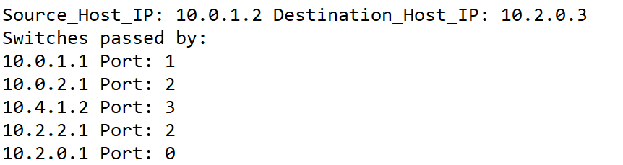
Routing Algorithm(2) Applying Routing Algorithm
We simulated the routing path from 10.0.1.2 to 10.2.0.3 using the routing algorithm mentioned in the paper.
Notes:
After doing that, we can run simulation. This result shows the switches the packet went through from source host to destination host. First, the gateway switch of the source host (10.0.1.1) will only match the packet with the /0 first-level prefix, and therefore will forward the packet according to the table. In that table, the packet matches the 0.0.0.3/8 suffix, which points to port 2 and switch 10.0.2.1. Switch 10.0.2.1 also follows the same steps and forwards on port 3, connected to core switch 10.4.1.1. The core switch matches the packet to a terminating 10.2.0.0/16 prefix, which points to the destination pod 2 on port 2, and switch 10.2.2.1. This switch belongs to the same pod as the destination subnet, and therefore has a terminating prefix, 10.2.0.0/24, which points to the switch responsible for that subnet, 10.2.0.1 on port 0. From there, switches deliver the packet to the destination host 10.2.0.3.

Slide 7
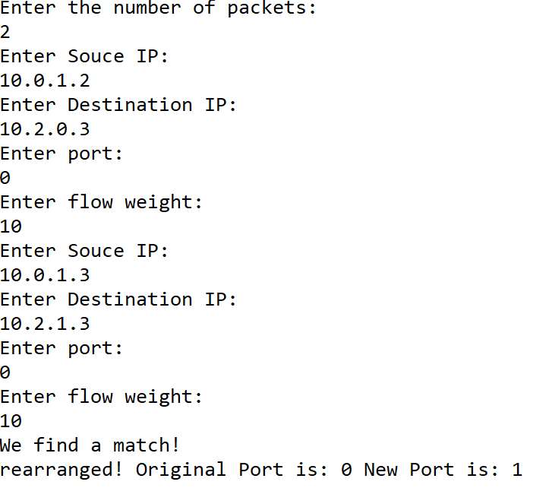
Flow Classification & Scheduling
We also ran several simulations on flow classification.
When there is a new flow coming, we can run the flow classification algorithm in order to :
1.Recognize subsequent packets of the same flow, and forward them on the same outgoing port.
2.Periodically reassign a minimal number of flow output ports to minimize any disparity between the aggregate flow capacity of different ports.
Notes:
We also ran several simulations on flow classification.
When there is a new flow coming, we can run the flow classification algorithm in order to :
1.Recognize subsequent packets of the same flow, and forward them on the same outgoing port.
2.Periodically reassign a minimal number of flow output ports to minimize any disparity between the aggregate flow capacity of different ports.

Slide 8
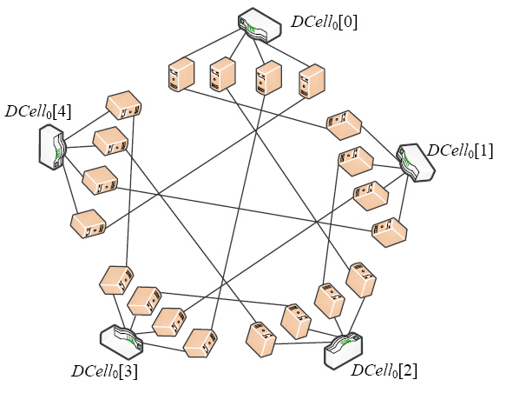
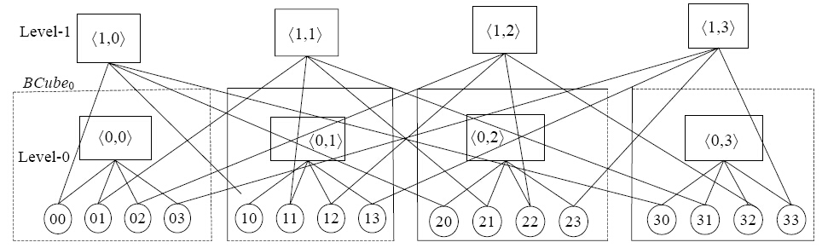
Explanation of Future Alternatives
Fat-Tree: center on switches.
Its scalability is limited by the number of core switches.
The flow scheduling algorithm depends on core switches.
Alternative Architectures: DCell, BCube: center on server.
BCube provide multipath routing and load equalization.
If switch is down, impact on performance can be buffered.
DCell have a high scalability.
Architectures center on server have a larger scalability, but also a higher complexity.
Image Source: http://www.jos.org.cn/html/2014/6/4444.htm
Notes:
Fat-Tree: center on switches.
Its scalability is limited by the number of core switches.
The flow scheduling algorithm depends on core switches.
Which also limits its expandability.
Although don’t need to run the query, it will suffer a severe decrease of performance when a switch down.
Alternative Architectures: DCell, BCube: center on server.
BCube provide multipath routing and load equalization.
If switch is down, impact on performance can be buffered.
DCell have a high scalability.
Architectures center on server have a larger scalability, but also a higher complexity

Slide 9
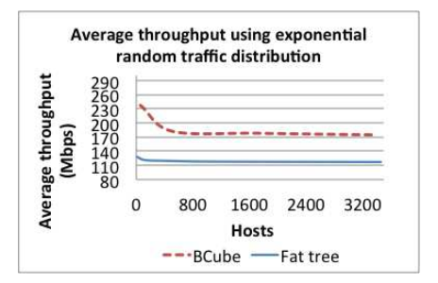
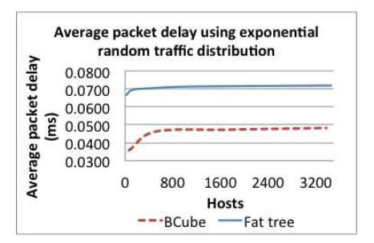
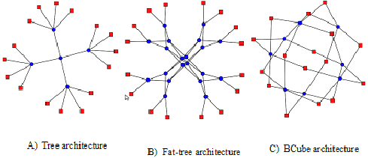
BCube V.S. Fat-Tree
image source: https://www.researchgate.net/figure/278333846_fig9_Figure-10-Tree-Fat-tree-and-BCube-architecture
Notes:
In recent years, modular data center (MDC) has become a new approach to building datacenter. The BCube architecture serves as a suitable fundamental building block to realize a MDC design, which requires special features such as as higher network capacity and graceful performance degradation in the event of hardware failures.
One of the reasons why BCube performs better in both metrics is due to its network architecture having multiple possible paths to send a traffic flow from point A to point B. This would bring about lesser traffic congestion and more available bandwidth.
Moreover, servers in the BCube architecture act as relay nodes and help one another to speed up packet routing and traffic flow, thus resulting in improved throughput and packet delay performance over the Fat tree architecture.

Slide 10
Our ideas: Combine
Use the combination of center-on-server architecture and center-on-switch architecture.
In a large data center, we can use center-on-server structure for a upper level network, like BCube, and use center-on-switch structure for a lower level network, like Fat-Tree.
Notes:
Use the combination of center-on-server architecture and center-on-switch architecture.
In a large data center, we can use center-on-server structure for a upper level network, like BCube, and use center-on-switch structure for a lower level network, like Fat-Tree.
BCube Topology have a smaller scale and a better scalability, which can make the whole data center network occupy less storage space and maintain a higher scalability. Plus when there are some accidents happen, BCube structure can protect our loss to be minimum
Fat-Tree topology have a less routing complexity, the lower level of data center, which always have many hosts. A lower complexity can help the establishment of Data center network easier.

Slide 11
Thanks for listening!
Notes:
So this is our project,

