Slide 1
Chapter 5 Syntax-Directed Translation
Section 0 Approaches to implement Syntax-Directed Translation
1、Basic idea
  Guided by context-free grammar (Translating when parsing )
  Attaching attributes to the grammar symbols representing the program construction.
  Values for attributes are computed by “semantic rules ”associated with the grammar productions.

Slide 2
Chapter 5 Syntax-Directed Translation
Section 0 Approaches to implement Syntax-Directed Translation
2、Two notations for associating semantic rules with productions
  Syntax-directed definitions
    E→E₁+E₂ {E.val=E₁.val+E₂.val}

Slide 3
Chapter 5 Syntax-Directed Translation
Section 0 Approaches to implement Syntax-Directed Translation
2、Two notations for associating semantic rules with productions
  Translation schemes
    S →{B.ps=10}B{S.ht=B.ht}

Slide 4
Chapter 5 Syntax-Directed Translation
Section 1 Syntax-Directed Definitions
1、Definitions
  1)Syntax-directed definition
    A generalization of a context-free grammar in which each grammar symbol has an associated set of attributes

Slide 5
Chapter 5 Syntax-Directed Translation
Section 1 Syntax-Directed Definitions
1、Definitions
  2)Attribute
    Represent anything we choose: a string, a number, a type, a memory location, etc.
    Notes: The value of an attribute at a parse-tree node is defined by a semantic rule associated with the production used at that node.

Slide 6
Chapter 5 Syntax-Directed Translation
Section 1 Syntax-Directed Definitions
1、Definitions
  3)Types of Attribute
    Synthesized attribute
      The value of a synthesized attribute at a node is computed from the values of attributes at the children of that node in the parse tree
    Inherited attribute
      The value of an inherited attribute is computed from the values of attributes at the siblings and parent of that node.

Slide 7
Chapter 5 Syntax-Directed Translation
Section 1 Syntax-Directed Definitions
1、Definitions
  4)Annotated parse tree
    A parse tree showing the values of attributes at each node
    Notes: The process of computing the attribute values at the nodes is called annotating or decorating the parse tree.

Slide 8
Chapter 5 Syntax-Directed Translation
Section 1 Syntax-Directed Definitions
2、Form of a Syntax-Directed Definition
  Each grammar production A →α has associated with it a set of semantic rules of the form b=f(c1,c2,….,ck), f is a function,
  1) b is a synthesized attribute of A
  c1, c2,….,ck are attributes belonging to the grammar symbols of the production

Slide 9
Chapter 5 Syntax-Directed Translation
Section 1 Syntax-Directed Definitions
2、Form of a Syntax-Directed Definition
  2) b is an inherited attribute of one of the grammar symbols on the right side of the production
  c1, c2,….,ck are attributes belonging to the grammar symbols of the production
  Notes: In either case, we say that attribute b depends on attributes c1, c2,….,ck

Slide 10
Chapter 5 Syntax-Directed Translation
Section 1 Syntax-Directed Definitions
3、Attribute grammar
A syntax-directed definition in which the functions in semantic rules cannot have side effects.
Notes: (1)Functions in semantic rules will often be written as expressions.
(2) Occasionally, semantic rules are written as procedure calls or program fragments (in the time, we name the attribute of non-terminal as a dummy attribute)
(3)Values for attributes of terminals are usually supplied by the lexical analyzer

Slide 11
E.g.
Production | Semantic rules
A →E n (n for new-line) | Print(E.val) (A has a dummy attribute)
E →E ⁽¹⁾*E⁽²⁾ | E.val= E⁽¹⁾.val* E⁽²⁾.val
E →E ⁽¹⁾ + E⁽²⁾ | E.val= E⁽¹⁾.val+E⁽²⁾.val
E →(E ⁽¹⁾) | E.val= E⁽¹⁾.val
E → digit | E.val=digit.lexval

Slide 12
Chapter 5 Syntax-Directed Translation
Section 1 Syntax-Directed Definitions
4、 Synthesized Attributes
  S-attributed definition
  A syntax-directed definition that uses synthesized attributes exclusively

Slide 13
Chapter 5 Syntax-Directed Translation
Section 1 Syntax-Directed Definitions
4、 Synthesized Attributes
  2)Annotation for a parse tree for an S-attributed definition
  By evaluating the semantic rules for the attributes at each node bottom up, from the leaves to the root.

Slide 14
E.g. Annotated parse tree for 3*5+4 n
L
n
E.val=19
E.val=15 + T.val=4
T.val=15
F.val=4
T.val=3 * F.val=5
digit.lexval=4
F.val=3
digit.lexval =5
digit.lexval =3

Slide 15
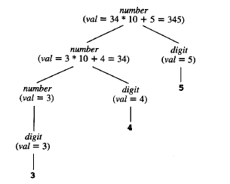

Slide 16
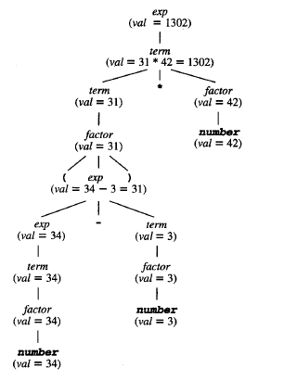

Slide 17
Chapter 5 Syntax-Directed Translation
Section 1 Syntax-Directed Definitions
5、Inherited Attributes
Although it is always possible to rewrite a syntax-directed definition to use only synthesized attributes, it is often natural to use syntax-directed definition with inherited attributes.

Slide 18
E.g. Syntax-directed definition with inherited attribute L.in
Production | Semantic rules
D →T L | L.in=T.type
T →int | T.type= integer
T →real | T.type=real
L →L ⁽¹⁾,id | L ⁽¹⁾.in=L.in addtype(id.entry, L.in)
L → id | addtype(id.entry, L.in)

Slide 19
E.g. Parse tree with inherited attribute in at each node labeled L. (real id1,id2,id3)
D
T.type=real L.in=real
real L.in=real , id3
L.in=real , id2
id1

Slide 20
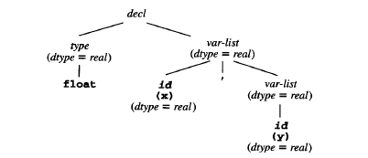

Slide 21
Chapter 5 Syntax-Directed Translation
Section 2 Bottom-up evaluation of the S-attributed definitions
1、Basic idea
  Evaluated by a bottom-up parser as the input is being parsed.
  The parser keeps the values of the synthesized attributes associated with the grammar symbols on its stack.

Slide 22
Chapter 5 Syntax-Directed Translation
Section 2 Bottom-up evaluation of the S-attributed definitions
1、Basic idea
  When a reduction is made, the values of the new synthesized attributes are computed from the attributes appearing on the stack for the grammar symbols on the right side of the reducing production.

Slide 23
Chapter 5 Syntax-Directed Translation
Section 2 Bottom-up evaluation of the S-attributed definitions
1、Basic idea
  Notes: 1)A translator for an S-attributed definition can often be implemented with an LR-parser
  2)The stack is used to hold information about sub-trees that have been parsed.
  3)We can use extra fields in the parser stack to hold the values of synthesized attributes

Slide 24
Chapter 5 Syntax-Directed Translation
Section 2 Bottom-up evaluation of the S-attributed definitions
1、Basic idea
  E.g.
State | Symbol | Val
… |  | …
 | X | X.val
 | Y | Y.val
… |  | …

Slide 25
Chapter 5 Syntax-Directed Translation
Section 2 Bottom-up evaluation of the S-attributed definitions
2、Evaluating the Synthesized attributes
Production | Code fragment
L →E$ | Print(val[top])
E →E ⁽¹⁾ + T | Val[ntop]= val[top-2]+val[top]
E →T
T→T ⁽¹⁾*F | Val[ntop]= val[top-2]*val[top]
T →F
F→(E) | Val[ntop]= val[top-1]
F → digit

Slide 26
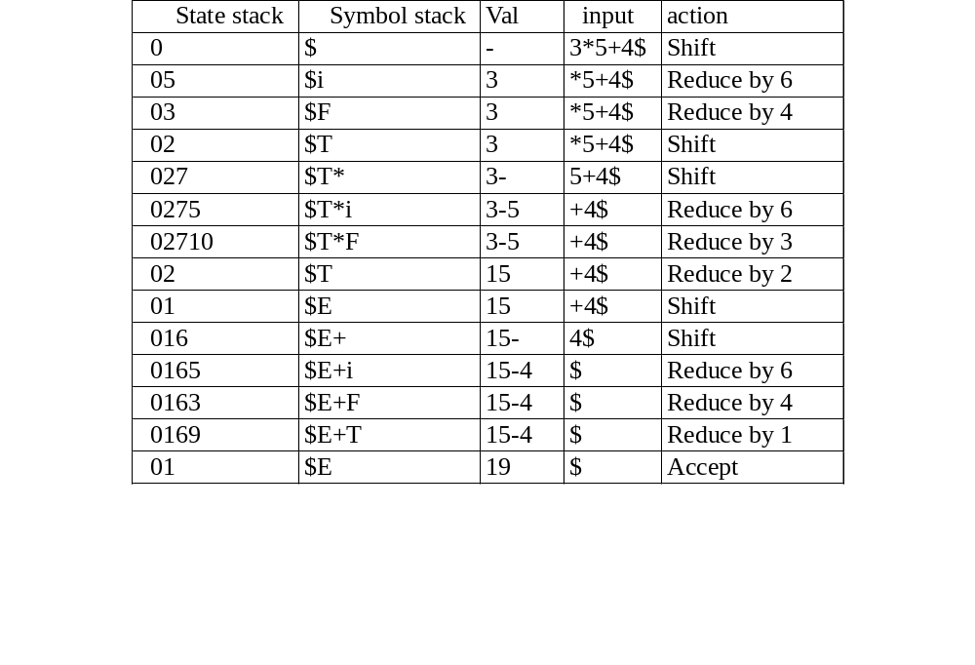
Moves made by translator on 3*5+4$

