Slide 1
報名序號：111052 團隊名稱：Geek 極客
2022全國智慧製造大數據分析競賽決賽
團隊測驗報告

Slide 2
一、資料前處理
若數據列數小於此特徵列數最大值，則用最後一列來填充，以獲得相同維度的特徵值
# If the number of data in one column is smaller than maximum, we'll use the last value of that column # to fill in to get a same dimension in one feature(column) s = time.time() print('B...', end='') for i in range(len(sg_B)): if sg_B[i].size < max_num: sg_B[i] = np.append( sg_B[i], [[sg_B[i][-1]] * (max_num - sg_B[i].size)]) print('cost time: ', time.time() - s)
sg_A| 1: 416001 26: 416001 27: 284001 46: 284001 ------------------------------------------------------------- sg_B| 1: 416001 26: 416001 27: 284001 46: 284001 sg_C| 1: 416001 26: 416001 27: 284001 46: 284001 sg_D| 1: 416001 26: 416001 27: 284001 46: 284001 sg_E| 1: 416001 26: 416001 27: 284001 46: 284001 sg_F| 1: 416001 26: 416001 27: 284001 46: 284001 sg_G| 1: 416001 26: 416001 27: 284001 46: 284001 sg_H| 1: 416001 26: 416001 27: 284001 46: 284001 sg_I| 1: 416001 26: 416001 27: 284001 46: 284001 spike_A| 1: 1040001 26: 1040001 27: 710001 46: 710001 ------------------------------------------------------------- spike_B| 1: 1040001 26: 1040001 27: 710001 46: 710001 spike_C| 1: 1040001 26: 1040001 27: 710001 46: 710001 spike_D| 1: 1040001 26: 1040001 27: 710001 46: 710001
sg_A|| 1: 416001 26: 416001 27: 416001 46: 416001 ------------------------------------------------------------- sg_B|| 1: 416001 26: 416001 27: 416001 46: 416001 sg_C|| 1: 416001 26: 416001 27: 416001 46: 416001 sg_D|| 1: 416001 26: 416001 27: 416001 46: 416001 sg_E|| 1: 416001 26: 416001 27: 416001 46: 416001 sg_F|| 1: 416001 26: 416001 27: 416001 46: 416001 sg_G|| 1: 416001 26: 416001 27: 416001 46: 416001 sg_H|| 1: 416001 26: 416001 27: 416001 46: 416001 sg_I|| 1: 416001 26: 416001 27: 416001 46: 416001 spike_A| 1: 1040001 26: 1040001 27: 1040001 46: 1040001 ------------------------------------------------------------- spike_B| 1: 1040001 26: 1040001 27: 1040001 46: 1040001 spike_C| 1: 1040001 26: 1040001 27: 1040001 46: 1040001 spike_D| 1: 1040001 26: 1040001 27: 1040001 46: 1040001

Slide 3
一、資料前處理
轉換n_spike資料頻率→ A = 0.001, 0.002, 0.003
# Calculate B's, C's, D's values at A = 0.001, 0.002, 0.003..... s = time.time() print('B...', end='') for i in range(len(B)): index = range(3, spike_B[i].size-1, 5) value = [(B[i][j-1] + B[i][j])/2 for j in index] B[i] = insert(B[i], index, value) print('cost time: ', time.time() - s)
1_sg_A: [0. 0.001 0.002 0.003 0.004 0.005 0.006 0.007 0.008 0.009] 1_spike_A: [0. 0.0004 0.0008 0.0012 0.0016 0.002 0.0024 0.0028 0.0032 0.0036]
1_sg_A: [0. 0.001 0.002 0.003 0.004 0.005 0.006 0.007 0.008 0.009] 1_spike_A: [0. 0.001 0.002 0.003 0.004 0.005 0.006 0.007 0.008 0.009]

Slide 4
一、資料前處理
將n_sg、n_spike絕對座標轉換成相對座標（每單位時間的位移）
# Change in sg --> change the data from absolute coordination to relative coordination (distance in each timestep) s = time.time() print('B...', end='') CISG_B = [np.array([i[j]-i[j-1] for j in range(1, len(i))]) for i in sg_B] print('cost time: ', time.time() - s)
# Change in spike --> change the data from absolute coordination to relative coordination (distance in each timestep) s = time.time() print('B...', end='') CISP_B = [np.array([i[j]-i[j-1] for j in range(1, len(i))]) for i in B] print('cost time: ', time.time() - s)
B[0]: [24.921879 28.295334 30.417959 ... -0.66332 -0.09476 -0.09476 ] CISP_B[0]: [0. 3.373455 2.122625 ... -0.113712 0.56856 0. ]

Slide 5
一、資料前處理
計算n_spike BCD分別的總路徑長、總位移
# Sum up the distance that process during one timestep 0.001 # final_abs_: total path s = time.time() print('B...', end='') final_abs_B = [[abs(CISP_B[j][i*3+1:i*3+4]).sum() for i in range(0, CISG_B[j].size-1)] for j in range(len(CISP_B))] print('cost time: ', time.time() - s)
# fianl_: distance s = time.time() print('B...', end='') final_B = [[CISP_B[j][i*3+1:i*3+4].sum() for i in range(0, CISG_B[j].size-1)] for j in range(len(CISP_B))] print('cost time: ', time.time() - s)
final_abs_B[0]: [0. 5.6856 1.212927 ... 0.833888 0.492752 0.682272] final_B[0]: [0. 5.6856 1.212927 ... 0.530656 -0.492752 0.454848]

Slide 6
一、資料前處理
計算n_sg、n_spike在三維空間中的總路徑長、總位移
s = time.time() print('BCD abs Distance...', end='') BCD_abs_distance = [[pow(pow(final_abs_B[j][i], 2) + pow(final_abs_C[j][i], 2) + pow(final_abs_D[j][i], 2), 0.5) for i in range(len(final_abs_A[j]))] for j in range(len(final_abs_A))] print('cost time: ', time.time() - s) BCD_abs_distance = np.array(BCD_abs_distance)
s = time.time() print('BDF Distance...', end='') BDF_distance = [[pow(pow(sg_B[j][i], 2) + pow(sg_D[j][i], 2) + pow(sg_F[j][i], 2), 0.5) for i in range(len(sg_B[j]))] for j in range(len(sg_B))] print('cost time: ', time.time() - s) BDF_distance = np.array(BDF_distance)
s = time.time() print('BCD Distance...', end='') BCD_distance = [[pow(pow(final_B[j][i], 2) + pow(final_C[j][i], 2) + pow(final_D[j][i], 2), 0.5) for i in range(len(final_A[j]))] for j in range(len(final_A))] print('cost time: ', time.time() - s) BCD_distance = np.array(BCD_distance)
BCD abs Distance[0]: [0. 8.89395472 4.52528009 ... 1.60452467 1.29934987 1.40047245] BCD Distance[0]: [0. 8.64753223 2.31520873 ... 0.55584651 0.71991559 0.47604884] BDF Distance[0]: [298.27261882 298.26778789 298.26354919 ... 304.56714609 304.56284631 304.55956073]

Slide 7
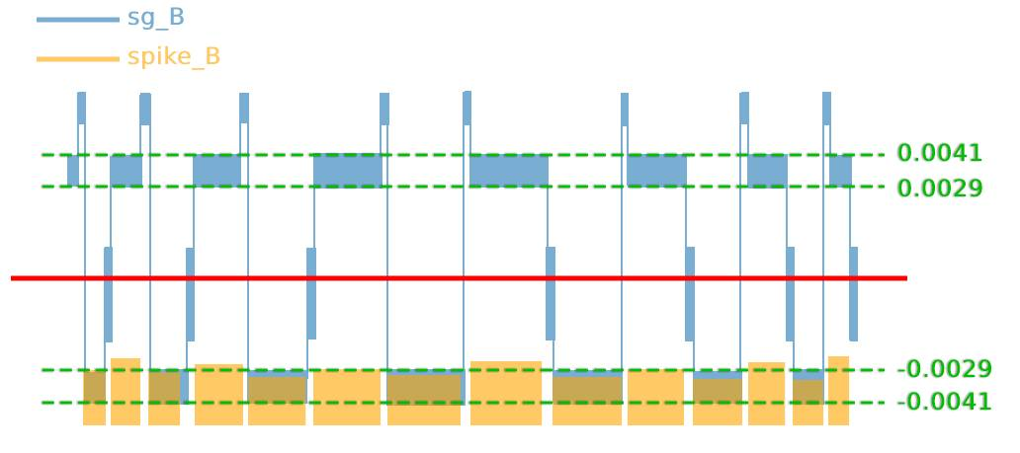
一、資料前處理
觀察n_sg、n_spike的B特徵，得出經前處理後的sg_B絕對值在0.0029至0.0041外是可能的雜訊
work_B = [[1 if abs(sg_B[i][j]) >= 0.0029 and abs(sg_B[i][j]) <= 0.0041 else 0 for j in range(len(sg_B[i]))] for i in range(len(sg_B))] spike_abs_B_lower_noise = spike_abs_B * work_B spike_B_lower_noise = spike_B * work_B
*示意圖僅供參考

Slide 8
一、資料前處理
觀察得出下列特徵與磨耗最大值相關係數較高
n_spike_B、n_spike_C、n_spike_D總位移
n_spike_B、n_spike_C低雜訊總位移
n_sg_B絕對值與n_spike_B、n_sg_D絕對值與n_spike_C相、n_sg_F絕對值與n_spike_D相減總位移
n_sg_B絕對值與n_spike_B、n_sg_D絕對值與n_spike_C相、n_sg_F絕對值與n_spike_D相乘累加
獲得shape(70, 15)的特徵輸入

Slide 9
二、演算法和模型介紹
使用DNN(深度神經網路) ，3層全連接隱藏層作為演算法模型。
最佳化：Adam
激勵函數：ReLU
學習率：0.0005
Batch_size：15
Epochs：500
model = Sequential() model.add(Dense(128, activation='relu', input_dim=Input_shape)) model.add(Dense(4, activation='relu')) model.add(Dense(1)) model.summary() learning_rate = 0.0005 batch_size = 15 epochs = 500 # Adam RMSprop model.compile(optimizer=tf.optimizers.Adam( learning_rate=learning_rate), loss=rmse) history = model.fit(input_train, output_train, validation_data=(input_test, output_test), batch_size=batch_size, epochs=epochs, verbose=1)
Model: "sequential" _________________________________________________________________ Layer (type) Output Shape Param # ================================================================= dense (Dense) (None, 128) 768 dense_1 (Dense) (None, 4) 516 dense_2 (Dense) (None, 1) 5 ================================================================= Total params: 1,289 Trainable params: 1,289 Non-trainable params: 0 _________________________________________________________________

Slide 10
三、執行環境/套裝選擇/執行方式
執行環境：tensorflow_keras
套裝選擇：
資料前處理：numpy、pandas
模型訓練：tensorflow、sklearn、keras
其他：copy、os
執行方式：
訓練資料前處理(train1&train2)
執行train1_preprocessing.py與train2_preprocessing.py
獲得已完成前處理的特徵.npy數據檔案
測試資料前處理(test)
執行test_preprocessing.py
獲得已完成前處理的特徵.npy數據檔案
訓練模型
執行DNN_train.py
獲得訓練後的模型，輸入測試資料，將獲得的預測值儲存至.csv檔案中

Slide 11
四、驗證集結果與改善方向
Test RMSE:
改善方向：
程式碼最佳化
使用更多特徵

